Slide 1
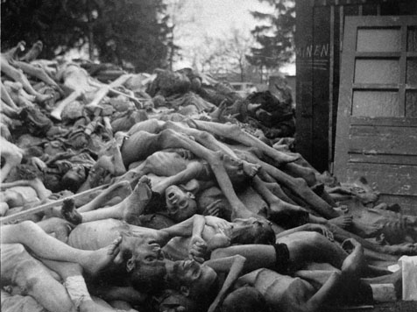
World History Chapter 24 World War Two and the Holocaust
http://www.abc-clio.com/Current/ContentPages/EventIndex.aspx?entryId=1842075

Slide 2
German path to war- Hitler and his ideas.
He believed Germans belonged to the Aryan race “superior to all others”. They wanted to build a great civilization but needed more land. (to the east-Soviet Union) Hitler thought that after he conquered the S.U. he could resettle the land w Germans and have the Slavic people as slave labor.
Crash course WWII 13 min.
http://www.youtube.com/watch?v=Q78COTwT7nE&safe=active

Slide 3
Hitler violates Treaty of Versailles- limiting Germany’s military power. H-liar, liar says he just wants Germany to be on = footing. Airforce and draft the next week. Army from 100k to 550k Big violation!! Britain, France and Italy all say “Bad Germany” but because of the depression everyone has their own problems. H doesn’t think anyone will use force to enforce treaty. Germany goes into Rhineland-DMZ area for Germany………

Slide 4
France not going to use force w/out Britain support. Britain ok with Germany going into area-”reasonable action by a dissatisfied power” this policy is appeasement- let unhappy countries do some things to keep the peace and stability.
Hitlers new friends-Mussolini of Italy, Franco of Spain. Rome-Berlin axis. Then Germany and Japan sign Anti-Comintern-against expanding communism. HaHaHa!!!!

Slide 5
Germany a world power again, Hitler next goal..Anschluss- join Austria with Germany. Invite us in or else! They put Nazis in charge of Gov’t then new gov’t invites nazis troops in to keep peace, next day Hitler annexed A into G. That’s just the beginning….. Sudetenland, then Bohemia, Moravia, Poland being threatened. Finally, Britain and France see the need to stop Hitler- they realize that they will need the SU. They start talking to Stalin.

Slide 6
Hitler talks to Stalin too. Beats them to agreement. Hitler promises tons but is ok with breaking them. Hitler invades Poland, Britain and France declare war on Germany.

Slide 7
Jap soldiers disguised as Chinese soldiers blow
up portion of railroad to blame it on Chinese. Use as excuse to take control of Manchuria. Resources!!! League of Nations calls foul on Jap, Jap withdrawals from L of N. U.S. not acknowledge takeover but not willing to use force. Over next few years- Japan continues to expand-Mongolia and N. China. Military control comes soon.

Slide 8
War with China- Japan takes more and more land in China, Chiang Kai-shek to worried about Chinese Communists to worry about Japan. Then Japan declares war on China.
Japan went looking for resources in French Indochina, US not happy. Japan needed US for oil and iron. Japan decides surprise attack on US and European colonies in SE Asia.

Slide 9
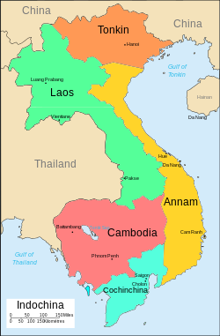

Slide 10
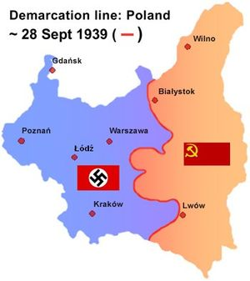
Blitzkrieg-”lightning war” Hitler surprise attack on Poland-kicked serious butt! Quickly Poland surrendered, Germany and Soviet Union divided Poland.
WH Chapter 24 Section 2

Slide 11
Hitler takes the winter off, then attacks Denmark and Norway with the same blitzkrieg method. Next comes Netherlands, Belgium, and France. Germany went around Frances defense line. French and British troops trapped. Navy and civilians able to evacuate 240,000 soldiers.
France signs armistice- Germany in control! Britain still free- Winston Churchill rallies people.

Slide 12
US says bad Hitler, but follows policy of isolationism. Us does not want to get involved in a “European problem”. US started sending food, ships, weapons, to Britain.
The Battle of Britain- Hitler’s huge airforce bombed British air and naval bases, harbors and war industries. That wasn't enough so he began bombing large cities. Gave military time to rebuild. Hitler stopped.

Slide 13
Attack on the Soviet Union-Hitler thought that Britain stayed in war because of Soviet support. Hitler believed SU army weak. Hitler seized both Greece and Yugoslavia. Hitler quickly attacked SU. But winter set in (remember Bonaparte) stops army.

Slide 14
Japan at War-Dec.7, 1941 Jap attack at Pearl Harbor. 18 ships, 350 aircraft, 3500 Americans destroyed. Jap attacked Philippines same day. Soon they controlled almost all of Southeast Asia and western Pacific. Jap military leader Tojo thought the surprise attack on US would make US accept Jap domination in Pacific. WRONG. US joined with European nations and Nationalist China and declared war on Japan. Hitler declared war on US. New global war.

Slide 15
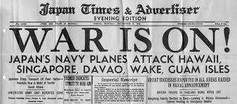
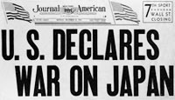

Slide 16
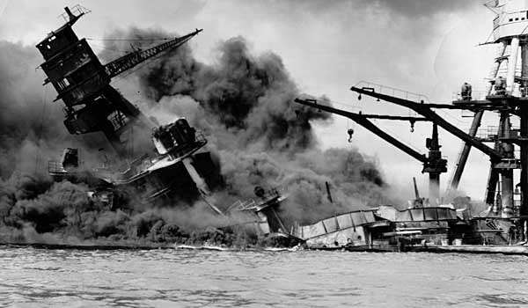

Slide 17
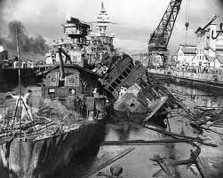

Slide 18
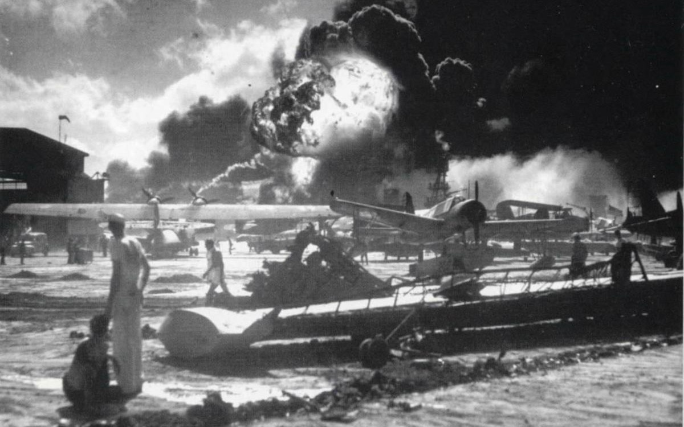

Slide 19
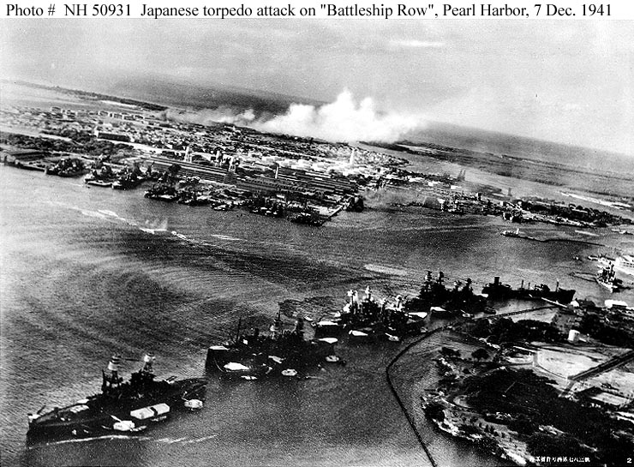

Slide 20
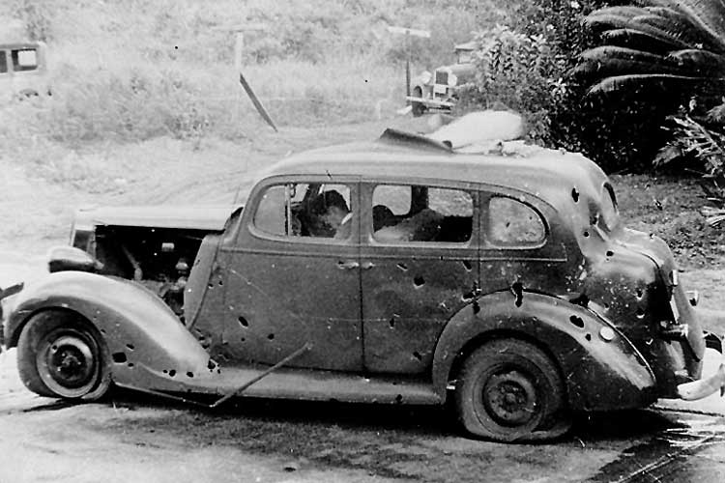

Slide 21
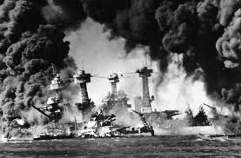

Slide 22
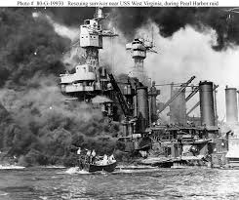

Slide 23
The Allies Advance- GB-US-SU agreed to set aside politics and concentrate of military operations. They agreed to fight until the Axis powers Germany-Italy and Japan surrendered unconditionally with no favorable conditions-Hitler could not divide his foes.
European Theater-Hitler kickin butt in N. Africa and SU. BUT by fall of 1942 tide turns.

Slide 24
The Tide Turns-British beat Germans and Italians in N. Africa. German troops surrounded and starved out in USSR near Stalingrad. Hitler realizes USSR not to be won. http://www.youtube.com/watch?v=OUX7mAeeF04&safe=active
Asian Theater- USA ships protect Australia from Japanese invasion. Battle of Midway-US destroys 4 Japanese aircraft carriers , US gains naval control of Pacific.

Slide 25
WH 24 L 3-WWII was a total war-covered most of the world. 20 million killed-many were children.
Homefronts-
SU-lots of land battles, city of Leningrad (St. Petersburg) under siege for 900 days. People ate dogs, cats, mice etc… 1.5 m died. As Germans advanced SU dismantled machinery and shipped inland (so they could continue making items necessary for war. Since so many resources going towards war food scarce.

Slide 26
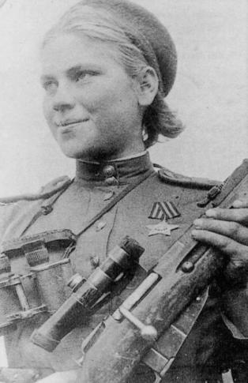
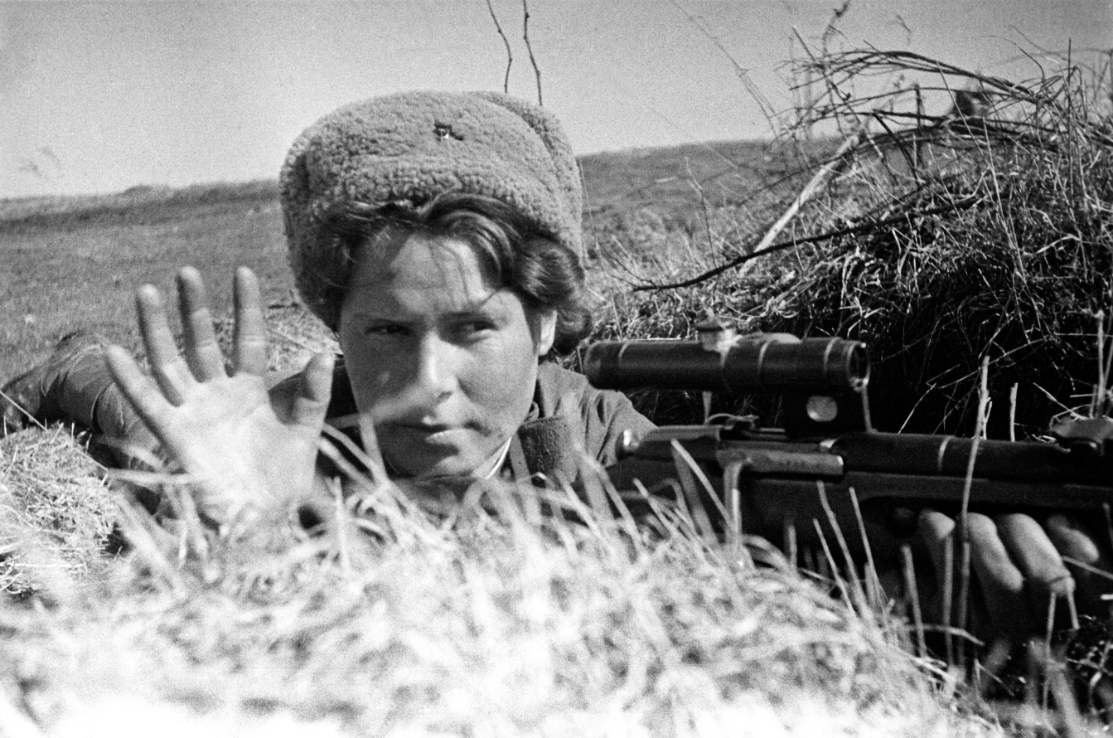
SU con’t-Women were involved in war effort too. Worked in factories, mines, dug anti=tank trenches, also fought in battle-snipers and aircrews of bombers.

Slide 27
US-Not fighting on its own territory, we were the arsenal of the Allied Powers producing most of the military equipment. Manufacturing created boomtowns- shortages of housing and schools. 1 m blacks moved north-racial tension. 1 m blacks joined army.
Jap-Am-living on the west coast were placed in internment camps, US afraid they were traitors. 65% born in US.

Slide 28
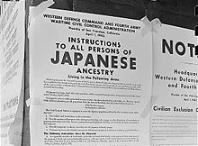
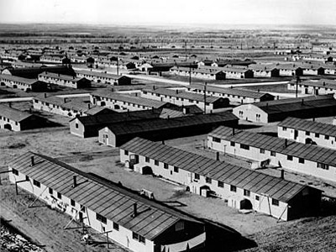

Slide 29
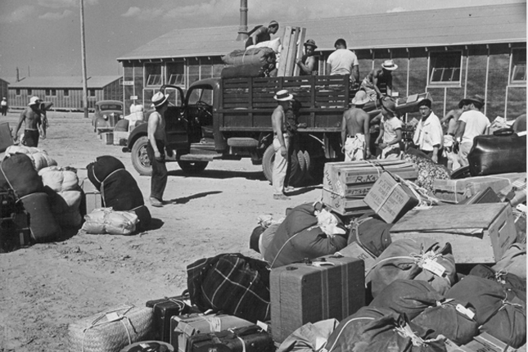

Slide 30
Germany-Hitler wanted to maintain moral at home-he did not change production of consumer goods. Blitzkrieg gave his soldiers much of what they needed by plunder. BUT when they started losing economic situation changed. Schools, theaters, cafes were closed all to focus war effort production. Women were not very involved in mfg.

Slide 31
Japan-Gov’t controlled prices, wages, labor and resources and traditions encouraged citizens to be obedient and sacrifice for the cause. Young men were encouraged to be kamikaze pilots-”1 way trip.” Females not utilized except in farming and textiles.

Slide 32
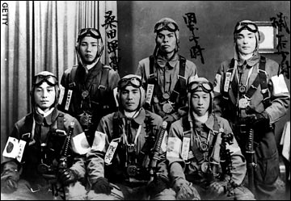
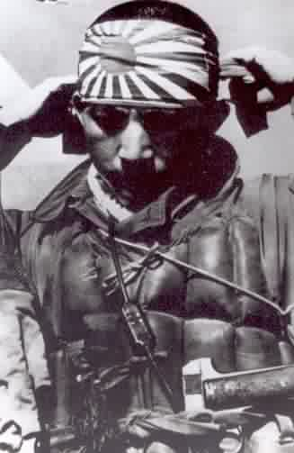

Slide 33
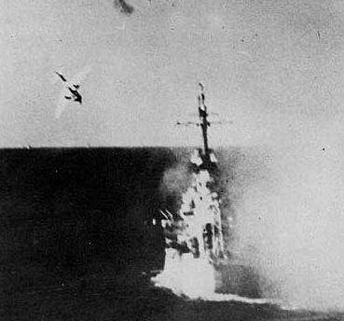

Slide 34
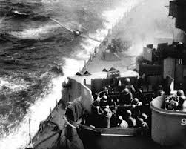

Slide 35
Bombing of Cities- targeted military bases, troops and cities, range and capacity.
Britain-London was bombed nightly for months! Thousands of civilians killed and many buildings destroyed. The blitz=air raids, soon included other British towns. Moral stayed high- bombing civilians would NOT force peace. 6 mill children and mothers were moved outside of cities.

Slide 36
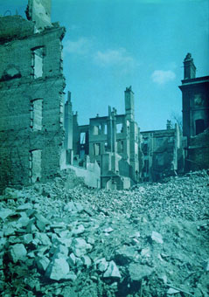

Slide 37
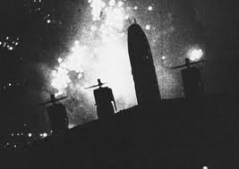

Slide 38
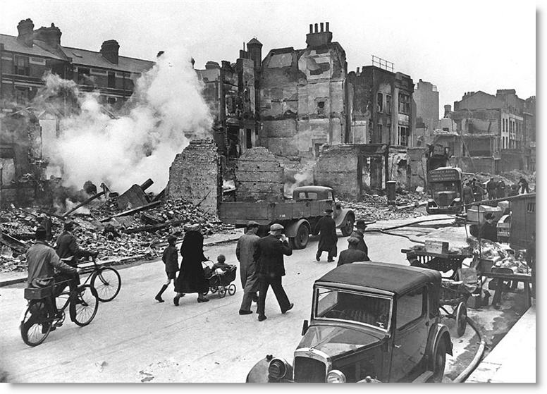

Slide 39
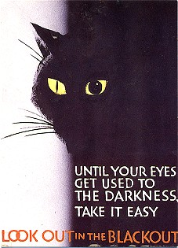
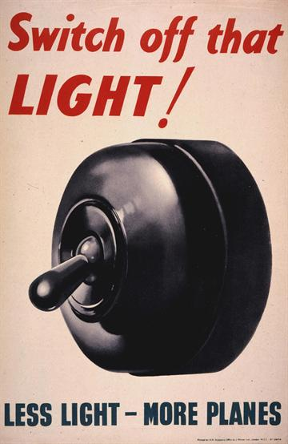

Slide 40
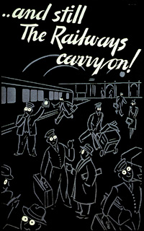
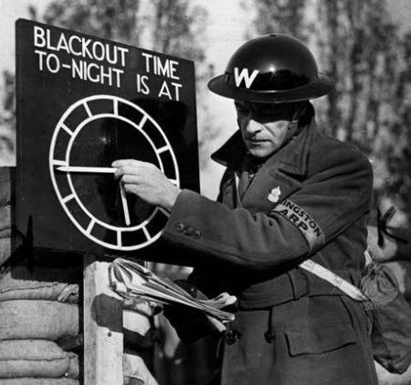

Slide 41
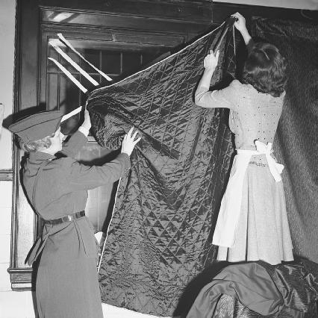
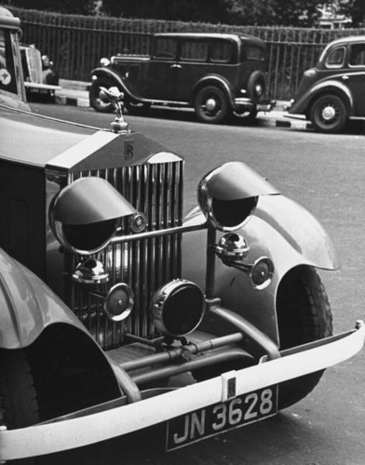

Slide 42
Germany- Bombing of major cities added to the problems of food, clothing and fuel shortages. Many sent their children to live in the country.1/2 m civilians died, 1 m buildings destroyed. War production not impacted but due to infrastructure destruction goods not getting to military.

Slide 43
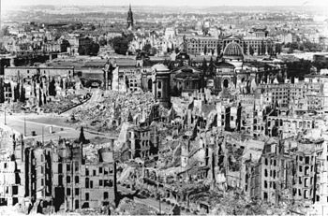
Bombing of Dresden in World War II

Slide 44
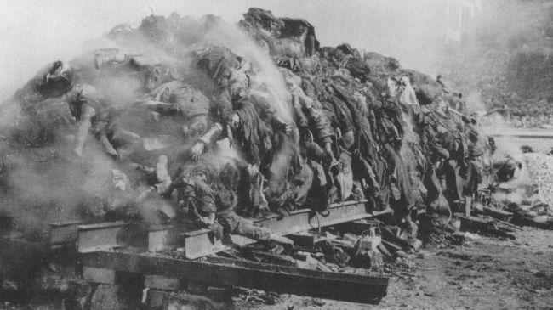
More than 500,000 German civilians and refugees, mostly women and children, were slaughtered by Britain’s saturation bombing in 1945

Slide 45
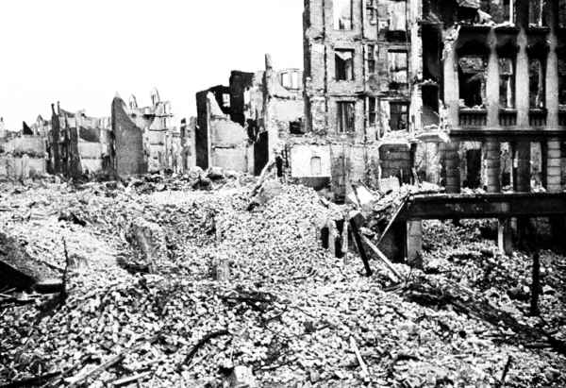

Slide 46
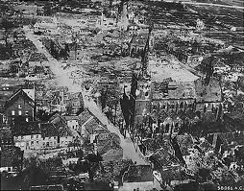

Slide 47
Japan- destruction of their air force let them venerable to air strike. Cities very crowed and poorly constructed. In 6 months of bombing many industries destroyed as well as ¼ of dwellings. Japan responded with “Peoples Volunteer Corps” 13-60 yrs.
August 1945 President Truman orders the dropping of atomic bombs.
End of 24.3

Slide 48
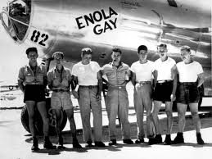

Slide 49
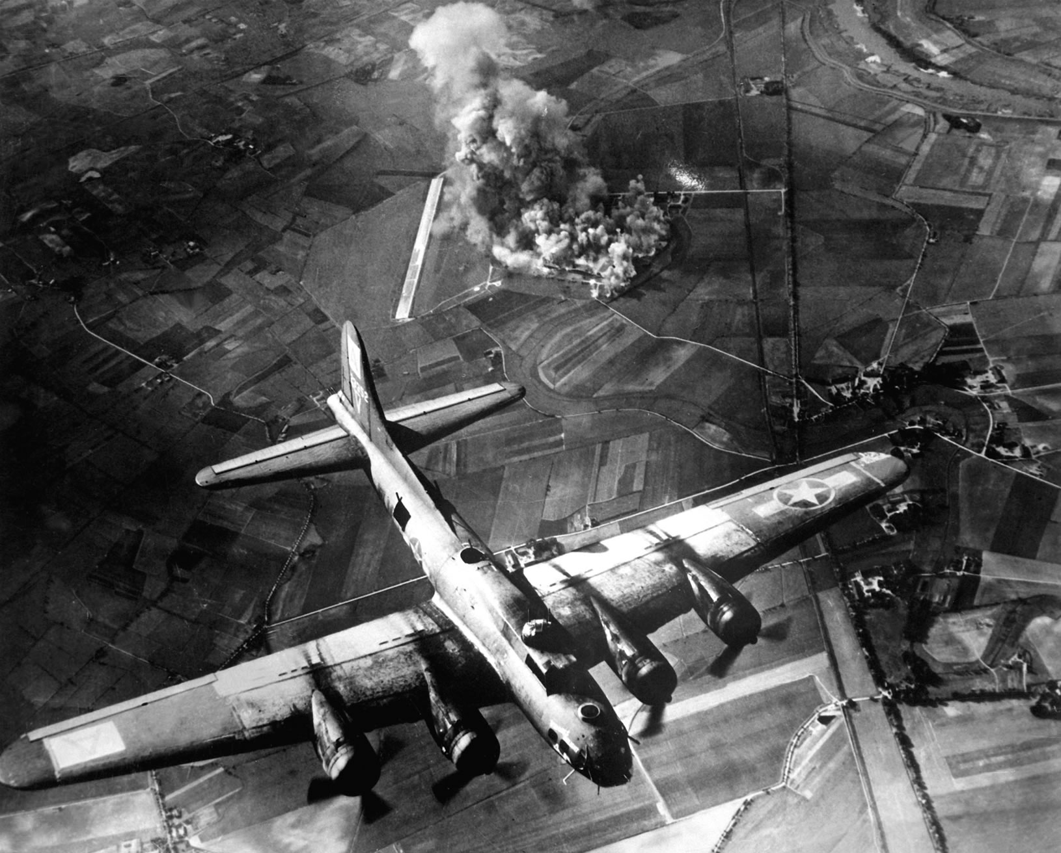

Slide 50
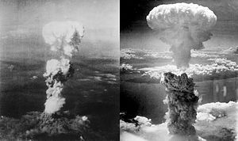

Slide 51
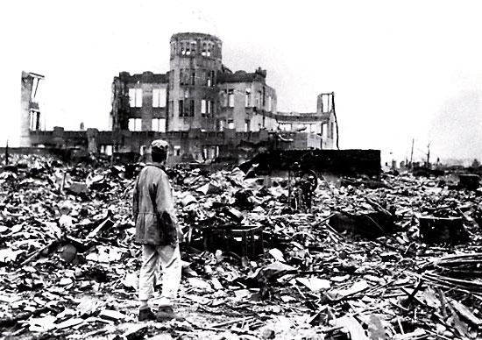

Slide 52
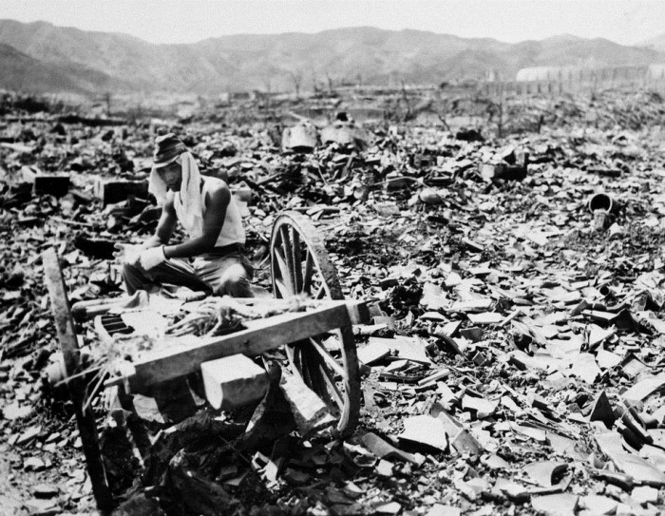

Slide 53
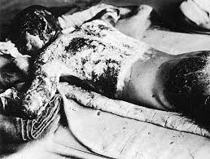

Slide 54
24.4
Most of Europe under Nazi control. Himmler the SS leader was in charge of resettlement. Slavic people would become the slaves to Germans. They moved millions of people around. 7 million in forced labor for Nazis, made many resist Nazi occupation.

Slide 55
Holocaust-deliberate attempt to exterminate the Jews. Hitler blamed the loss of WWI and the depression on Jews.
Einsatzgruppen-SS strike forces who’s task was to carry out genocide. Step one-move all Jews to getto, limit food to starve them. In SU SS death squads followed regular army and rounded up all Jews, executed and mass burial. 1 mil killed.

Slide 56
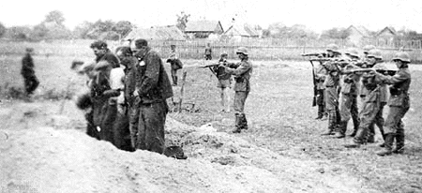

Slide 57
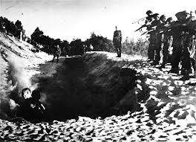

Slide 58
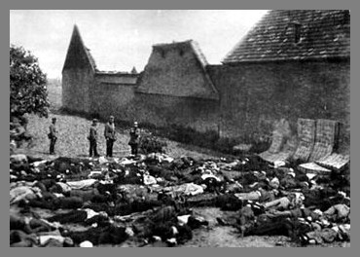

Slide 60
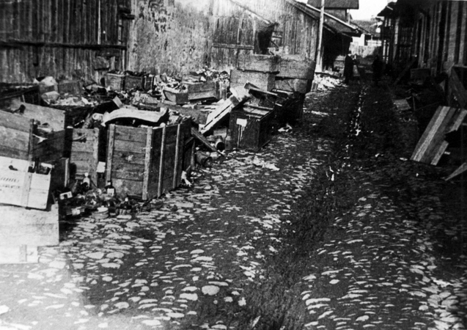
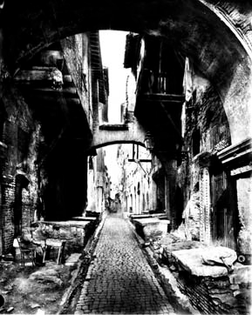

Slide 61
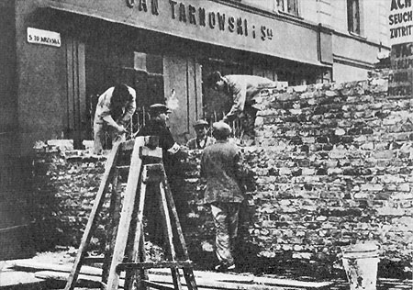

Slide 62
Death Camps-the answer to Nazi wish to speed up process. 6 extermination camps were constructed in Poland- Jews in countries occupied by Germany or sympathetic to Germany were rounded up placed in cattle train cars and shipped to camps. 30% work to death, rest went to gas chamber. Some were subjected to medical testing. Poland first priority, then France, Belgium and Holland, Greece and Hungry. Continued until the very end.

Slide 63
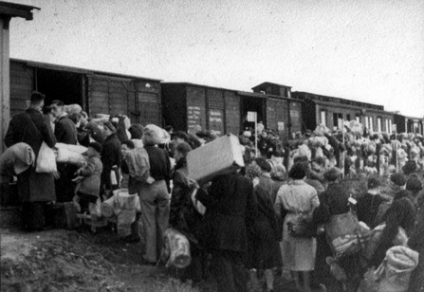

Slide 64
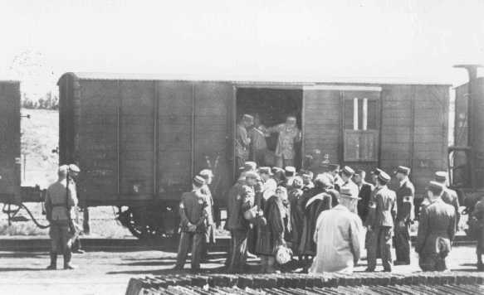

Slide 65
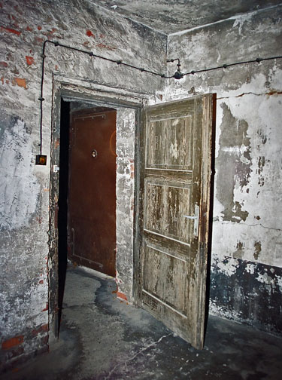

Slide 66
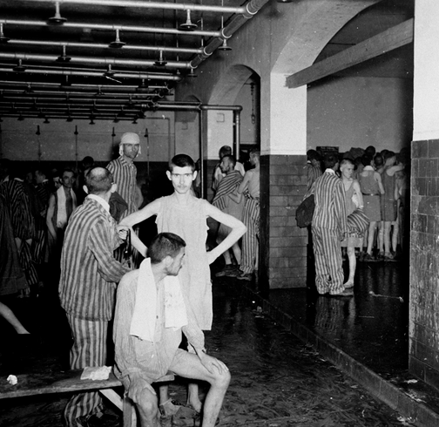

Slide 73
6 million Jews killed-90% of the Jewish population in Poland and the Baltic countries. 2/3 of all European Jews killed!!!
9-10 million non-Jewish people also killed. Shot, starved or overworked-Gypsies, Slavic people. Some people even helped Nazis hunt Jews. Others helped hide and save them. Allies knew about camps but not full extent of the horror of what was occurring at camps.

Slide 74
24.5 Last years of war
Early 1943 Germany, Italy and Japan not doing well. Allies took Sicily (island) then on to mainland of Italy. Germans and allies fight for Italy.
Allied invasion of France from GB across the English Channel. D Day!!! US gen. Dwight D. Eisenhower landed on Normandy beach in the greatest naval invasion. Not pretty!!
Underwater mines, barbwire, machine gun nests.

Slide 84
Within 3 months Allies had landed 2 mil men and 500k vehicles. The began moving inland and by August they had liberated Paris.

Slide 85
French resistance

Slide 87
Germans try to retake the Belgium seaport of Antwerp. “Battle of the Bulge” Both sides had huge losses, Allies held line, crossed the Rhine River and went into Germany.

Slide 91
By April 1945 Allied forces met up with SU. Soviet troops moved through Hungry, Romania, and Bulgaria. Allied troops advanced into Nazi occupied Europe. They freed concentration and death camps, Nazi’s tried to destroy most evidence of their evil actions but Allied troops saw enough.
Hitler retreated to a bunker in Berlin, blamed the war on the Jews and committed suicide. 7 days later Germany surrendered. War in Europe over. But Japan…….

Slide 92
Allies needed to take strategic positions in Pacific. The islands of Iwo Jima and Okinawa fit the bill-they had air fields that could be used to attack mainland Japan. Allies won but at huge cost of life. Leaders felt that if war continued many more would perish. To drop the bomb or not to drop the bomb…that is the question. Pres. Truman said drop it. 1st bomb-Hiroshima-190,000 died, 3 days later Nagasaki. Both cities leveled. Emperor Hirohito unconditionally surrendered. 8-14-45

Slide 93
Peace and a New War-the Cold War-and ideological conflict between SU and US would continue until the 1980’s. The big 3-GB, US and SU met to discuss post war plans. United Nations, divide Germany into 4 pcs, free elections for Poland. Next meeting Potsdam, Germany-big argument about free elections in Eastern European countries- Stalin said NO, he wanted to control EE. It would take invasion to change his mind-no way.

Slide 94
Allies agreed that leaders of the war crimes should be tried. Tried and condemned in Nuremberg, Germany and Japan and Italy.
As things calmed two views prevailed-SU part of worldwide communist conspiracy and US-global capitalist expansionism.
Winston Churchill speech- “Iron curtain “ descended across the continent. Dividing east and west.

