Slide 1
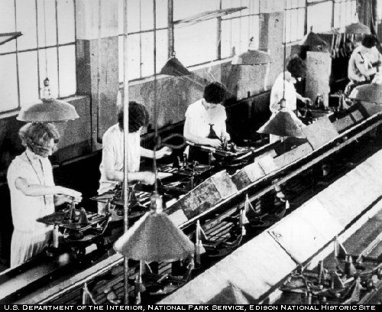
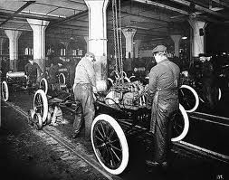
Chapter 18-19
Henry Ford 1913-more efficient mass production of goods.

Slide 2
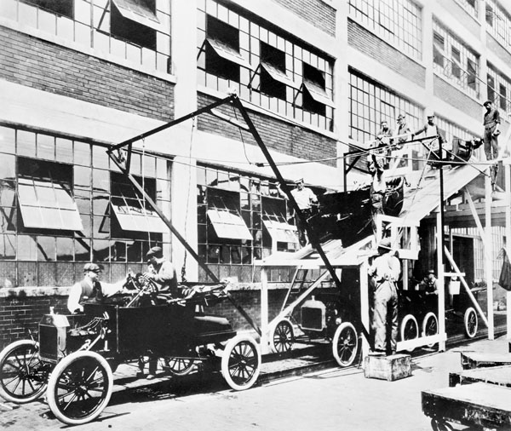

Slide 3
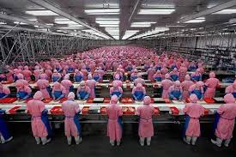

Slide 4
A world economy is developing, goods are being bought and sold around the world.
Working classes are organizing. Unions-to improve workers rights. Right to strike.
Karl Marx- Communist Mantifesto-blamed workers poor conditions on industrial capitalism. “profit”
Some thought revolution necessary others revision. Bourgeoisie v. proletariat (workers)

Slide 5
Women- many entered the work force in white collar jobs. Most W married and raised children. Birth rate declined-BC. Family was the central institution of middle class life. Less kids=more time devoted to each kid. Working class women worked to help support family-their children were generally apprenticed by 9-10 or working. Some families started to be supported by husband only.

Slide 6
Women’s Rights- some wanted equality. Husbands had total control over wives property. Some wanted right to attend universities and equal political rights.
Right to vote= suffrage, wanted full citizenship.
Treated horribly by authorities.

Slide 7
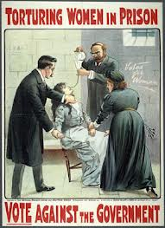
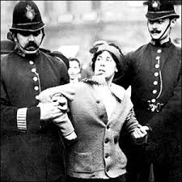

Slide 8
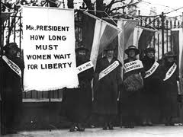

Slide 9
The United States-4 years of Civil War-South destroyed.
13th Amendment-abolishing slavery
14th Amendment-citizenship for slaves
15th Amendment-voting rights for black males
Southern state laws soon blocked blacks right to vote.
US led steel and iron production- 3 cites over 1 mil. US richest nation in world. 9% owned 71% of wealth. US began to expand-Hawaii, Samoan Islands, Puerto Rico, Guam, Philippines.

Slide 10
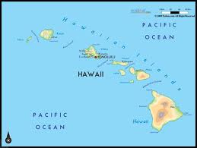
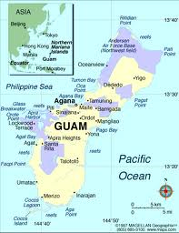
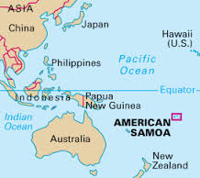
Sugar

Slide 11
Impressionism-movement started in France-artists went to countryside to paint nature.
Claude Monet, interplay light, water, sky
Postimpressionism- Vincent Van Gogh “paint what you feel” color, color, color
Decline in realism painting=George Eastman=Kodak camera 1888
Abstract= Pablo Picasso

Slide 12
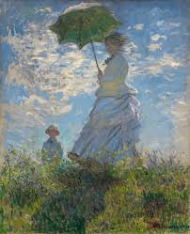
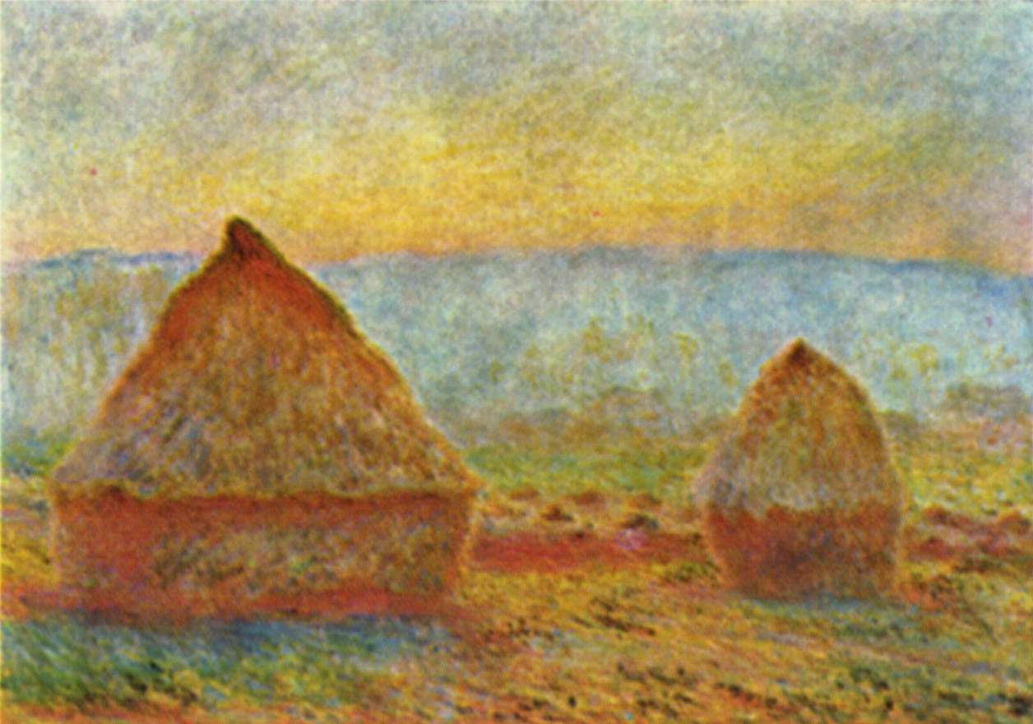
Monet

Slide 13
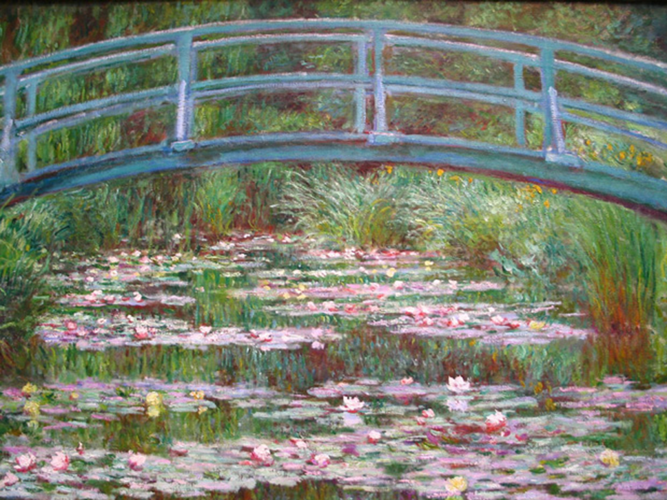

Slide 14
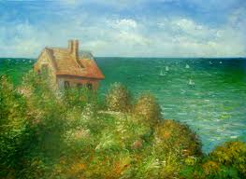

Slide 15
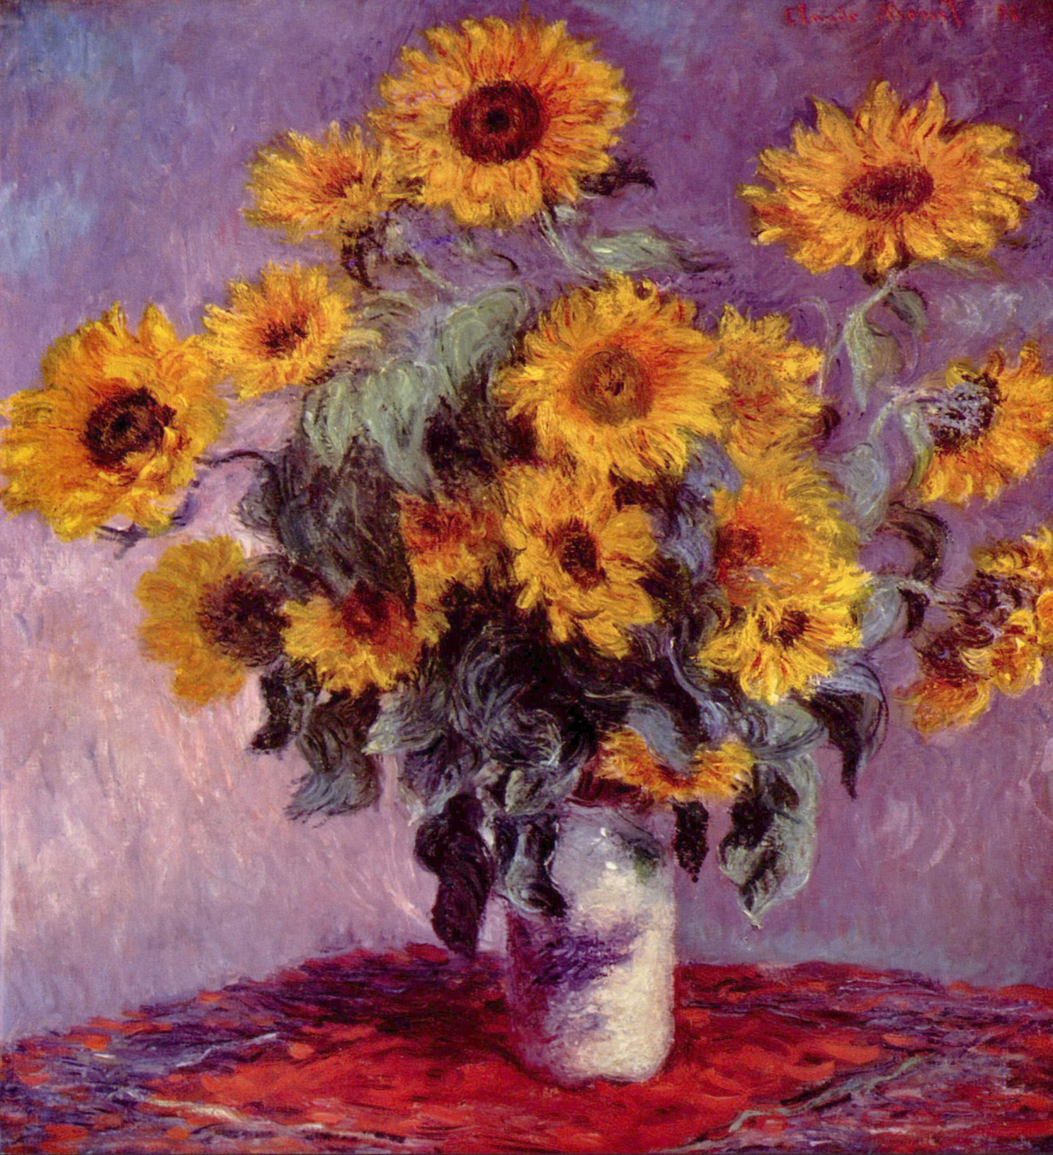

Slide 16
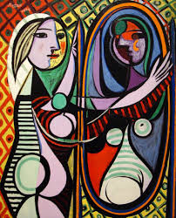
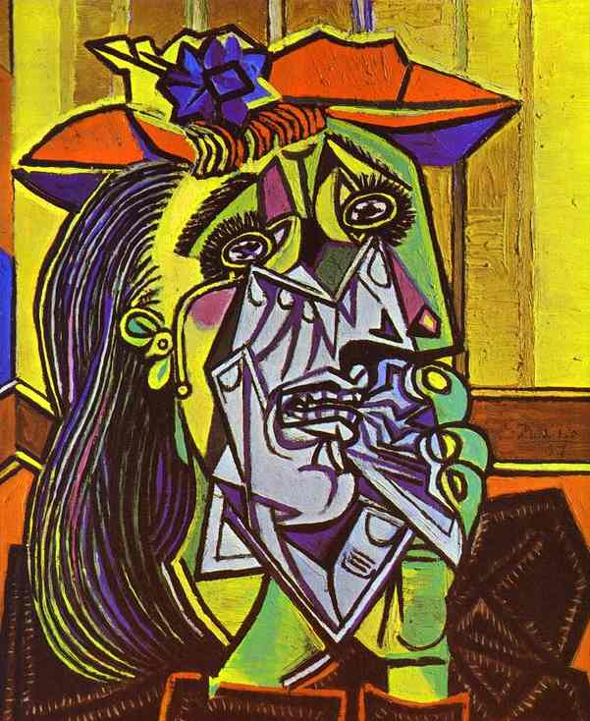
Picasso

Slide 17
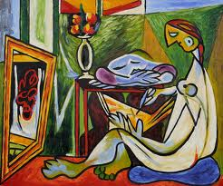

Slide 18
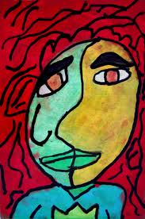

Slide 19
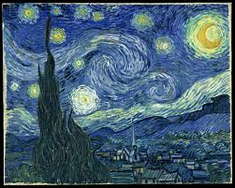
Van Gogh

Slide 20
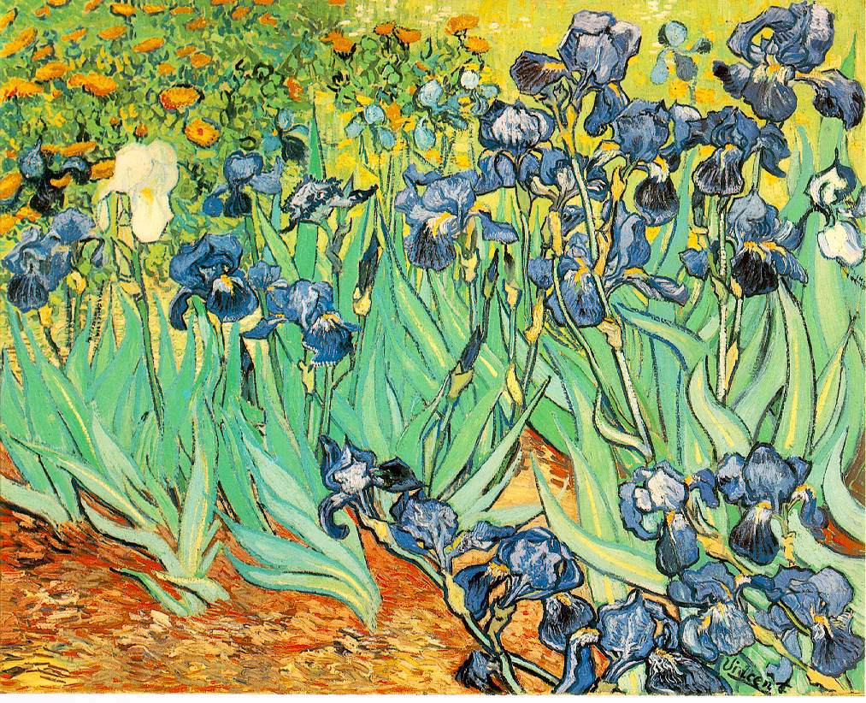

Slide 21
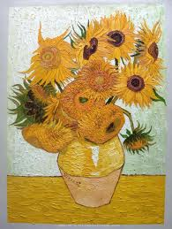

Slide 22
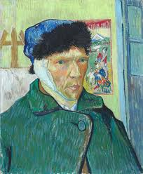

Slide 23
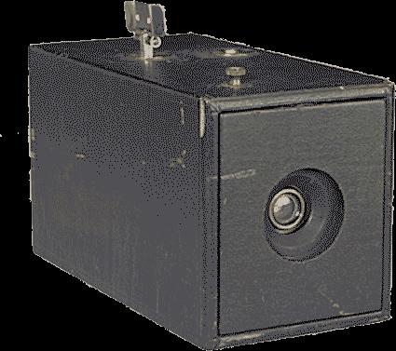
George Eastman first kodak camera

Slide 24
Music- Igor Stravinsky- The Rite of Spring
http://www.youtube.com/watch?v=Z0xNo2894Fw&safe=active

Slide 25
Science-many believed that by applying scientific laws, humans could understand the physical world and reality.
Marie Curie-1st woman to win Nobel Prize-Physics for her study of radiation. She showed atoms were not just material bodies but small active worlds.

Slide 26
Einstein- Relativity
Space and time are not absolute but are relative to the observer. Matter just another form of energy.
Freud-Psychoanalysis
Human behavior strongly determined by past experiences and internal forces of which people are largely unaware. Psychoanalysis-probing memory and looking at repressed memories to determine origin of behaviors.

Slide 27
Social Darwinism- ”survival of the fittest”, applied to human activities.
Pogroms-organized massacre of a minority group of people, esp. Jews. Many fled Russia.
(think Nazi Germany)

Slide 28
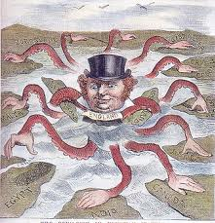

Slide 29
Chapter 19 Imperialism
European countries scrambled for control of overseas territory. This is not new-the US was a former colony in North America. This new imperialism was different-countries wanted total control not just trading posts. Why?? $$$$ Looking for markets for finished goods and raw materials. Also needed colonies for prestige and posturing against rivals. Social Darwinism ???

Slide 30
US-
During Spanish- American War, US forces take the Philippines from Spain. President McKinley makes it an American colony. Gives US access to trade with China and keeps away from Japanese. “our duty to civilize the world” they did NOT want to be colony of US. 3 years of bloody warfare.

Slide 31
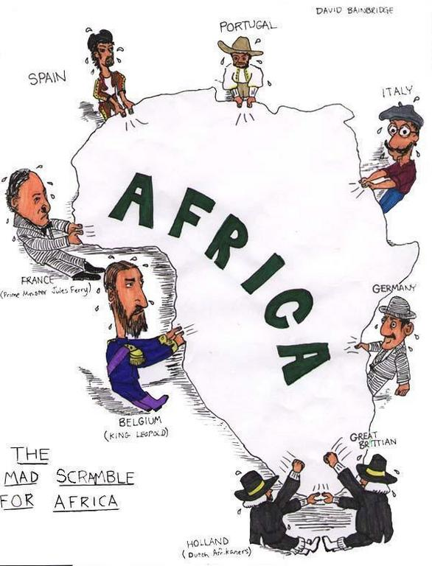

Slide 32
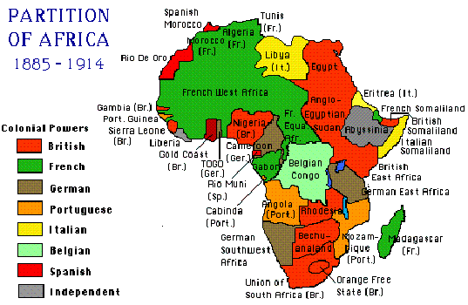

Slide 33
Racism-belief that race determines traits and abilities, racists believe that some races are superior or inferior.
Other reasons-religious=bring Christian message to the “heathen masses” or, humanitarian = responsibility to civilize primitive people.

Slide 34
Not all welcomed colonization, some resisted. Direct v. indirect rule. Some got to continue to govern themselves, others…..
19.2 by 1900 virtually all Africa under European rule. Britain, France, Germany, Belgium, Italy, Spain, Portugal. Wanted the raw materials and the markets. Slave trade was over by this time.

Slide 35
Muhammad Ali seized control of Egypt. Modernized the country, industry, education etc. Had Suez Canal constructed that connected Mediterranean and Red Sea (without having to go all the way around Africa). BUT once canal completed British now want to control it! “Lifeline to India” . Full control in 1914 after revolt.

Slide 36
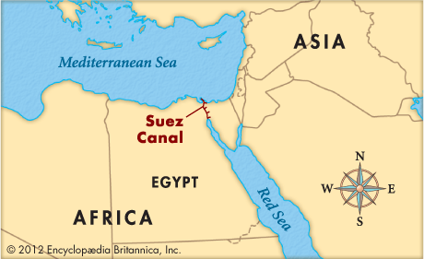

Slide 37
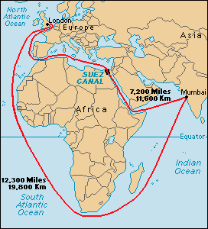

Slide 38
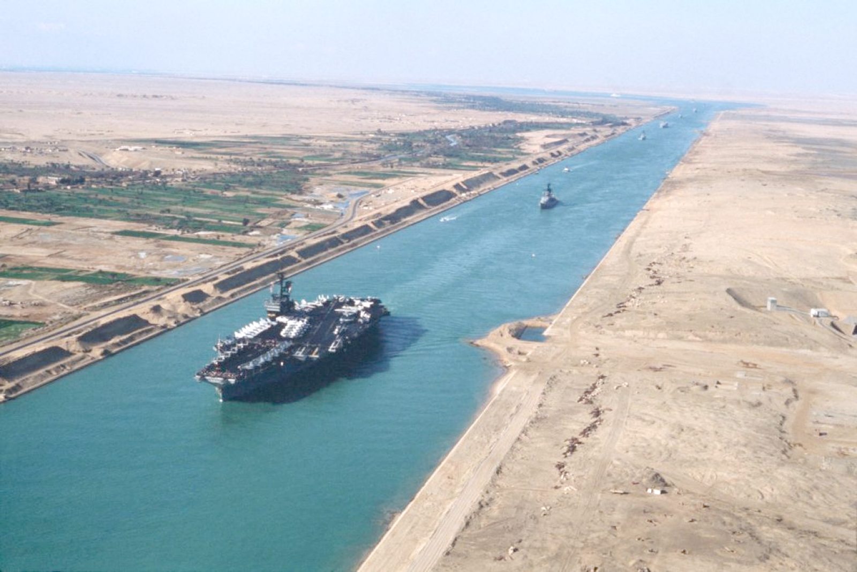

Slide 39
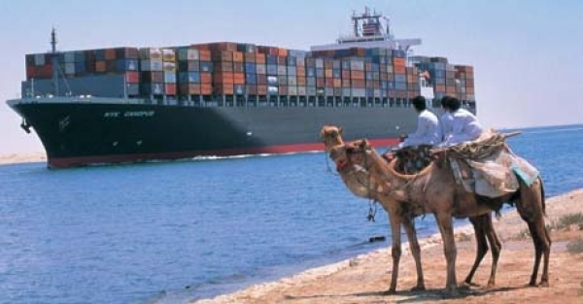

Slide 40
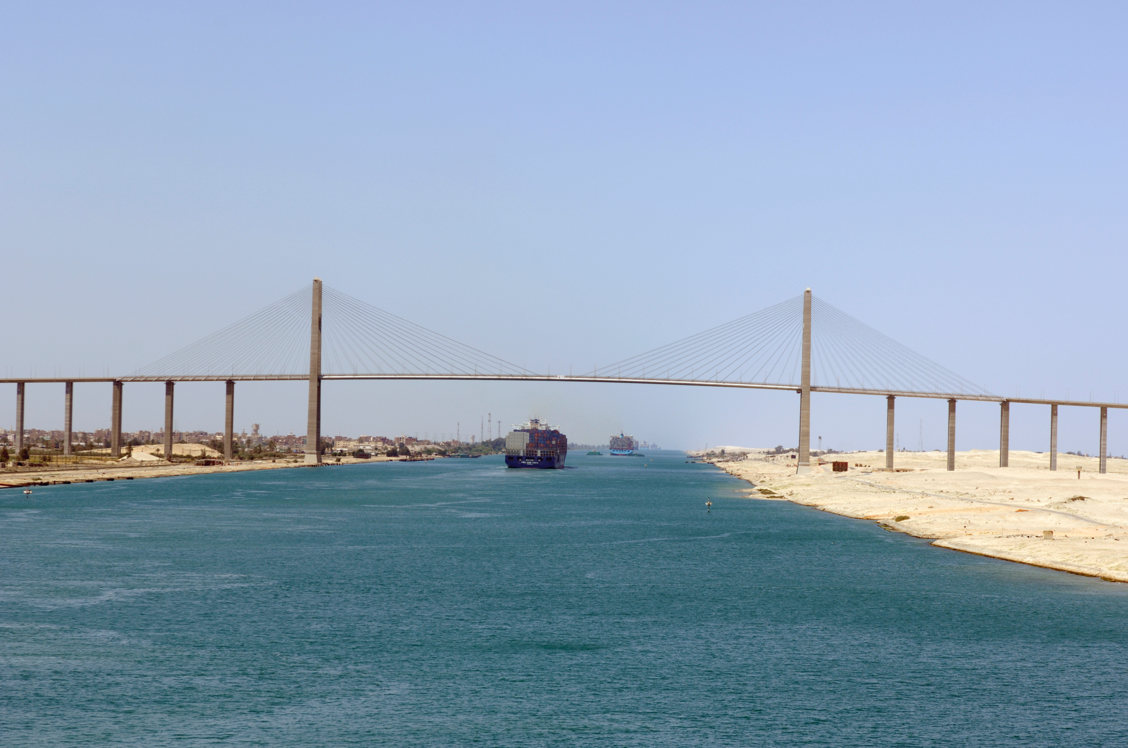

Slide 41
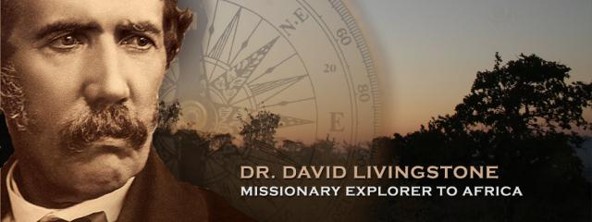
Central- Explorer David Livingstone spent 30 years in Africa. His major goal was to find a navigable river that would open Central Africa to European commerce and Christianity. Found after missing for some time by Henry Stanley. Stanley convinced King Leopold of Belgium to colonize the Congo.

Slide 42
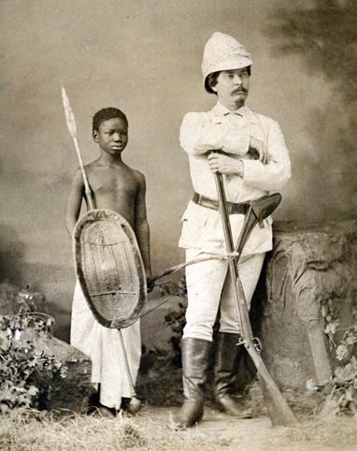
STANLEY

Slide 43
South Africa- Boers ( descendants of original Dutch settlers) They believed that white superiority was ordained by God. They were defeated by the British eventually. Boers moved out eventually had conflict with the Zulu. Shaka their leader created their own empire. Free until British joined the battle.
Effects of Imperialism- by 1914 only Liberia (homeland for former slaves in the US) and Ethiopia were free. Others who tried to resist were devastated by superior European military force.

Slide 44
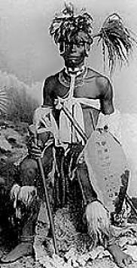
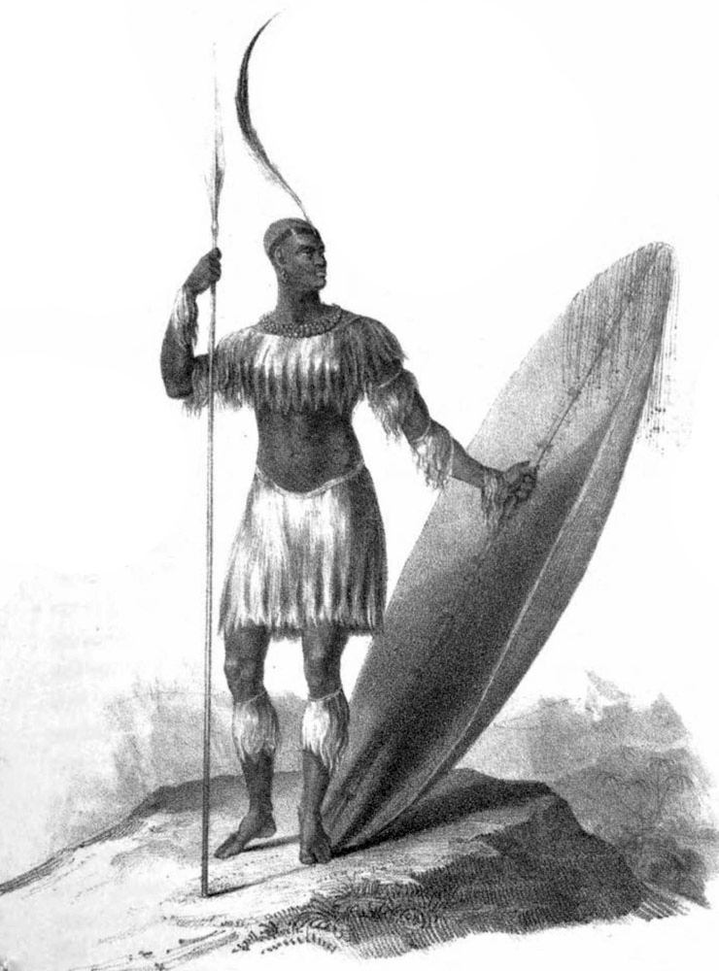

Slide 45
Colonial Rule-
British- indirect rule- basically British made all the decisions and locals enforced them. (cheap) Does not disrupt local customs BUT it does keep old elite in power- seeds for class tension.
Direct rule-France- French official at top, tried to assimilate African subjects into French culture. Locals were able to run for high positions.
Many sought independence by end of century.

Slide 46
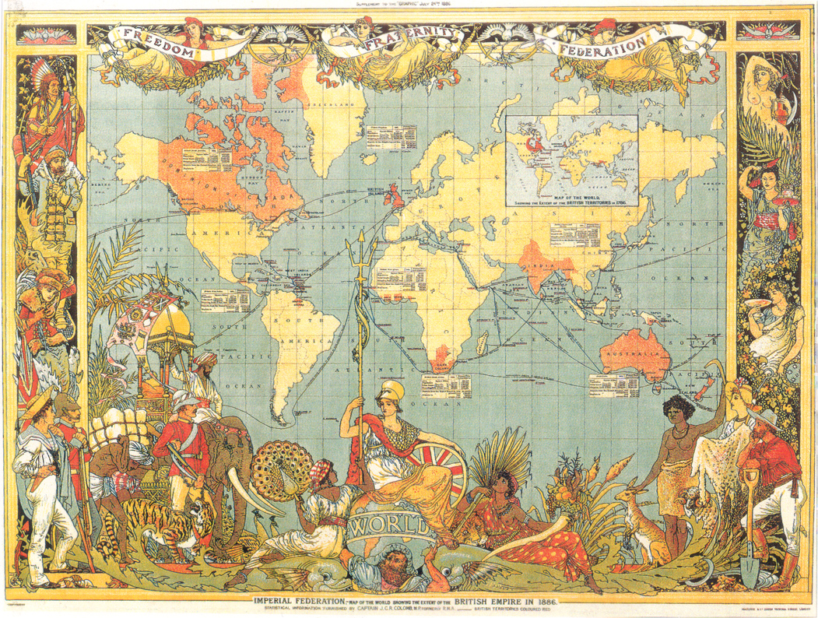

Slide 47
19.3 British Rule in India- Britain gave the British East India Company (a trading co) the right to be involved in India’s military and political affairs. They had their own soldiers and also hired Sepoys (Indian soldiers).
1st Revolt- 1857 rumor that rifle cartridges had pig and cow fat freaked the sepoys out! Cow sacred to Hindus, pig taboo to Muslims.
Several soldiers were punished for refusing to use cartridges. Revolt !! Indians # > British !!! But not organized well and Hindus v. Muslim kept them from working together.

Slide 48
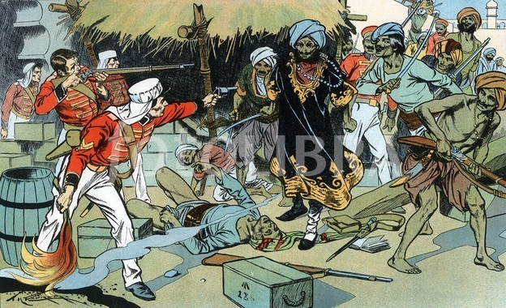

Slide 50
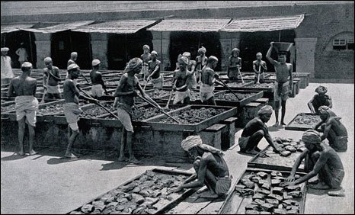

Slide 51
British Parliament transferred the powers of EITC to British gov’t. 1876 Queen Victoria took the title of Empress of India- they are now her subjects.
Colonial rule was direct after Sepoy Mutiny, viceroy-governor who is representative of monarch and British civil service staff of 3500 who ruled 300m. Pro’s- order/stability, honest form of gov’t. New school system, only benefitted the upper class. Roads, hospitals, canals, universities, postal system…. Health and sanitation systems also better.

Slide 52
Con’s-
British rule kept best jobs and homes for Britons. This led to an Indian nationalist movement, the first members were upper class, English educated. Many preferred reform to revolution. They met INC- Indian National Congress- wanted independence for all Indians regardless of religion. Led to problems. Hindu v. Muslim
Mohandas Gandhi- led nonviolent resistance, to improve conditions of poor and gain independence for India.

Slide 53
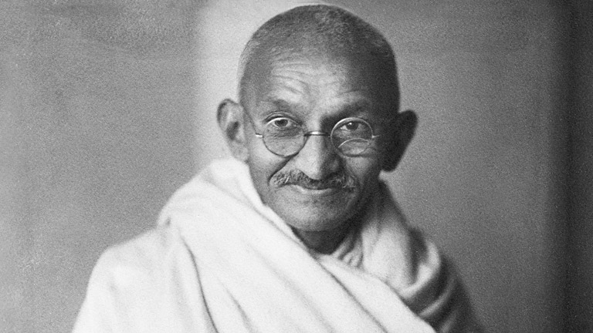

Slide 55
19.4-
Spanish-American War, 1898 – Cuba became a protectorate of US, Puerto Rico annexed to US.
1903 Pres. Teddy Roosevelt supported rebellion that helped Panama separate from Colombia. US got 10 mile wide strip of land through the country. Panama Canal constructed here.

Slide 56
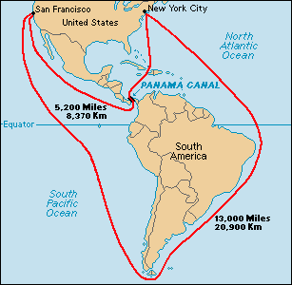

Slide 57
