Slide 1
Chapter 12 Conflict and Absolutism in Europe
https://mail.google.com/mail/u/0/?shva=1#inbox/143c751e69ce68dc?projector=1
How to become monarch….. funny
http://www.history.com/topics/thirty-years-war/videos#mankind-in-2-minutes

Slide 3
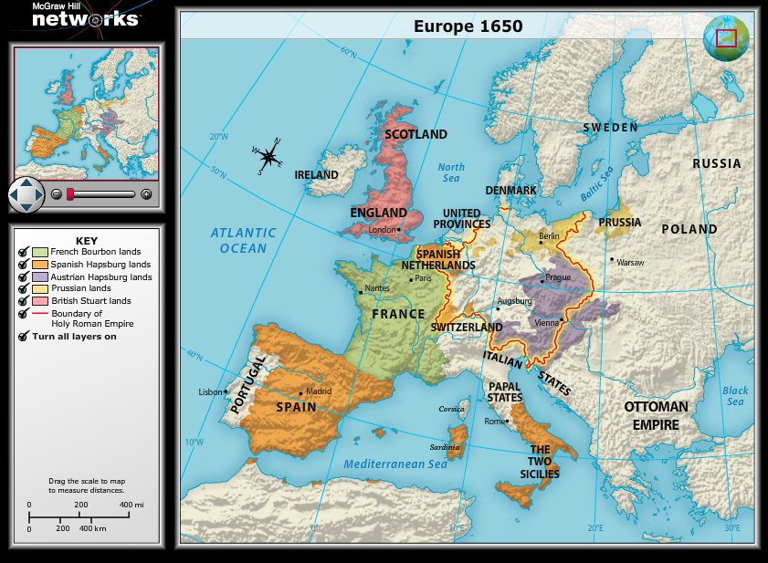

Slide 6
Catholicism and Calvinism became highly militant religions. They fought for converts and authority. The worst of the religious wars was the French Wars of Religion. French Kings persecuted protestants, this did not stop its spread.

Slide 7
King Phillip II of Spain by 1598 controlled the most populous empire in the world. He had consolidated lands in Spain, to the Netherlands, parts of Italy and the Americas. To strengthen his control he insisted on strict conformity to the Catholic faith. But Spain was broke and very much weakened. Lost ships sent to attack England….
He did win the Battle of Lepanto (Greece) against Turks.

Slide 8
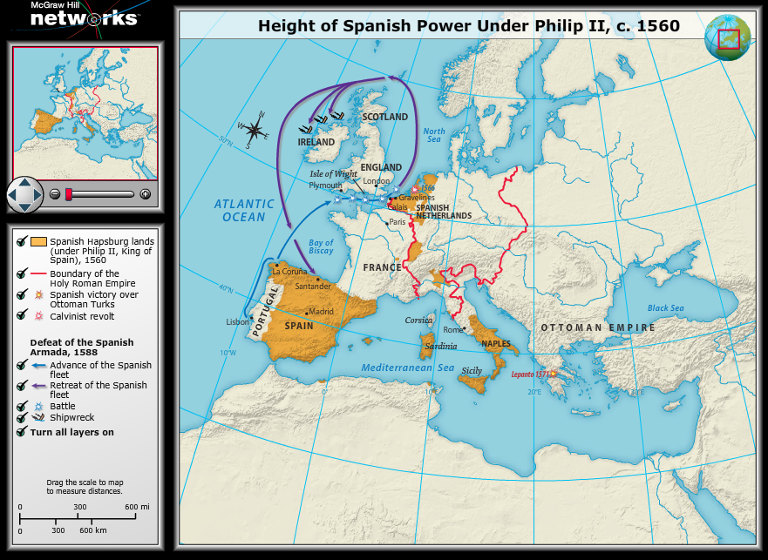

Slide 9
Queen Elizabeth of England- England became the leader of Protestant nations of Europe and laid foundations in the rest of the world. She repealed the laws favoring Catholics. She was moderate in her religion and her foreign policy. She attempted to keep Spain and France from becoming to powerful. Phillip II tried to conquer England by sea but lost most of its ships during storms.

Slide 14
Query
What was the significance of the defeat of the Spanish Armada?
Both Spain’s navy and its prestige as a world power were greatly damaged by the defeat, and political power shifted to England and France.

Slide 15
Huguenots-French Protestants, made up ~ 7 % of population but 40-50 % were nobility. French Catholics (and king) strongly outnumbered Huguenots. Henry of Navarre, a Huguenot became king of France (Henry IV). He converted to Catholicism when he realized he would never be accepted if Protestant. His crowning stopped fighting in France. The Edict of Nantes recognized Catholicism as Frances official religion but allowed Huguenots to worship.
n

Slide 16
Crisis in Europe-political upheaval, religious warfare, severe economic crisis. Inflation=rising prices, caused by growing population that increased demand for food and land causing prices to go up for both.

Slide 17
Social Crises, War, and Revolution
Inflation= rising prices
Spain's economy had become dependent on imported silver (which was decreasing), ships were being pirated, loss of Muslim and Jewish artisans and merchants. (remember they were told to get out, convert or die). Populations in Europe began to decline by 1650 (plague, famine, warfare) this created social tensions.

Slide 18
Witchcraft or magic had been part of village culture for centuries. The religious zeal that led to the Inquisition and the hunt for heretics was extended to witchcraft. (mostly common, poor, 75 % women, single or widowed and over age 50) Usually under intense torture, they would confess.

Slide 19
30 year’s war-the “last of the religious wars” started in Germany. The Peace of Augsburg had not recognized Calvinism. (only Lutheranism) Started as religious war then evolved into political as well. Germany plundered and destroyed by all but England. Holy Roman Empire broken up into 300 states- it was no longer a political entity-only religion. Peace at Westphalia ended war.

Slide 20
Thirty Years War, in 5 mins

Slide 21
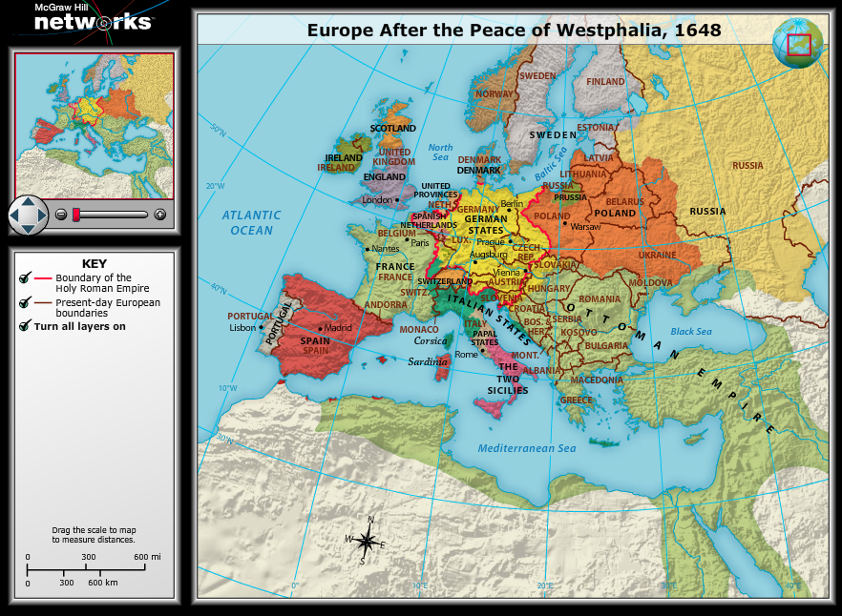

Slide 22
Ch 12.1 Discussion & Review
King Philip II of Spain was supportive of which religion?
What French document lessened tensions btwn Huguenots and Catholics?
What is another term for ‘a fleet of ships’?

Slide 23
Ch 12.1 Discussion & Review
King Philip II of Spain was supportive of which religion?
Catholicism
What French document lessened tensions btwn Huguenots and Catholics?
Edict of Nantes
What is another term for ‘a fleet of ships’?
Armada

Slide 24
War and Revolution in England
Ch 12.2, p. 217
http://www.youtube.com/watch?v=ga6Q0WjHuHc
Glorious revolution 3 min

Slide 27
Ch 12.2 Vocab
Divine right of kings
Puritans
Cavaliers
Roundheads
Natural rights
Commonwealth
Restoration
convert

Slide 28
King vs. Parliament
After Elizabeth I dies, James I steps up
Believed in divine right of kings
Got power from & responsible only to God
Parliament (made up of nobles) gets upset b/c they want to have a say
Then Charles I inherits the throne from his father (James I) and ignores Parliament even further
Like father, like

Slide 29
Many of the members of Parliament were Puritans
Puritans were British Protestants who wanted further separation from the Roman Catholic Church
Fled to America in 1620 to escape persecution
1628 Petition of Right- parliament passed-limited kings power to tax, imprison citizens w/o cause, quarter troops, institute martial law. At first king accepted POR then he ignored it.

Slide 30
Civil War, then Commonwealth
Conflicts btwn Charles I and Parliament lead to Civil War (1642)
Supporters of the king = Cavaliers or Royalists
Supporters of Parliament = Roundheads commanded by Oliver Cromwell (he is a military genius!!
Parliament wins !! Charles I executed ☹
Cromwell named leader of new gov’t….a COMMONWEALTH is born. Monarchy and House of Lords is abolished.
http://www.youtube.com/watch?v=O4b0G_auKCI
Roundheads v. cavaliers 2 min

Slide 31
Commonwealth, cont’d.
Cromwell eventually establishes a military dictatorship b/c dealing with parliaments is troublesome
Dies in 1658 and gov’t. falls apart
Monarchy restored
http://www.youtube.com/watch?v=OzR1dwjhVsU
http://www.youtube.com/watch?v=YCmFBsS1BhA Cromwell warts. 2 min

Slide 32
Restoration of Monarchy
Charles II (son of Charles I) becomes king in 1660
Called the ‘Restoration’
BUT parliament still powerful
Charles II tries to suspend Parliaments anti-Catholic laws
Parliament passes law that only allows Church of England members to hold office “Test Act”

Slide 34
A ‘Glorious’ Revolution
After James II has a male heir, (catholic) the Parliament invites Dutch leader William of Orange to invade England
Some soldiers abandon James II to join William.
James runs away to France
William and wife, Mary, become King and Queen of England (Mary is James II daughter) William wants to fight France!!

Slide 35
William of Orange

Slide 36
Query
Why is it called a glorious revolution?
Little blood was shed
A Bill of Rights was enacted (similar to Petition of Rights)
Establishing England’s first official constitutional monarchy
William king by the grace of Parliament not God!

Slide 37
Bill of Rights
Gave Parliament the right to:
make and levy taxes
raise armies
Cruel and unusual punishment banned
People had right to : right to a jury trial, right to keep arms
Laid the foundation for a limited government.

Slide 38
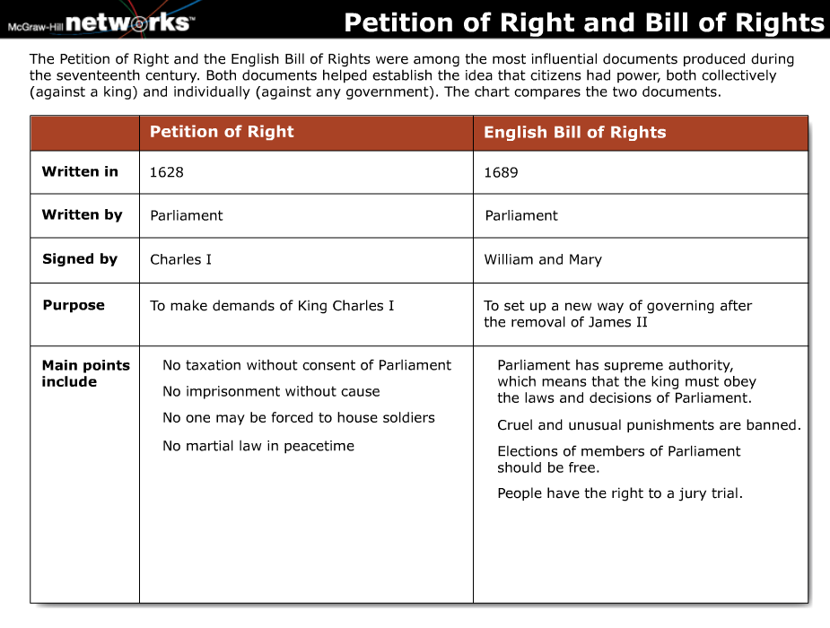

Slide 39
Philosophizers
Thomas Hobbes
John Locke
Everyone has natural rights= life, liberty and property
Write Two Treatises of Government
Argued against absolute rule
Ruled by the consent of the governed.
Everyone is selfish and inherently destructive
Wrote Leviathan
Believed in absolute rulers to preserve order

Slide 40
Ch 12.2 Discussion and Review
What does ‘divine right of power’ mean?
What document gave Parliament the right to raise and army, among others?
The ideas of ____________ can be found in the US Constitution and Declaration of Independence.

Slide 41
Ch 12.2 Discussion and Review
What does ‘divine right of power’ mean?
God given right to rule
What document gave Parliament the right to raise and army, among others?
Bill of Rights
The ideas of ____________ can be found in the US Constitution and Declaration of Independence.
John Locke

Slide 42
Absolutism in Europe
Ch 12.3, p. 221

Slide 45
Ch 12.3 Vocab
Absolutism
Boyar
Czar
Stability
Emerge
Authority

Slide 47
Absolute Monarchy in France- their response to crises in other countries.
Absolutism = ruler has total power, idea of divine right of kings. King received power from God and he was responsible only to God.
Richelieu and Mazarin -Served as ministers for Louis XIII and Louis XIV. R. strengthened monarch’s power (spies to get traitors)
Louis XIV aka “Sun King”-Source of light for all ppl

Slide 48
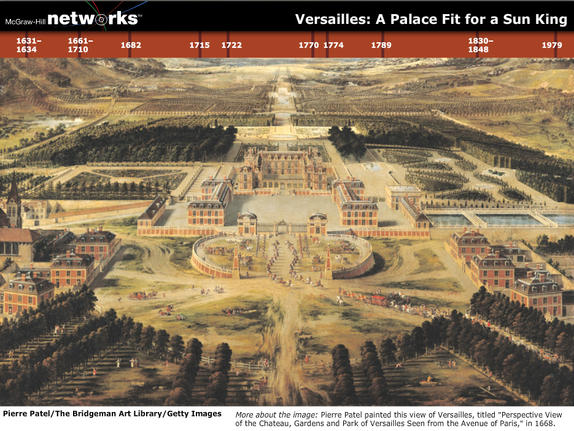

Slide 49
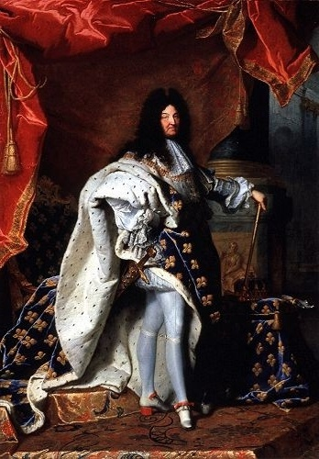
Louis XIV
Control of policy making
Anti-protestant policy
Colbert’s control of finances-mercantilism
Increase exports decrease imports made country more $
Built and army
Waged wars to expand control/lands

Slide 50
Louis XIV
Louis XIV felt like he failed…BUT
New roads/canals to improve communications and transportation of goods
encourage new industry,
made France a world powerhouse

Slide 51
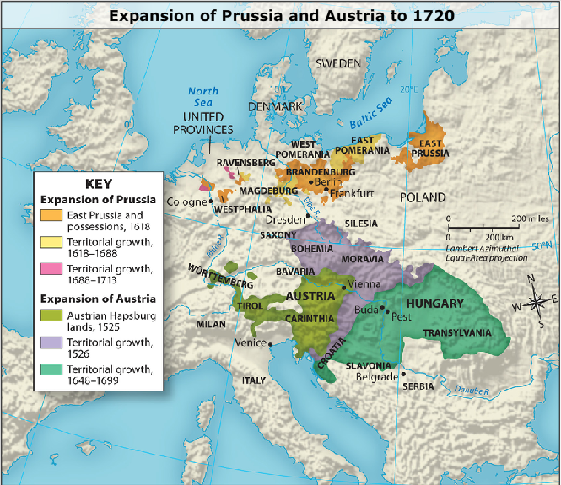
Prussia and Austria Emerge
Frederick William (of Prussia) raises a 40,000 man army
Set up a General War Commissariat to raise taxes
The Austrian Hapsbergs
Crippled by 30 yrs war
Originally part of the Holy Roman Empire
Left w/ lots of land

Slide 52
Ivan IV first ruler to take title of czar. He expanded Russian lands to the east. He crushed the boyars. (Russian nobility)

Slide 53
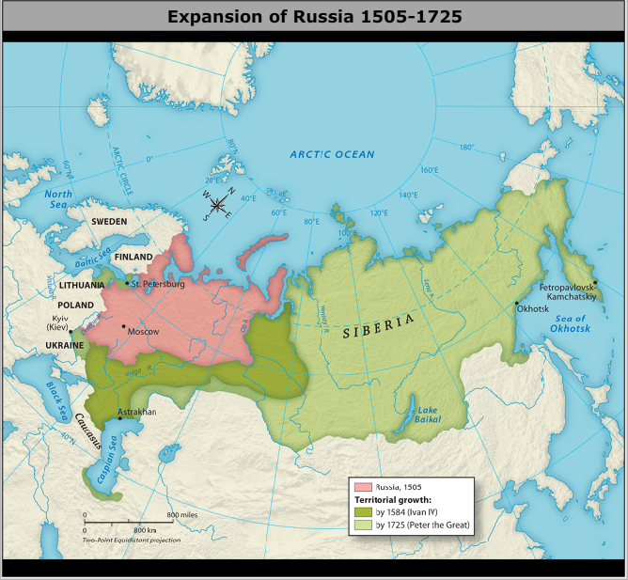
Expansion of Russia
Peter the Great
Became Czar in 1689, part of a long line of Romanov Dynasty (1613 – 1917)
Definitely an absolute monarch
Tried to westernize Russia’s military and gov’t.
BUT still wanted a police state…

Slide 58
Query
How did Peter maintain a central gov’t. under his control?
He divided Russia into provinces w/ strong enforcement of the law

Slide 59
Ch 12.3 Discussion & Review
What does absolutism mean?
Rulers hold total power
T/F: The Hapsburgs were from Prussia.
False, Austria
Peter the Great wanted to __________ Russia, to be more like the country’s European neighbors.
Westernize

Slide 60
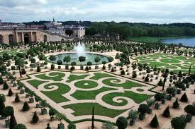

Slide 61
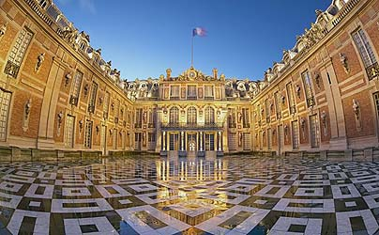

Slide 62
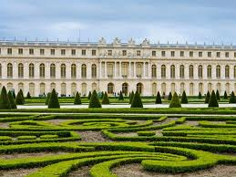

Slide 63
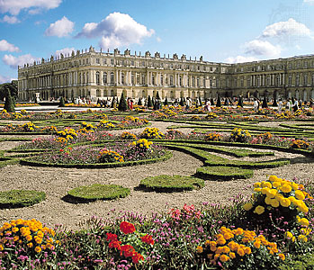

Slide 64
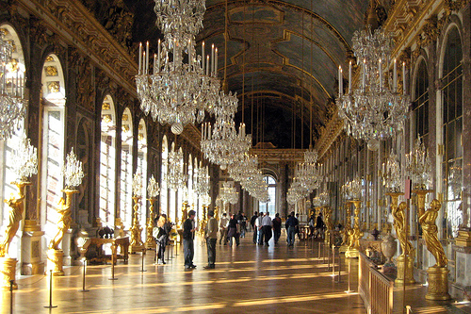

Slide 65
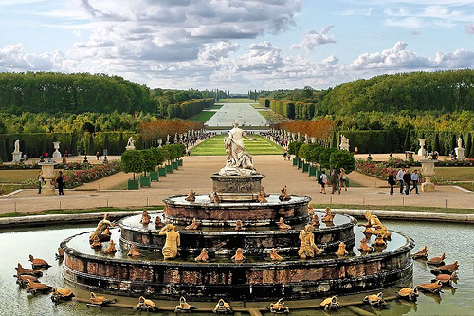

Slide 66
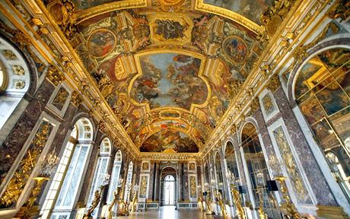

Slide 67
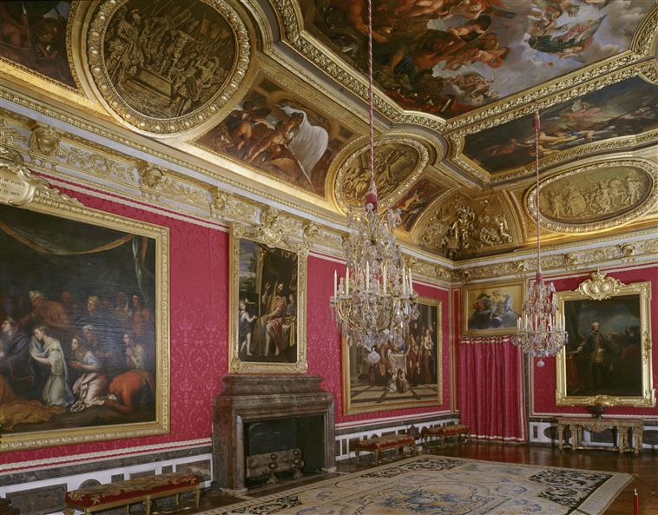

Slide 68
Lesson 4
Mannerism- ended Renaissance, started in Italy. 1520’s
Mannerism art= refused to follow Renaissance rules of balance, harmony and moderation. Now rules of proportion ignored, showed suffering, strong emotions etc. Spread all over Europe. El Greco most prominent painter. Figures are often elongated (contorted) works often reflect religious tensions.

Slide 69
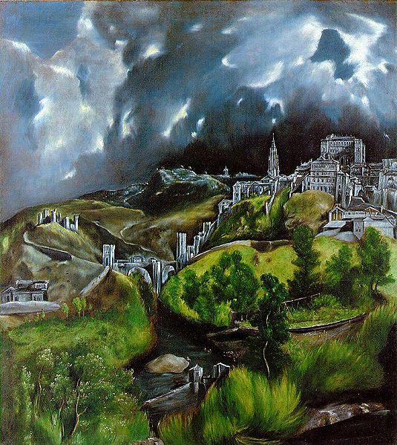

Slide 70
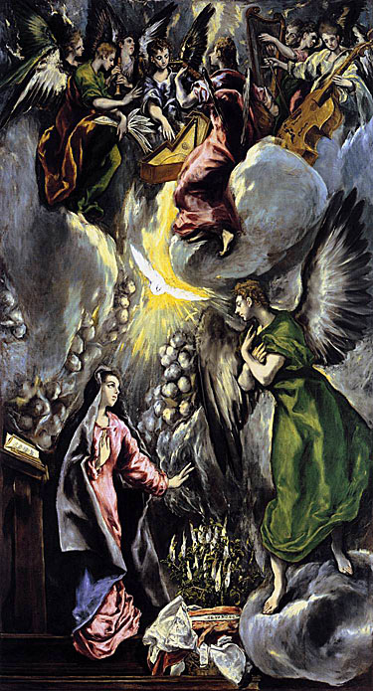

Slide 71
Baroque Art- Replaces Mannerism- starts in Italy, spreads. Very much adopted by Catholic Reform. Tried to bring together the classical ideas of Renaissance art and spiritual feelings of 16th century religious revival. “power”
Gian Lorenzo Bernini- St. Peters Basilica
Action, exuberance and dramatic effects

Slide 72
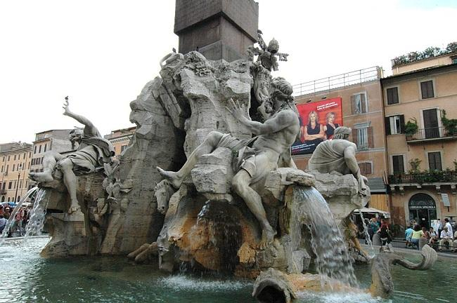

Slide 73
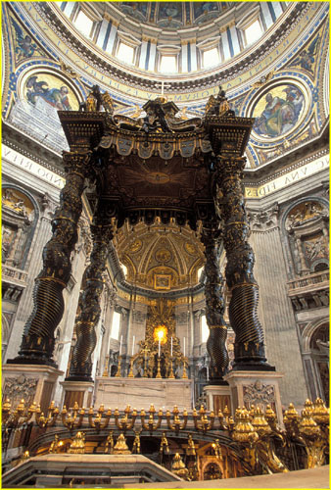

Slide 74
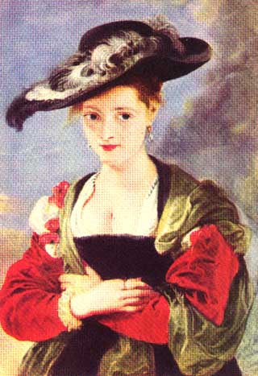
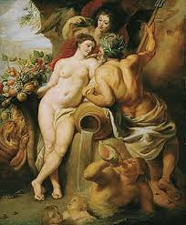
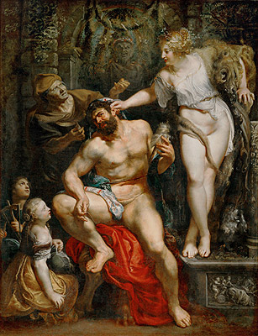
Rubens

Slide 75
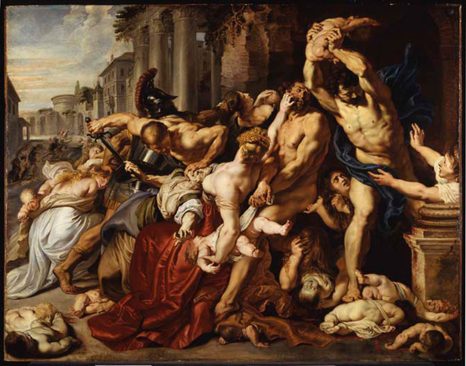
Peter Paul Rubens: "Massacre of the innocents", 1610/11- $76.7 million (£49.5 million) - Bought by Kenneth Thompson at Sotheby's London, July 2002.

Slide 76
Baroque Music-
Johann Sebastian Bach = Mass in B Minor
Greatest composer of all time.
https://www.youtube.com/watch?v=TX9zAlSXSOo
George Frederic Handel- best known for his religious music. Handel’s Messiah.
https://www.youtube.com/watch?v=il7uhFe-vUY
https://www.youtube.com/watch?v=sLB-uMPj27s&feature=related dumb and dumber

Slide 77
Golden Age of Literature- Drama- theater growing
William Shakespeare- “complete man of theater” wrote plays, acted, theater owner.
Wrote tragedies, comedies, histories- very adept at understanding the human condition.

Slide 78
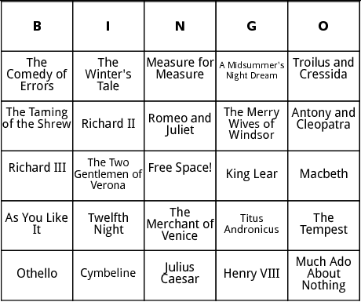

Slide 79
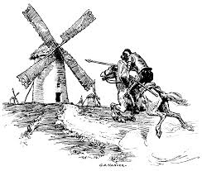
Spain-
Cervantes – Don Quixote
Idealist knight and Sancho the realists.

