Slide 1
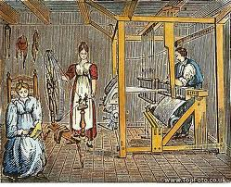
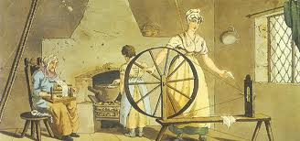
Industrialization
Chapter 17Section 1
The Industrial Revolution-a shift from an economy based on farming and handicrafts to an economy based on manufacturing by machines in factors. This began in Britain in the 1780's, it took several decades (10 yrs.) to spread to other nations.

Slide 2
Why did it begin in Britain?
Change in agricultural practices,(Agricultural Revolution)-more farmland, good weather, improved transportation and new crops increased the food supply. More food could be produced with less labor. Even average families to purchase manufactured goods.
Surplus food led to increased population, which created a large labor force to work in the new factories.
Britain had a large supply of capital (money to invest in machines/factories. Britain had plentiful natural resources.

Slide 3
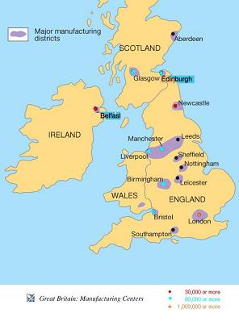

Slide 4
Many rivers provided water power and a way to transport raw materials and finished products from one place to another.
Lastly, Britain had many places to sell their goods in their colonial empire (India, Africa, Islands)
Entrepreneurs-people who are interested in finding new business opportunities and new ways to make profits.
natural resources were plentiful.

Slide 5
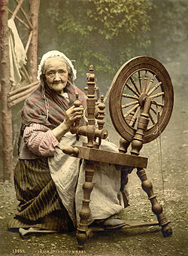
Cotton
2 step process to make cotton, 1st-spinners made cotton thread from raw cotton. 2nd-weavers wove the thread into cloth on looms. Until the 18th century, this was done at home= (cottage industry) A series of technological advances in the 18th century made cottage industries inefficient. The flying shuttle made weaving faster, so weavers needed more thread. The spinning jenny was invented that spun thread much faster.

Slide 6
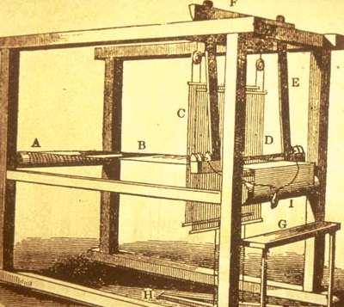
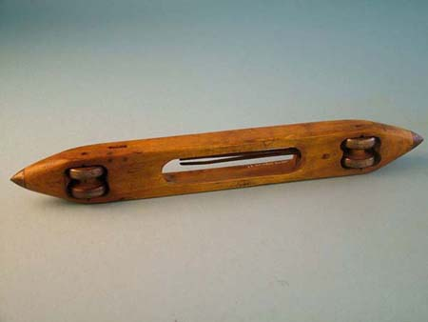
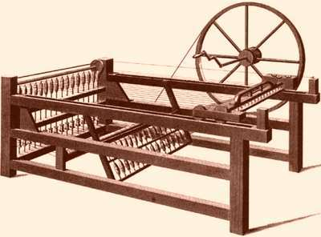

Slide 7
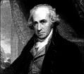
The cotton industry became even more efficient when James Watt, invented the steam engine, this allowed the engine to drive machinery. These engines were driven by coal, they did not need to be located near rivers. (The first water powered loom had to be near rivers) The steam engine was crucial to Britain's Industrial Revolution. Coal appeared to be unlimited in quantity.

Slide 8
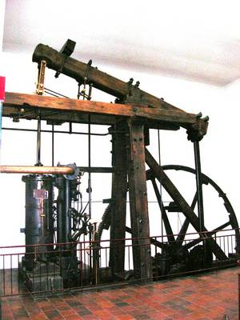

Slide 9
The factory was another important part of the Industrial Revolution. Factory owners wanted to use their new machines constantly, so workers were forced to work in shifts to keep the machines producing at a steady rate.
Shoulder Buddy Q:
What is a shift? What does it accomplish?

Slide 10
http://www.youtube.com/watch?v=zhL5DCizj5c&safe=active
Crash course – industrial revolution. 11 min.

Slide 11
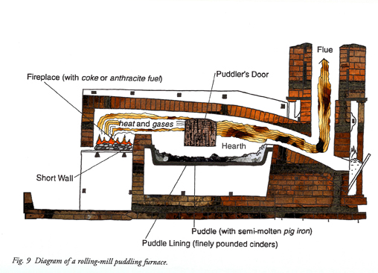
The success of the steam engine increased the need for coal. It also led to the iron industry. Puddling was invented that allowed for the making of a higher quality iron. This high quality iron was used to make machinery, and new means of transportation.

Slide 12
Railroads
A more efficient way to move resources and goods. Railroads were very important to the success of the Industrial Revolution. Building railroads created new jobs for farm laborers and peasants. Less expensive transportation led to lower priced goods creating more demand.

Slide 13
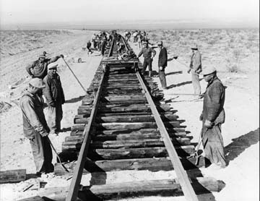

Slide 14
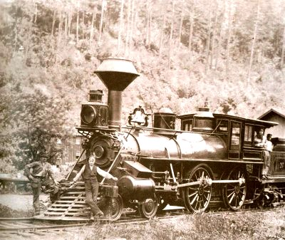
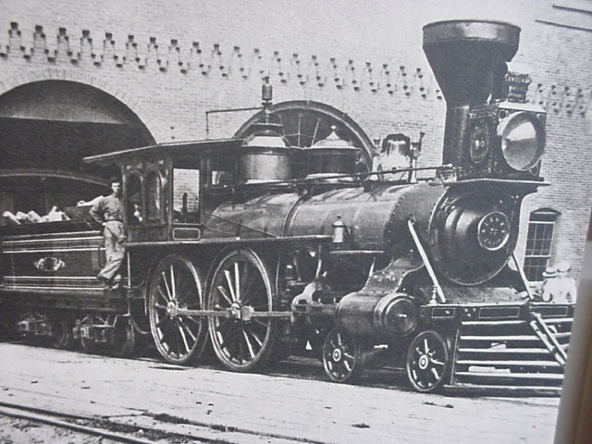

Slide 15
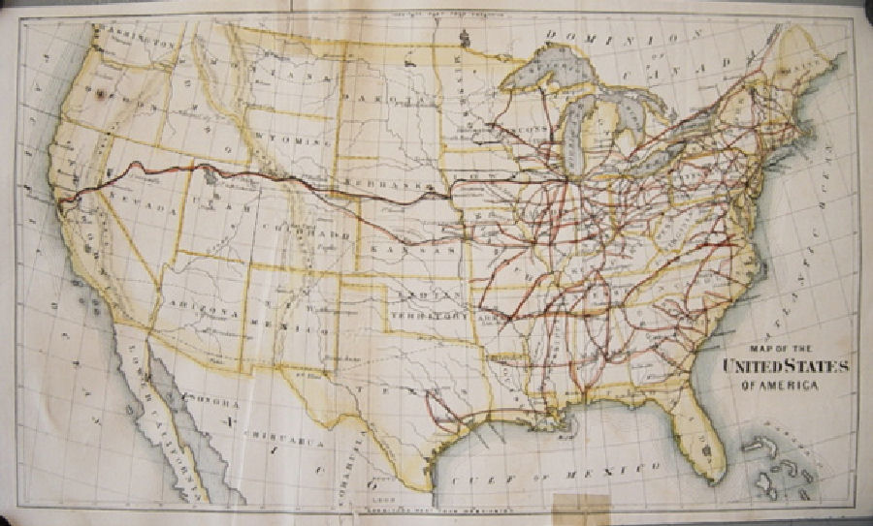
In the U.S. between 1830 and 1860 30,000 miles of railroad track was installed.

Slide 16
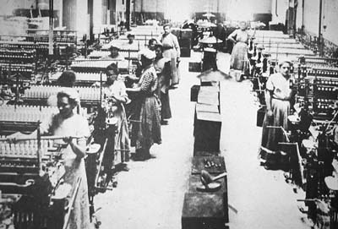

Slide 17
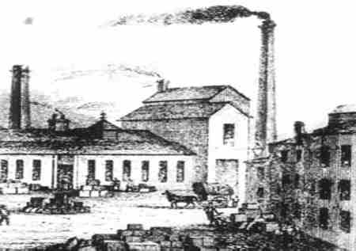

Slide 18
The Industrial Revolution spread across Europe, fastest to countries whose governments were active in encouraging industrialization. By 1850, a network of iron rails had spread across Europe. The I.R. also occurred in the United States, from 1800 to 1860 the population went from 5m to 30m. Roads and canals were built to link east and west.

Slide 19
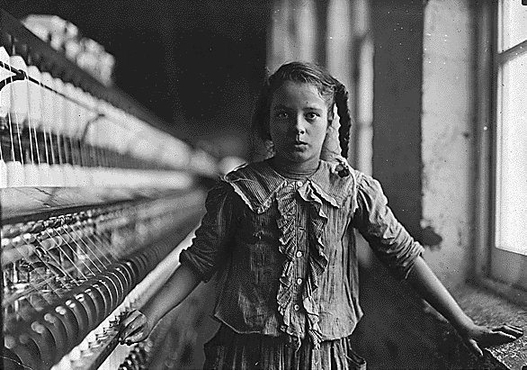

Slide 20
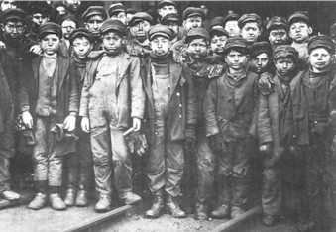

Slide 21
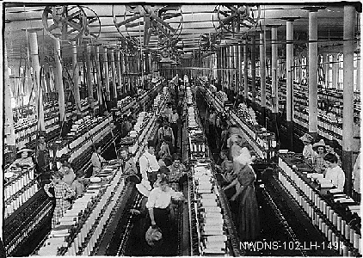

Slide 22
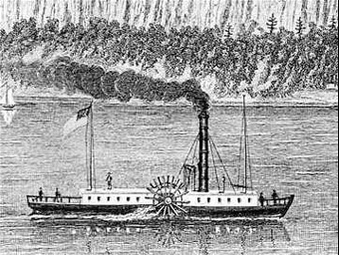
Robert Fulton built the first paddle-wheel steamboat, the Clermont in 1807. By 1860, 1000 steamboat provided transportation on the Mississippi River and along the Atlantic coast.
In the U.S. between 1830 and 1860 30,000 miles of railroad track was installed.

Slide 23
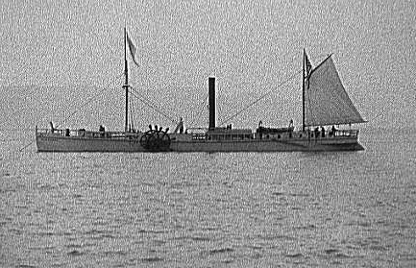

Slide 24
Social impact in Europe and the world, the Industrial Revolution led to the growth of cities and two new social classes, the industrial middle class and the industrial working class. The population in Europe doubled by the 1850's, this was caused by the decline in: death rate, wars, and diseases (smallpox, plague). The increase in food supply made people healthier. Most industrial working class worked 12-16 hour days, 6 days per week in wretched working conditions.
Shoulder Buddy Q:
Were on the job accidents more common then or now? Why?

Slide 25
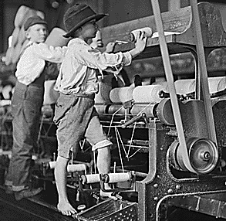
Conditions in the coal mines were dangerous, cave-ins, explosions, gas fumes along with cramped conditions led to death, deformed bodies and ruined lungs.
In Britain, women and children made up to 2/3 of the cotton industry's workforce. When the factory act of 1833 was passed (no kids under age 9), women took the place of children, they were paid half or less than what men were paid.

Slide 26
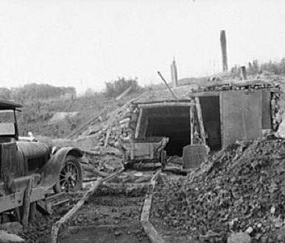

Slide 27
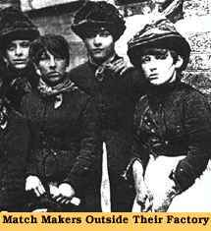

Slide 28
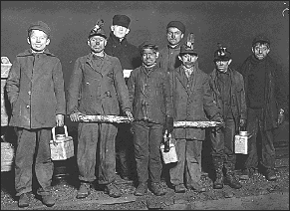

Slide 29
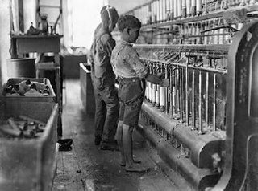

Slide 30
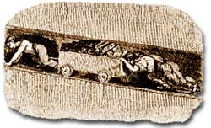

Slide 31
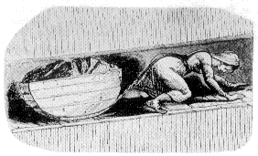

Slide 32
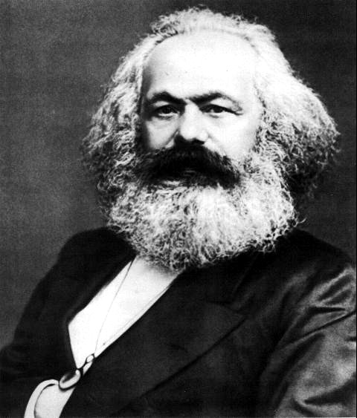
Socialism is a system where the government owns and controls the means of production such as factories and utilities. They believed that cooperation should replace competition.
Karl Marx

Slide 33
Taking Notes pg. 316
Inventors Inventions
Hargreaves Spinning jenny
Watt Steam engine
Cort puddling
Trevithick Steam locomotive
Fulton Paddle wheel steamboat

Slide 34
Critical Thinking pg. 317
In what way does this image depict factory work?
The workers are women and children, using large machines and handling heavy objects. There are small windows and no chairs.
Geography Connection pg. 319
1. Which major ports are located along coalfields?
Newcastle, Sunderland, Liverpool, and Bristol
2. What geographical factors help explain why industrialization began in Great Britain?
It had resources such as coal and iron necessary for industrialization.

Slide 35
DBQ pg. 320
Why might the British Parliament have examined the conditions of child factory workers?
Women and children were two-thirds of workers, and conditions came to the attention of Parliament.
Progress Check pg. 318
Why might it be important to have fast, reliable transportation between Manchester and Liverpool?
The faster that goods can be moved from factories in Manchester to the port at Liverpool, the faster they can be shipped.

Slide 36
Progress Check pg. 320
How did the effects of industrialization in the United States compare with those in Great Britain?
Industrialization led to urbanization. As factories grew, both expanded their transportation systems.
Progress Check pg. 321
Why do you think the working conditions during the Industrial Revolution led some to argue for socialism?
Working conditions were dangerous. Reformers thought giving government control of the factories would improve conditions.

Slide 37
Lesson Review pg. 321
1. Write a paragraph describing the importance of urbanization to the growth of industrial capitalism in Great Britain.
For industrial capitalism to expand, factory owners need many workers, and factories are located in cities, not rural areas.
2. Use your graphic organizer to discuss the major inventors and inventions covered in this lesson.
Answers may include, James Hargreaves invented spinning jenny and Richard Trevithick invented steam locomotive.
3. What was the significance of the Agricultural Revolution in Great Britain?
Better farming practices led to an increase in available food. The population grew, and many people moved to towns, creating a workforce for factories.

Slide 38
4. Why did the Industrial Revolution start in Great Britain?
Students’ answers should include: Because of the enclosure movement, there was available labor. Great Britain has capital to invest in new industries.
5. What factors fed the spread of industrialization in Europe and North America?
Students’ answers should include the migration of people from farms to the cities and the development of rail and steamboat transport.
6. What was the social impact of industrialization?
Crowded living conditions in the cities and brutal working conditions in factories led to calls for reform. The Factory Act of 1833 protected working children.

Slide 39
17.2
Universal male sufferage- ______________________________
___________________________________________________
Multinational empire-_________________________________
___________________________________________________
Shoulder Buddy Q- Why did the revolutions of 1848 fail?
____________________________________________________
____________________________________________________
____________________________________________________
____________________________________________________

Slide 40
Chapter 17 Section 2-Nationalism and Political Revolutions
Revolutions followed in the following countries, France (yes again), Germany, Austrian Empire, Italian States, many failed.
http://www.youtube.com/watch?v=Nosq94oCl_M&safe=active
Crash Course Nationalism.
Italy and Germany-finally successful in unification.
Leaders:
Germany- Otto von Bismarck

Slide 41
Another French Revolution- 1830 French king attempted to reduce the rights of the middle class. He was overthrown and replaced with his cousin Louis-Philippe and a constitutional monarchy was formed. L-P 16 years later refused to make further reforms to benefit the low and middle classes. He was overthrown by a group who wanted a republic. (government by elected representatives and a new constitution)
Universal Male Suffrage-all adult men could vote. The government also set up work for the unemployed. (cost lots of $) program was ended by the moderates- workers revolted-4 days of bloodshed killed thousands- many more thousands were sent to the French prison colony of Algeria in N. Africa.
11-4-1848 The Second Republic-single legislature elected by universal male suffrage. President elected by the people served 4 years. Napoleons’ nephew was elected.

Slide 42
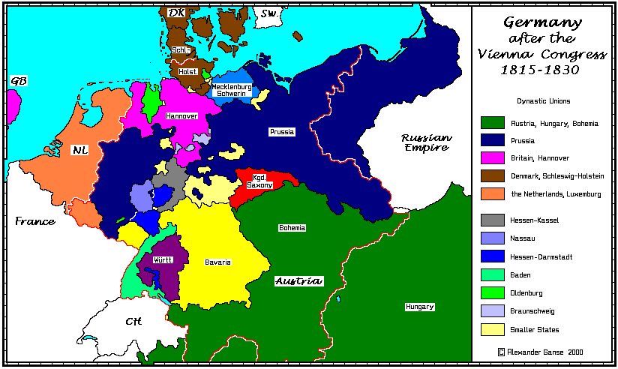
German States-feeling the ripple effect from France-their Congress recognized the existence of 38 independent German states= German Confederation. Austria and Prussia were the big dogs on the block. They tried to create a parliamentary government with a hereditary emperor-assembly never got the support it needed. No unification.

Slide 43
Central Europe-Austrian-multinational empire=multiple languages, cultures. Germans, Czechs, Magyars, Slovaks, Romanians, Poles, Croats, ……The Germans (25% of population) were major leaders of the Austrian Empire. Several countries attempted to revolt but all were put down!
Italy-all revolts failed too.
Why failure: In the beginning revolutionaries are united BUT often soon get divided over their goals. Thus loosing unity and the end game.

Slide 44
17.3-Nationalism, Unification and Reform
Militarism-_____________________________________________
______________________________________________________
Plebiscite-_____________________________________________ ______________________________________________________
Kaiser-________________________________________________
Abolitionism-___________________________________________ ______________________________________________________
Emancipation-__________________________________________ ______________________________________________________

Slide 45
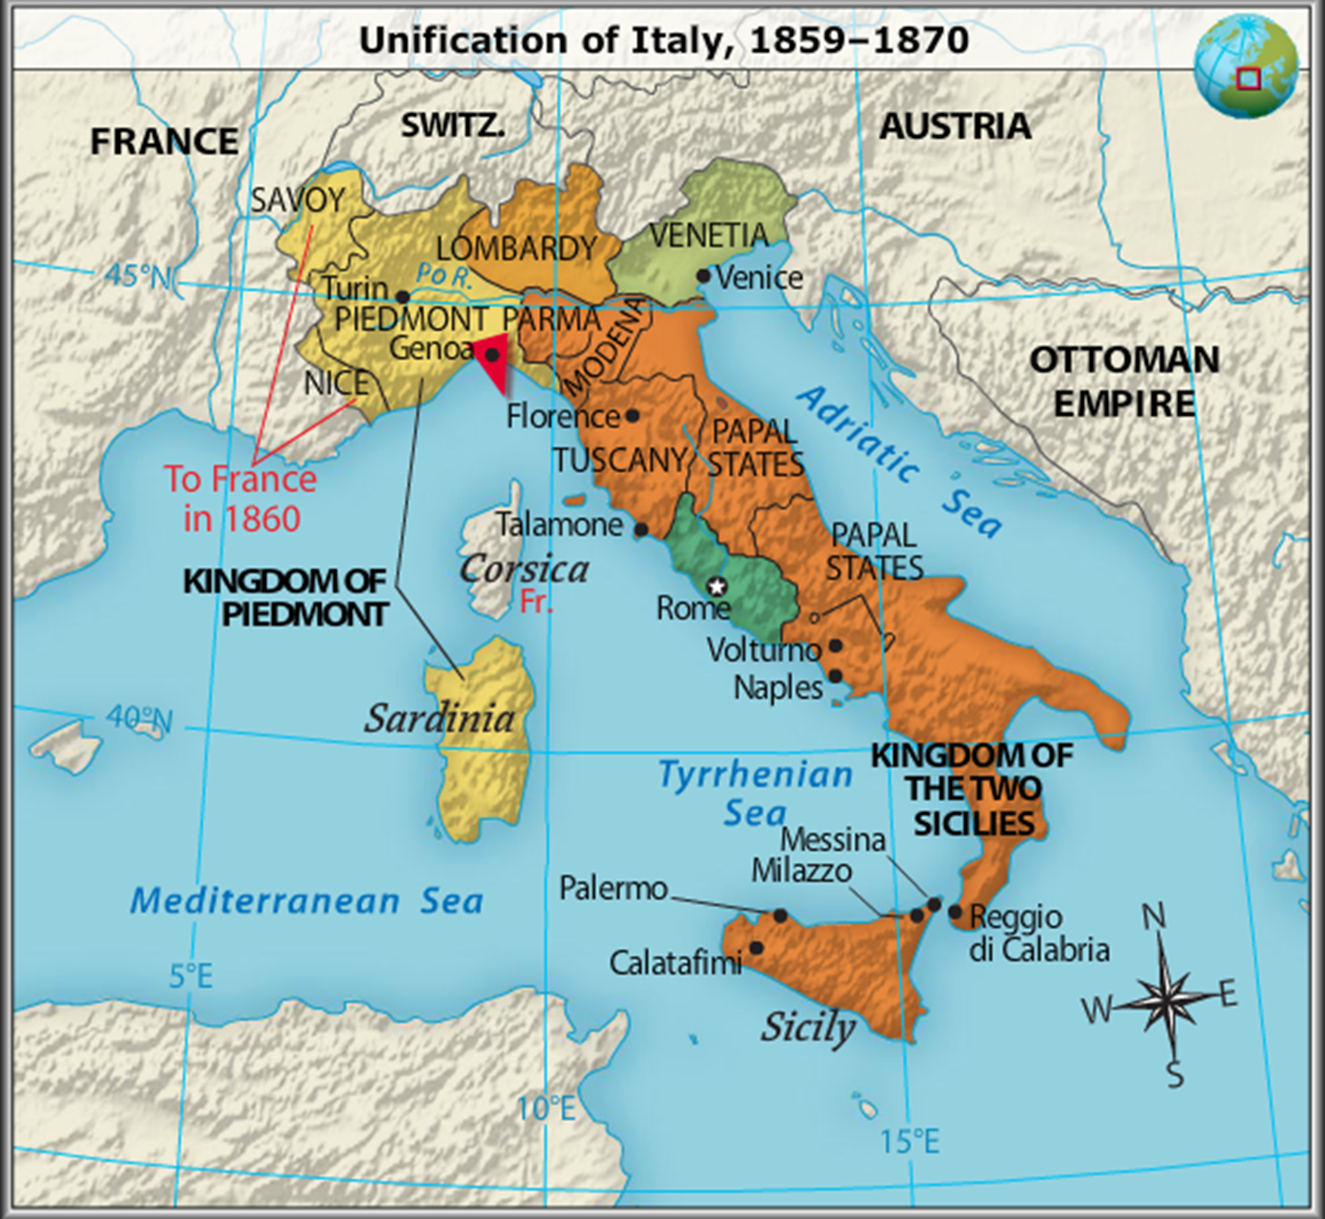

Slide 46
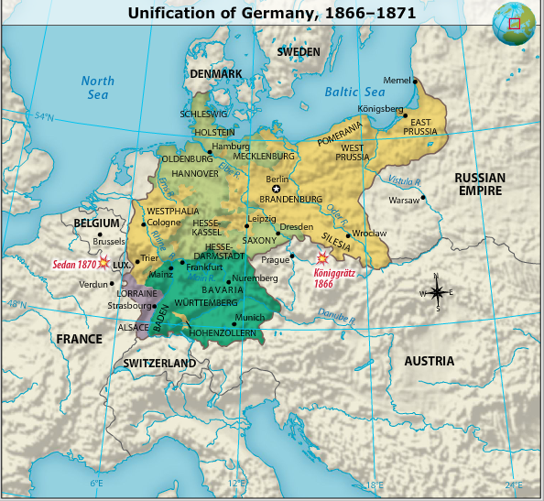

Slide 47
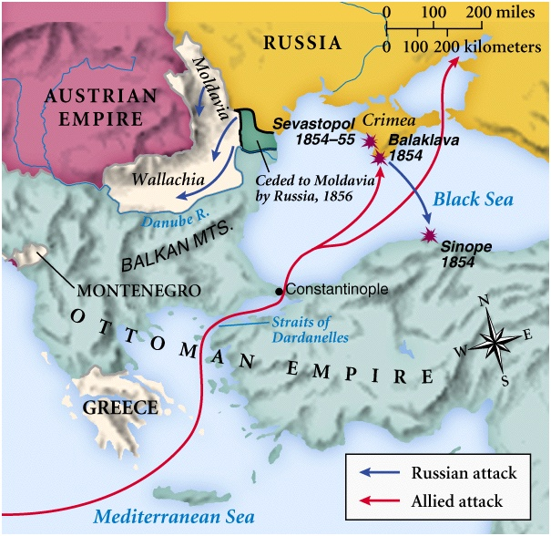
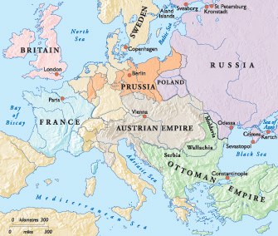
Revolutions in Germany and Italy failed in 1848 but by 1871 they are unified….what changed? Crimean War Russia v. Ottoman Empire
http://www.youtube.com/watch?v=Pqik0WDMDco

Slide 48
Why??? Control of the Dardanelles (straight between the Black Sea and the Mediterranean Sea. If Russia could control this they would become the major power in Eastern Europe and challenge the British navy for control of the eastern Mediterranean. Other European nations feared Russian ambition.
Russia invaded Turkish Balkan, Moldavia and Walachia. Ottoman Turks declared war on Russia. Great Britain and France declared war on Russia too. This was the Crimean War- poorly planned and poorly fought-heavy losses caused Russia to seek peace.
Treaty of Paris- (yes, another one)- outcome= the chief powers before the war are now enemies. Austria and Russia. Austria now without friends in powerful place so made it ripe for Italy and Germany to unify.

Slide 49
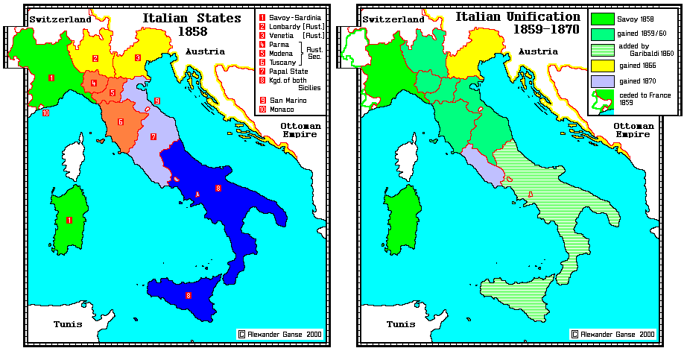
Italian Unification-Guiseppe Garibaldi

Slide 50
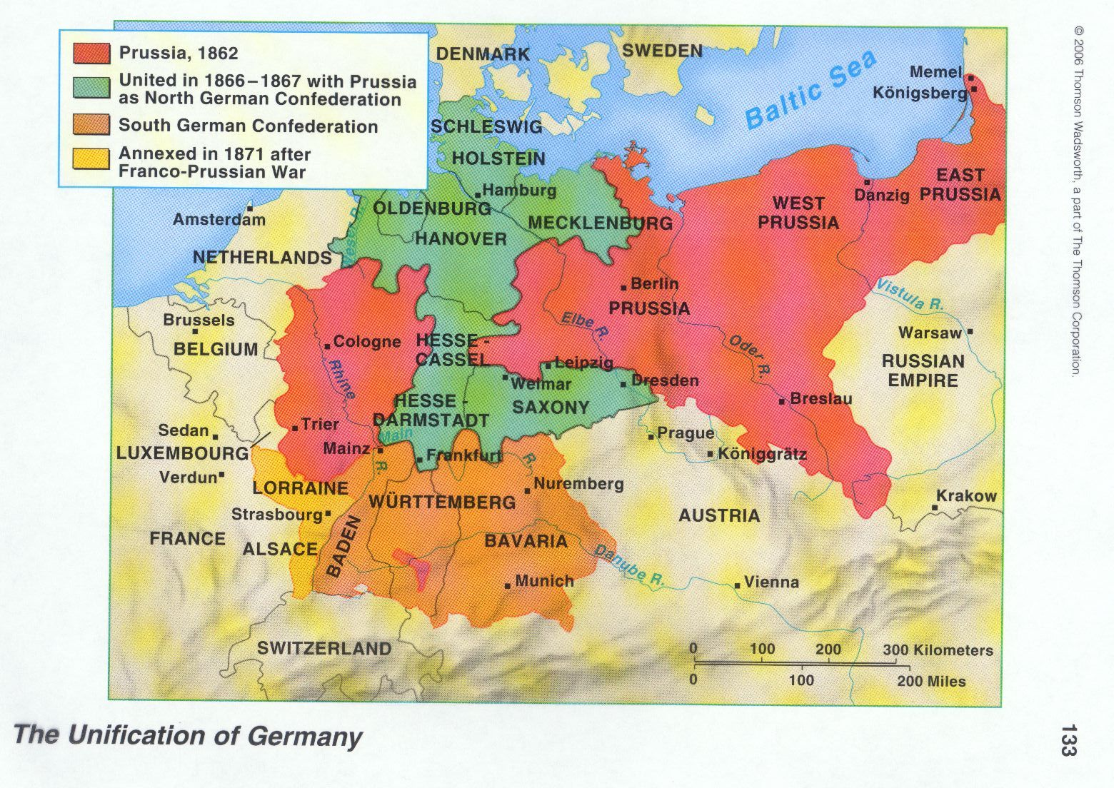
German Unification-Otto von Bismark

Slide 51
Nationalism and Reform in Europe
Great Britain- avoided revolutions by increasing number of male voters, social and political reforms, economic growth. Queen Victoria ruled from 1837-1901-created national pride.
France- after 1848 revolution-worked to restore monarchy. Napoleon III become Emperor. Held almost all power, increased the economy, infrastructure, rebuilding program in Paris. Ultimately he gave the legislature more power. Empire fell after Franco-Prussian War 1870.

Slide 52
Russia-Rural, agricultural and under an all powerful czar. Embarrassed by defeat in Crimean War. Serfdom was huge problem, 3-3-1861 Czar Alexander issued emancipation-freed the serfs. Peasants could now own land. Government bought land for the surfs, but they got the worst land. Now unhappy, land starved free folks. He tried to make more reforms but was assassinated. His son returned to old ways.

Slide 53
Nationalism in the United States- constitution created a nation committed to liberalism and nationalism. But federalist and anti-federalist. Strong central gov’t v. stronger states was still a problem.
Slavery- the economy of the South is dependent upon slave labor, primarily used growing cotton on plantations. North wants to end slavery (abolitionism).
Abraham Lincoln-Emancipation Proclamation declared most enslaved people “forever free” Civil War erupts. South (Confederate) surrenders 4-9-1865.

Slide 54
17.4 Nation Building in Latin America
American Revolution began to influence creole elites. They have been governed by Spain and Portugal and their peninsulares. Napoleon’s wars weakened monarchies of Spain and Portugal. This enabled most of Latin America to become independent.
Haiti-slaves revolt and seize control of country.
Mexico-priest Hidalgo incited mestizos and native people to revolt-they lost. Ultimately, Mexico becomes a republic.

Slide 55
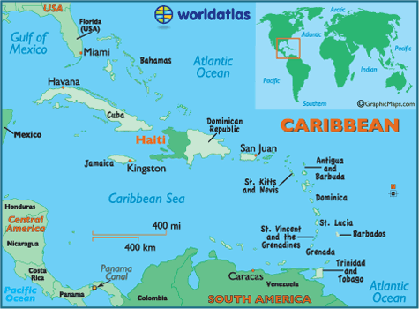

Slide 56
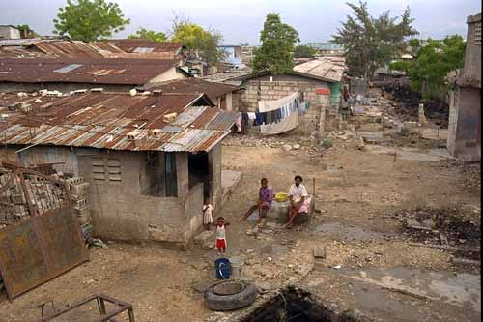

Slide 57
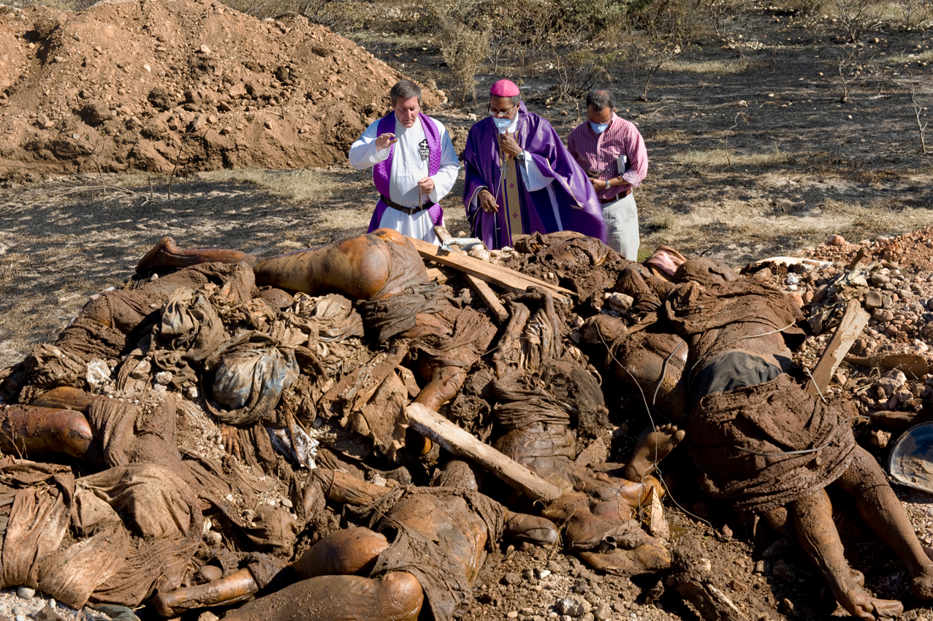

Slide 58
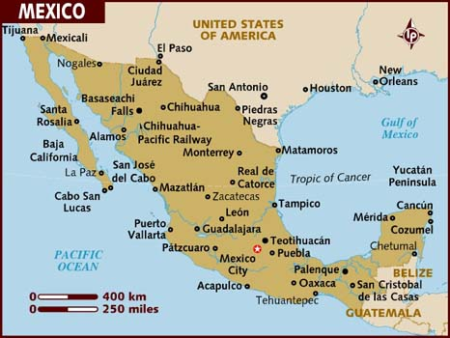

Slide 59
South America-
Argentina-Jose de San Martin-liberated Argentina from Spain, also Chile (after going over Andes), he joined with Bolivar to free Peru of Spanish rule.
Venezuela- Simon Bolivar-led revolt to free Venezuela and Ecuador from Spain. Bolivar and Martin unite to free Peru.
By 1824, Peru, Uruguay, Paraguay, Colombia, Venezuela, Argentina, Bolivia, Chile=free from Spain.
US-Pres. James Monroe-The Monroe Doctrine-stated that the Americas are off limits for any colonization. He warned against any European intervention in the Americas. British navy protected coast of Latin America. “they wanted to trade with Latin Am)

Slide 60
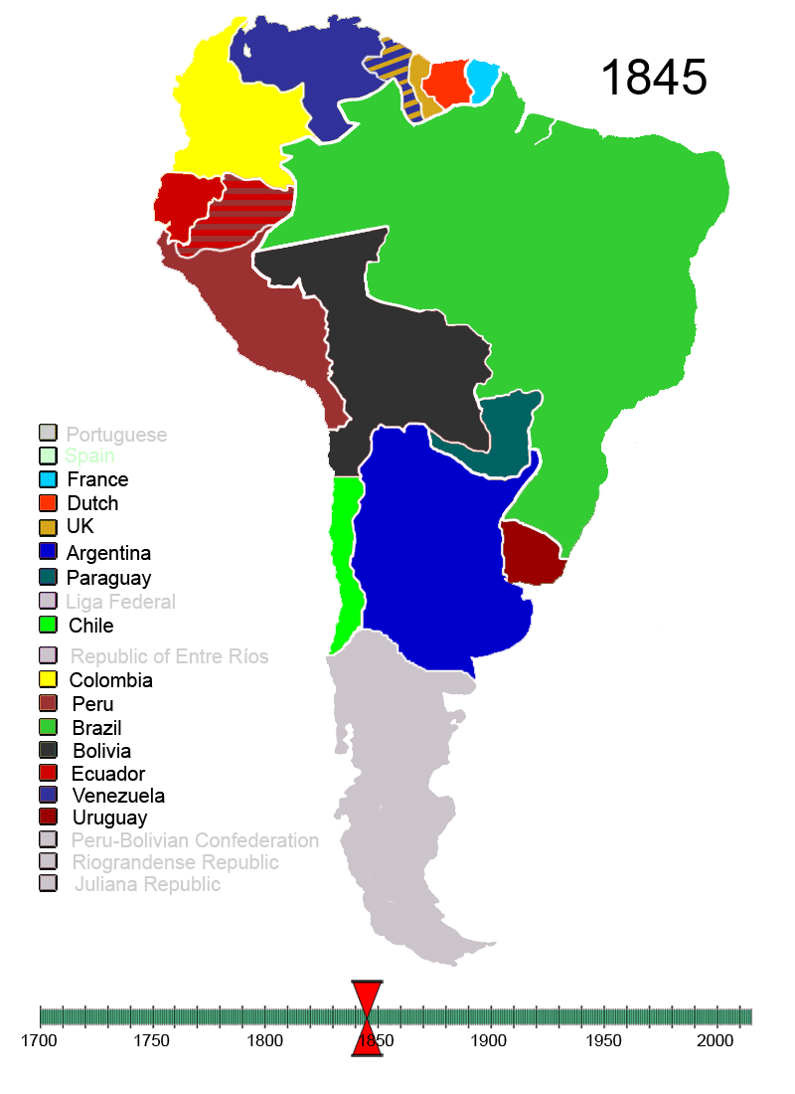
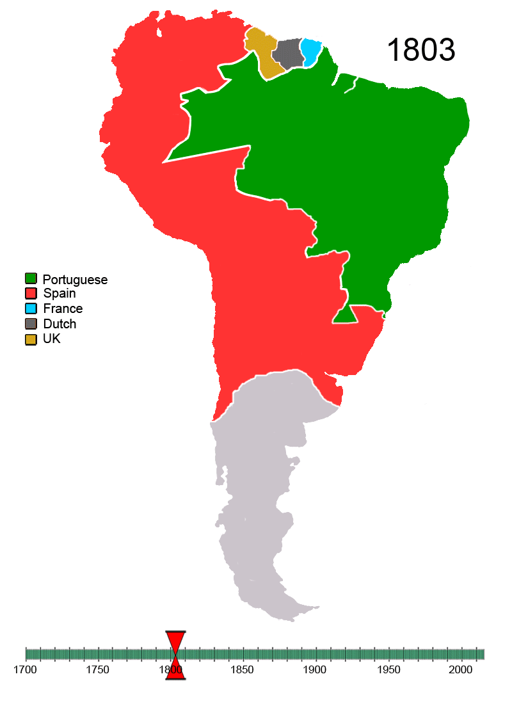

Slide 61
Wars of independence caused huge loss in lives, property and livestock.
Nation building-many countries fell to caudillos. (strong leaders) Some good some bad.
Mexico-General Santa Anna ruled Mexico horribly. American settlers in Mexican state of Texas revolted and gained independence. Texas gained statehood 1845, Mexico v. US war-Mexico lost almost ½ territory to US.
Benito Juarez leads Mexico after Santa Anna- many reforms.
Generally, caudillos ruled Latin America-when they died civil wars were frequent. Most control was held by landed elites.(people who owned/controlled) massive quantities of land. Most grew cash crops.

Slide 62
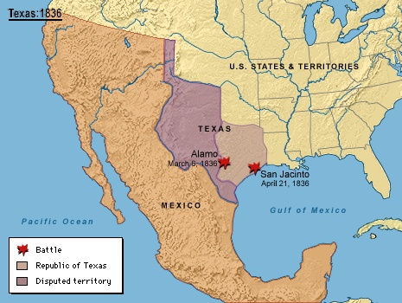

Slide 63
Imperialism and Economic Dependence
Britain and US replaced Spain and Portugal as the dominate market for Latin Americas raw materials. They also imported finish products from B/US.

Slide 64
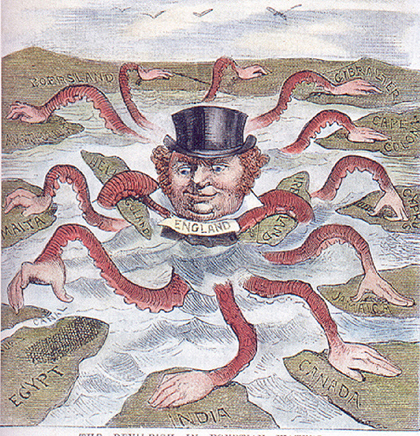

Slide 65
Romanticism = focused on feelings, emotion and imagination. Valued the uniqueness of each person.
Enlightenment- stressed reason as main way to discover truth.
Revival-rebirth of medieval architecture.

Slide 66
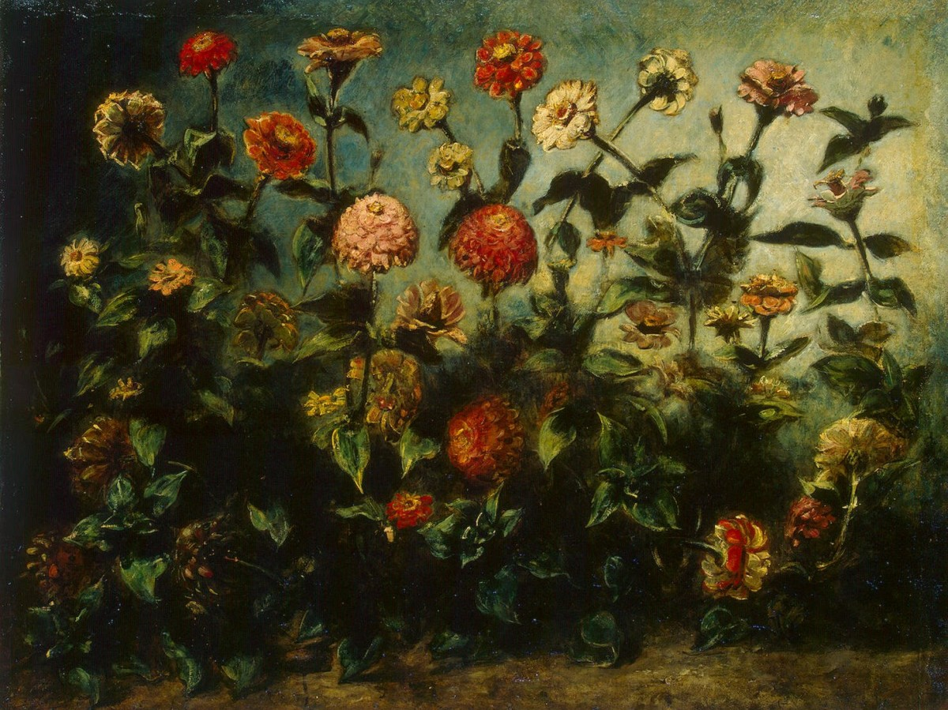
Art- Eugene Delecroix- into exotic and color.

Slide 67
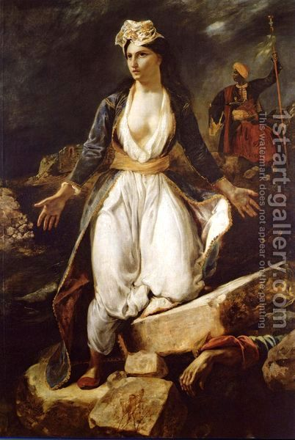

Slide 68
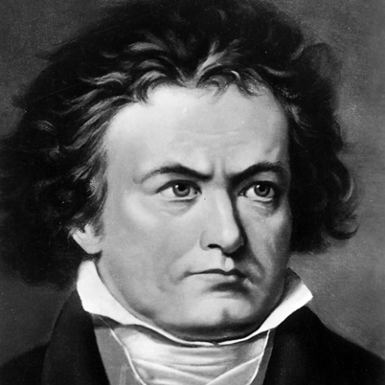
Music- Ludwig van Beethoven
Fantasia
http://www.youtube.com/watch?v=tHvztnHOWEQ&safe=active
Third Symphony

Slide 71
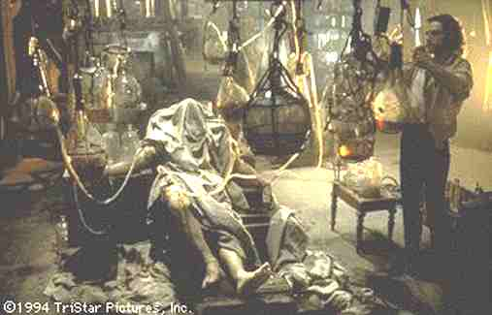

Slide 72
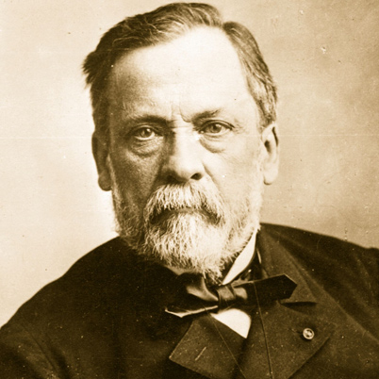
Science
Louis Pasteur-germ theory of disease, led to modern medical practices.
Pasteur fought to convince surgeons that germs existed and carried diseases, and dirty instruments and hands spread germs and therefore disease. Pasteur's pasteurization process killed germs and prevented the spread of disease.

Slide 73
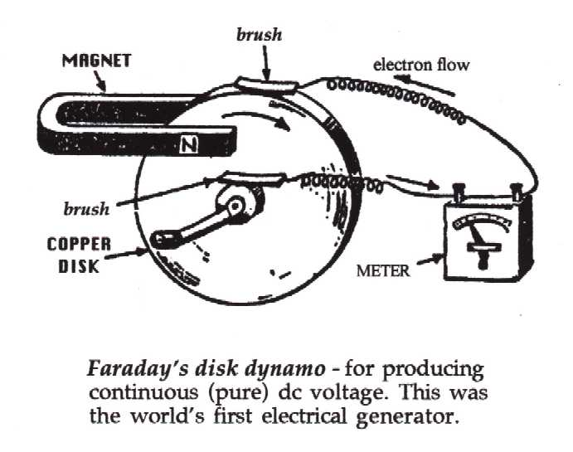
Michael Faraday-primitive generator-led to use of electric current.

Slide 74
Europeans began to have more faith in science, this undermined the religious faith of many. Secularization – avoidance of religious consideration.
Charles Darwin- Natural Selection- each species, plant, animal has evolved over a long period of time from earlier simpler forms of life. Organic evolution. He believed that more individuals were born that can possibly survive, each born with slight variations that make them more adaptable to environment. Natural Selection= “Survival of the fittest” those unfit for the environment do not survive. Survivors pass on variations until new species emerge.

Slide 76
Realism- what it is. Authors wrote about real life not romanticism.
Charles Dickens- Oliver Twist and David Copperfield –about lower class in the industrial age.
Artists- sought to show every day life. Gustave Courbet

