Slide 1
Chapter 16 French Revolution
~ Napoleon
1789 New USA and beginning of the French Revolution
F.R.- more: violent, complex and radical. It tried to create a new political order and a new social order.
One long-term cause for the revolution was the condition of French society. Population divided into 3 orders or estates.

Slide 2
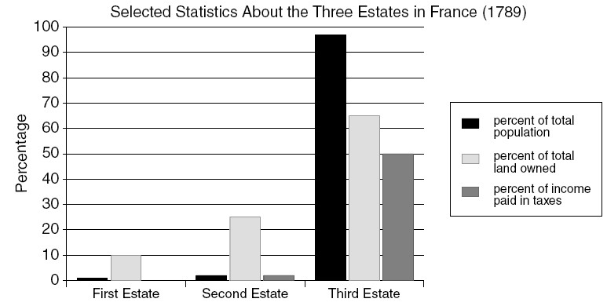
Estates

Slide 3
The 1st estate- clergy,130,000 people out of 27 million. They were exempt from the taille-tax. They owned 10% of the land. This land brought them a great deal of wealth from the products produced on it, and in the form of rent from peasants. They also received a tithing, or tax of 10% of all the earnings of those who lived on their land. This tithing was meant to run the church. But, it was often used to fund the extravagant lifestyles of the 1st estate.

Slide 4
The 2nd estate= the nobility, 350,000 people, they owned about 25-30% of the land. They held many of the important positions in the government, the military, law courts, and higher church officials. They also were exempt from the taille. Took power from the monarchy.

Slide 5
The 3rd estate- the commoners-the majority of society. 75-80% of population. Divided by occupation, wealth, level of education. Owned 35-40% of land. Serfdom almost gone, but some peasants still had obligations to landlords. (leftover from feudalism) Another part of 3rd estate were skilled craftspeople, shopkeepers. Prices rose, wages stayed the same (inflation) reduced buying power.

Slide 6
Bourgeoisie-middle class part of the 3rd estate. 8% of the population, merchants, bankers, industrialists, lawyers, doctors and writers. Unhappy with the privileges the nobles had. But, many rich 3rd class entered the nobility. Aristocrats and bourgeoisie liked ideas of the Enlightenment period.

Slide 7
Short term cause for the revolution was the near collapse of government finances. Food shortages, rising prices, unemployment. The poor 1/3 of population were in crisis at the eve of the revolution. But the government continued to spend, spend, spend for wars and court luxuries. (also USA war)

Slide 8
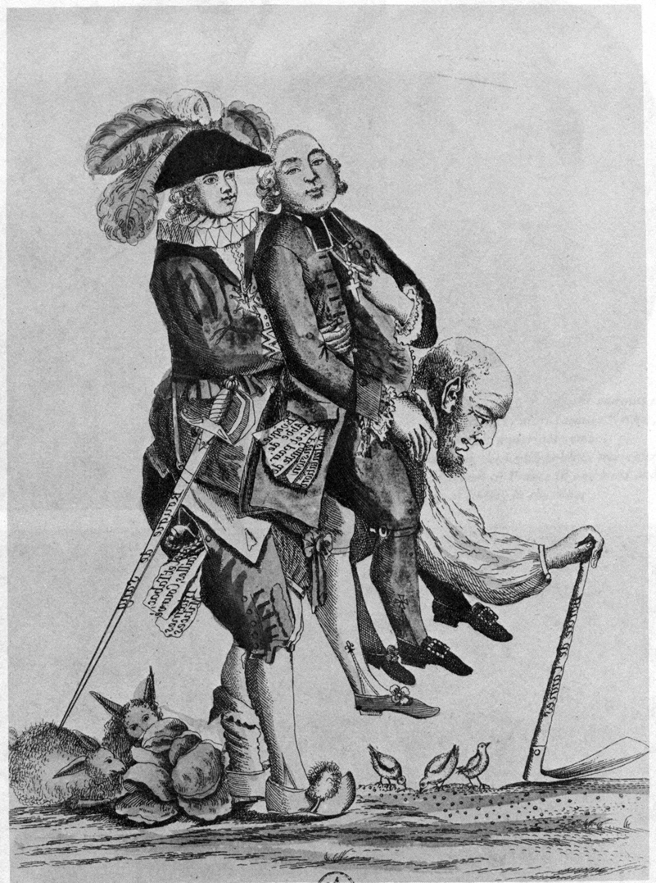

Slide 9
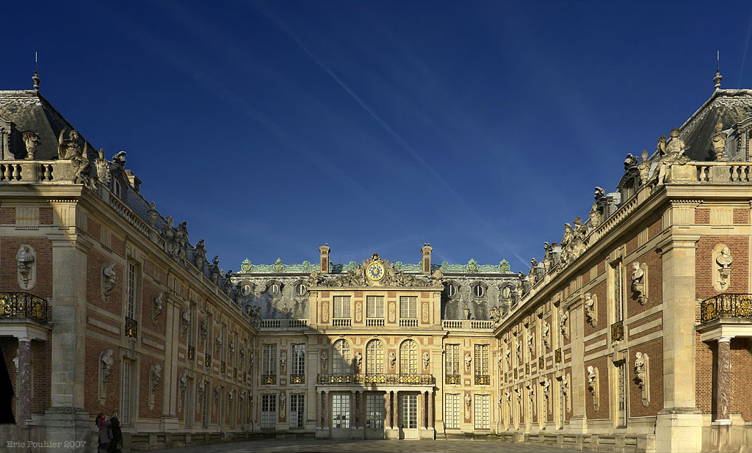

Slide 10
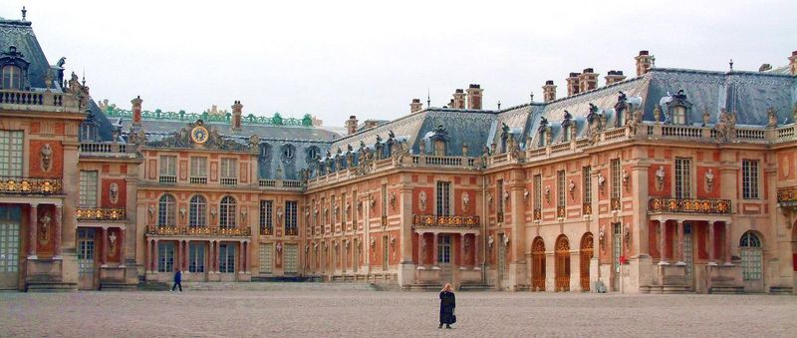

Slide 11
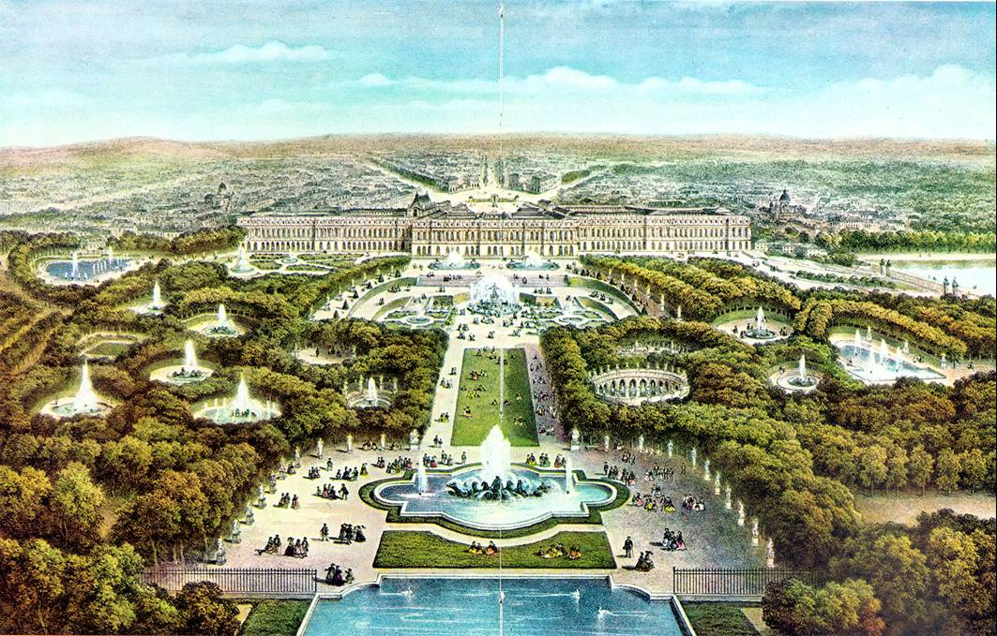

Slide 12
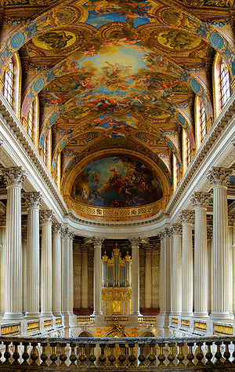

Slide 13
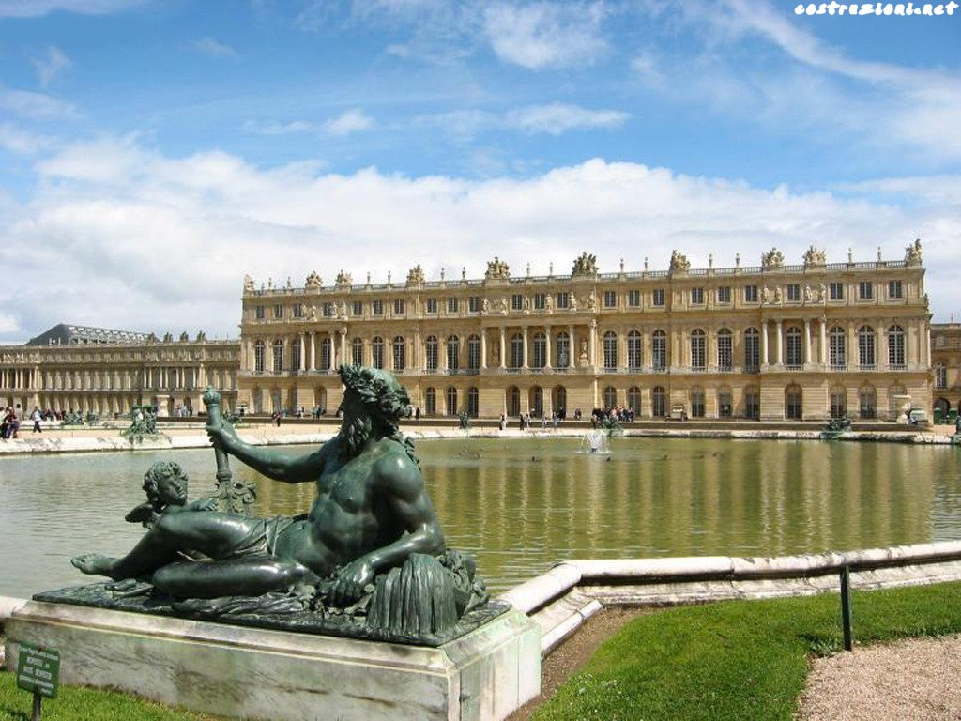

Slide 14
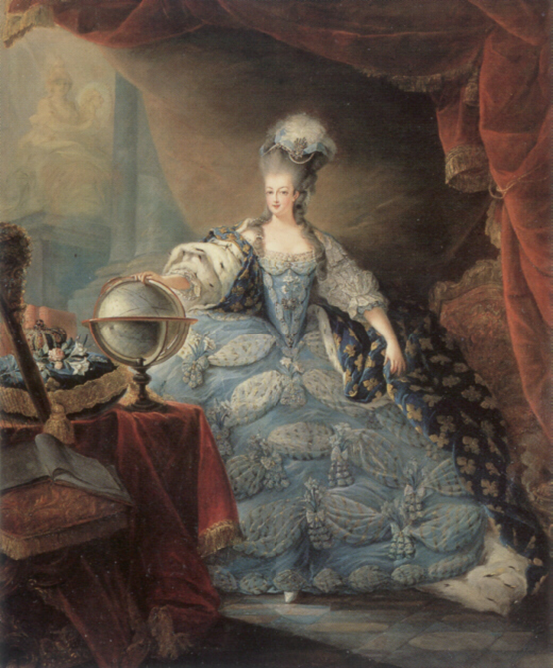

Slide 15
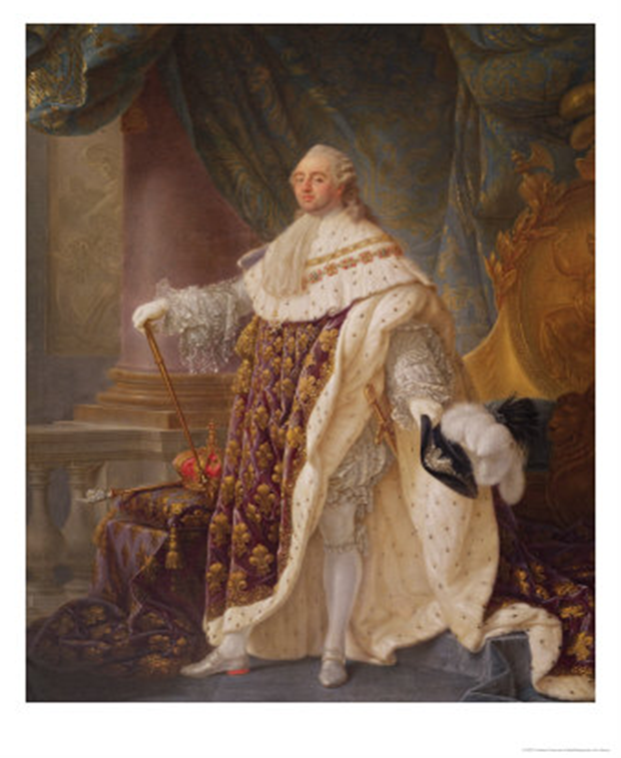

Slide 16
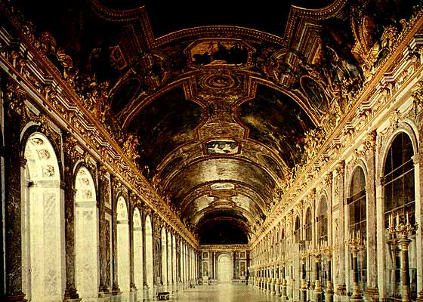

Slide 17
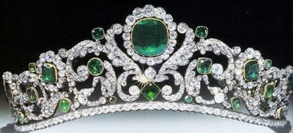
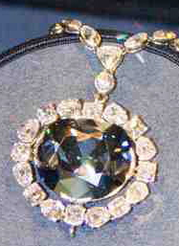

Slide 18
Estates-General = French parliament, 1st and 2nd Estate 300 representatives each. The 3rd estate had 600 reps. most who were lawyers. 3rd Estate wanted to fix financial problems by setting up a constitutional government and abolish tax exemptions to clergy and nobility. (not a popular idea with 1st and 2nd Estates)

Slide 19
Historically each Estate had 1 vote, but, 3rd Estate demanded that each rep. had 1 vote,(would give them majority) King said no! In response 3rd Estate called itself a National Assembly and drafted a Constitution. They were locked out of their meeting place so they moved to a nearby indoor tennis court.

Slide 20
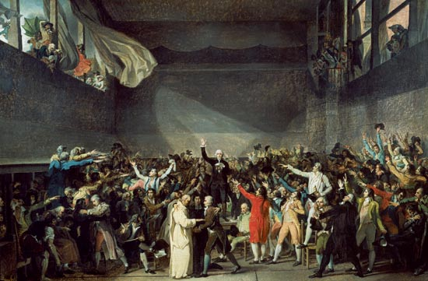

Slide 21
They swore the Tennis Court Oath-promise to keep meeting until the Constitution was complete. King Louis XVI was going to use force against the 3rd Estate until commoners stormed the Bastille and took it apart brick by brick. King realized he could no longer trust his own royal guard, rebellions broke out across France.

Slide 22
Fall of the Bastille 7/14/1789 Group attacked armory (where weapons stored)/prison. Soldiers surrendered, this was the beginning of the French Revolution. This protected the General Assembly while they drafted the Constitution.

Slide 23
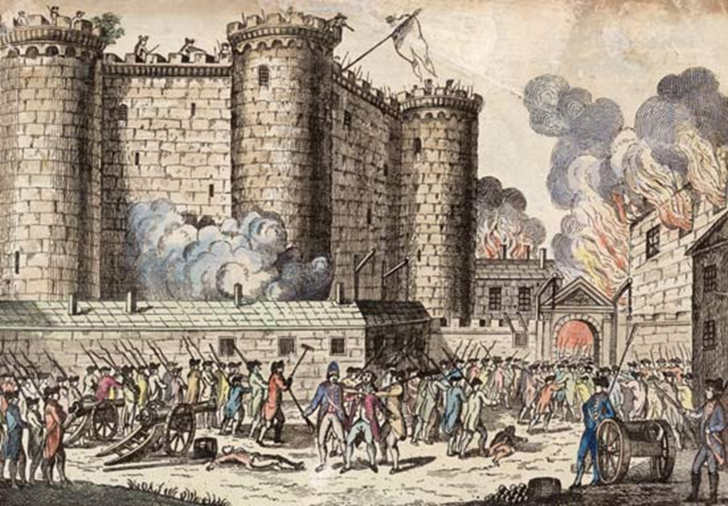

Slide 24
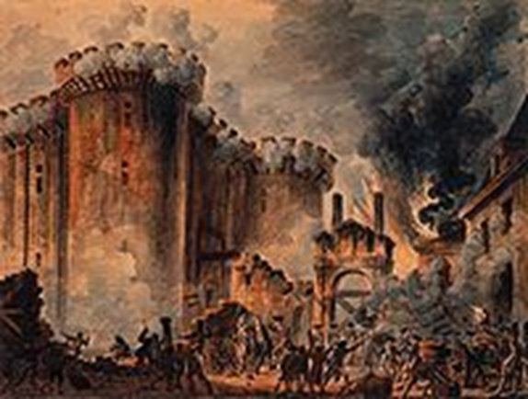
http://www.youtube.com/watch?v=AoXKrr14uY8&safe=active
Storming the Bastile 3 min.
http://www.youtube.com/watch?v=otnADq4Y0-A&safe=active
Horrible Histories

Slide 25
Citizens feared that foreign troops would invade France and support the monarchy (king), they formed militias. One of the National Assembly's first acts was to abolish the rights of landlords, and remove the financial privileges of the clergy and nobles.
The final end to feudalism.
http://www.youtube.com/watch?v=lTTvKwCylFY&safe=active
Crash Course 12 min

Slide 26
Declaration of the Rights of Man was adopted by the National Assembly on 8-26-1789. They were inspired by the American Declaration of Independence, Constitution and Bill of Rights. The document affirmed the absolute rights of man-liberty, property, security, = rights for all men, end of taxation exemptions.

Slide 27
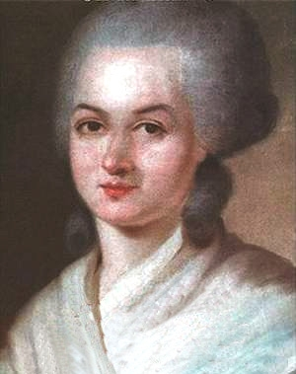
Did equal rights for all men include women? Most men said yes but not political rights. Olympia de Gouges fought for women's rights.

Slide 28
While all this is going on king is hiding out at Versailles. He refused to accept National Assembly's decrees that abolished feudalism and the Declaration of Rights. Thousands of women marched on Versailles, they carried brooms, pitchforks, swords, pistols and muskets. A small group met with the king to tell him how their children were starving. They forced the king to accept the decrees.

Slide 29
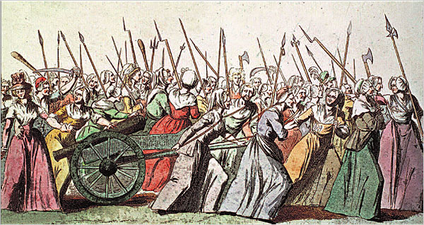

Slide 30
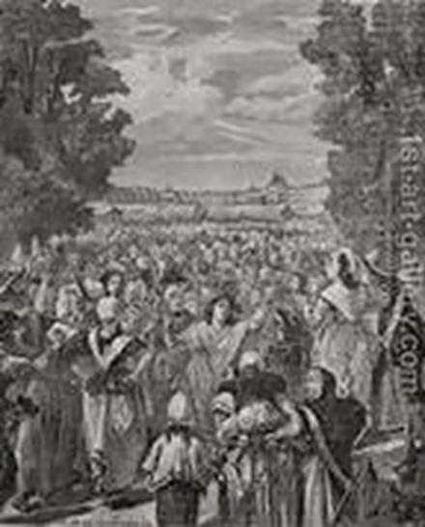

Slide 31
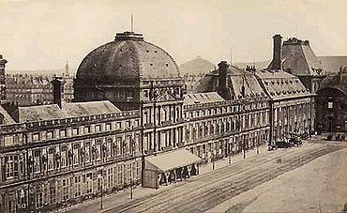
They insisted that the king come back to Paris to show support for the National Assembly. The royal family became prisoners in Paris.
House arrest. They attempted escape only to be caught 18 miles from safety.

Slide 32
Church Reforms- because the church was associated with the old way, it too was changed. The National Assembly needed money so they seized and sold all church lands, the church was also secularized. Government now ran the church.

Slide 33
The National Assembly adopted the new Constitution 1791. It created a limited monarchy, king would still exist but Assembly would make laws. All male citizens had same rights, but only men who paid so much in taxes could vote.
Some radicals still wanted more drastic reforms. France's relations with the rest of Europe lead to the fall of Louis XVI.

Slide 34
Other European countries feared that the revolution would spread, Austria and Prussian rulers threatened to use force to restore Louis XVI. Insulted by the threat, The Assembly declared war on Austria and Prussia.

Slide 35
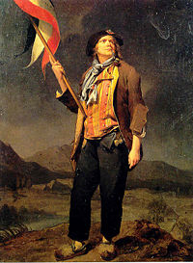
Radical political group called the commune kidnapped the king and forced the Assembly to suspend the monarchy and have a National Convention where ALL men could vote. The commune was made up primarily of working class people, they called themselves the sans-culottes.

Slide 36
The French Revolution
Long-Range | Immediate
Inability to enforce laws | Food shortages
Social inequality | Collapse of government finances
Economic Problems | Estates-General
Lesson 1
Taking Notes pg. 292
Use a graphic organizer to identify long-range and immediate causes of the French Revolution.

Slide 37
The French Revolution
Long-Range | Immediate
Inability to enforce laws | Food shortages
Social inequality | Collapse of government finances
Economic Problems | Estates-General

Slide 38
Critical Thinking pg. 293
How are each of the three estates depicted? What is the commentary being made?
The First Estate is the clergy; the Second Estate is the knight; both support the monarchy. The man supporting everything is the Third Estate.
Critical Thinking pg. 294
David was a member of the Third Estate. How might his painting convey a biased view of the oath?
Those listening to the speaker are raising their arms in agreement, and the group includes people who are poorly dressed, clearly members of the Third Estate.

Slide 39
Critical Thinking pg. 296
Why did the royal family attempt to leave France?
After the fall of the Bastille, Louis knew he could not trust his troops. He tried to flee to a safer part of France, hoping to amass loyal forces.

Slide 40
DBQ pg. 295
How does this document (The Declaration of the Rights of Man and the Citizen) reflect Enlightenment thought?
It emphasizes equality and freedom of speech and ideas, which were key tenets of the Enlightenment.
Progress Check pg. 294
How were the economic problems a contributing cause of the French Revolution?
The majority of the population belonged to the Third Estate. The king spent money on wars and luxuries.

Slide 41
Progress Check pg. 295
What was the connection between the actions of the representatives of the Third Estate and the Estates-General and those of the peasants during the Great Fear?
Their actions were motivated by dissatisfaction with, and a desire to gain distance form, the current system.
Progress Check pg. 297
In what ways did the end of the old order move the revolution toward a more radical phase?
The restrictions imposed by the new constitution, the actions of radicals, and the threat of foreign invasion moved the revolution to a more radical phase.

Slide 42
Chapter 18 Section 2
Radical Revolution and Reaction
The sans-culottes sought revenge on anyone who aided the king or resisted the popular will. These people were arrested and massacred.
The new National Convention met and abolished the monarchy, the established the French Republic.

Slide 43
The group could not agree over the fate of the king. Two of the most important factions (dissenting groups) were the Girondins=country people and the Mountain=city people. The Mountain won- the Convention passed a decree condemning Louis XVI to death. He was beheaded on the guillotine.

Slide 44
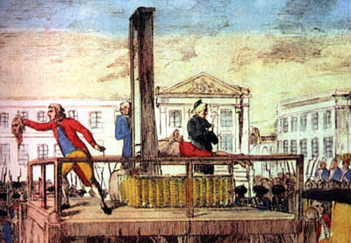
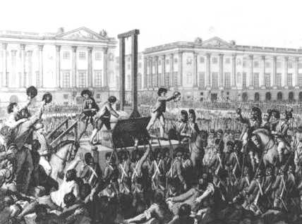
Horrible Histories wife swap
http://www.youtube.com/watch?v=qemOK1Kcw1M&safe=active

Slide 45
Execution of the king made new enemies at home and abroad. Austria, Prussia, Spain, Portugal, Britain and the Dutch Republic took up arms against France who retreated. The National Convention gave huge powers to the Committee of Public Safety (12). Maximilien Roberspierre.

Slide 46
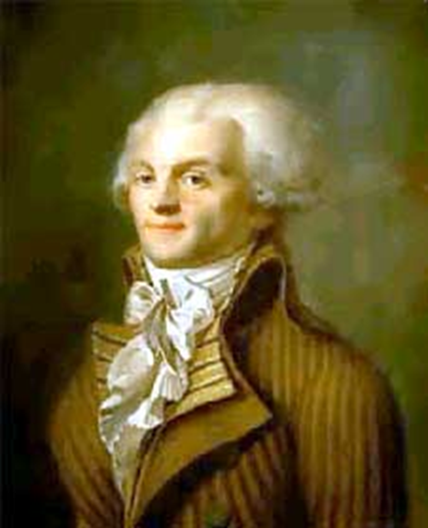

Slide 47
Reign of Terror-1year of where the Committee of Public Safety took control, they acted to defend France from foreign and domestic threats. Revolutionary courts prosecuted internal enemies of the republic. 40,000 died, including Marie Antoinette (queen) and many others who opposed the authority of the National Convention. 15% clergy and nobles the rest bourgeoisie and peasant classes.

Slide 48
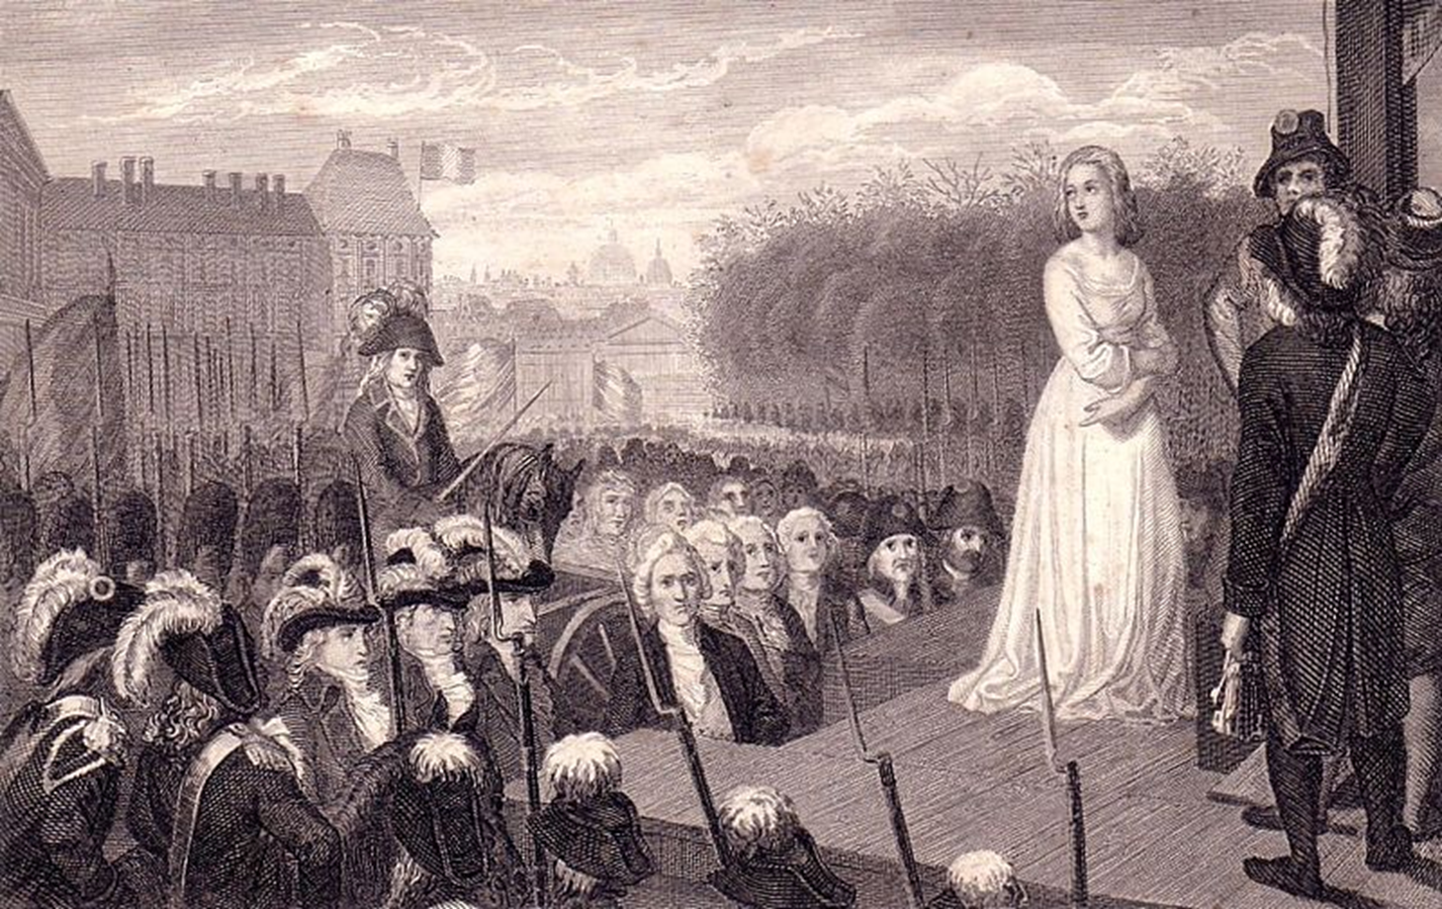

Slide 49
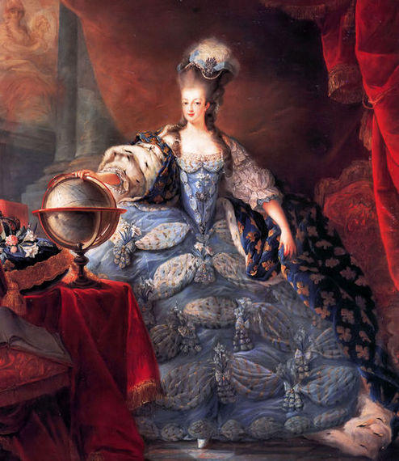
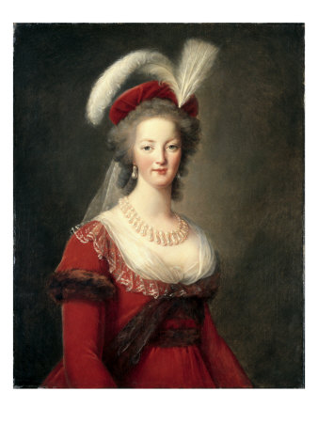

Slide 50
The National Convention pursued a policy of dechristianization. Churches closed, lord saint removed from names, new calendar (no Sunday). Robespierre realized this didn't work because France was primarily Catholic.
Vendémiaire (vintage) - Sept. 22 - Oct. 21 Brumaire (fog) - Oct. 22 - Nov. 20 Frimaire (frost) - Nov. 21 - Dec. 20 Nivôse (snowy) - Dec. 21 - Jan. 19 Pluviôse (rainy) - Jan 20 - Feb. 18 Ventôse (windy) - Feb. 19 - March 20 Germinal (sprouting bud) - March 21 - April 19 Floréal (flowery) - April 20 - May 19 Prairial (meadow) - May 20 - June 18 Messidor (harvest) - June 19 - July 18 Thermidor (heat) - July 19 - Aug. 17 Fructidor (fruit) - Aug. 18 - Sept. 16

Slide 51
To protect France from foreign enemies the government raised a huge army (1 mil). The army was a creation of the peoples government, it was their war and it was destructive. The army pushed the invaders out of France. The Reign of Terror continued, Robespierre continued to "rid" France of corrupt elements. His deputies condemned him to death and things settled down.

Slide 52
National Convention reduced power of the Committee of Public Safety. New government (Directory) was very corrupt! The Directory relied upon the army to maintain power. In 1799, A coup d'etat (sudden overthrow) by popular general, Napoleon Bonaparte seized power of the government.

Slide 53
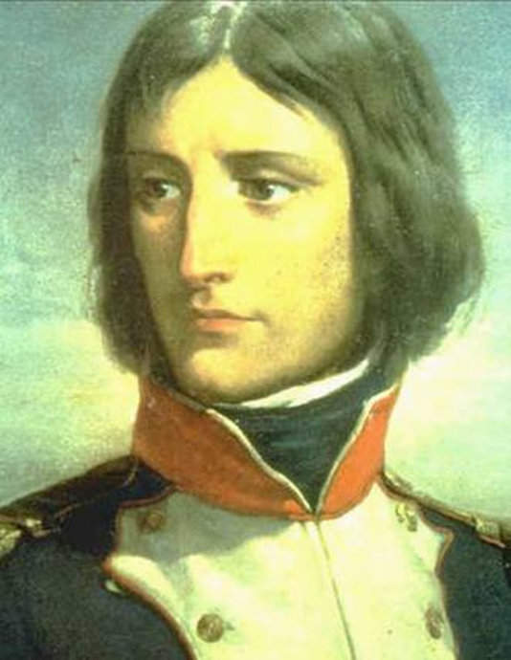

Slide 54
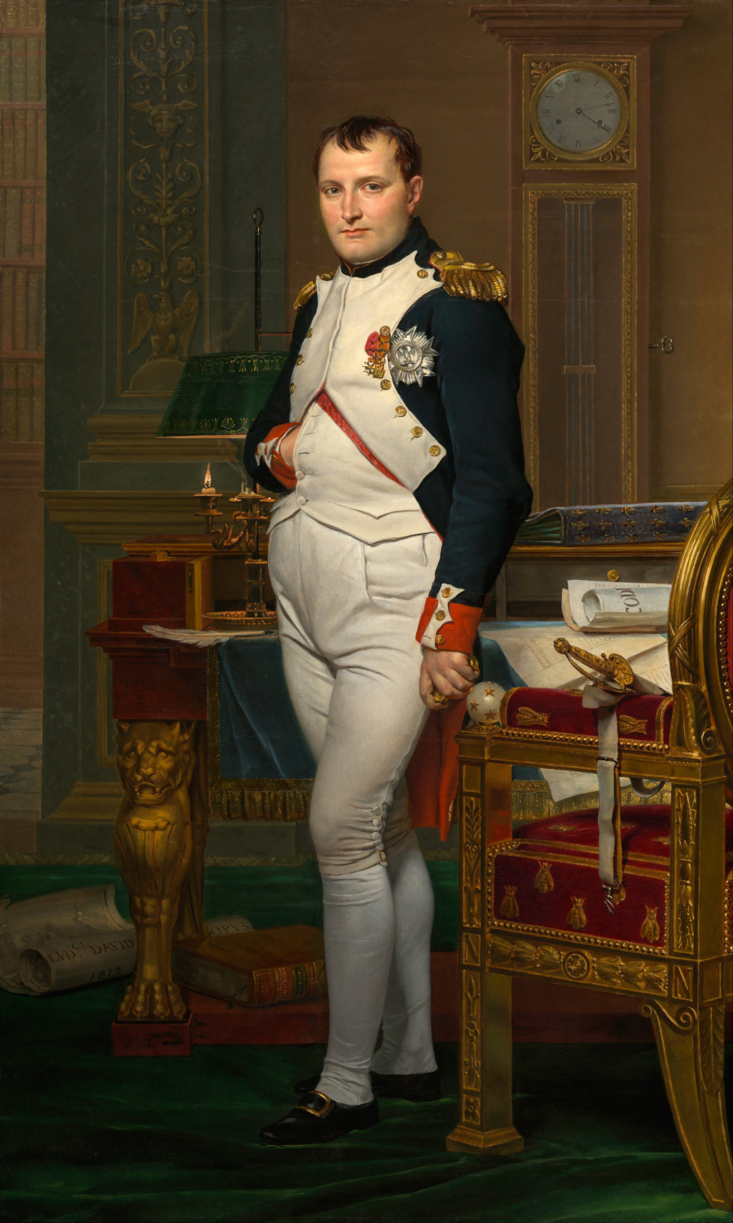
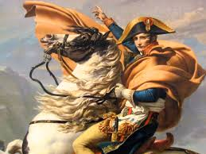
http://www.history.com/topics/napoleon/videos/napoleon

Slide 56
Lesson 2
Actions taken by the National Convention
Abolished monarchy
Established French republic
Condemned the king to death
Committee of Public Safety
Taking Notes pg. 298

Slide 57
Critical Thinking pg. 299
Why might the method of the king’s execution be significant?
Example: Beheading was a common form of execution and the revolutionaries wanted to have the king’s head on a pole.
Critical Thinking pg.300
Why, by 1793, would some Parisians hold a parade mocking the Church?
An anti-Church parade was a public signal of agreement with the de-Christianization policy and allegiance to revolutionary ideals.

Slide 58
Critical Thinking pg. 301
What was the cause of the foreign crisis in the spring of 1793?
A coalition of Austria, Prussia, Spain, Portugal, Britain, and the Dutch Republic planned to invade France.
Progress Check pg. 299
What radical steps did the National Convention take?
The National Convention established a republic. It voted to condemn Louis XVI to death and had him executed.

Slide 59
Progress Check pg. 301
Why did the French government use force against its own people?
Many groups did not support the new government. Counterrevolutionaries were often executed during the Reign of Terror.
Progress Check pg. 301
How did the French army become the people’s army?
The Committee of Public Safety issued a decree calling on volunteers to fight to save the Republic.
Progress Check pg. 302
Did the transition from the Committee of Public Safety to the Directory help respond to the French people’s needs?
No, because the Directory was unable to solve the economic problems that affected the people on a daily basis.

Slide 60
Lesson Review pg. 302
Explain how the coup d’état in which Napoleon took part differed from other transitions in the revolutionary French government?
The coup d’état of Napoleon was less bloody than other transitions. He controlled the military, so taking over the relatively powerless Directory was easy.
Use your notes to write a paragraph describing the actions taken by the National Convention and some of the consequences of these actions.
The Convention abolished the monarchy, executed the king, established the republic, and gave power to the Committee for Public Safety. In reaction to the violence, a weak, and corrupt Directory was created. This opened the door for Napoleon’s coup.

Slide 61
Why did the French Revolution become more radical?
There was a threat of invasion from foreign powers, and the economic problems that affected the common people led to unrest.
How did the new French government deal with crisis?
The French government adopted policies that became known as the Reign of Terror and raised a large army.
How did the constant transition within the French government influence its effectiveness?
Constant transition kept any one group form ruling effectively. Power was divided and consensus was difficult to reach.

Slide 62
Chapter 18 Section 3
Napoleon Bonaparte dominated French and European history for 16 years. He was born in Corsica an island in the Mediterranean. He was the son of a lawyer whose family was nobility. He went to military schools, studied old military campaigns and took advantage of opportunities.

Slide 63
Napoleon rose quickly through the ranks of the French army, soon he was a commander in Italy where he used quickness, deception and surprise to win a series of victories. He won the confidence of his men with his quick decisions, confidence, and energy.

Slide 64
Napoleon's most famous domestic achievement was his codification of the laws. Before now there were some 300 different legal systems. He created 7, the most important being the Civil Code or Napoleonic Code. This code preserved most of the gains made in the revolution=equality of law, religious toleration, and the abolition of serfdom. But women lost lots of rights!

Slide 65
Napoleon also created bureaucracy (organization to run government) in which promotion was based upon ability not rank or birth. He also created a new aristocracy (nobility), based upon merit in the state service. Most were from the middle class. All articles had to be approved by the government.

Slide 66
After the coup d'état, a new government was established. A republic, but actually Napoleon had absolute power. He was made consulate for life, and 2 years later he crowned himself Emperor. He made a deal with the Catholic Church, Catholicism was recognized as the religion of the France, and the Church agreed not to ask for its land back.

Slide 67
Napoleon wanted to spread the principles of legal equality, religious toleration, and economic freedom to his entire kingdom. His kingdom collapsed as fast as it rose. Why?
Nationalism- unique cultural identity of a people based on common language, religion, and nation symbols. Good and bad, other countries hated them, others saw that they too could unite.

Slide 68
Napoleon's downfall came in 1812 with his invasion of Russia. Russia wouldn't stay in the system. He invaded. Napoleon relied upon a quick victory. But, Russian forces kept retreating and burning their own villages and countryside as they retreated. This prevented Napoleon's army from finding food. They retreated for home, all but 40,000 starved to death on the way home.

Slide 70
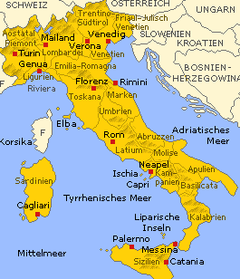
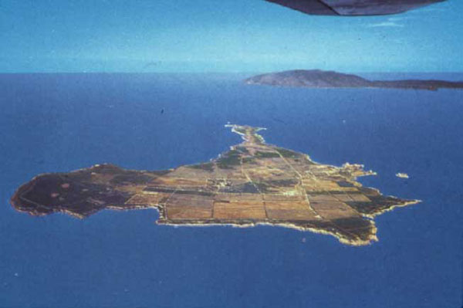
The Russian disaster led other enemy countries to attack the crippled French army. Napoleon was exiled to the island of Elba. Louis XVI's brother was made the new king.

Slide 71
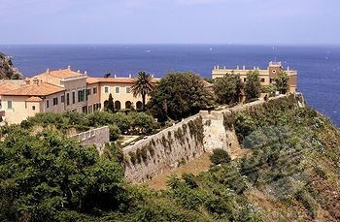

Slide 72
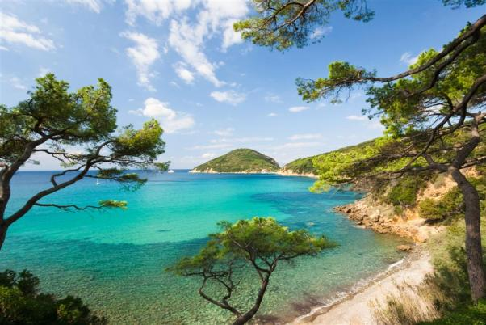

Slide 73
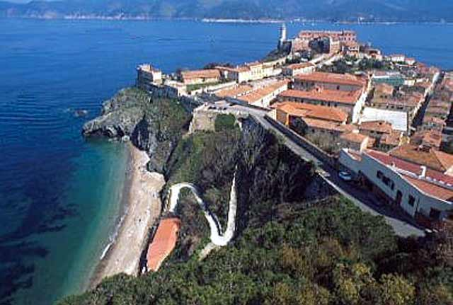

Slide 74
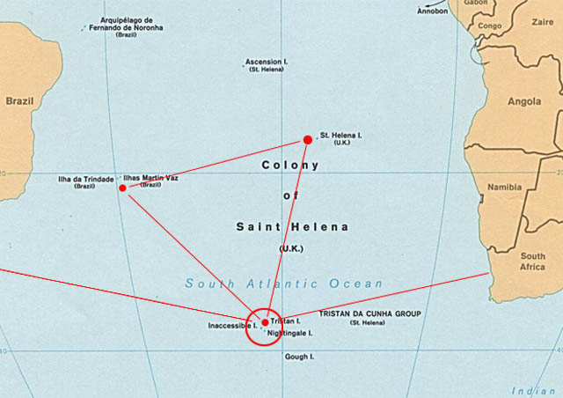
Napoleon came to power once again, he was soundly defeated at the Waterloo by the Duke of Wellington. This time they exiled Napoleon to the island of St. Helena.

Slide 75
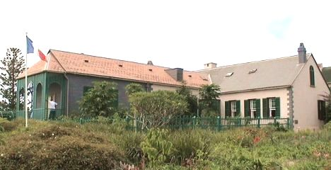

Slide 76
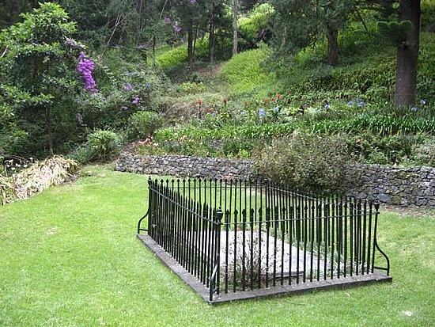

Slide 77
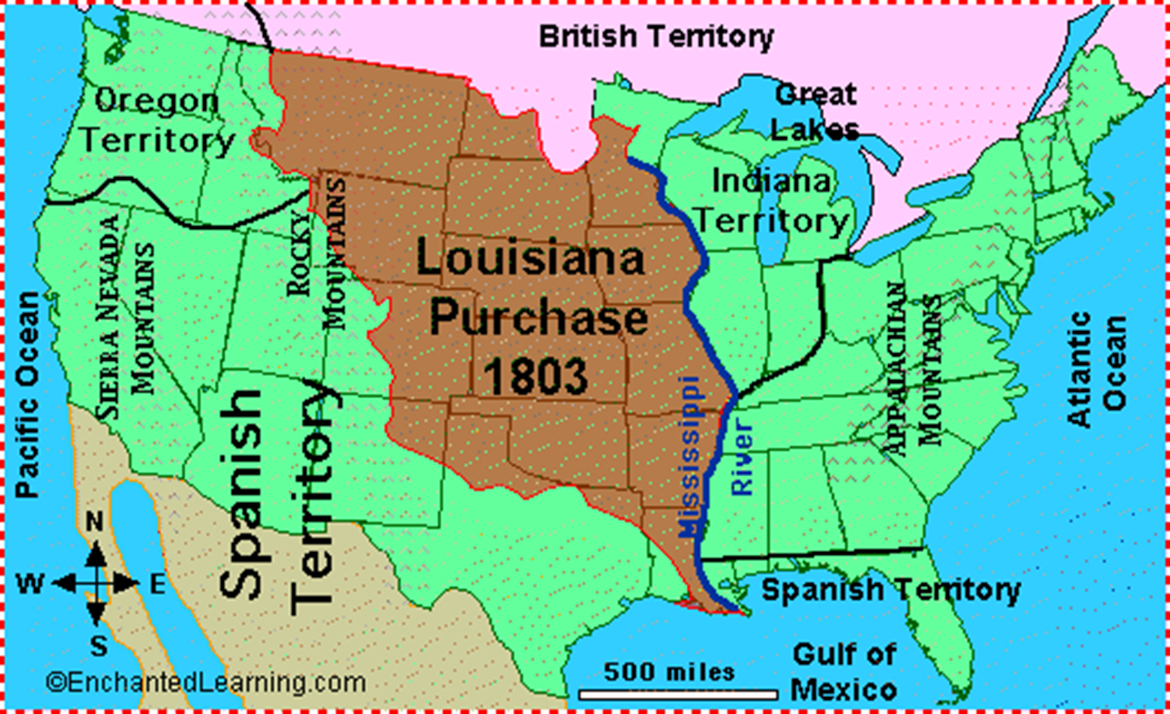
Chapter 18 Section 3

Slide 78
France controlled the area known as the Louisiana Territory from 1699 until 1762, the year it lost the territory to Spain. (French/Indian War) Under Napoleon Bonaparte, France took back the territory in 1800 in the hope of re-establishing an empire in North America. A slave revolt in Haiti and an impending war with Britain, however, led French officials to abandon these plans and sell the entire territory to the United States.

Slide 79
The Louisiana Purchase was an incredible deal for the United States, the final cost totaling less than five cents per acre at $15 million (about $283 million in today's dollars). France's land was mainly unexplored wilderness, and so the fertile soils and other valuable natural resources we know are present today might not have been factored in the relatively low cost at the time.

Slide 80
The Louisiana Purchase stretched from the Mississippi River to the beginning of the Rocky Mountains.
The Louisiana Purchase stretched from the Mississippi River to the beginning of the Rocky Mountains.

Slide 81
Lesson 3
Achievements of Napoleon's Rule
Peace with Catholic Church
codification of laws
development of bureaucracy
some principles of French Revolution spread

Slide 82
Critical Thinking pg. 304
How does David portray Napoleon in this painting?
Napoleon is shown in attire once worn by roman emperors. He is standing and all eyes are turned toward him. The pope gives added authority. Napoleon has taken the crown away from the pope and is ready to crown himself Emperor, which takes authority from the pope and gives it to himself.
Geography Connection pg. 306
Why might Napoleon have chosen to ally with states instead of taking them over?
Taking over states instead of making them allies might have caused a backlash and required additional resources.

Slide 83
What do the countries allied against France have in common?
None of the states allied against Napoleon are in central Europe.
DBQ pg. 307
How did Napoleon understand his role as leader of the French people?
He saw himself as the representative of the people.
Progress Check pg. 305
How did Napoleon’s civil code address the problems with the French legal system that were present before the revolution?
Equal rights from men dissolved feudalism, provided religious toleration, and reduced all legal systems to just seven.

Slide 84
Progress Check pg. 307
What were the consequences for a country conquered by Napoleon’s Grand Army?
The traditions of the old regime and the social order would be dissolved in favor of the principles of the French Revolution.
Lesson Review pg. 307 1-6
What is nationalism, and what role did it play in Napoleon’s fall from power?
Conquered territories did not want their national identity changed by France. Motivated by national pride, the people in these nations unified against Napoleon.

Slide 85
Why do you think Napoleon used the ancient Roman term first consul to define his new role in the government?
Napoleon might have used the term first consul in homage to the Roman Empire, as well as to lend legitimacy to his new reign.
Use your notes on the achievements of Napoleon to compare Napoleon’s achievements to those of the French government during the Reign of Terror.
Example: Napoleon developed a capable bureaucracy and gave out titles based on merit; the Committee used fear to establish its domestic rule.

Slide 86
How did instability in the French government create an opportunity for Napoleon to take power?
The Directory was so weak that it relied upon the military to keep order. Napoleon saw an opportunity to seize power and plotted with Directory members.
Why would changes in France cause concern in other European countries?
If the French government became much stronger and began to effectively use the huge military it created, it could pose a threat to other nations.
How did Napoleon’s military background shape his perspective?
His rapid advancement in the military may have given him the confidence he needed for conspiring to seize power and then building an empire.

Slide 87
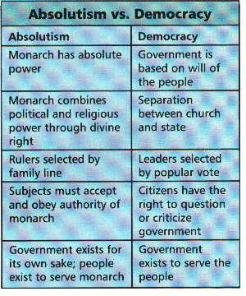

Slide 88
Study Guide: French Revolution
Estates Class system in France before the French
Revolution. There were three Estates, First
Estate was Clergy, Second was Nobility,
and Third was peasants, merchants, and
townspeople.
Anciens regime Old social class system of the 3 estates
Old Regime Same as anciens regime
Bourgeoisie Educated, middle class people
Deficit spending Government spends more money than it
collects
Cahiers Notebooks of the 3 estates which listed
their grievances [complaints]
Estates General The legislative body of France. Each Estate
was entitled to one vote on legislative
matters. Louis XVI was forced to call it
together in 1789 to get more money.
National Assembly Third Estate declared themselves this body;
First new government during the first stage
of the French Revolution.
Tennis Court Oath Oath taken by 3 rd Estate promising to write
a new constitution for France
Bastille Prison in Paris where political prisoners
were held; storming of Bastille marked the
beginning of the Revolution
Émigré Nobles who fled France during the
Revolution
Sansculotte
Working class radicals of the Revolution
Great Fear Period of chaos caused by famine in which
peasants rioted against nobles
“Liberty, Equality, Fraternity” The slogan used in the French Revolution
of 1789 to mean freedom for all persons,
equal treatment regardless of inherited
status, and brotherhood of all people
working together to make a better world.
Declaration of the Rights of Man and
Citizen
Revolutionary document of the French
Revolution. Written in 1789, it spelled out
certain rights believed to be universal to all
mankind. Patterned on the American
Declaration of Independence.
Lafayette Hero of American Revolution; Led the
National Guard
National Guard A middleclass
militia created to fight
against the royal troops
Tricolor Flag of the Revolution (red, white, and
blue)
Civil Constitution of the Clergy 1790bishops
and priests became elected,
salaried officials; Papal authority over
French Church ended; dissolved convents
and monasteries. Many peasants did not
agree with this.
Constitution of 1791 Made France a limited monarchy; created
the Legislative Assembly to make laws,
collect taxes, and decide on issues of war
and peace.
Declaration of Pilnitz Emperor of Austria threatened to intervene
in France to protect the French monarchy
Jacobins Radical leaders of Legislative Assembly;
mostly middleclass
lawyers or
intellectuals
Legislative Assembly Lawmaking body created by Constitution
of 1791.
Constitutional Monarchy A political system in which a country is
ruled by a monarch who has limited power
due to a constitution
September Massacres Attack on prisons holding many nobles and
priests; these prisoners were killed along with many common criminals Louis XVI King of France during the Revolution; he was executed in January 1793.
Marie Antoinette Queen of France who has disliked by the French people. She was executed in
October 1793.
Suffrage The right to vote
French Republic Government of France ruled by the National Convention
National Convention Legislative body created by Radicals after the September Massacres
Committee of Public Safety 12 member committee that ruled with absolute power; goal was to defend France from antirevolutionaries;led by Robespierre; ran the Reign of Terror Robespierre Jacobin leader who become leader of Committee of Public Safety; goal was to make France a “Republic of Virtue”; instituted the Reign of Terror
Reign of Terror Period during the Revolution from July 1793 to July 1794 when thousands of
people were executed without fair trials Guillotine Method of execution used during the Reign
of Terror
Directory 5 man ruling body created by the Constitution of 1795; held power from 1795 to 1799; it was ineffective and corrupt.
Nationalism Pride in one’s country or culture, often excessive in nature. This was an effect of
the Revolution and rule of Napoleon
“La Marseillaise” Patriotic song of Revolution, which was banned by Napoleon and later became
France’s national anthem
Olympe de Gouges Leader of women’s rights; created a “Declaration of the Rights of Women”;
gains were taken away by Napoleon
Jacques Louis David Leading artist of this period Napoleon General and emperor; ended the period of
revolution and violence in France by stabilizing the government and the currency, promoted equality of the people before the law, as well as religious toleration through the Napoleonic Code of Laws.
Corsica Island where Napoleon was born
Plebiscite Ballot where voters say yes or no to an issue; used by Napoleon to gain power
First Consul Title taken by Napoleon after his coup d’etat overthrew the Directory
French Empire French territory under rule of Napoleon;
Napoleon annexed territory and abolished the Holy Roman Empire
Continental System Napoleon attempt to block trade between Great Britain and the rest of Europe as a
way to weaken Great Britain
Abdicate To give up power to rule
Napoleonic Code A series of laws established by Napoleon that affected the lands he conquered
throughout Western Europe. This law code reinforced many of the ideals of the French Revolution such as religious toleration and equality before the law.
Waterloo Place in Belgium where Napoleon faced his final defeat
Congress of Vienna Conference held after the defeat of Napoleon, led by Austria under the
direction of Prince Metternich. Its goals were to turn back the clock (reactionary) and erase the ideals of the French Revolution.
Balance of power A political policy in which countries attempt to preserve peace by keeping an
equal military and economic status.
Prince Metternich Austrian prince who led the Congress of Vienna; goal was to create a lasting peace
by establishing a balance of power.
1. What were the causes of the revolution?
Causes: special privileges of 1 st & 2 nd Estates, high taxes, huge government debt,
Enlightenment ideas, high food prices.
2. What were the different phases of the Revolution?
1 st phase: Creation of National Assembly (Tennis Court Oath )
Storming
of Bastille (July 14, 1789)
Declaration
of Rights of Man
2 nd phase: Constitution 1791Limited
monarchy
(Moderate) Constitution of civil clergy – put church under state control
3 rd phase (radical): 1793King
& Queen are executed
National
Convention set up Committee of Public Safety.
Reign
of Terror July 1793 – July 1794
4 th phase (moderates): Directory
– 5 man rule 17951799
5 th phase: Rule of Napoleon (17991815)
coup
d’etat –overthrow of government.
Plebiscite
3. What ideas were embodied in the Declaration of the Rights of Man and
Citizen?
All
men have natured rights
Equality
under the law
Religious
freedom
fair
taxes
4. Why did the Revolution become radical?
War against other nations was going badly; king’s guards are attached; radicals took over
assembly; King & Queen executed.
5. How and why did Napoleon come to power?
Directory was ineffective; Napoleon was popular general who had won victories for
France & restore order; coup d’etat put him in power; became 1 st consul; 1804 declared
himself emperor; defeated in 1814 & exiled to Elba; returned for 100 days – finally
defeated at Battle of Waterloo.
6. How did France change under the reign of Napoleon?
Changes by Napoleon:
Economy:
encourage new industries, built roads & canals, controlled
prices
Education:
built schools (free public education)
Napoleonic
Code: equality of citizens before the law.
7. How did the Napoleonic Age influence Europe?
Rise
of Nationalism
Spread
of Enlightenment ideas
Legal
systems influenced by Napoleonic Code

