Slide 1
World War I
Ch 21.1, p.410
https://www.youtube.com/watch?v=_XPZQ0LAlR4
https://www.youtube.com/watch?v=y59wErqg4Xg

Slide 3
Word.
Conscription
Mobilization
Military
Complex

Slide 4
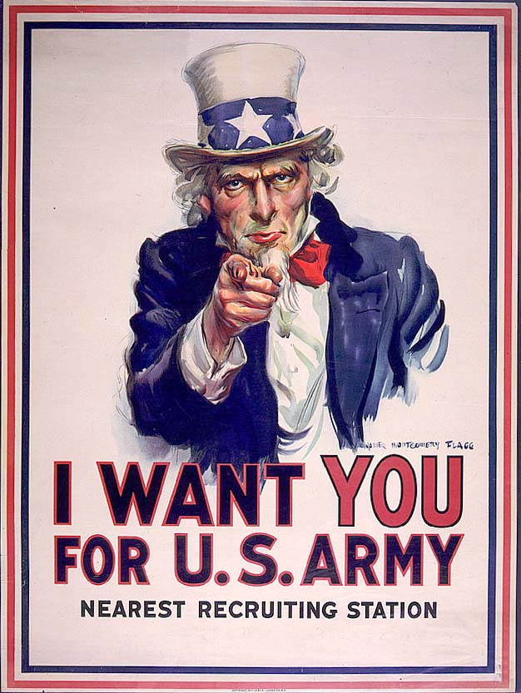

Slide 5
Causes of WWI
Nationalism → development of national identity
Imperialism → establishing colonies around the globe
Militarism → making militaries
Alliances →let’s hold hands

Slide 6
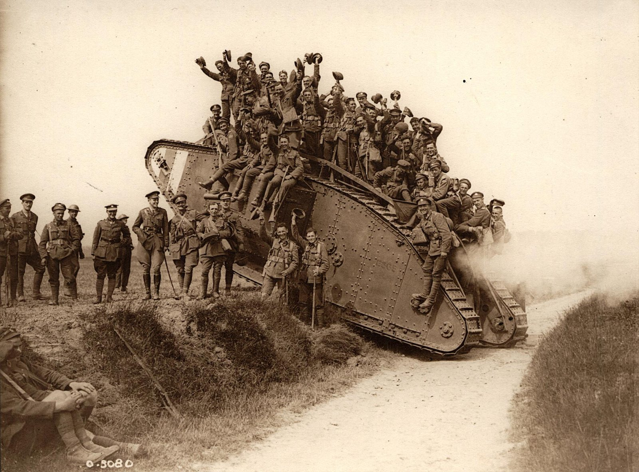

Slide 7
Alliances
Battle lines drawn btwn:
Triple Alliance vs. Triple Entente
Alliance: Germany, Austria-Hungary, and Italy
Entente: UK, France, and Russia

Slide 8
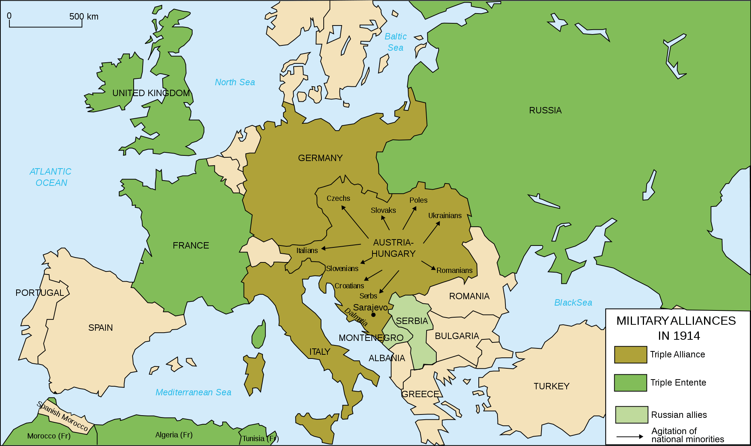

Slide 9
Balkan Powder Keg
From 1908 to 1913 the Balkans experience several crises.
Concluding w/ the assassination of Archduke Francis Ferdinand on June 28, 1914 (a freaking Hapsburg!)
Which occurred b/c both Russia and Austria-Hungary wanted a piece of the Balkans

Slide 10
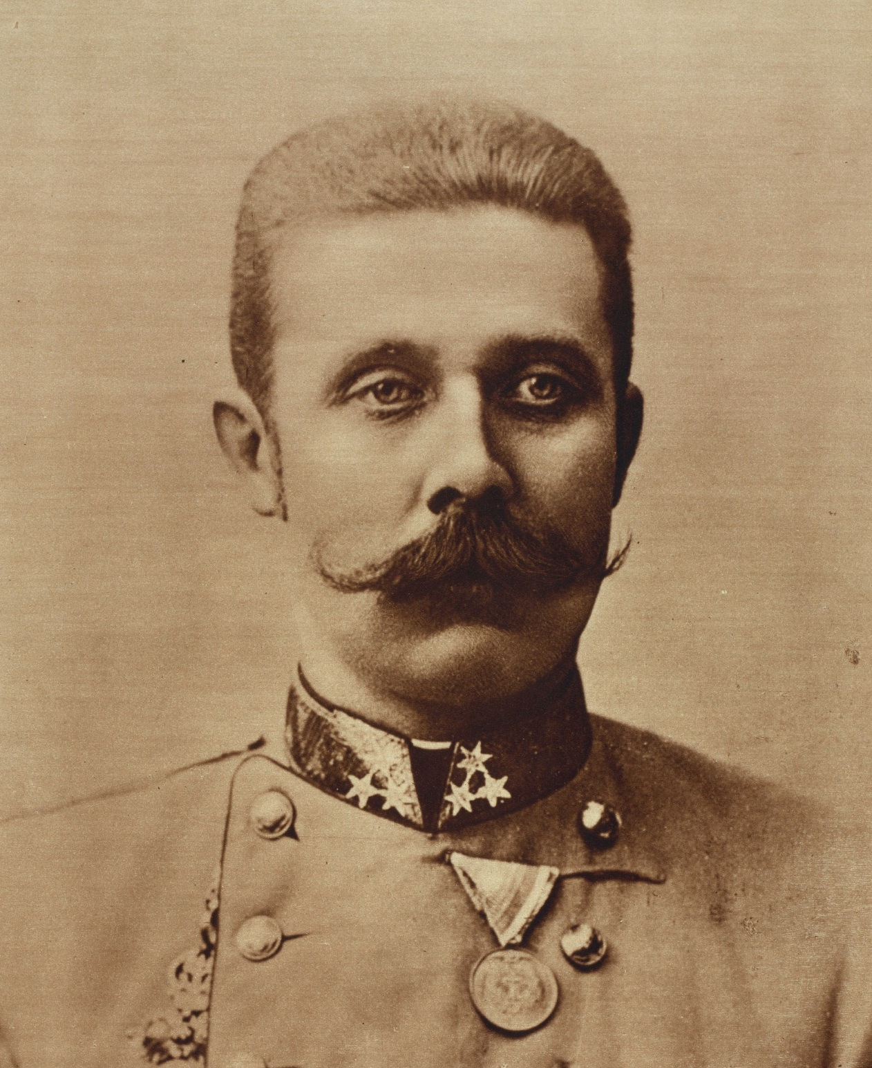

Slide 11
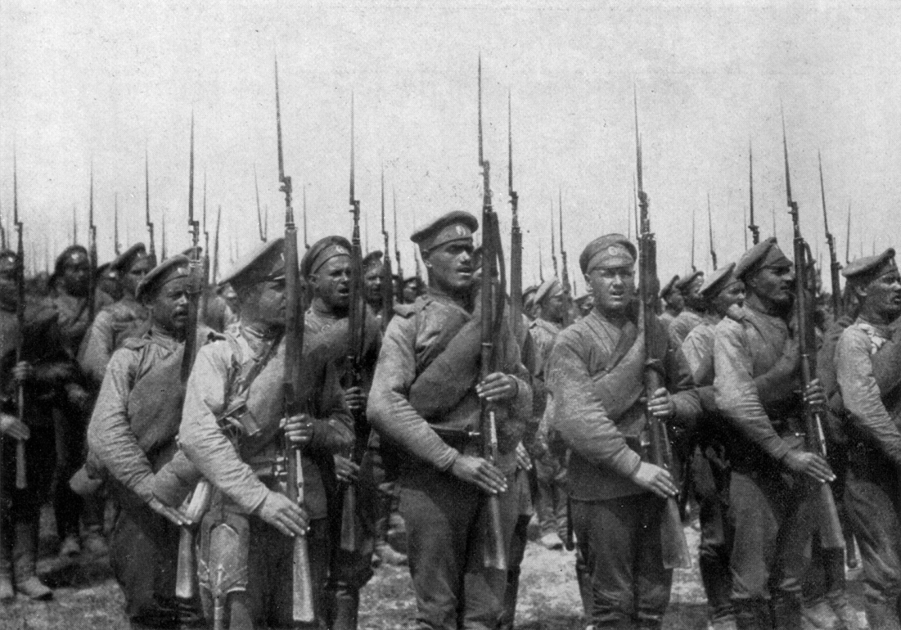
Next
The Alliance and Entente mobilize b/c both alliances are determined to have the Balkans.
Crazily, the Russians fully mobilize the largest army in the world…which Germany assumes is an act of war.

Slide 12
Shtuff Gets Real.
Germans react quickly.
Tell Russia to demobilize w/in 12 hrs, or else!
THE SCHLIEFFEN PLAN!
Two-front war w/ France and Russia
Distraction host vs. Russia while main force fights France, to cripple the weaker enemy

Slide 13
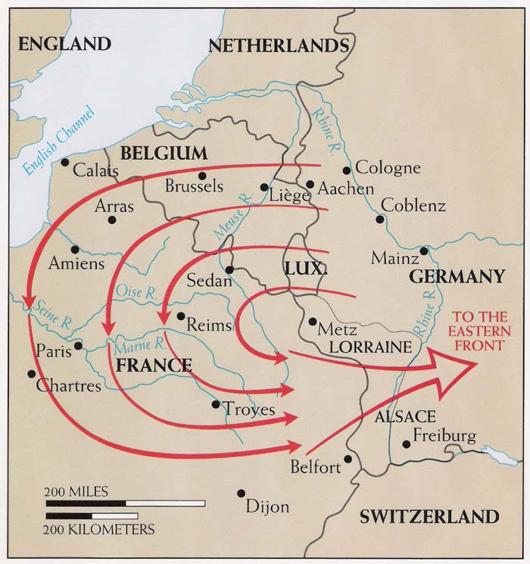

Slide 14
Poor Belgium
Germany has to walk through neutral Belgium
Which upsets the British (supposedly)
And England enters the ring on the Belgian pretense.

Slide 16
World War I is on, like Donkey Kong.

Slide 17
Queries
What is mobilization?
The process of assembling troops and supplies for war.
What factors caused WWI?
Nationalism, Imperialism, Militarism and Alliances
What famous Hapsburg was assassinated in the Balkan Powder Keg?
Archduke Francis Ferdinand

Slide 18
World War I
http://www.tentimesone.com/if-world-war-one-was-a-bar-fight/
Bar fight
Ch 21.2, p. 414

Slide 19
Vocab 2 Go
Propaganda
Trench Warfare
War of attrition
Total war
Planned economies
Target
Unrestricted

Slide 20
Ideas Can Be Deadly
Propaganda lead nations to believe their causes were just.
Everyone believed these battles would be over in a few weeks.
Kickoff in 1914 w/ the dead of AFF

Slide 21
Western Front
At first The Schlieffen Plan seemed to be working.
Germany quickly advanced into France
Then 2000 taxicabs sent fresh French troops to the rescue.
Trench warfare, from the English Channel to Switzerland ensued

Slide 22
Eastern Front
1st Russia seems to be kicking booty
BUT Germany rocks @ battle and swiftly crushes Russia in two major conflicts
So things are going well for the Central Powers
Except that Italy always changes sides and jumps ship to join the UK, France and Russia → bringing the Alliance name with them
These nations are now called the Allies

Slide 23
Central Powers vs. Alliance
Alliance:
Italy, France, UK, Russia, Balkans and all of N. Africa
Central Powers:
Germany, Austria-Hungary, Bulgaria, Ottoman Empire (what’s left of it)
So really the Central Powers are just Germany

Slide 24
War of Attrition
Trenches protected soldiers in theory, but created a long, drawn-out war where lots of people died in spurts of battle w/in no-man’s land.
During the battle of Verdun (#France), 700,000 men died in 10 months.

Slide 25
Aircraft
In 1915, planes start being used
First to spot enemies
Then to attack via machine guns mounted to plane noses

Slide 26
German Zeppelins
A Zeppelin is a giant blimp filled with hydrogen gas
Which explodes very easily.
Hilarious AND INEFFECTIVE

Slide 27
Colonies in Danger!
After Gallipoli near Constantinople in 1915
The Ottomans are attacked by a British officer named Lawrence of Arabia → who raises Middle Eastern Arabs against Ottomans
Allies also seized German-held islands in the Pacific, including New Guinea.

Slide 28
‘Merica!
The Lusitania is sunk in 1915.
The USA gets upset, but does nothing for two years
100 Americans are killed
By 1918 we are full steam ahead
US contributes money, weapons and men

Slide 30
Increased Gov’t. Power
Desperate times call for desperate measures
Governments all over the world took complete control over economies → called planned economies
E.g. in the USA, automakers only made war machines and weapons instead of cars.

Slide 31
Total War
We call this total war
All resources dedicated to victory, home and abroad
Lots of propaganda needed to keep ppl happy

Slide 32
The Flu?!
In 1918, a crazy deadly influenza – probably spread by soldiers – killed 50 million ppl.
Known as the deadliest epidemic in history.

Slide 33
Societal Affects
Women work and vote
Finally.

Slide 34
Q&A
What is trench warfare?
Fighting from ditches, often protected by barbed wire and machine gun nests
Why did the USA enter WWI?
Lusitania sunk, Americans die
What happens to women after WWI?
They gain greater respect and legal rights

Slide 35
The Russian Revolution
Ch 21.3, p. 420

Slide 36
Vocab
Soviet
Abdicate
War communism
Revolution
Aid

Slide 37
Pre-Revolution Background
Before WWI Russia wasn’t ready to fight.
Soldiers poorly equipped
About 8 million Russian casualties during WWI
Also, everyone hated Czar Nicholas II b/c ppl weren’t getting enough food/supplies throughout Russia
Riots → provincial government

Slide 38
Soviets
Soviets were Russian councils of representatives → similar to a union

Slide 39
Unleash Lenin!
The Germans ship Lenin back into his home territory to generate dissent
Lenin wants a revolution!
Plans to redistribute land, stop the war, take over businesses and feed everyone.
These sound good to the dying Russians

Slide 40
Bolsheviks
Bolsheviks were the group that supported Lenin
In 1918 Lenin takes over Russia, from the provisional government, and signs a peace deal with Germany, the Treaty of Brest-Litovsk
Loses a lot of land, but Lenin doesn’t care → communism inevitable.

Slide 41
Civil War in Russia
The Allies and local ppl weren’t 100% happy with Lenin’s communist ideas
Massive civil war fought all over with Allied aid shipped in to fight commies

Slide 42
Why did the Commies win?
Three Reasons:
United by a common goal.
War communism: gov’t. seizure of economy.
Death to deserters and weak.
Communism here to stay.

Slide 43
Questions
During the civil war that followed the Bolshevik Revolution, why did the Allies fight the communists?
Allies wanted Russia to fight in WWI
What was the name of the Treaty which gave Russia peace in WWI?
Treaty of Brest-Litovsk
Which leader seized power in Czarist Russia in 1918, during the Bolshevik Revolution?
Lenin

Slide 44
WWI Fin.
Ch 21.4, p. 425

Slide 45
Verbiage
Armistice
Mandate
Reparation
Psychological
Cooperation

Slide 46
Last Year - 1917
With Russia’s withdrawal, Germany thought victory was assured.
Then the US entered the ring.
Nuf ‘sed.
German General Ludendorff’s plan to make a final push for Paris failed.

Slide 47
Germany’s Gov’t.
Because of a few awesome sailors in northern Germany, a democratic rebellion stirred and the German King was forced to step down
The new German republic signed an armistice on November 11, 1918 (Armistice Day)

Slide 48
Peace
President Woodrow Wilson wanted international peace
His “Fourteen Points” hit all the major topics and tried to suggest ideas to prevent future war
The theme: international cooperation

Slide 49
Paris Peace Conference
1919
Everyone has different motivations:
More territory
Reparations (England)
Safety (France)
The Big Three (England, US and France) agree to a League of Nations and some random line drawing
But the US Senate refuses to ratify…so worthless

Slide 50
Treaty of Versailles
Actual peace happens
Germany admits guilt in agreement
Has to demilitarize

Slide 51
Consequences
Tons of new nations formed in Europe and Middle East
Arabs promised independence from Ottomans in fighting commies, but Allies “forgot” all about this term
Random line drawing
League of Nations, minus USA

Slide 52
Q&A
What are reparations?
Payments made to the victors of war to cover the costs of war
Which President attempted to create international cooperation through the League of Nations?
Woodrow Wilson
T/F: the Germans loved the Treaty of Versailles.
False

