Slide 1
What does senatorial courtesy apply to, what is it?

Slide 2
“senatorial courtesy" refers to a tacit (unwritten, unofficial, and nonbinding political custom) agreement among senators not to vote for any presidential nominee who is opposed by the senators from the nominee’s home state. This is regarding Federal District Court Positions.

Slide 3
What is precedent?
Previous court ruling of a similar nature. It is a principle or rule established in a previous legal case that is either binding on or persuasive for a court or other tribunal when deciding subsequent cases with similar issues or facts.

Slide 4
3. What is judicial restraint?

Slide 5
When a judge interprets the Constitution according to the Framers original intention. Very strict view. This encourages judges to limit the exercise of their own power. It asserts that judges should hesitate to strike down laws unless they are obviously unconstitutional, though what counts as obviously unconstitutional is itself a matter of some debate.

Slide 6
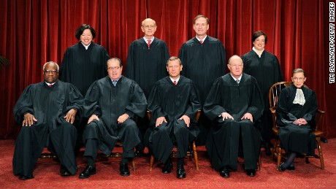
4. How many justices are on the SC today?

Slide 7
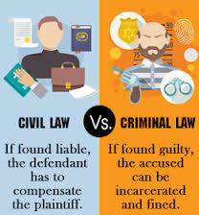
5. What is the difference between a civil and criminal charge?

Slide 8
Criminal charge-you can go to jail, and the state is who is pressing the charges, Civil- is person v. person or corporation v. person etc. it is generally about money or specific performance.

Slide 9
6. Which court serves as the trial court at the federal level? The Federal District Courts

Slide 10
7. What is appellate jurisdiction?

Slide 11
The type of jurisdiction that is held by a court to review the proceedings of a lower court.

Slide 12
8. Who makes the legal complaint in a court proceeding?

Slide 13
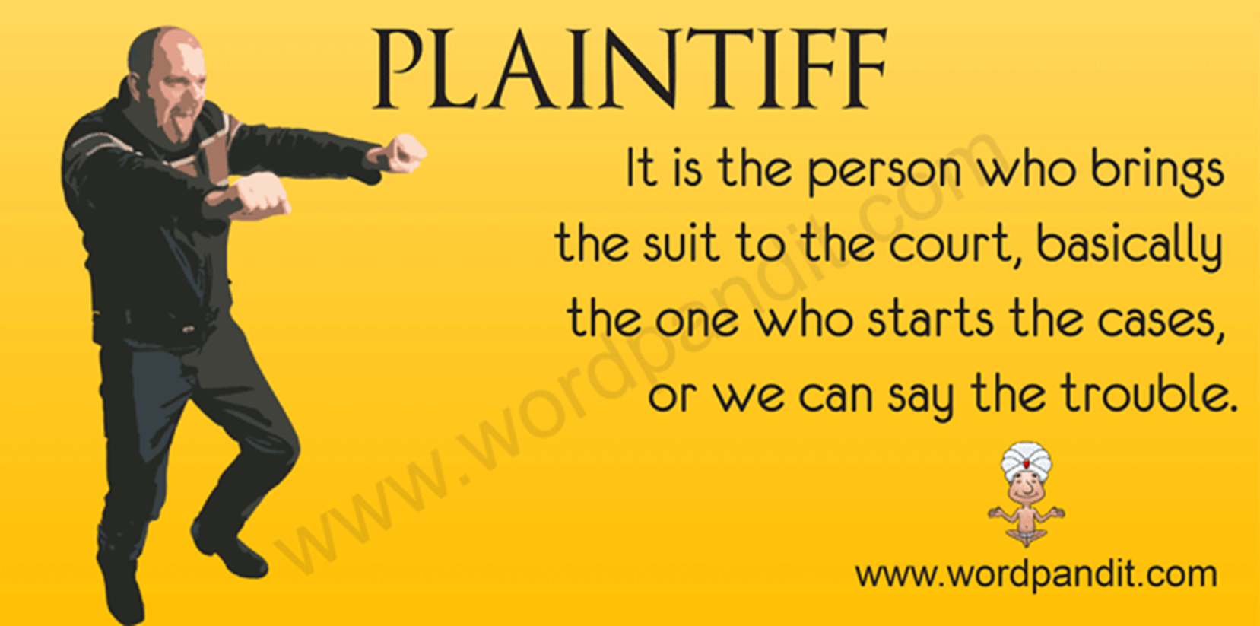

Slide 14
9. What is exclusive jurisdiction?

Slide 15
When only 1 court has the sole right to hear a case.
copyright cases, admiralty cases, lawsuits involving the military, immigration laws, and bankruptcy proceedings.

Slide 16
10. What courts hear the majority of the cases in the US?

Slide 17
State Courts

Slide 18
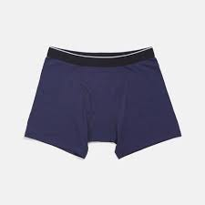
What are briefs?

Slide 19
a written legal argument presented to an appellate court. Its purpose is to persuade the higher court to uphold or reverse the trial court's decision. Briefs of this kind are therefore geared to presenting the issues involved in the case from the perspective of one side only.

Slide 20
Who files an appeal?

Slide 21
Appellant
Person who was not “happy” with the outcome of the trial court.

Slide 22
13. Who provides security at federal courthouses?

Slide 23
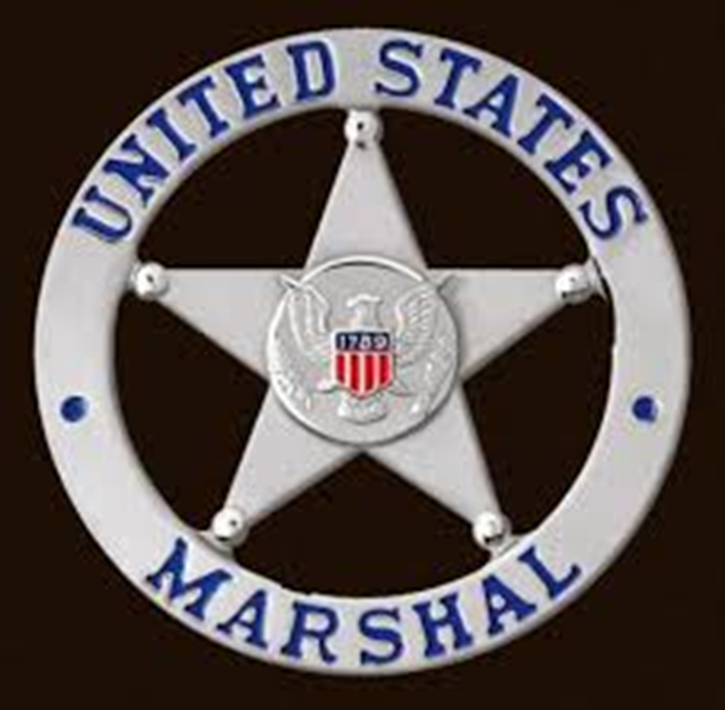
US Marshall Service

Slide 24
14. What is the US attorney's job?

Slide 25
To represent the US in court.

Slide 26
15. Know the differences between misdemeanor and felony.

Slide 27
Misdemeanors are minor offenses, punishable by less than 1 year in jail, a felony is a more serious charge, punishable by > 1 yr in prison.
ONE YEAR
MISDEMENOR
FELONY

Slide 28
16. How long does a Article III judge serve?
William Orville Douglas was nominated by friend Franklin Roosevelt. At 40 years old he was the second youngest Supreme Court justice in U.S. history, and he would serve for the next 36 years, 209 days from April 17, 1939 to November 12, 1975.

Slide 29
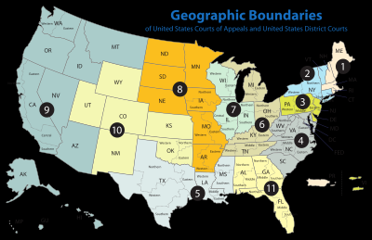
17. What is the main job of a federal district court judge?

Slide 30
They are known as the work horses because they deal with most of the court cases. Both civil and criminal cases are filed in the district court, which is a court of law, equity, and admiralty.

Slide 31
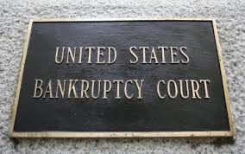
What is bankruptcy?

Slide 32
When a person or company uses a legal process to receive court protection and assistance in settling their debts when they cannot pay their bills.

Slide 33
19. How does congress and the states check the federal judiciary?

Slide 34
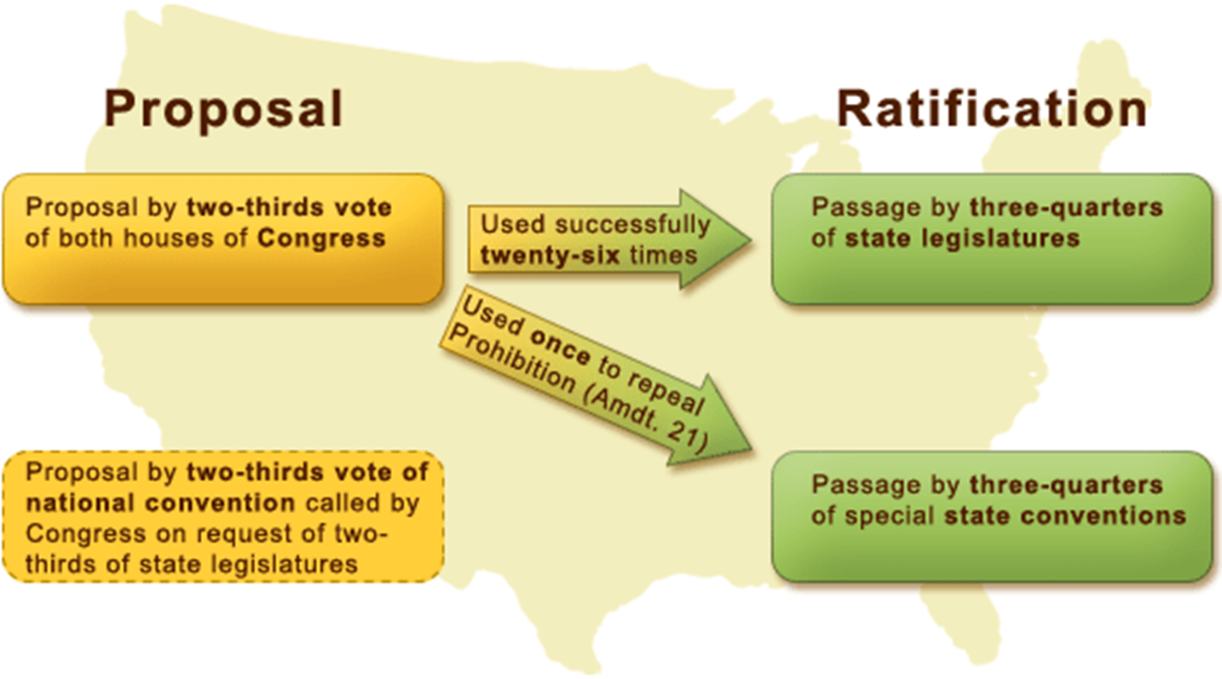

Slide 35
20. Why did the founding fathers make the federal judgeships permanent?

Slide 37
21. What is sovereign immunity?

Slide 38
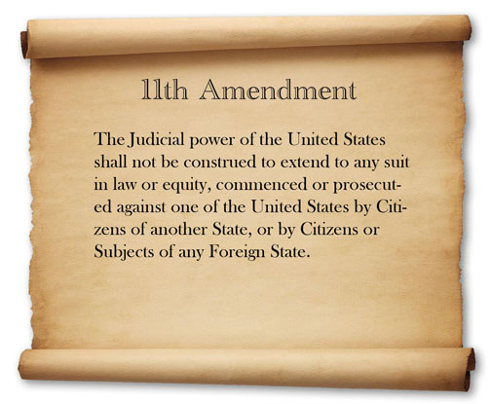
The US status as a nation that cannot be sued unless it agrees to be.

Slide 39
What court handles prosecution of military members for military matters?
All participants are military
Only requires a 2/3 vote to find guilt
Only involves violations of military law

Slide 40
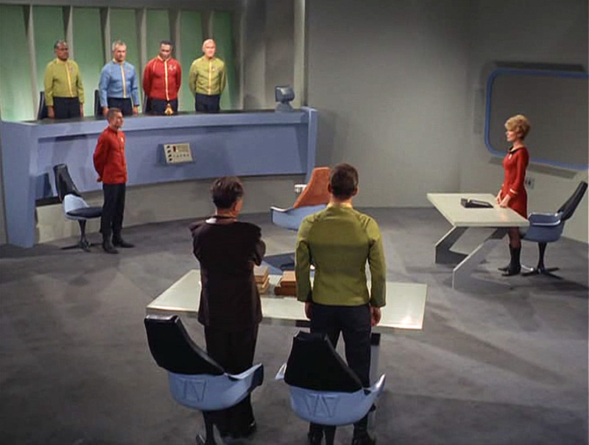
Court martial

Slide 41
23. What were the military commissions created by Bush after 9/11?
President George W. Bush and his response to the September 11, 2001 terrorist attacks on the United States. Days after the attacks, Bush demanded that the Taliban government in Afghanistan turn over Osama Bin Laden and shut down Al-Qaeda training camps. When the Taliban refused, Bush ordered strikes on the country. After hundreds of enemy combatants were captured on the battlefield in Afghanistan, in the U.S., and around the world, the question of how detainees in the War on Terror should be treated became problematic. Were accused terrorists criminals, or were they illegal combatants (aggressors guilty of breaking laws of war)? Bush’s answer to that question—that they were illegal combatants not entitled to due process protections of U.S. law, but who should be subject to Military Tribunals

Slide 42
Were struck down by the SC.
In 2004, the Supreme Court held in Hamdi v. Rumseld that
habeas corpus did not depend on citizenship status.
The President responded by convincing the Republican-led
Congress to pass the Military Commissions Act of 2006,
which addressed wartime conditions when habeas corpus
did not apply to alien enemy combatants. The Court found the Military Commissions Act of 2006 to be an unconstitutional suspension of habeas corpus. Enemy combatant detainees at Guantanamo were entitled to the Fifth Amendment’s protection of due process.

Slide 43
24. What SC case gave the court judicial review?

Slide 44
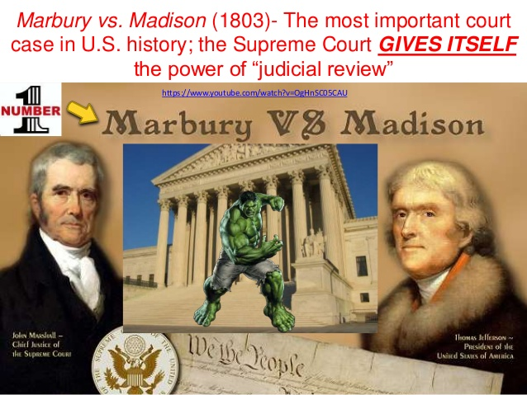
Marbury v. Madison

Slide 45
25. What court stated that Congress lacked the power to outlaw slavery in the territories?

Slide 46
Dred Scott v. Sandford
In Dred Scott v. Sandford (argued 1856 -- decided 1857), the Supreme Court ruled that Americans of African descent, whether free or slave, were not American citizens and could not sue in federal court. The Court also ruled that Congress lacked power to ban slavery in the U.S. territories. Finally, the Court declared that the rights of slaveowners were constitutionally protected by the Fifth Amendment because slaves were categorized as property.

Slide 47
26. After the Civil War how did the SC view economic regulation?

Slide 48
Was an assault on property rights.
From the Civil War to the 1930s, the Supreme Court was primarily occupied with economic regulation by government.

Slide 49
27. What was FDR's reason for wanting to "pack" the SC?

Slide 50
So the New Deal programs would survive constitutional challenge.
the "Four Horsemen" (Justices James McReynolds, Pierce Butler, George Sutherland, and Willis Van Devanter) mostly opposed New Deal programs proposed by President Franklin D. Roosevelt. The liberal "Three Musketeers" (Justices Harlan Stone, Benjamin Cardozo, and Louis Brandeis) generally supported the New Deal. Two justices (Chief Justice Charles Evans Hughes and Justice Owen Roberts) stood in between. By the 1939 term, Roosevelt had moved the Court to a more liberal position by appointing four new justices including strong liberals

Slide 51
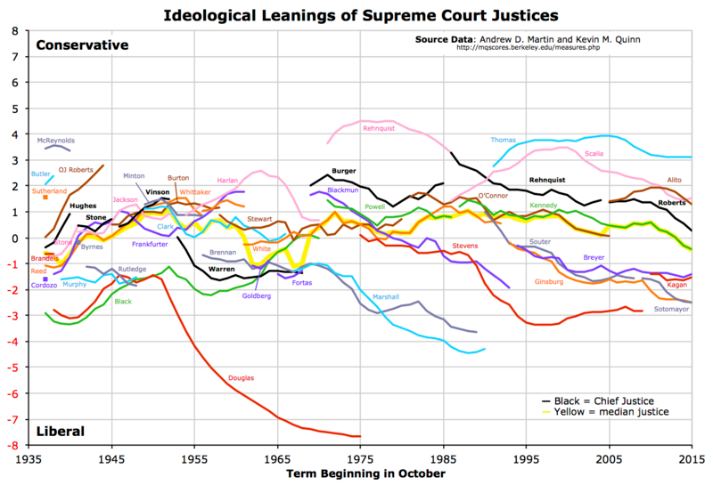
28. Who was the chief justice of the SC during its liberal era?

Slide 52
Earl Warren
Among the Warren Court's most important decisions was the ruling that made racial segregation in public schools unconstitutional. Brown v. Topeka Board of Education

Slide 53
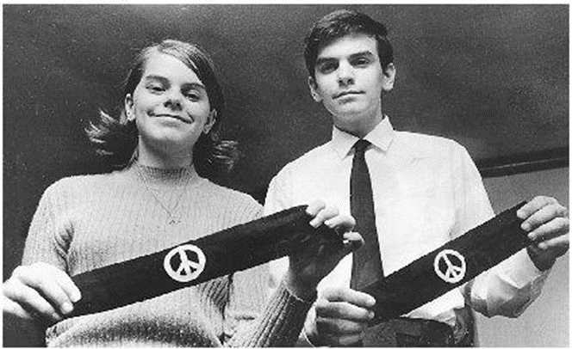
29. What SC case held that schools could not prevent students protesting the Vietnam War?

Slide 54
Tinker v. Ohio
2/24/2005 A Missouri high school prohibits a student from wearing a gay pride t-shirt at school. A San Diego high school prohibits an anti-gay t-shirt from being worn. Free speech rights of students expressed in what they wear to school is putting Tinker v Des Moines and a student's freedom of expression back into the news.

Slide 55
30. Where what court do most SC cases come from? Same as 34.

Slide 56
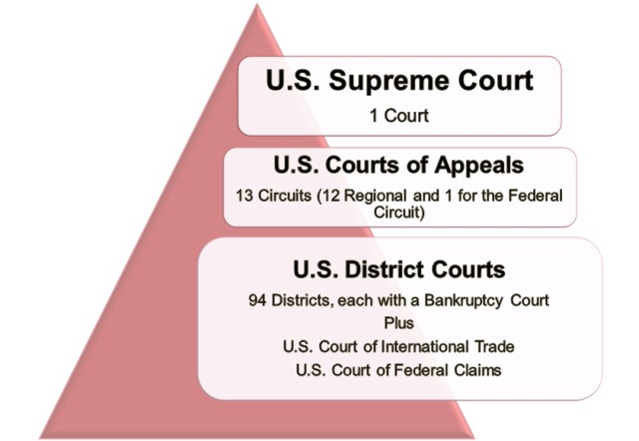
Federal Court of Appeals

Slide 57
31. What is a writ of certiorari?

Slide 58
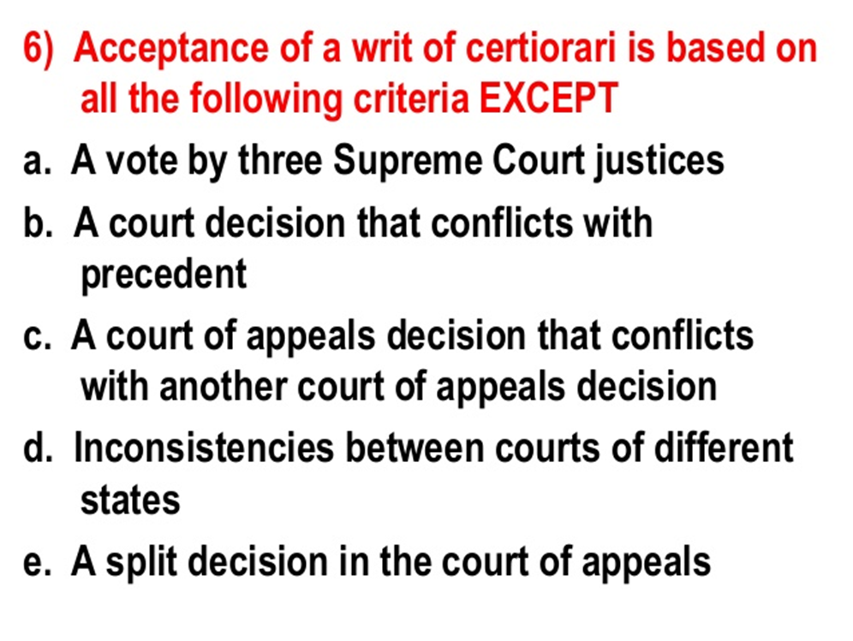
Request to SC to review the ruling of a lower court.

Slide 59
32. What do SC justices do after reading the briefs?

Slide 60
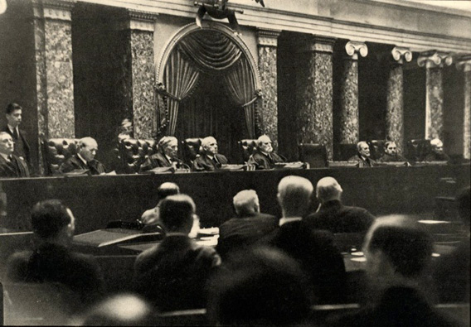
Listen to oral arguments
Cameras are not allowed in Supreme Court proceedings-
so no pics…except
1932

Slide 61
33. What is a majority opinion?

Slide 62
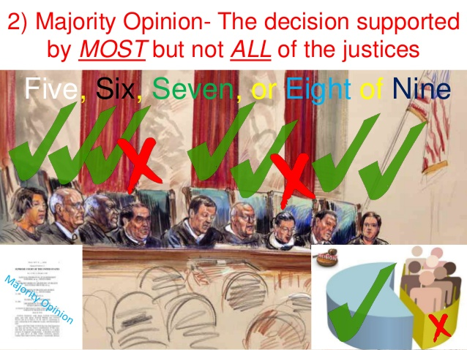
One agreed to by at least 5 justices

Slide 63
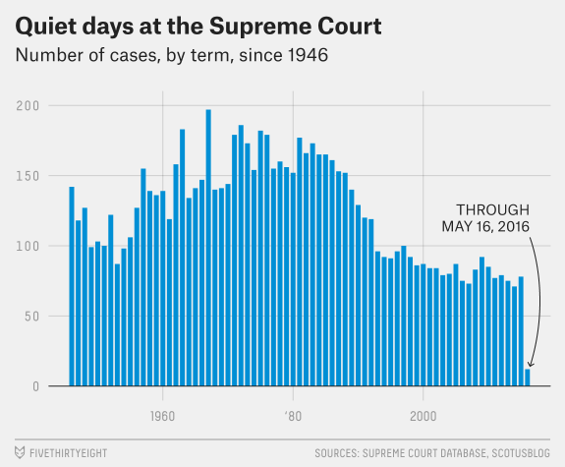
34. What type of cases make up the major part of the SC case load?

Slide 64
Appeals

Slide 65
35. Who holds the power to impeach a federal judge?

Slide 66
Congress, Article III federal judges are appointed to life terms
while serving "during good Behaviour," as stated
in Section 1 of Article III of the United States Constitution.
15 Federal Judges have been impeached. 8C, 4A, 3 Resigned
Mental instability and intoxication on the bench (1803)
Abuse of contempt power and other misuses of office
Improper business relationship with litigants
Convicted: By the Senate and removed from office on January 13, 1913.
Income tax evasion and remaining on the bench following a criminal conviction
Perjury and conspiring to solicit a bribe
Accepting bribes and making false statements under penalty of perjury (2010)

