Slide 1
American Government Honors EOC Review

Slide 2
Every kind of government has and exercises three basic kinds of power.
1. Legislative power - the power to make law and to frame public policies CONGRESS
2. Executive power - the power to execute, enforce, and administer law PRESIDENT AND CABINET
3. Judicial power - the power to interpret laws, to determine their meaning and to settle disputes that arise within the society. SUPREME COURT AND LOWER
These powers of government are often outlined in a country's Constitution, which is the body of fundamental laws setting out the principles, structures, and processes of a government.

Slide 3
State-political unit with the power to make and enforce laws over a group of people living in a clearly defined territory. Over the course of human history, the state has emerged as the dominant political unit in the world. To be considered a state, there are four requirements.
A state must have the following:
Population
Territory
Sovereignty
Government

Slide 4
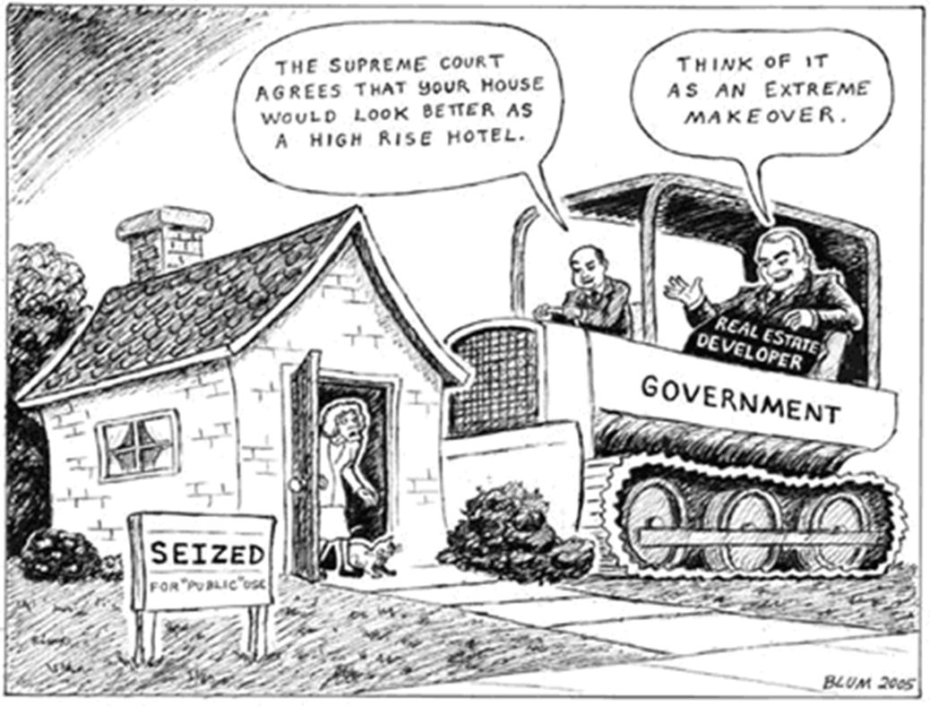

Slide 5
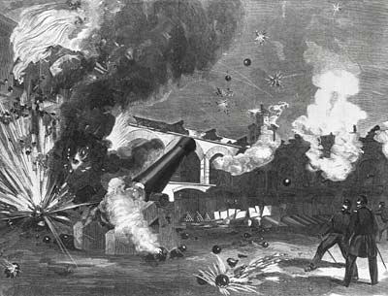
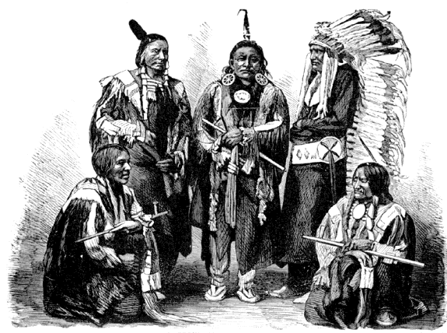
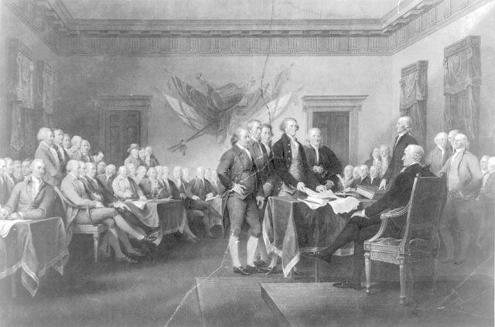
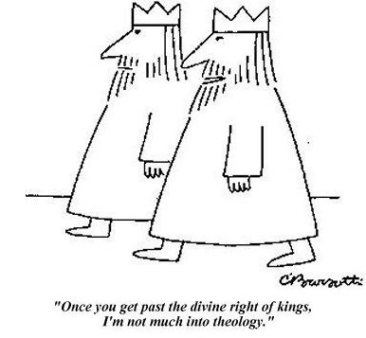
Major Theories of Rule
The Force Theory
The Evolutionary Theory
Social Contract Theory
The Divine Right Theory

Slide 6
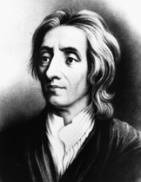
John Locke (1632–1704) Courtesy Library of Congress "The great and chief end, therefore, of men uniting into commonwealths, and putting themselves under government, is the preservation of their property." —Treatises of Government, 1690 The ideas of English Enlightenment philosopher John Locke influenced the Declaration of Independence.
Philosophy and Writings In the 1690s, Locke began publishing works on religion, education, empiricism (the theory of knowledge), and political theory. In Two Treatises of Government, 1690, he expressed an optimistic version of the social contract. Locke believed that people have natural rights—including life, liberty, and property— and that governments exist to protect those rights. If a government does not act in the best interests of its people, the people have the right to overthrow it and to create a new government. Locke also favored a balance among legislative, executive, and judicial branches of government. These ideas and his faith in reason made Locke a major figure of the English Enlightenment.
John Locke
(1632–1704)
Courtesy Library of Congress

Slide 7
The Social Contract Theory argues that the state arose out of a voluntary act of free people. It holds that the state exists ONLY to serve the will of the people, that they are sole source of political power, and that they are free to give or to withhold that power as they choose.
The Declaration of Independence justified its revolution through the social contract theory arguing that King George III and his ministers had violated the contract.

Slide 8
The Preamble to the Constitution
We the People of the United States, in Order to form a more perfect Union, establish Justice, ensure domestic Tranquility, provide for the common defense, promote the general Welfare, and secure the Blessings of Liberty to ourselves and our Posterity, do ordain and establish this Constitution for the United States of America.

Slide 9
Federal Government
One in which the powers of government are divided between a central government and several local governments. Also known as division of powers.
Federal government
State government

Slide 10
Principals of American Democracy
Worth of the individual-freedom, responsibility, reliance, achievement.
Rule of law-Everyone is subject to the rules/laws
Majority Rule/Minority Rights-decisions are made by the majority BUT minority rights must be protected.

Slide 11
The basic notions of ordered government, limited government and, representative government can be traced to several landmark documents in English history.
The Magna Carta
The Petition of Right
The English Bill of Rights

Slide 12
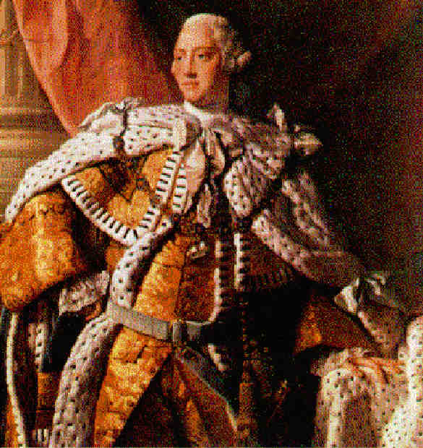
In 1760, when George III came to the throne, Britain began to deal more firmly with the colonies. Restrictive trading acts were expanded and enforced. New taxes were imposed, mostly to support British troops in North America.
TO pay for the war!

Slide 13
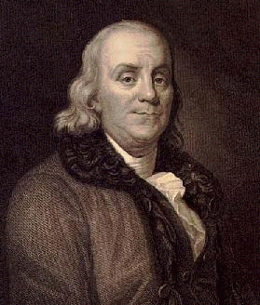
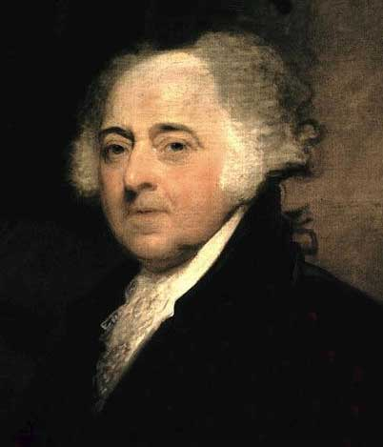
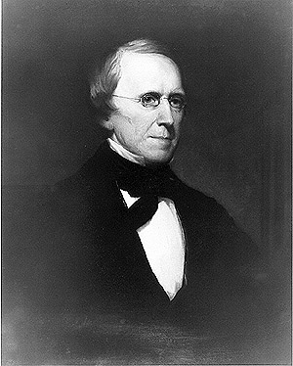
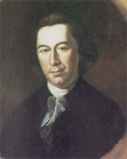
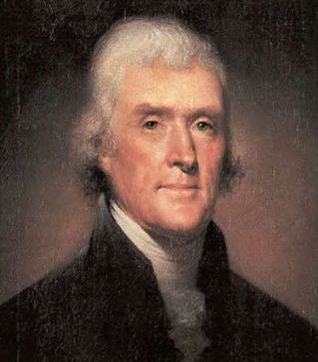
Congress named a committee of five - Benjamin Franklin, John Adams, Roger Sherman, Robert Livingston, and Thomas Jefferson - to prepare a proclamation of independence.
Benjamin Franklin
John Adams
Roger Sherman
Robert Livingston
Thomas Jefferson

Slide 14
"We hold these truths to be self-evident, that all men are created equal, that they are endowed by their Creator with certain unalienable Rights, that among these are Life, Liberty, and the pursuit of Happiness. That to secure these rights, Governments are instituted among Men, deriving their just powers from the consent of the governed. That whenever any Form of Government becomes destructive of these ends, it is the Right of the People to alter or to abolish it, and to institute new Government, having its foundation on such principles and organizing its powers in such form, as to them shall seem most likely to effect their Safety and Happiness."

Slide 15
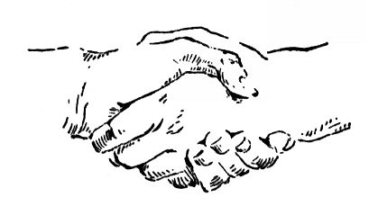
The Articles of Confederation established a "firm league of friendship" among the States. Each State kept:
"its sovereignty, freedom, and independence, and every Power, Jurisdiction, and right....not expressly delegated to the United States, in Congress assembled"
Basically, the States came together "for their common defense, the security of their Liberties, and their mutual and general welfare."

Slide 16
Weaknesses of the Articles of Confederation
Several important powers of Congress were missing in the Articles of Confederations kept Congress from governing effectively.
Congress did not have the power to tax (it could only raise money by borrowing it and by ASKING the States for funds)
Congress also did not have the power to regulate trade between the States.
Congress also had no power to MAKE the States obey the Articles
Finally the Articles could only be changed with the consent of all 13 of the State legislatures - this proved to be an impossible task; not one amendment was ever added to the Articles of Confederation

Slide 17
A Need For A Stronger Government
Problems cuz Articles of Confederation week, soon surfaced. With a weak central government unable to act, the States began to bicker among each other, and often refused to support the new central government. War debts, poor economy, no money, states negotiating w foreign gov’t.
Treaty of Paris 1783 ended war.

Slide 18
12 of the 13 States, all but Rhode Island, sent delegates to Philadelphia, for what is now referred to as the Constitutional Convention
55 Delegates from the States attended the convention. The group of delegates who attended the Philadelphia Convention are known as the Framers of the Constitution.
The average age of the delegates was only, 42, and nearly half were only in their 30's. Indeed, most of the real leaders were in that age group - James Madison was 36, Gouverneur Morris 35, Edmund Randolph 34, and Alexander Hamilton 32. Benjamin Franklin was the oldest at 81.

Slide 19
. Most of what is known of the work of the convention comes from James Madison's voluminous Notes. Madison contributed more to the Constitution than did any of the others, and was given the title
"Father of the Constitution."

Slide 20
The conflicts of power and representation were finally settled by a compromise suggested by the Connecticut delegation. Under the Connecticut Compromise, it was agreed that:
Congress would be composed of two houses (bicameral).
House
Representation would be based upon population
Senate
Representation would be equal
By combining basic features of the rival Virginia and New Jersey Plans, the conventions most serious dispute was resolved.
The Connecticut Compromise was so pivotal to the writing of the Constitution that it has often been called …. The Great Compromise

Slide 21
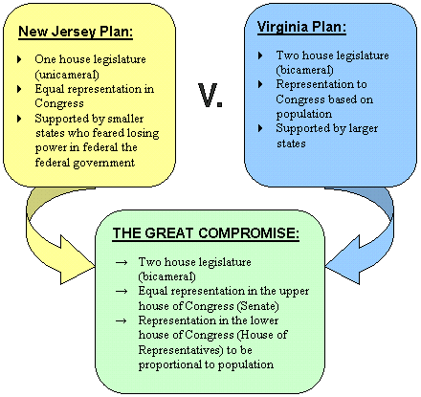

Slide 22
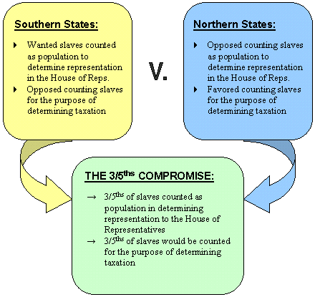
Other Compromises:
3/5th Compromise

Slide 23
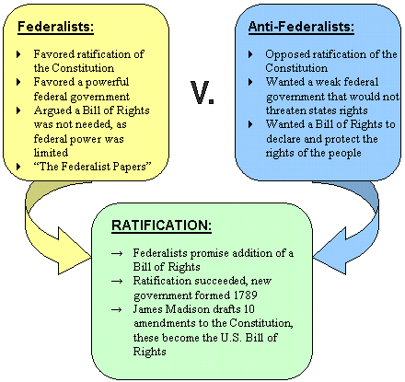
The Constitution was printed, circulated, and debated vigorously. Two groups emerged in each of the States: The Federalists, who favored ratification, and the Anti-Federalists who opposed it.

Slide 24
Antifederalist-opposed the Constitution
Feared a too powerful national gov’t
To much power taken away from states and people
Strong executive = king
No bill of rights to protect individuals liberties.
Wanted the basic rights of people spelled out in the Constitution!!!

Slide 25
Federalists-wanted a powerful national gov’t
To defend the nation
Regulate trade
Control domestic disturbances
Also, limits placed on gov’t power
Federalist Papers-Alex Hamilton, John Jay and James Madison wrote defending the new Constitution. “Publius” discuss how the new structure limits authority and preserves liberty.
Anti-Fed wrote Brutus and Federal Farmer

Slide 26
Bill of Rights-James Madison suggested a number of rights to be protected by amendments to the Constitution.
12 proposed- 10 were ratified by the states.
B of R = First 10 Amendments

Slide 27
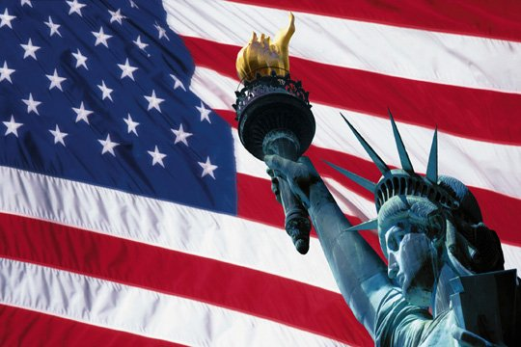
The Constitution is this nation's fundamental law. It is, by its own terms, "the supreme Law of the Land" --the highest form of law in the United States.

Slide 28
6 Goals of the Constitution-Preamble
Form a more perfect union-have a better system of gov’t
Establish justice-fair laws to govern
Ensure domestic tranquility-peace within the country
Provide for common defense-defend against enemy nations
Promote the general welfare-laws for the good of all citizens
Secure blessings of liberty for themselves and the generations to follow-system to protect freedoms.

Slide 29
Constitution 3 Parts
Preamble
Articles
Amendments (27)

Slide 30
The Constitution is built around six basic principles:
Popular Sovereignty
Limited Government
Separation of powers
Checks and Balances
Judicial Review
Federalism

Slide 31
Many of the words are the same, and much of their meaning remains the same. But some of its words have been changed, some have been eliminated, and some have been added. And very importantly, the meanings of many of its provisions have been modified as well.
The Framers knew that even the wisest of constitution makers cannot build for all time. Thus the constitution provides for its own amendment - that is for changes in its written word.
These changes or amendments can be either formal or informal.

Slide 32
Please look at the diagram on page 80 to see which of the steps then depends on another step.
All but 1 of the 27 amendments were proposed in Congress and then ratified by the State legislatures.

Slide 33
Amendment I
Congress shall make no law respecting an establishment of religion, or prohibiting the free exercise thereof; or abridging the freedom of speech, or of the press; or the right of the people peaceably to assemble, and to petition the government for a redress of grievances.

Slide 34
Amendment II
A well regulated militia, being necessary to the security of a free state, the right of the people to keep and bear arms, shall not be infringed.

Slide 35
Amendment III
No soldier shall, in time of peace be quartered in any house, without the consent of the owner, nor in time of war, but in a manner to be prescribed by law.

Slide 36
Amendment IV
The right of the people to be secure in their persons, houses, papers, and effects, against unreasonable searches and seizures, shall not be violated, and no warrants shall issue, but upon probable cause, supported by oath or affirmation, and particularly describing the place to be searched, and the persons or things to be seized.

Slide 37
Amendment V
No person shall be held to answer for a capital, or otherwise infamous crime, unless on a presentment or indictment of a grand jury, except in cases arising in the land or naval forces, or in the militia, when in actual service in time of war or public danger; nor shall any person be subject for the same offense to be twice put in jeopardy of life or limb; nor shall be compelled in any criminal case to be a witness against himself, nor be deprived of life, liberty, or property, without due process of law; nor shall private property be taken for public use, without just compensation.

Slide 38
Amendment VI
In all criminal prosecutions, the accused shall enjoy the right to a speedy and public trial, by an impartial jury of the state and district wherein the crime shall have been committed, which district shall have been previously ascertained by law, and to be informed of the nature and cause of the accusation; to be confronted with the witnesses against him; to have compulsory process for obtaining witnesses in his favor, and to have the assistance of counsel for his defense.

Slide 39
Amendment VII
In suits at common law, where the value in controversy shall exceed twenty dollars, the right of trial by jury shall be preserved, and no fact tried by a jury, shall be otherwise reexamined in any court of the United States, than according to the rules of the common law.

Slide 40
Amendment VIII
Excessive bail shall not be required, nor excessive fines imposed, nor cruel and unusual punishments inflicted.

Slide 41
Amendment IX
The enumeration in the Constitution, of certain rights, shall not be construed to deny or disparage others retained by the people

Slide 42
Amendment X
The powers not delegated to the United States by the Constitution, nor prohibited by it to the states, are reserved to the people.

Slide 43
Other Amendments have come during periods of crisis. Civil War Congress-13-15th Amendment.
13th-banned slavery
14th- African Americans are citizens
15th-gave African Am men right to vote.
17th-extended democracy by having direct election of Senators.
19th-women right to vote

Slide 44
Governmental power in the United States is divided between National and State governments.
This division is called Federalism

Slide 45
Federalism's major strength is that it allows local action in matters of local concern, and national action in matters of wider concern.
Local traditions, needs, and desires vary from one State to another, and federalism allows for this very significant fact.

Slide 46
The National Government is a government of delegated powers.
That is, it has only those powers delegated (granted) to it in the Constitution.
There are three types of delegated powers:
Expressed-listed in Article I for Congress
implied and
inherent

Slide 47
Exclusive Powers
These powers can be delegated by the National government alone. They cannot be exercised by the States under any circumstances.
Examples:
power to coin money
make treaties with foreign states
and to lay taxes on imports

Slide 48
Concurrent Powers
Those powers that both the National Government and the State possess and exercise.
For example:
the power to levy and collect taxes
to define crimes and set punishments for them
to condemn (take) property for public use.
Those powers that the Constitution does not grant exclusively to the National Government, and that, at the same time, does not deny to the States. BUT if laws conflict….

Slide 49
Full Faith and Credit
The Constitution commands that
"Full Faith and Credit shall be given in each State to the public Acts, Records, and judicial Proceedings of every other States."
-Article IV,

Slide 50
Privileges and Immunities
The Constitution also provides that
"The Citizens of each State shall be entitled to all Privileges and Immunities of Citizens in the several States."
-Article IV, Section 2, Clause 1
This clause means that no State can draw unreasonable distinction between its own residents and those persons who happen to live in other States.

Slide 51
House of Representatives:
At least 25 years old
A US citizen for at least 7 years
A resident of the state he/she represents
2 year terms
Each term of Congress lasts for two years, so every two years the entire House must run for reelection.
Short terms means that, for House members, the next election is always just around the corner. That fact tends to make them pay close attention to “the folks back home.”

Slide 52
Senate:
2 per state At least 30 years old
US citizen for at least 9 years
100 members
17th Amendment changed their appointment to popular election.
6 year terms
Terms staggered so that every two years 1/3 of Senate is up for re-election. This prevents major changes in the Senate in any single election.

Slide 53
Congress:
Declares war
Create an army and navy and fund it
Power of the purse over the military
War Powers Resolution- president must report to Congress when ever he sends troops into possible conflict without a declaration of war.

Slide 54
Expressed powers:
Coining money- ie the printing and striking of coins
Postal service
Copyrights and patents
Weights and measures- a pound in FL is the same as one in CA
Bankruptcy-
Naturalization-becoming a citizen
Federal courts
Congressional elections

Slide 55
Implied Powers of Congress: Given to Congress in the necessary and proper clause. Allows them to take actions needed to carry out the expressed powers.
Loose constructionists- federalists- wants Congress to have freedom to act vigorously. To take any action that is N/P to exercise expressed power. A. Hamilton
Strict constructionist- Only what the Constitution says-Jefferson

Slide 56
Presidential Action on a Bill:
Signs it – it becomes a law
Not sign- after 10 days (if Congress still in session) it becomes law. If Congress adjourns w/in 10 days bill fails (pocket veto)
Veto
To override a veto it takes 2/3 votes in both chambers. Rare !
106/2500
SC ruled line item veto was unconstitutional.

Slide 57
Requirements stated in the Constitution
1. The President must be a "natural born citizen....of the United States."
2. The President must be at least 35 years of age.
3. The President must "have been 14 years a Resident within the United States."

Slide 58
To prevent future Presidents from following this precedent, the 22nd Amendment made the unwritten custom limiting presidential terms a part of the written constitution. The 22nd Amendment was adopted in 1951.

Slide 59
The electoral college, then is a group of people, the electors, chosen form each State and the District of Columbia to formally select the President and Vice President.
435 + 100 ⁺ 3 = 538

Slide 60
25 Amendment
Congress fixes the order of succession following the Vice President. The present law on the matter is the Presidential Succession Act of 1947. After #3 they are in order of when Congress created the department.
1. Vice President
2. Speaker of the House
3. President pro tempore of the Senate
4. Secretary of State
5. Secretary of the Treasury
6. Secretary of the Defense
7. Attorney General

Slide 61
Paying for the Government-
Collecting revenue and borrowing money. Revenue comes from taxes, fees and nontax sources.
Income Taxes-16th Amendment gives Congress right to charge a income tax. Personal or corporate on income. Today the income tax collects the largest share of the governments revenue.

Slide 62
Income tax is a progressive tax- a tax whose rates increase as the amount that is subject to taxation increases. Rates are from 0 to ____ .
Proportional Tax- tax that is applied at the same rate against all income. (some say it is also regressive)

Slide 63
Government Spending- mandatory and discretionary.
Mandatory- spending required by law and not subject to the annual budget process. A large % goes to entitlement programs that people are entitled to by law, ie.

Slide 65
Courts:
Settle disputes
Determine if a law has been broken
Decide what penalty to apply
Determine how to provide relief to harmed
Determine meaning of law or Constitution

Slide 66
The Supreme Court- highest court in land, hears mostly appeals, hears cases in which a state is a party. 9 justices. Life appointment
Judicial Review-Marbury v. Madison-SC has the power to rule on the constitutionality of laws and executive action.

Slide 67
Highlights of the Supreme Court- has grown in power over the years.
McCulloch v. Maryland (1819)- court made the necessary and proper clause a powerful tool to expand the implied powers of Congress. States cannot tax federal government (national bank)
Gibbons v. Ogden- fed gov’t power to regulate interstate commerce.

Slide 68
Gideon v. Wainwright-(1963) the right to an attorney.
Miranda v. Arizona- the right to have your rights read to you when taken into custody by the police.
Tinker v. Ohio- schools cannot prevent students from protesting the Vietnam War.
Bush v. Gore- determined that Bust was winner of 2000 presidential election

Slide 69
Many interest groups have PACs (Political Action Committee) that support candidates for political office. The PAC raises and contributes money to campaigns and candidates
PP=organization that tries to elect its members to public office so that its views can become public policy. Each party has an ideology (set of ideas, theories, and aims) that the supporters share. These are united into their social/political program. This is what separates the different parties and places them on the spectrum.

Slide 70
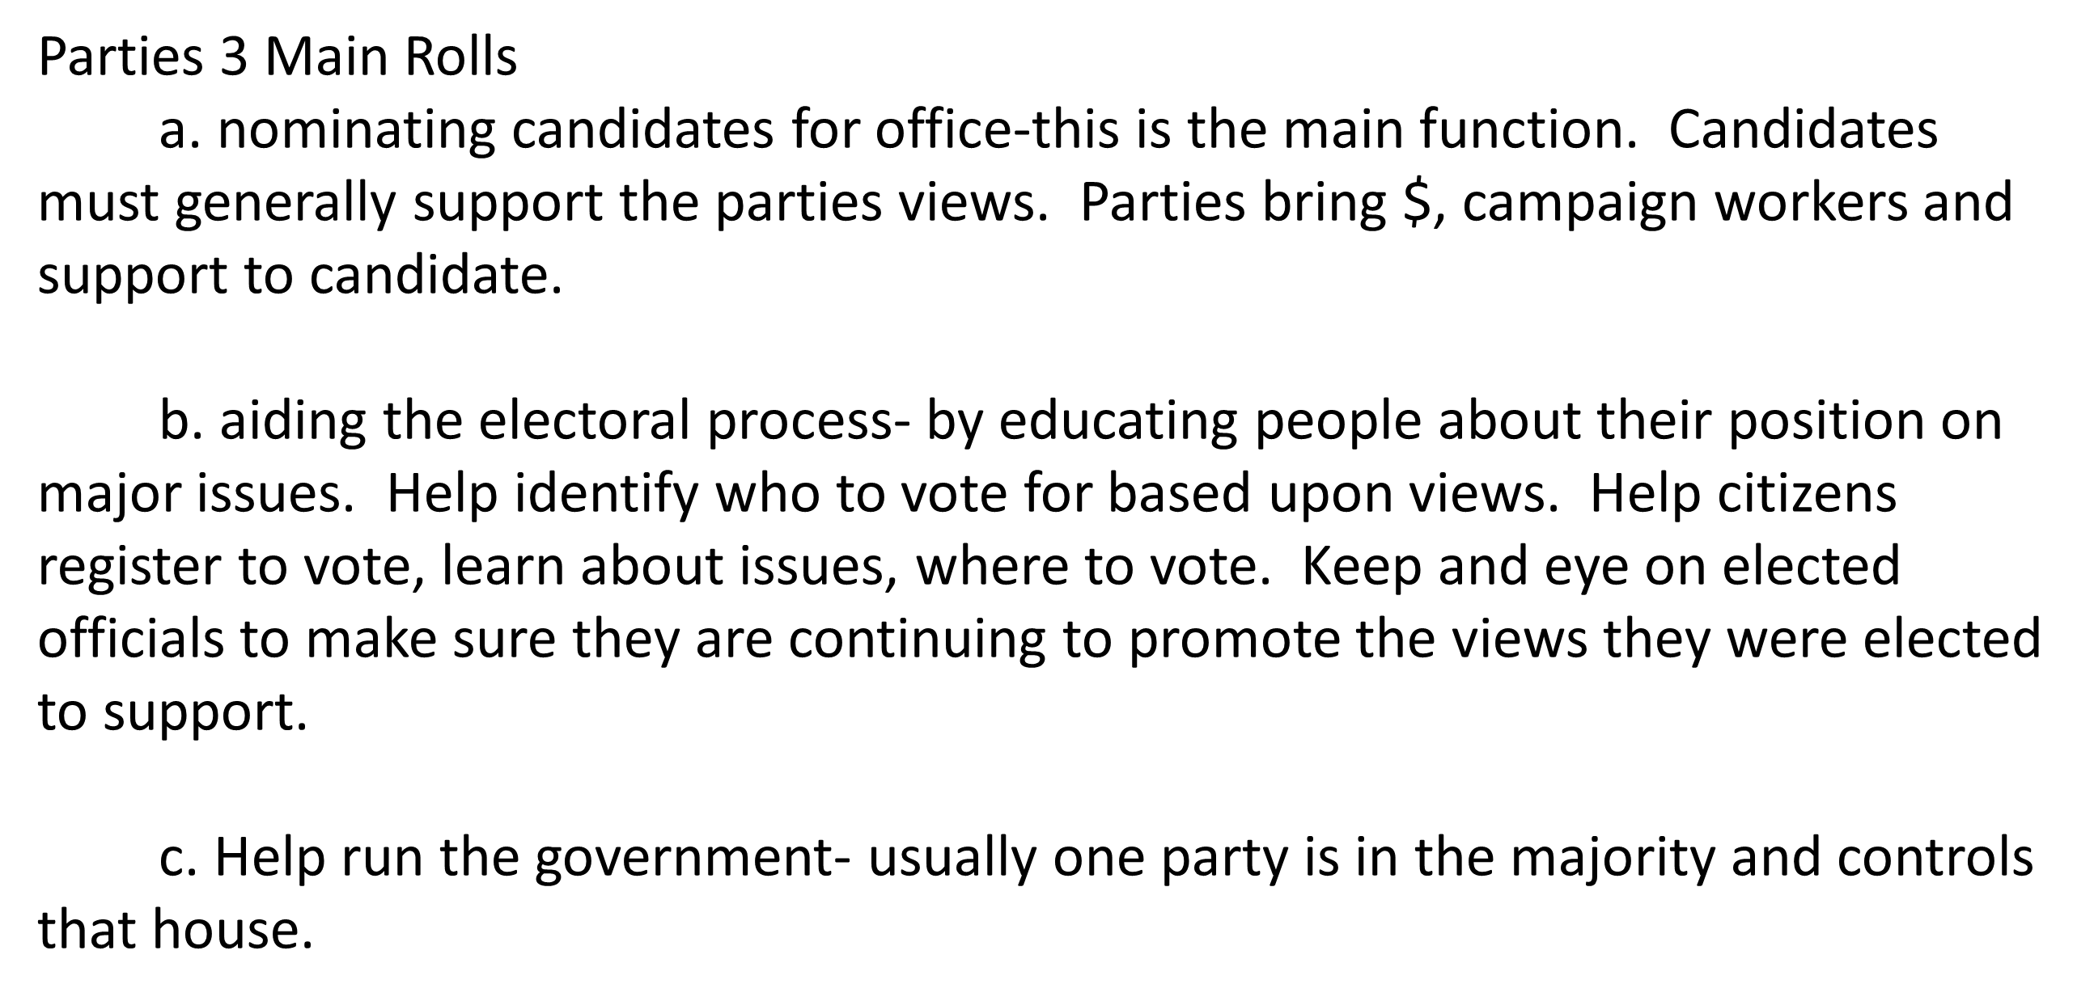

Slide 71
Primary Elections- held when more than one candidate from the same party is running for the same position.
Florida is a closed primary state.
Voting Behavior
Voting is a right, some believe a DUTY.
<2/3 eligible voters voted in presidential election, state and local is even lower.
To vote:
US citizen
18 years of age
Resident of the state in which you wish to vote

Slide 72
Civil liberties- basic freedoms to think and act that all (unless you lose them-jail) people have and are protected against government abuse.
Civil rights- rights of fair and equal status and treatment and the right to participate in government. These were not immediately granted to all Americans. (black and women)

Slide 73
Due Process clause of the 14th Amendment.
States may not pass any laws that “deprive any person life, liberty or property without due process of law”. Ie)following established and complete legal procedures.
SC has merged most of the Bill of Rights protections into the 14th A. the incorporation doctrine. Certain protections are essential to due process and cannot be denied.

Slide 74
Lemon v. Kurtzman (1971) created Lemon test- a law must meet certain standard in order to be constitutional.
Symbolic speech- communication of ideas through symbols and actions. OK as long as it does not pose a major threat to property or public order.
Tinker v. DesMoines School (arm bands)

Slide 75
Court ruled that gov could limit 1st A. press and speech if it creates a “Clear and Present Danger” Schenck v. US- man encouraging men to refuse to fight in WWI.
New Jersey v. T.L.O.- SC held that students have fewer 4th A protections while at school.

