Slide 1
Chapter 4 (?)
Market systems

Slide 2

PERFECT competition
Perfect competition is a market structure in which a large number of firms all produce the same product.
In order for perfect competition to occur, four conditions must be met...

Slide 3
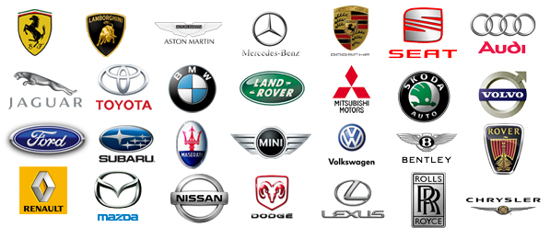

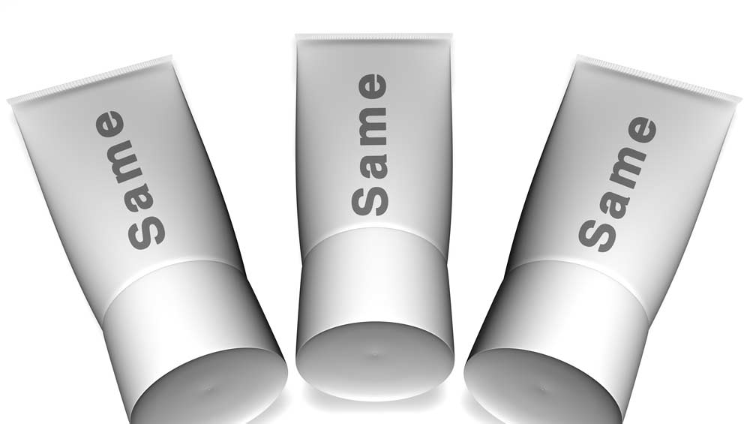
It’s Conditional
1. Many Buyers and Sellers
There are many participants on both the buying and selling sides.
2. Identical Products
There are no differences between the products sold by different suppliers.
3. Informed Buyers and Sellers
The market provides the buyer with full information about the product and its price.
4. Free Market Entry and Exit
Firms can enter the market when they can make money and leave it when they can’t. They are not forced to stay or leave.

Slide 4



Barriers to entry
There are certain factors that make it difficult for new firms to enter the market. These factors are called Barriers to entry. There are two major barriers to entry:
Start-up Costs
The expenses that a new business must pay before the first product reaches the customer are called start-up costs.
Technology
Some markets require a high degree of technological know-how. As a result, new entrepreneurs cannot easily enter these markets.

Slide 5



Price and Output
One of the primary characteristics of perfectly competitive markets is that they are efficient. In a perfectly competitive market, price and output reach their equilibrium levels.
Market Equilibrium in Perfect Competition
Supply
Price
Equilibrium Price
Equilibrium Quantity
Demand
Quantity

Slide 6
Section 1 Questions
1. Which of the following is NOT a condition for perfect competition?
  (a) many buyers and sellers participate
  (b) identical products are offered
  (c) market barriers are in place
  (d) buyers and sellers are well-informed about goods and services
2. How does a perfect market influence output?
  (a) Each firm adjusts its output so that it just covers all of its costs.
  (b) Each firm makes its output as large as possible even though some goods are not sold.
  (c) Different firms make different amounts of goods, but some make a profit and others do not.
  (d) Different firms each strive to make more goods to capture more of the market.

Slide 7
Section 2
MONOPOLIES

Slide 9
What is a monopoly ?
A monopoly is a market dominated by a single seller.
Monopolies form when barriers prevent firms from entering a market that has a single supplier.
Monopolies can take advantage of their monopoly power and charge high prices.

Slide 10
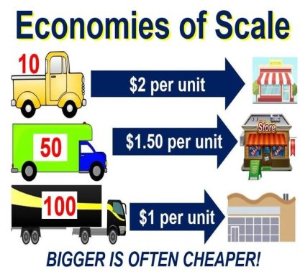
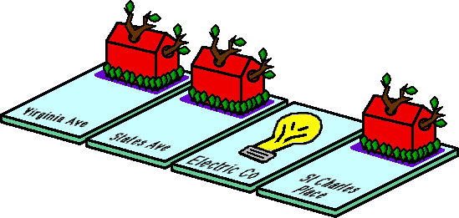
There are different types?
Different market conditions can create different types of monopolies.
1. Economies of Scale
If a firm's start-up costs are high, and its average costs fall for each additional unit it produces, then it enjoys what economists call economies of scale. An industry that enjoys economies of scale can easily become a natural monopoly.
2. Natural Monopolies
A natural monopoly is a market that runs most efficiently when one large firm provides all of the output.
3. Technology and Change
Sometimes the development of a new technology can destroy a natural monopoly.

Slide 11
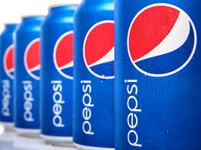


Government Monopolies
A government monopoly is a monopoly created by the government... Shocker.
Technological Monopolies
  The government grants patents, licenses that give the inventor of a new product the exclusive right to sell it for a certain period of time.
Franchises and Licenses
  A franchise is a contract that gives a single firm the right to sell its goods within an exclusive market. A license is a government-issued right to operate a business.
Industrial Organizations
  In rare cases, such as sports leagues, the government allows companies in an industry to restrict the number of firms in the market.

Slide 12

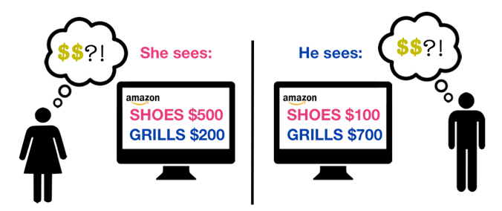
Price Discrimination
Price discrimination is the division of customers into groups based on how much they will pay for a good.
Although price discrimination is a feature of monopoly, it can be practiced by any company with market power. Market power is the ability to control prices and total market output.
Targeted discounts, like student discounts and manufacturers’ rebate offers, are one form of price discrimination.
Price discrimination requires some market power, distinct customer groups, and difficult resale.

Slide 13
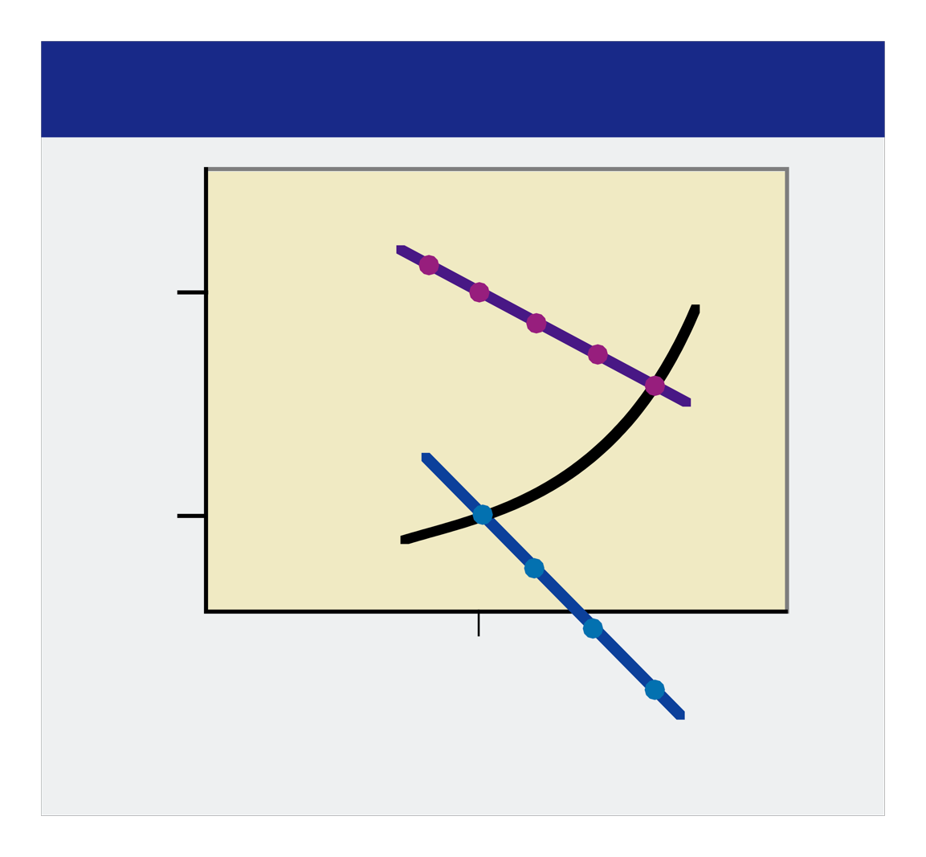
Output Decisions
A monopolist sets output at a point where marginal revenue is equal to marginal cost.
Even a monopolist faces a limited choice – it can choose to set either output or price, but not both.
Monopolists will try to maximize profits; therefore, compared with a perfectly competitive market, the monopolist produces fewer goods at a higher price.
Setting a Price in a Monopoly
Market Price $11
Marginal Cost
B
C
Price
Demand
$3
A
9,000
Output
(in doses)
Marginal Revenue

Slide 14
Section 2 Questions
1. A monopoly is
  (a) a market dominated by a single seller.
  (b) a license that gives the inventor of a new product the exclusive right to sell it for a certain amount of time.
  (c) an industry that runs best when one firm produces all the output.
  (d) an industry where the government provides all the output.
2. Price discrimination is
  (a) a factor that causes a producer’s average cost per unit to fall as output rises.
  (b) the right to sell a good or service within an exclusive market.
  (c) division of customers into groups based on how much they will pay for a good.
  (d) the ability of a company to change prices and output like a monopolist.

Slide 15
Section 3
Monopolistic competition

Slide 16

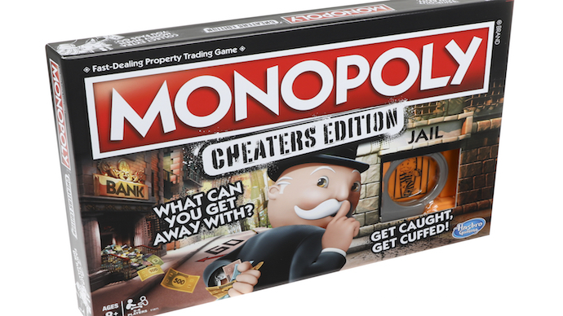
It’s a thing
In monopolistic competition, many companies compete in an open market to sell products which are similar, but not identical.
1. Many Firms
As a rule, monopolistically competitive markets are not marked by economies of scale or high start-up costs, allowing more firms.
2. Few Artificial Barriers to Entry
Firms in a monopolistically competitive market do not face high barriers to entry.
3. Slight Control over Price
Firms in a monopolistically competitive market have some freedom to raise prices because each firm's goods are a little different from everyone else's.
4. Differentiated Products
Firms have some control over their selling price because they can differentiate, or distinguish, their goods from other products in the market.
VS.

Slide 17



Non-price Competition
Non-price competition is a way to attract customers through style, service, or location, but not a lower price.
1. Characteristics of Goods
The simplest way for a firm to distinguish its products is to offer a new size, color, shape, texture, or taste.
2. Location of Sale
A convenience store in the middle of the desert differentiates its product simply by selling it hundreds of miles away from the nearest competitor.
3. Service Level
Some sellers can charge higher prices because they offer customers a higher level of service.
4. Advertising Image
Firms also use advertising to create apparent differences between their own offerings and other products in the marketplace.

Slide 18
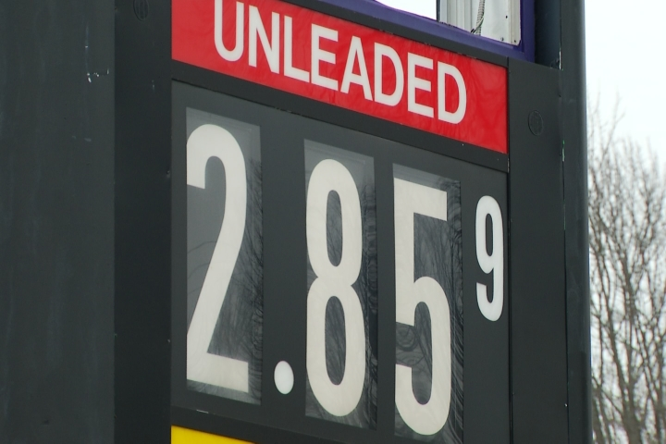

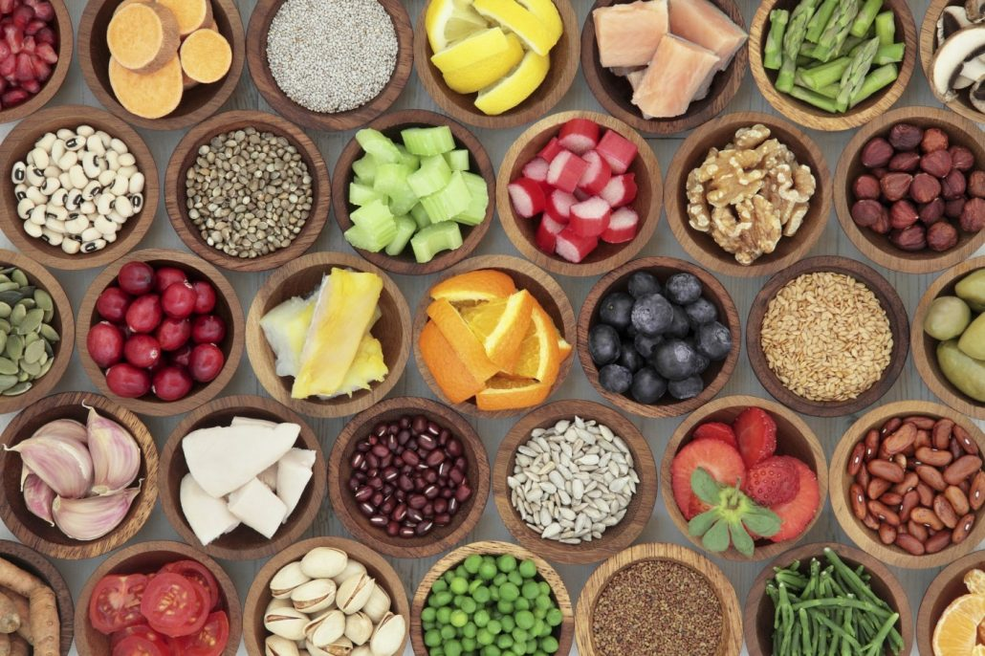
Prices, Profit, Output
Prices
  Prices will be higher than they would be in perfect competition, because firms have a small amount of power to raise prices.
Profits
  While monopolistically competitive firms can earn profits in the short run, they have to work hard to keep their product distinct enough to stay ahead of their rivals.
Costs and Variety
  Monopolistically competitive firms cannot produce at the lowest average price due to the number of firms in the market. They do, however, offer a wide array of goods and services to consumers.

Slide 19

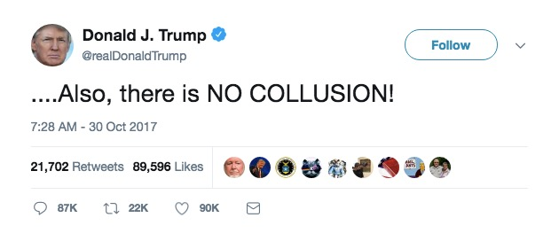
Oligopoly describes a market dominated by a few large, profitable firms.
Collusion
Collusion is an agreement among members of an oligopoly to set prices and production levels. Price- fixing is an agreement among firms to sell at the same or similar prices.
Cartels
A cartel is an association by producers established to coordinate prices and production.

Slide 20
Comparison of Market Structures
Markets can be grouped into four basic structures: perfect competition, monopolistic competition, oligopoly, and monopoly
Comparison of Market Structures
Perfect Competition
Monopolistic Competition
Oligopoly
Monopoly
Number of firms
Many
Many
Two to four dominate
One
Variety of goods
None
Some
Some
None
Control over prices
None
Little
Some
Complete
Barriers to entry and exit
None
Low
High
Complete
Examples
Wheat,
shares of stock
Jeans,
books
Cars,
movie studios
Public water

Slide 21
Section 3 Assessment
1. The differences between perfect competition and monopolistic competition arise because
  (a) in perfect competition the prices are set by the government.
  (b) in perfect competition the buyer is free to buy from any seller he or she chooses.
  (c) in monopolistic competition there are fewer sellers and more buyers.
  (d) in monopolistic competition competitive firms sell goods that are similar enough to be substituted for one another.
2. An oligopoly is
  (a) an agreement among firms to charge one price for the same good.
  (b) a formal organization of producers that agree to coordinate price and output.
  (c) a way to attract customers without lowering price.
  (d) a market structure in which a few large firms dominate a market.

Slide 22
Section 4
Regulation and deregulation

Slide 23


THEY HAVE THE POWER
Market power is the ability of a company to control prices and output.
Markets dominated by a few large firms tend to have higher prices and lower output than markets with many sellers.
To control prices and output like a monopoly, firms sometimes use predatory pricing. Predatory pricing sets the market price below cost levels for the short term to drive out competitors.
Y
PRICING

Slide 24


Government Competition
Government policies keep firms from controlling the prices and supply of important goods. Antitrust laws are laws that encourage competition in the marketplace.
1. Regulating Business Practices
The government has the power to regulate business practices if these practices give too much power to a company that already has few competitors.
2. Breaking Up Monopolies
The government has used anti-trust legislation to break up existing monopolies, such as the Standard Oil Trust and AT&T.
3. Blocking Mergers
A merger is a combination of two or more companies into a single firm. The government can block mergers that would decrease competition.
4. Preserving Incentives
In 1997, new guidelines were introduced for proposed mergers, giving companies an opportunity to show that their merging benefits consumers.

Slide 25


Deregulation
Deregulation is the removal of some government controls over a market.
Deregulation is used to promote competition.
Many new competitors enter a market that has been deregulated. This is followed by an economically healthy weeding out of some firms from that market, which can be hard on workers in the short term.

Slide 26
1. Antitrust laws allow the U.S. government to do all of the following EXCEPT
  (a) regulate business practices
  (b) stop firms from forming monopolies
  (c) prevent firms from selling new experimental products
  (d) break up existing monopolies
2. The purpose of both deregulation and antitrust laws is to
  (a) promote competition
  (b) promote government control
  (c) promote inefficient commerce
  (d) prevent monopolies

