Slide 1
Section 1 Congressional Membership (Article I)
Bicameral Legislature-because of Great Compromise
We the people-really means we elect people to represent us in Congress.

Slide 2
Congressional Sessions-
Term begins on Jan 3 of years ending in odd numbers. Last for 2 years with 2 sessions each of a year long.
Neither can break for > 3 days without consent of other.

Slide 3
House of Representatives:
2 year terms
435
Each term of Congress lasts for two years, so every two years the entire House must run for reelection.
Representation based upon states population. All guaranteed 1.
Short terms means that, for House members, the next election is always just around the corner. That fact tends to make them pay close attention to “the folks back home.”

Slide 4
House Qualifications: D 194 R 241
25 years old
Citizen of the US for at least 7 years
Legal resident of the state in which they are elected.
Elections are held in November of even numbered years.
Every 2 years the entire House is up for reelection. 90% are reelected.

Slide 5
House of Representatives
Parties: Republican: 241; Democrat: 194; Independent: 0
Gender: Men: 248; Women: 83
Race: White: 339; Black: 46; Hispanic: 33; Asian: 10; Other: 3

Slide 6
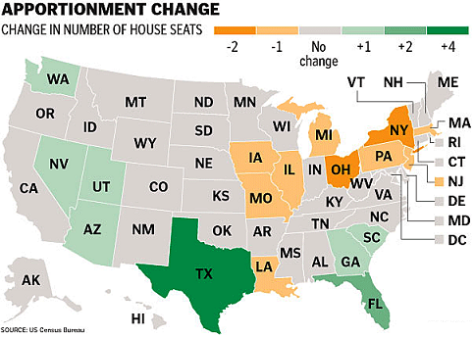
Representation and Reapportionment-House ONLY
Each of the 435 seats is meant to represent about the same number of people.
Census every 10 years. Count population of country to assign reps. Some states will lose some will gain depending on population movements. Every state guaranteed to have at least 1rep.

Slide 7
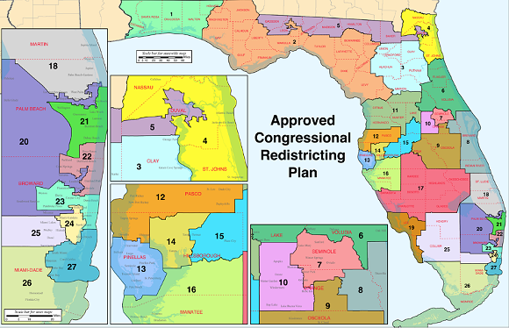
Redistricting- when a state gains or looses representatives (population gain or loss) district lines must be redrawn. ~ 710,000 people per district

Slide 8
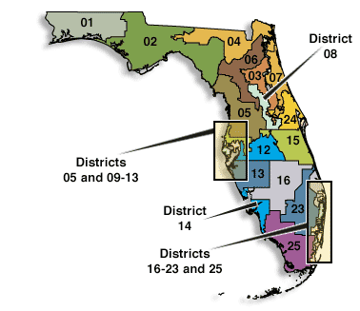
Average rep serves 710,000 people. Redistricting occurs when populations move. Some problems do arise- gerrymandering= trying to create a district that has an advantage. (irregular shape) SC states that new districts must be of roughly equal populations.

Slide 9
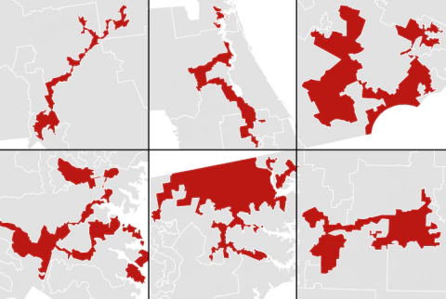
Gerrymandering- redistricting that intentionally gives one party a political advantage.

Slide 10
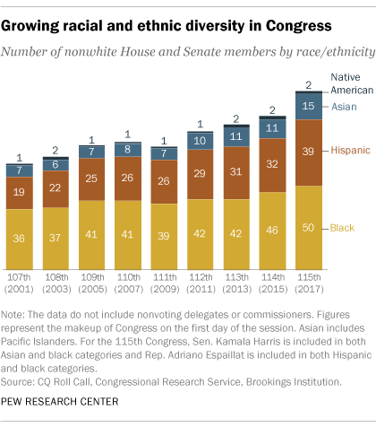

Slide 11
Senate:
2 per state (represent the entire state)
100 members
17th Amendment changed their appointment to popular election.
6 year terms
Terms staggered so that every two years 1/3 of Senate is up for re-election. This prevents major changes in the Senate in any single election.

Slide 12
Senate
Parties: Republican: 52; Democrat: 46; Independent: 2
Gender: Men: 78; Women: 21
Race: White: 90; Black: 3; Hispanic: 4; Asian: 3

Slide 13
The Senate: upper house (higher prestige) represent the entire state. 52 R, 46D, 2I
Formal:
At least 30 years old
US citizen for at least 9 years
A resident of the state they represent
Informal:
Even older and richer than members of House and whiter.
20 women, 2 black, 4 latino, 1 Islander
6 year term, every 2 years 1/3 of Senate is up for reelection.
Longer term to allow members to focus on needs of nation rather than reelection.
Election:
17th Amendment made election by popular vote.

Slide 14
If Senator dies or resigns-congress can authorize his governor to appoint a replacement for the remainder of his term, or he can order a special election.
$$$$ and Benefits-
27th A- Congress can give it self raises but they take effect the next congress.
$174,000 per year since 2009 with COLA.
Lots of Bennies.
Sweet retirement
Privledges-during Congress or on way to or from Congress they are free from arrest “in all cases except treason, felony, and breach of peace”
Cannot be sued for anything they say they say on floor of Congress. BUT can for things said away from Congress.

Slide 15
Majority of Senate or House can censure a members actions. (spankin for naughty behavior)
2/3 vote for expulsion- kicked out of Congress- treason, bribery etc.
100 Senators
435 House members
5 delegates in house to represent-DC, Guam, American Samoa, Northern Marianas and the Virgin Islands and a resident commissioner for Puerto Rico.- they do NOT get to vote on final passage of Bills.

Slide 16
Almost ½ of Congress are Lawyers- (this helps cuz they understand the complex legal issues that impact legislation)
On average 90% of incumbents are reelected. 2016 = 98%
Campaigning-
Oldschool= TV, radio
New= Internet, social media.
This is not always good news. New technology…. Just about everything you say or do is recorded especially if you are in the public eye.
Term Limits…ie) should their be a limit on how many times a S or H member can be elected?
SC- said NO when Arkansas tried.
End of 5.1

Slide 17
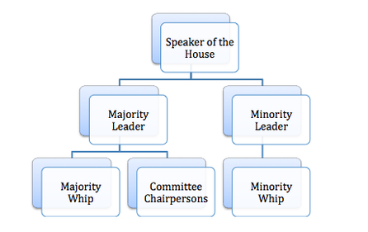

Slide 18
House- rules= constitution in Art. 1 states that each House may determine the Rules of its Proceedings. Thomas Jefferson
Political parties play a huge role- party in the majority selects leaders and controls flow of legislation.
House-
Speaker of the House- Paul Ryan – highest ranking member of the majority party. (elected by members of his party)
He assigns members to committees, recognizes who may speak, schedules bills for action.
In line for Presidency after VP

Slide 19
Speaker of the House- chosen by other members, is a member of the political party that holds the most seats. (majority party) Constitution does not list speakers powers, they are based upon tradition.
Presides over debates and recognizes speakers
Rules on points of order
Assigns bills to committees
Determines when or IF an item comes up for debate.
Assigns house members to certain committees.
Second in line of succession to the presidency. Pres, VP, SofH.

Slide 20
Floor Leader-each party elects one to manage the actions and strategy of their party. Majority leader serves as the assistant to the S of H. Minority leader is the main spokes person for the minority party.
Whips- each also elect whips (think enforcers) they encourage party members to vote along party lines.
These positions are chosen during party caucus at beginning of term.
House Rules- Constitution gives Congress authority to make its own rules. They can get rid of a member for about any reason (as long as get vote) can issue a reprimand or a censure.
Rules Committee- determines when, how and how long debate on a bill will take place.

Slide 21
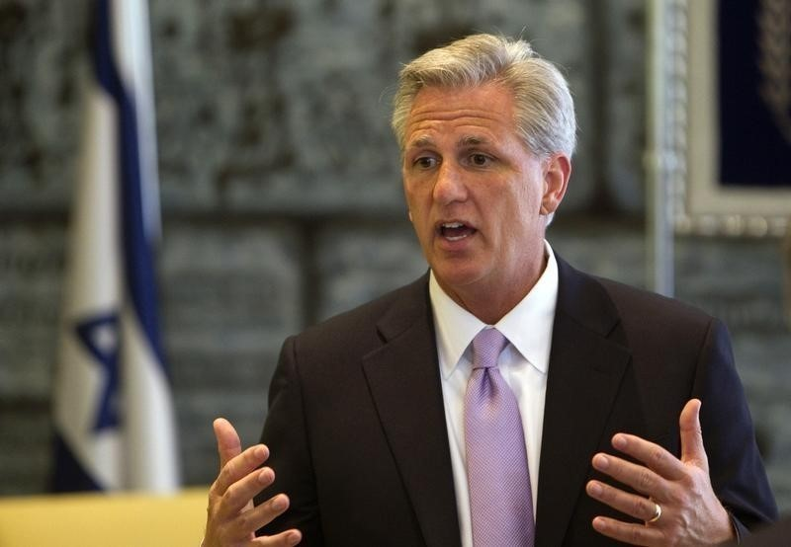
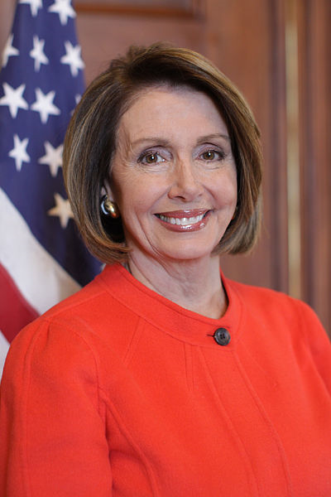
Speaker of the House
Paul Ryan
Republican from Ohio, he is the presiding officer of the House and it's most powerful member. He follows the Vice-President in line of succession to the presidency.
Nancy Pelosi
minority leader Dem. CA
Kevin MCCARTHY
majority leader Republican CA

Slide 23
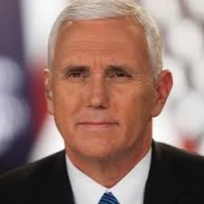
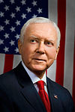
Senate Leadership- Constitution states that VP is the president of the Senate. A largely ceremonial role, he may preside over debate but not take part or vote except to break a tie. If membership is divided equally by party, the presidents party will be considered the majority.
Mike Pence
President pro tempore- person who presides when VP not available. Member from the majority party with the longest service. This person is in line after the S of H in succession.
Orrin Hatch- Utah

Slide 24
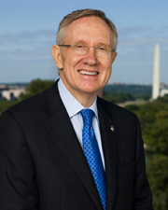
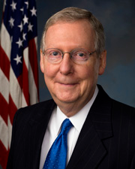
Senate majority leader- chosen at beginning of term by other party members, serves as main strategist for the party. Sets party agenda. There are whips too, just like the House.
Mitch McConnell of Kentucky and.
Senate minority leader
Minority Leader Chuck Schumer of New York

Slide 25
Committees: provides expertise in different areas of public policy.
Standing Committees: 20 permanent-(with at least 4 subcommittees) -they consist on the areas of which the majority of proposed laws come from: agriculture, budget, armed forces.
Ways and Means-taxes and other revenue areas. Huge because all revenue bills or appropriations bills must start in the house!!!
Select Committees- for a specific task, limited in time.
Joint Committees-ie. House and Senate
Each committee has a chair, it is a very powerful position. Chosen by the majority party, seniority is a factor but not a lock for the job.
Members request appointment to certain committees, not all are granted.

Slide 26
Both senators and House members may introduce bills, EXCEPT any involving taxation and appropriations MUST start in House.
Private bill-affects a particular person, family or small group.
Public bill- affects all society.
Rider- a provision that bears little relationship to the bills main provisions. ( a hitch hiker to a strong bill) poison pill-when really bad rider is added to bill with intention to kill it.
Joint resolution-similar to a bill becomes law when passes both houses and signed by president. (use of force in Iraq 2002)
Concurrent resolutions-effect operations of both houses but are not signed by president and do not carry force of law.

Slide 27
Bills in Committee: Most bills DIE in committee. This is where bills are studied.
Referral-how bills are assigned to committee. May also be assigned to a subcommittee. Hearings then take place-open to the public, subpoena power etc. Majority chairs can shape view of bill by limiting minority members witnesses.
Subcommittee reports to committee: in favor, against or neutral.
Markup-full committee, modifies bill, debate etc. Decide to report the bill to full chamber or not.
Discharge petition- vote by house to force bill out of committee.
= rights for women. 1970 20years.

Slide 28
Rules and Traditions: Senate very strict about this.
Very few rules regarding debate so……
Filibuster- when opponents of a measure take the floor of the senate and refuse to stop talking in an effort to prevent the measure from being voted on. Used when minority knows the measure is likely to pass if voted on.
Can be stopped with a 60/100 vote = cloture (an end to the debate)
Discipline- expulsion requires a vote of 2/3. May also censure or denounce a member.
Vacancies- filled by Governor of the state. Serves until a special election can be held to fill vacancy. Usually pick from their party.
end 5.4

Slide 29
Conference Committee: Can only become laws when they are passed in identical form by BOTH houses. For minor bills the two sides work informally to compromise on wording etc. Major bills get a CC- generally from the members of the committee that worked on the bill. S of H picks and presiding officer of Senate. Works sometimes other not. Once agreed upon report issued and both houses can debate BUT not make changes. If both still agree it moves to president for signature.

Slide 30
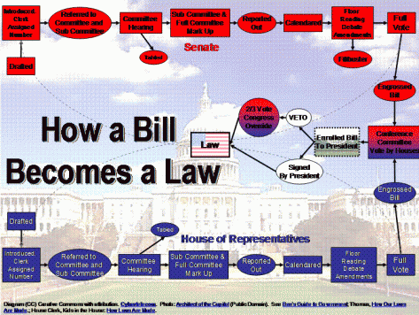

Slide 31
Presidential Action on a Bill:
Signs it – it becomes a law
Not sign- after 10 days (if Congress still in session) it becomes law. If Congress adjourns w/in 10 days bill fails (pocket veto)
Veto
To override a veto it takes 2/3 votes in both chambers. Rare !
106/2500
SC ruled line item veto was unconstitutional.
Signing statements-president declares an intention to enforce a law in a particular way. Some see this as an encroachment on the law making power of congress.

Slide 32
Privileges-free from arrest" in all cases except treason, felony and breach of the peace" when on way to or from attending Congress. Cannot be sued for anything they say in Congress. But can be for statements made outside of Congress.
Members who behave poorly may be censured.
Treason or accepting bribes are the only grounds for expulsion.

