Slide 1
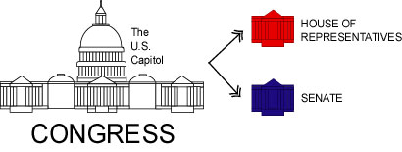
Section 1 Congressional Membership (Article I)
Bicameral Legislature-because of Great Compromise
We the people-really means we elect people to represent us in Congress.

Slide 2
Constituents-the people that live within the area from which a member is elected. Representative has to balance demands from:
Constituents
Interest groups
Country as a whole
Demographic of Congress: compared to the general population
White, Male, wealthier, older
But it is slowly changing to include more women and minorities.

Slide 3
House of Representatives:
2 year terms
Each term of Congress lasts for two years, so every two years the entire House must run for reelection.
Short terms means that, for House members, the next election is always just around the corner. That fact tends to make them pay close attention to “the folks back home.”

Slide 4
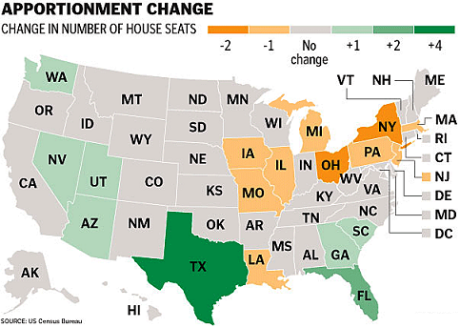
Representation and Reapportionment-House ONLY
Each of the 435 seats is meant to represent about the same number of people.
Census every 10 years. Count population of country to assign reps. Some states will lose some will gain depending on population movements. Every state guaranteed to have at least 1rep.

Slide 5
Senate:
2 per state
100 members
17th Amendment changed their appointment to popular election.
6 year terms
Terms staggered so that every two years 1/3 of Senate is up for re-election. This prevents major changes in the Senate in any single election.

Slide 6
Congress and Checks and Balances- Congress has checks on the executive and judicial branches.
“Power of the Purse”-only Congress can approve spending by the federal government. Appropriations bill- a bill that sets aside funds for a particular purpose. This is a way that Congress can prevent the executive branch from carrying out policies it disagrees with. (not funding them) also withhold funds for military actions it does not support. (not popular)

Slide 7
More checks and balances….
Advice and Consent:
Senate must approve the following actions by the president:
Treaties by 2/3 vote
Ambassadors
Federal judges
Supreme court justices
Impeachment- charging officials with wrongdoing and bringing them to trial. (treason, bribery or high crimes and misdemeanors) If found guilty removed from office.
House-brings the charges, a majority vote results in formal impeachment of the official (Clinton)
Then Senate tries the case- VP is judge, unless it is Pres or VP on trial then Chief Justice of the SC is judge. 2/3 vote of Senate is required for guilty.

Slide 8
More checks and balances…..
Congress begins the amendment process
Vote to override a presidential veto 2/3 vote of each house
Oversight-Congresses ability to make sure executive branch is following the laws, Congress can hold hearings, subpoena witnesses including officials from the executive branch..
End 5.1

Slide 9
Powers of Congress: (go back to chp. 4 if still fuzzy)
Expressed
Implied
Inherent
Powers denied-Article I Section 9

Slide 10
Expressed Powers- Article I Section 8
3 broad categories
Finance and revenue
Regulation of commerce
National defense
Plus specific issues of national importance-coining money, post offices.
Financing Powers: laying taxes (imports) and borrowing money
Indirect taxes-levied on one group but passed on to another to be paid ie) gasoline, tobacco, liquor (sin tax)
Direct tax-16th Amendment allowed for a federal income tax.
Deficit- spending more than collected.

Slide 11
Commerce Power: the right to regulate interstate commerce. Commerce clause has become the single most important source of government power.
Gibbons v. Ogden- SC struck down law that tried to grant monopoly to steamboat operating between 2 states.
Was used to outlaw racial segregation in certain types of public establishments.
Heart of Atlanta Motel, Inc. v. US-challenged idea that motel room rental affected interstate commerce. SC-said it did.

Slide 12
Defense- president has some power as well (chapter 6)
Congress:
Declares war
Create an army and navy and fund it
Power of the purse over the military
War Powers Resolution- president must report to Congress when ever he sends troops into possible conflict without a declaration of war.

Slide 13
Expressed powers:
Coining money- ie the printing and striking of coins
Postal service
Copyrights and patents
Weights and measures- a pound in FL is the same as one in CA
Bankruptcy-
Naturalization-becoming a citizen
Federal courts
Congressional elections

Slide 14
Implied Powers of Congress: Given to Congress in the necessary and proper clause. Allows them to take actions needed to carry out the expressed powers.
Loose constructionists- federalists- wants Congress to have freedom to act vigorously. To take any action that is N/P to exercise expressed power. A. Hamilton
Strict constructionist- Only what the Constitution says-Jefferson
Remember the national bank issue- it was the beginning of many battles to come….. And they are still ongoing. The SC has generally defaulted to Marshalls’ 1819 opinion of the necessary and proper clause. Aka elastic clause
SS and medicare were both justified by saying that they were reasonably related to the constitutional duty of preserving the general welfare.

Slide 15
Nonlegislative Powers:
Both-House and Senate
Power to propose amendments to the Constitution
Conduct investigations, call witnesses, subpoena power
Impeachment
Confirm presidents replacement of the VP if necessary.
House:
Choose president if no candidate gets majority of EC votes.
Senate:
Approve treaties made by President
Approve executive and judiciary branch appointments by pres.
Provide advice to pres regarding the above.

Slide 16
Limits on the power of Congress:
Separation of powers
Judicial review
Veto power
Lax enforcement by executive on act of Congress not supported by Pres. Or different interpretation (signing statement)
Specifically denied powers: Article 1 Section 9 Clause 2
May not suspend the writ of habeas corpus- your right to have judge inform you of the charges against you in timely manner. May be suspended in time of rebellion or invasion.
No bill of attainder- may not be punished without trial.
No ex post facto laws-may not pass law that would criminalize and action that took place in the past and was legal at the time.

Slide 17
Changing power of Congress:
Significant growth in the powers exercised by Congress. SS, welfare, NASA, Air Force, CIA, all new agencies controlled by executive branch but with funding and oversight by Congress.
End of 5.2

Slide 18
House: 233R, 203D, 3 vacant
Intended to be closely in touch with the people.
At least 25 years old
A US citizen for at least 7 years
A resident of the state he/she represents
Most live in the district they represent but not required.
May be expelled from House by 2/3 vote.
Reapportionment and Redistricting:
Changes in population require seats to be redistributed among states. Congress uses census results to allocate seats. 10 years

Slide 19
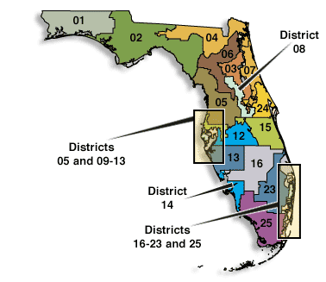
Average rep serves 710,000 people. Redistricting occurs when populations move. Some problems do arise- gerrymandering= trying to create a district that has an advantage. (irregular shape) SC states that new districts must be of roughly equal populations.

Slide 20
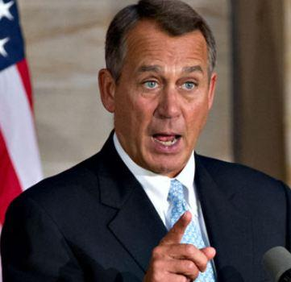
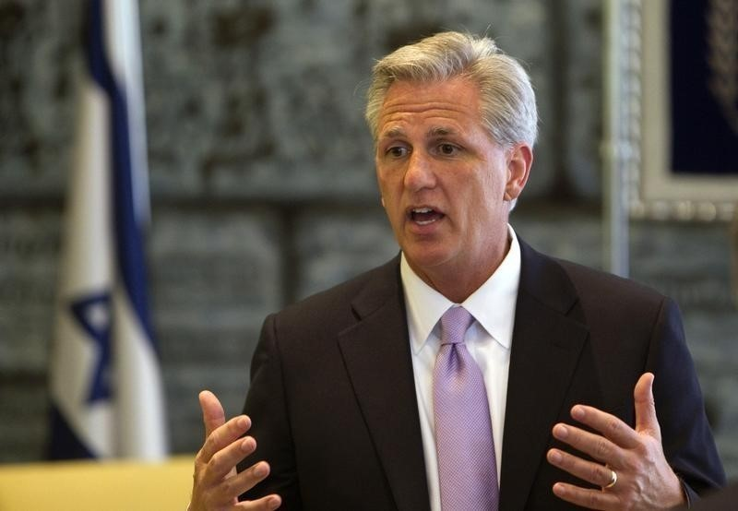
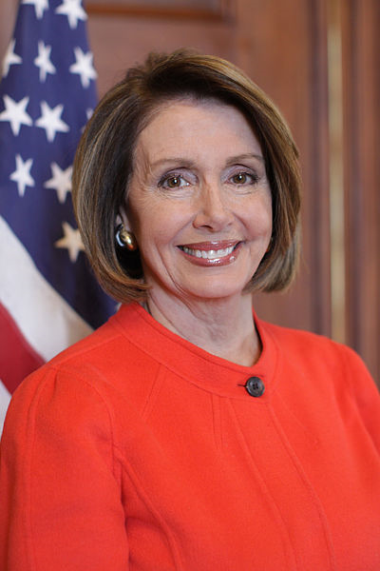
Speaker of the House
John Andrew BOEHNER
Republican from Ohio, he is the presiding officer of the House and it's most powerful member. He follows the Vice-President in line of succession to the presidency.
Nancy Pelosi
minority leader Dem. CA
Kevin MCCARTHY
majority leader Republican CA

Slide 21
Speaker of the House- chosen by other members, is a member of the political party that holds the most seats. (majority party) Constitution does not list speakers powers, they are based upon tradition.
Presides over debates and recognizes speakers
Rules on points of order
Assigns bills to committees
Determines when or IF an item comes up for debate.
Assigns house members to certain committees.
Second in line of succession to the presidency. Pres, VP, SofH.

Slide 22
Floor Leader-each party elects one to manage the actions and strategy of their party. Majority leader serves as the assistant to the S of H. Minority leader is the main spokes person for the minority party.
Whips- each also elect whips (think enforcers) they encourage party members to vote along party lines.
These positions are chosen during party caucus at beginning of term.
House Rules- Constitution gives Congress authority to make its own rules. They can get rid of a member for about any reason (as long as get vote) can issue a reprimand or a censure.
Rules Committee- determines when, how and how long debate on a bill will take place.

Slide 23
Committees: provides expertise in different areas of public policy.
Standing Committees: 20 permanent-(with at least 4 subcommittees) -they consist on the areas of which the majority of proposed laws come from: agriculture, budget, armed forces.
Ways and Means-taxes and other revenue areas. Huge because all revenue bills or appropriations bills must start in the house!!!
Select Committees- for a specific task, limited in time.
Joint Committees-ie. House and Senate
Each committee has a chair, it is a very powerful position. Chosen by the majority party, seniority is a factor but not a lock for the job.
Members request appointment to certain committees, not all are granted.

Slide 24
The Senate: upper house (higher prestige) represent the entire state. 45 R, 53D, 2I
Formal:
At least 30 years old
US citizen for at least 9 years
A resident of the state they represent
Informal:
Even older and richer than members of House and whiter.
20 women, 2 black, 4 latino, 1 Islander
6 year term, every 2 years 1/3 of Senate is up for reelection.
Longer term to allow members to focus on needs of nation rather than reelection.
Election:
17th Amendment made election by popular vote.

Slide 25
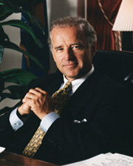
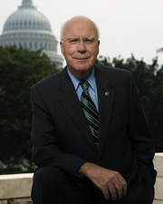
Senate Leadership- Constitution states that VP is the president of the Senate. A largely ceremonial role, he may preside over debate but not take part or vote except to break a tie. If membership is divided equally by party, the presidents party will be considered the majority.
Joe Biden
President pro tempore- person who presides when VP not available. Member from the majority party with the longest service. This person is in line after the S of H in succession.
Patrick Joseph Leahy Dem, Vermont

Slide 26
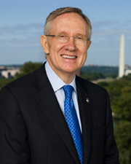
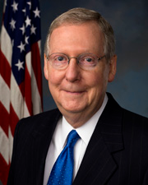
Senate majority leader- chosen at beginning of term by other party members, serves as main strategist for the party. Sets party agenda. There are whips too, just like the House.
Harry Reid, Dem, Nevada
Senate minority leader
Mitch McConnell Rep, Kentucky

Slide 27
Committees in the Senate: done very much like the House, so that senators can study an area of public policy in depth. Staffers are hired to provide specific knowledge and skills.
16 Standing committees
Select committees usually exist to examine an specific issue and advise the Senate or to provide oversight to a government agency.
Joint committees- Both House and Senate members.
Rules state that members may only serve on 3 committees and 5 subcommittees. Like the house they seek appointment to those that fit their interests or needs of their state. Preference given to members with longer service.
Seats given in proportion to party stats.

Slide 28
Chairman- always member of majority party, only 1. By new tradition chairs held to 6 year term limits as chair.
Senate Committee Power:
Some power exclusive to Senate- confirming certain presidential nominations. So many committees examine those nominations. Ie) Senate Judiciary Committee- researches nominations for federal judges. Committee recommendations generally followed by Senate.
Treaties= Senate Foreign Relations Committee

Slide 29
Rules and Traditions: Senate very strict about this.
Very few rules regarding debate so……
Filibuster- when opponents of a measure take the floor of the senate and refuse to stop talking in an effort to prevent the measure from being voted on. Used when minority knows the measure is likely to pass if voted on.
Can be stopped with a 60/100 vote = cloture (an end to the debate)
Discipline- expulsion requires a vote of 2/3. May also censure or denounce a member.
Vacancies- filled by Governor of the state. Serves until a special election can be held to fill vacancy. Usually pick from their party.
end 5.4

Slide 30
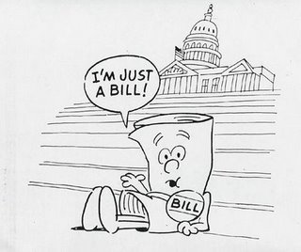
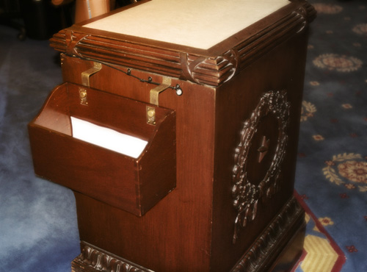
All laws start as bills. A proposed law is called a bill until both houses of Congress pass it and the president signs it.
According to the procedure currently in place, to introduce a bill in the House, representatives drop it into the hopper, a mahogany box that is accessible to all near the front of the chamber. Ideas for bills come from constituents, interest groups, members of congress and the president. ONLY MEMBERS OF CONGRESS MAY INTRODUCE A BILL. If senate gets S then #, if House gets H then #.

Slide 31
Both senators and House members may introduce bills, EXCEPT any involving taxation and appropriations MUST start in House.
Private bill-affects a particular person, family or small group.
Public bill- affects all society.
Rider- a provision that bears little relationship to the bills main provisions. ( a hitch hiker to a strong bill) poison pill-when really bad rider is added to bill with intention to kill it.
Joint resolution-similar to a bill becomes law when passes both houses and signed by president. (use of force in Iraq 2002)
Concurrent resolutions-effect operations of both houses but are not signed by president and do not carry force of law.

Slide 32
Bills in Committee: Most bills DIE in committee. This is where bills are studied.
Referral-how bills are assigned to committee. May also be assigned to a subcommittee. Hearings then take place-open to the public, subpoena power etc. Majority chairs can shape view of bill by limiting minority members witnesses.
Subcommittee reports to committee: in favor, against or neutral.
Markup-full committee, modifies bill, debate etc. Decide to report the bill to full chamber or not.
Discharge petition- vote by house to force bill out of committee.
= rights for women. 1970 20years.

Slide 33
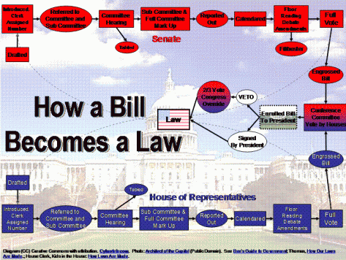

Slide 34
House Rules: once bill leaves committee it will get one of these.
Rules committee has BIG power!!!
Open- amendments can be made to bill
Closed- no amendments can be made to bill
Modified- certain parts may be modified.

Slide 35
Bill on the Floor-
House:
1st-adopt what rule will be followed. (see above)
Then debate as a whole or declares “Committee as a Whole” Speaker then appoints majority member chair of the committee. This is done because Constitution says that House can only conduct business when at least ½ are present=218 members. But for “Committee as a Whole” the quorum is only 100. Time granted by rules is split equally between parties.
Amendments may be discussed as well. Amendments must relate to the subject matter of the bill. (stuff happens)
C as a W-cannot pass a bill, whole house will vote on amendments first and then on the actual bill.

Slide 36
Record votes-most important because you have to publically announce how you are voting. Roll Call Vote must take place when 1/5 of those present demand.
Bill in Senate: No rules committee, no committee as a whole either. So generally no limit on debate. Time or amendments. To put rules on a bill it has to be a unanimous consent.
Roll call votes also on important bills.

Slide 37
Conference Committee: Can only become laws when they are passed in identical form by BOTH houses. For minor bills the two sides work informally to compromise on wording etc. Major bills get a CC- generally from the members of the committee that worked on the bill. S of H picks and presiding officer of Senate. Works sometimes other not. Once agreed upon report issued and both houses can debate BUT not make changes. If both still agree it moves to president for signature.

Slide 38
Presidential Action on a Bill:
Signs it – it becomes a law
Not sign- after 10 days (if Congress still in session) it becomes law. If Congress adjourns w/in 10 days bill fails (pocket veto)
Veto
To override a veto it takes 2/3 votes in both chambers. Rare !
106/2500
SC ruled line item veto was unconstitutional.
Signing statements-president declares an intention to enforce a law in a particular way. Some see this as an encroachment on the law making power of congress.

Slide 39
Only the President may call Congress into special session - a meeting to deal with some emergency situation. Of course, the fact that Congress now meets nearly year-round, due to the amount of business they must handle, reduces the likelihood of special session.
Although, as Congress nears the end of a session, the President sometimes finds it useful to threaten a special session if the two chambers do not act on some measure high on his legislative agenda.

Slide 40
Members also receive large allowances to pay for their office staff and assistants, trips home, telephones, telegrams, and newsletters. All members are entitled to an income tax deduction to help maintain two residences, one in their home state and one in Washington, D.C. Moreover, when they retire, senators and representatives may be eligible for pensions or $150,000 or more a year for life.

Slide 41
Privileges-free from arrest" in all cases except treason, felony and breach of the peace" when on way to or from attending Congress. Cannot be sued for anything they say in Congress. But can be for statements made outside of Congress.
Members who behave poorly may be censured.
Treason or accepting bribes are the only grounds for expulsion.

