Slide 1
American Government Honors
Chapter 9
The President

Slide 2
Diplomatic and Military Powers-
Power to negotiate treaties with foreign governments, needs 2/3 Senate approval.
Executive agreements between President and leader of another country-no approval needed.
President can recognize new country or legitimacy of new government.
President may take military action with out Congress declaring war. But, since 1973 he must consult with Congress and meet certain requirements before use of troops.

Slide 3
Legislative Powers-
President proposes legislation during State of the Union address and the federal budget proposal, and at any other time.
He can veto. (no line item veto=unconstitutional since 1998)
Judicial Powers-
Presidents nominate federal justices and judges, senate must approve.
Power to grant clemency!!!

Slide 4
Checks on the President’s Powers
Formal:
judicial review of his actions, ie) they can be declared unconstitutional.
Senate can block presidential nominations
Congress can override a veto
Informal:
Media-inform the public about abuses
Public approval- 41% approval rating this week
(successful presidents generally have strong public support)

Slide 5
Changes in Presidential Power-
It has grown significantly over the years, due to the growth in government and the US becoming a world power.
Lincoln- Civil War threatened Constitution-he took steps to preserve nation.
Theodore Roosevelt- pressured Congress to limit big business.
Franklin Roosevelt-government to solve social problems of the great depression.

Slide 6
Roles of the President

Slide 7
The President of the United States must fill a number of different roles, and must fill them all at the same time. Some roles are stated in the Constitution, others have developed over time.
Article II of the Constitution lists:
Chief Executive
Chief Administrator
Commander in Chief
Foreign Policy Leader
Chief Agenda Setter

Slide 8
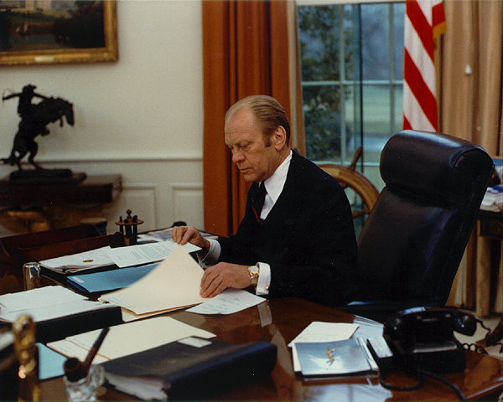
Chief Executive/Head of State (leader of nation)
The President is vested by the Constitution with the "Executive Power" of the United States. He directs the activities of 1000’s of government employees in order to carry out or execute the nations laws. His job is to implement laws passed by Congress. Art. 2 receive Ambassadors and other public Ministers. Many ceremonial duties.
ref: http://www.ford.utexas.edu/avproj/A8064-10A.jpg

Slide 9
150 departments, 2 million employees- President in charge of all of this people and their departments and agencies.
Source of authority- Article 2 Sec. 1 executive power vested in President.
Art. 2 Sec. 3 he shall take care that the laws be faithfully executed. Remember Congress controls the $ that is required for enforcement.

Slide 10
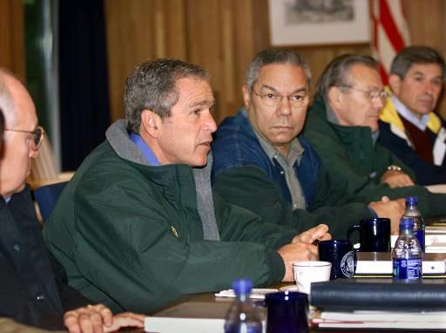
Chief Administrator
The President is also the director of the Federal Government, heading one of the largest governmental machines the world has known. Has 15 executive departments report to him.
ref: http://cryptome.org/david/pict41.jpg

Slide 11
Executive Powers
Appointment and removal of folks to the top posts in the executive branch. About 1/3 will need Senate approval. With exception of judges, president can remove at any time.
Executive Orders-formal rule telling executive branch officials how to do their jobs. EO have the force of law.
Executive Privilege-presidents ability to keep certain info confidential in the interest of national security. He may refuse to disclose info to Congress or a court.

Slide 12
Executive privilege is an implied presidential power that is recognized by the courts, most famously in the U.S. v. Nixon (1974) Supreme Court case.
There are generally four areas that an executive branch claim of privilege is based: 1) presidential communications privilege; 2) deliberative process privilege; 3) national security, foreign relations or military affairs, and 4) an ongoing law enforcement investigation.

Slide 13
6-20-12 President Obama today invoked executive privilege to shield documents related to the "Fast and Furious" gun walking scandal from a congressional investigation, marking the first time his administration has invoked the right and the 25th time it's been used since 1980.

Slide 14
Impoundment of funds- if executive and congress disagree HUGE about how a program should be carried out, he can freeze $. Limits on this since Nixon. Need congressional approval.

Slide 15
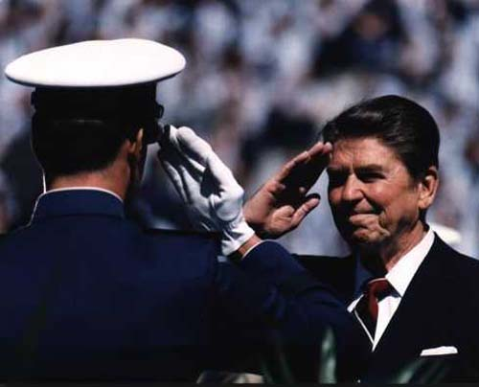
Commander in Chief
The Constitution makes the President the commander in chief of the nation's armed forces. While Congress has power to declare war, president can send forces into action.
ref: http://www.defenselink.mil/dodcmsshare/newsstoryPhoto/2004-06/200406086c.jpg

Slide 16
Congress declares war and provides funds. Remember the War Powers Act. 60 days then need Congressional approval.
USA Patriot Act- Congress passed after 9/11. Gave President and executive branch broad powers to gather information about possible suspects and to detain people suspected of terrorism. Wire taps, secret searches of U.S. citizens homes WITHOUT search warrants. Reauthorized in 2005 and 2010 with some modifications.

Slide 17
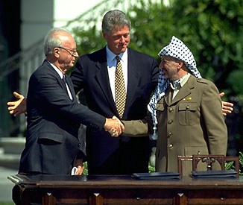
Foreign Policy Leader =Chief Diplomat
The President is the main architect of American foreign policy and the nation's chief spokesperson to the rest of the world.
ref: http://cache.eb.com/eb/image?id=20969&rendTypeId=4

Slide 18
Chief Agenda Setter- required annual State of the Union Address-President gives an outline of things he would like the country to accomplish-guidelines for Congress.
President appoints 7 member board of Federal Reserve – directs nations banking system.
President prepares the annual budget.

Slide 19
Unofficial Roles-
Chief of State
Party Leader
Chief Citizen

Slide 20
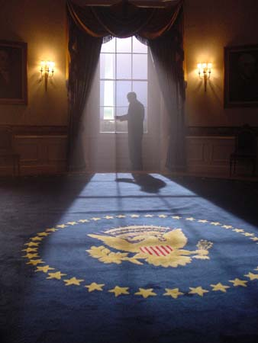
Chief of State
This means the President is the ceremonial head of the government of the United States, the symbol of all the people of the nation.
ref: http://www.jrsfilm.com/President%20in%20Oval%20Office%20full.jpg

Slide 21
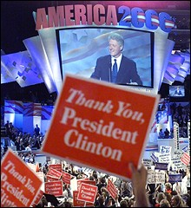
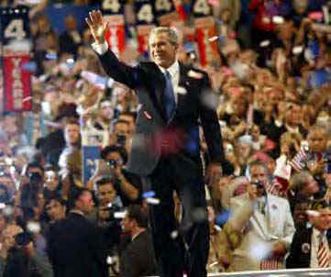
Chief of Party
The President acts as the acknowledged leader of the political party that controls the executive branch.

Slide 22
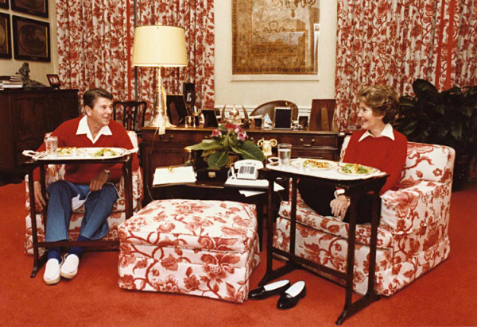
Chief Citizen
The President is expected to be "the representative of all the people." The President is expected to work for and represent the public interest against the many different and competing private interests.
End of Chapter 9
ref: http://www.whitehousemuseum.org/floor2/living-room-reagan-1981.jpg

Slide 23
Formal Qualification for the President

Slide 24
Requirements stated in the Constitution
1. The President must be a "natural born citizen....of the United States."
2. The President must be at least 35 years of age.
3. The President must "have been 14 years a Resident within the United States."

Slide 25
The President's Term
The Framers considered a number of different limits on the length of the presidential term, and settled on a four-year term.
Until 1951, the Constitution placed no limit on the number of terms a President might serve. Several Presidents, beginning with George Washington, refused to seek more than two terms, however. Soon, the "no-third term tradition" became an unwritten rule.

Slide 26
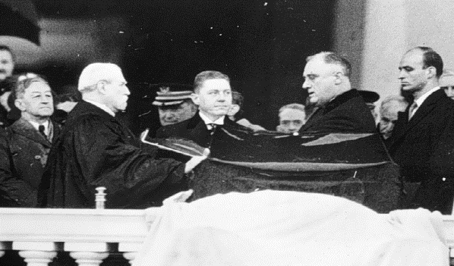
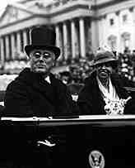
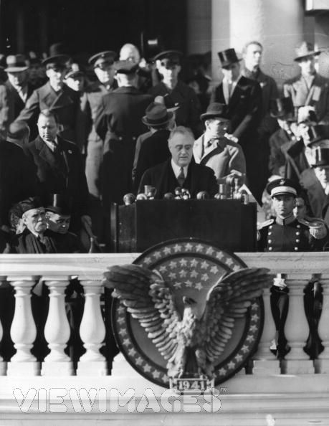
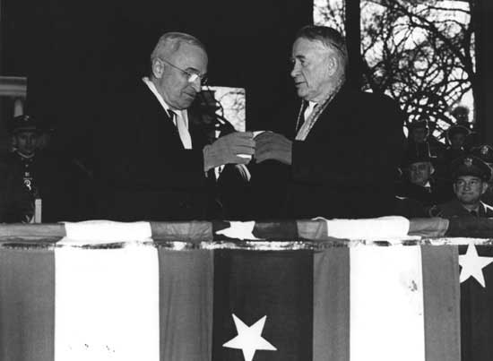
Franklin D. Roosevelt broke the tradition by seeking and winning a third term in 1940, and then a fourth in 1944.
Inauguration 1936
Inauguration 1932
Inauguration 1940
Inauguration 1944

Slide 27
To prevent future Presidents from following this precedent, the 22nd Amendment made the unwritten custom limiting presidential terms a part of the written constitution. The 22nd Amendment was adopted in 1951.

Slide 28
As a general rule, then, each President may now serve a maximum of two full terms - eight years - in office. A President who succeeds to the office after the midpoint in a term could possibly serve for more than eight years.
In that circumstance, the President may finish out the predecessor's term and then seek two full terms of his or her own.
However, no President may serve no more than 10 years in office.

Slide 29
The Framers gave more time to the method for choosing the President than to any other matter.
After weeks of debate, the Framers finally agreed on a plan. Under it, the President and Vice President were to be chosen by special body of presidential electors.
The Framer's intended the electors to be "the most enlightened and respectable citizens" from each State.
They were to be "free agent" in choosing the people best qualified to fill the nation's two highest offices.

Slide 30
The electoral college, then is a group of people, the electors, chosen form each State and the District of Columbia to formally select the President and Vice President.
435 + 100 ⁺ 3 = 538
To learn more about the electoral college and how it work, visit the following sites:
http://www.archives.gov/federal-register/electoral-college/about.html
http://www.howstuffworks.com/electoral-college.htm

Slide 31
All but Maine and Nebraska are “winner take all” electoral college votes. In theses states EC votes are split by district not state.

Slide 32
Presidential Succession

Slide 33
Presidential succession the scheme by which a presidential vacancy is filled.
Originally, the Constitution did not provide for the succession.
In practice the Vice President succeeded to the office when it became vacant. This precedent was set in 1841 when Vice President Jon Tyler succeeded President William Henry Harrison, who died of pneumonia just one month after taking office.

Slide 34
In 1967, the 25th Amendment made this practice into written word in the Constitution.
"In the case of the removal of the President from office or of his death or resignation, the Vice President shall become President."

Slide 35
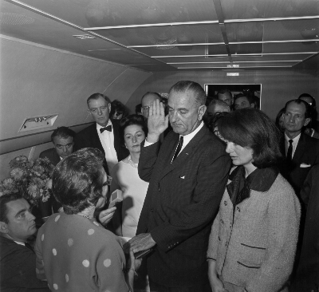
Vice President Lyndon B. Johnson taking the oath of office aboard
Air Force One after the assassinating of President Kennedy in 1963.

Slide 36
Congress fixes the order of succession following the Vice President. The present law on the matter is the Presidential Succession Act of 1947. After #3 they are in order of when Congress created the department.
1. Vice President
2. Speaker of the House
3. President pro tempore of the Senate
4. Secretary of State
5. Secretary of the Treasury
6. Secretary of the Defense
7. Attorney General
8. Secretary of the Interior
9. Secretary of the Agriculture
10. Secretary of Commerce
11. Secretary of Labor
12. Secretary of Health and Human Services
13. Secretary of Housing and Urban Development
14. Secretary of Transportation
15. Secretary of Energy
16. Secretary of Education
17. Secretary of Veterans Affairs
18. Secretary of Homeland Security

Slide 37
Before the passage of the 25th Amendment, there were serious gaps in the arrangement for presidential succession.
Neither the Constitution nor Congress had made any provision for deciding when a President was disabled.
Nor was there anything to indicate by whom such a decision was to be made.

Slide 38
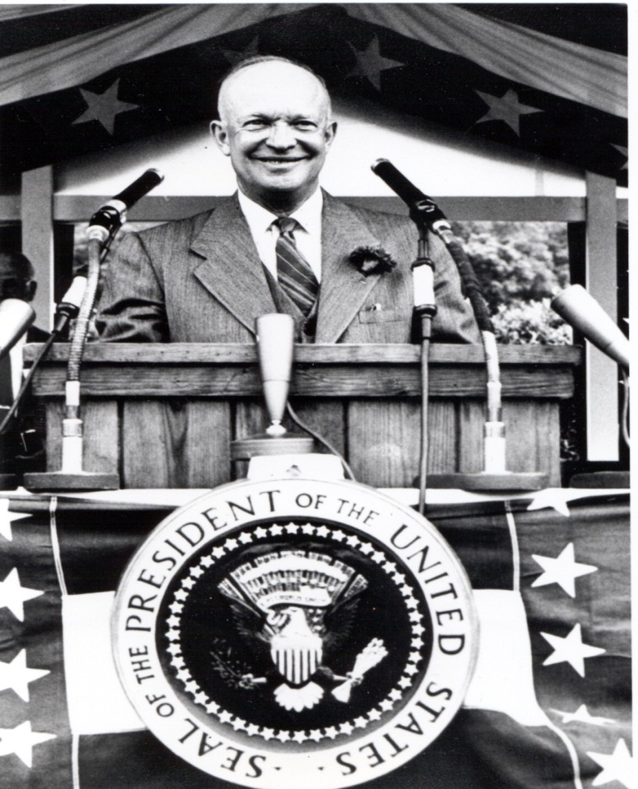
For nearly 180 years, then, the nation played with fate.
President Eisenhower suffered three serious but temporary illnesses while in office: a heart attack in 1955, ileitis in 1956, and a mild stroke in 1957.

Slide 39
Two other Presidents were disabled for much longer periods

Slide 40
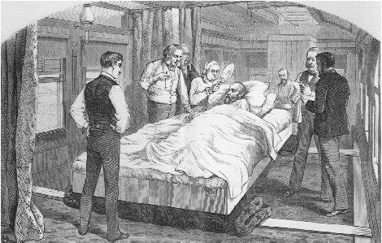
James Garfield lingered for 80 days before he died from an assassin's bullet in 1881.

Slide 41
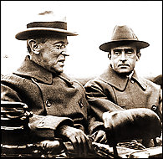
Woodrow Wilson suffered a paralytic stroke in 1919 and was an invalid for the rest of his second term
He was so ill he could not meet with his cabinet for 7 months after his stroke

Slide 42
Sections 3 & 4 of the 25th Amendment fill the disability gap, and in detail.
The Vice President is to become Acting President if:
(1) the President informs Congress, in writing, "that he is unable to discharge the powers and duties of his office," or
(2) the Vice President and a majority of the members of the Cabinet inform Congress, in writing, that the President is so incapacitated.

Slide 43
In either case, the President may resume the powers and duties of the office by informing Congress that no inability exists.
However, the Vice President and a majority of the Cabinet may challenge the President on this score. If they do, congress then has 21 days in which to decide the matter.

Slide 44
Congress determines the President's salary. It can neither be increased nor decreased during a presidential term.
The President's pay was first set at $25,000 a year in 1789. It is now $400,000 a year.
Congress has also provided the President with a $50,000-a-year expense allowance. That money many be spent however the President chooses; it is, in effect, a part of his pay, and it is taxed as part of his income.

Slide 45
The President is also provided with a great many benefits which include the following:

Slide 46
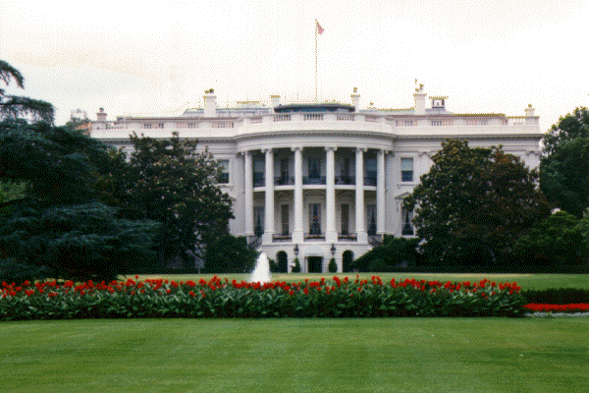
The White House
a 132 room mansion set on an 18.3 acre estate

Slide 47
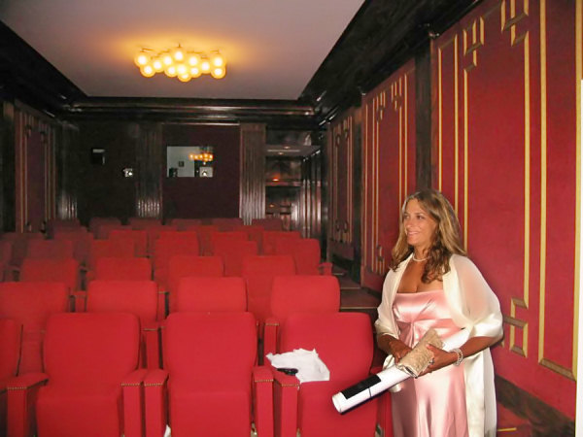
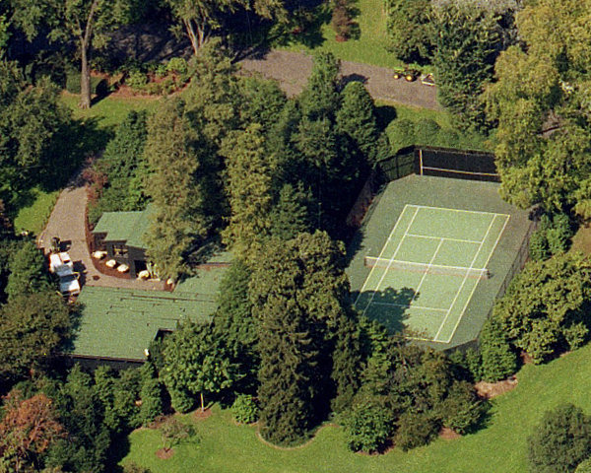
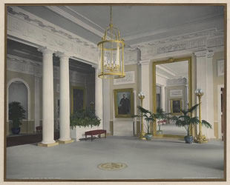
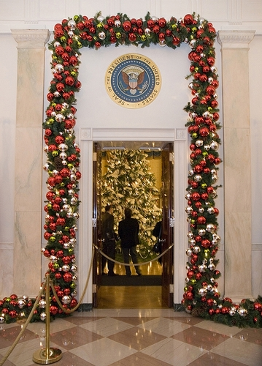
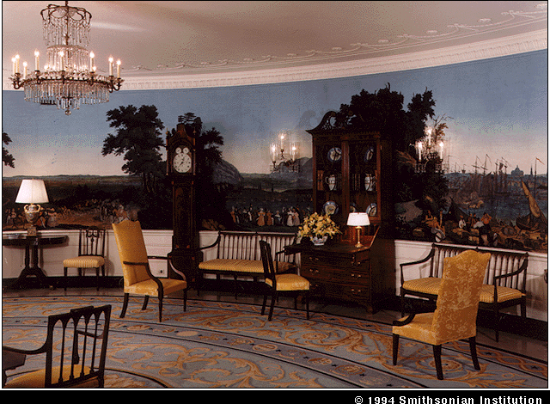
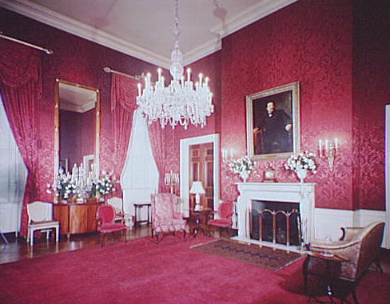
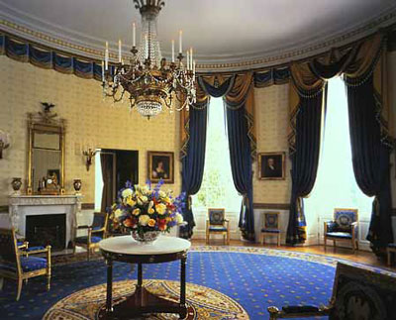

Slide 48
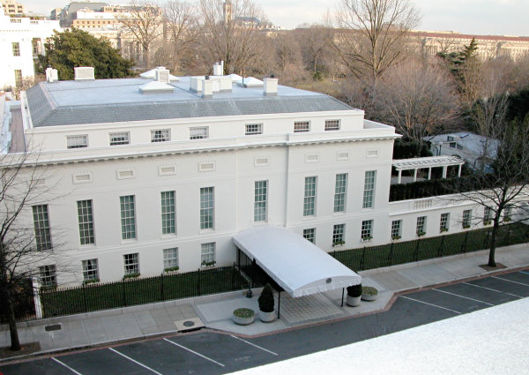
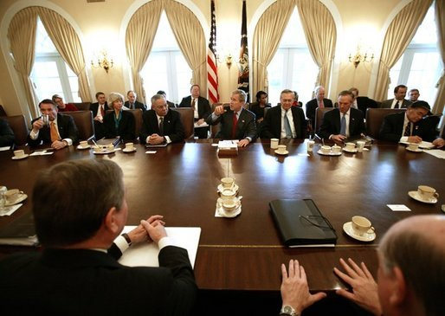
A sizeable suite of offices and a large staff

Slide 49
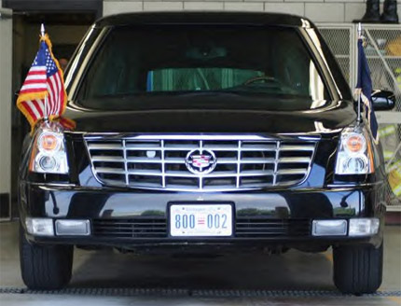
A fleet of automobiles

Slide 50
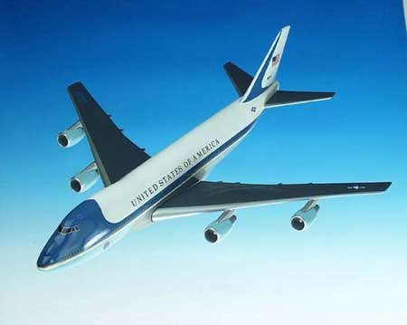
The Lavishly fitted Air Force One
and several other planes and helicopters

Slide 51
Unwritten Qualifications of the President- ie) describe the past presidents…….
White men, well educated, middle or upper class, Christian affiliation, 75% some military experience. Never a woman, B.O. first black president.
President needs to be gain support of American people, most are good communicators, be inspiring, good appearance (now that we have TV), and gain the confidence of the people. It is a 24/7 job. End of 6.1

Slide 52
Constitution grants president power to grant reprieve and pardons.
Reprieve=postponement of punishment
Pardon= can be partial, complete or conditional ex. Ford pardoned Nixon for Watergate involvement, Reagan pardoned Jr. Johnson for moonshining.
Amnesty-grants a group a pardon=A. Johnson granted all who fought for the confederacy.
ONLY FEDERAL OFFENSES

Slide 53
Informal powers-
Access to the media to spin their agenda.
Party leader- party members are expected to follow president’s lead on policy.

Slide 54
Presidents have often used the media to get their message out, goal is to convince voters and Congress to support their plans. Every word is well thought out and scripted to garner the support wanted. Experts advise-even what color tie to wear. What word to choose, etc.
end 6.2

Slide 55
EOP was formed when the creation of many of the great depression social programs were implemented. EOP was believed to be needed to manage the new agencies. Most members are nominated by president and confirmed by the Senate.
White House Office-key personal and political staff. No Senate confirmation. Chief of staff-manages day to day operations of the White House Office. Some are primary presidential advisor. Presidents legal counsel and personal secretary reports to C of S.

Slide 56
White House press secretary manages media relations.
EOP-
National Security Council- brings together top military, foreign affairs and intelligence officials, national security advisor is coordinator. Pres, VP, secs. Of: state, treasury, defense, intelligence, joint chiefs, attorney general, chief of staff, etc.

Slide 57
Council of Economic Advisers-provides pres with expert analysis of the economy and assistance with forming economic policy. 3 members nominated by pres, confirmed by Senate.
Office of Management and Budget- help develop the federal budget and oversee its execution by the agencies of the executive branch. Sets policies for the purchase of gov’t goods, services and property. Senate approves appointments.

Slide 58
Vice President-only other elected official in Presidents admin.
Presiding over the Senate
Opening and counting the electoral votes in presidential elections
Serving as the president if the president cannot.
Before the 12th Amendment- VP did little more than what is listed above. Now they help pres. get elected-balance the ticket. Modern VP-help make policy and carry out programs, office in the west wing and have full staff too.

Slide 59
The Cabinet-made up of the heads of the executive departments. They are responsible for carrying out laws, administering programs and making regulations in their particular area of responsibility. They advise the president.
Nominated by the president and confirmed by the Senate.
Remember constitution does not mention the term cabinet, does mention opinions from executive departments. Custom! There are 16 official cabinet positions today.

Slide 61
The Presidents Administration= all folks who work for the executive branch. Some are career some are appointed by president.
EOP- these departments help the president formulate and make policy.
Council of Economic Advisers
Council on Environmental Quality
Executive Residence
National Security Staff
Office of Administration
Office of Management and Budget
Office of National Drug Control Policy
Office of Science and Technology Policy
Office of the United States Trade Representative
Office of the Vice President
White House Office

