Slide 1
Chapter 9.1 Public Opinion
Public Opinion-collection of views shared by a segment of society on an issue of interest or concern. Obviously many issues will have groups on both sides.
Public Opinion & Public Policy (choices gov’t makes)
a. public opinion is “led” by the decisions and actions of political/social leaders. This is when public = 1 large group concerned about an issue.
b. When public = many publics each with different opinion, then it is said that peoples attitudes lead public policy.

Slide 2
Forming Public Opinion
Process of acquiring political beliefs is called political socialization. This is where those ideas generally come from:
a. family- usually most direct influence. (race, religion, politics etc)
b. school and work-learn about gov, citizenship, peer influence. Young adults frequently impacted by employers.
c. Other personal factors-age, race, gender, religion. Ie)religion may affect views on marriage, abortion, prayer in school.
http://pos.org/

Slide 3
Media and Public Opinion
Mass media are the means of communication that provide information to a large audience.
This can greatly impact and shape public opinion and public agenda.
Methods to mass media
television
radio
magazine
newspaper
WEB
Growth- in news readership is way down, but radio, tv and web use has exploded.
Media has huge influence on public opinion. Media determines which stories it covers, the spin on those stories etc.
advertising to create public
support for their policies.

Slide 4
Criticism of Media – Bias in reporting, bias in story selection, factual inaccuracy, media consolidation. (small group own most in US)
http://fair.org/take-action-now/media-activism-kit/how-to-detect-bias-in-news-media/
Future- speed of internet information dissemination does not mean it is accurate. Ie) Wikipedia- !!! Use several sources to check out an issue to avoid propaganda. Statements to influence public opinion or promote a cause.
Measuring Public Opinion-
Public opinion poll-survey of people scientifically selected to provide opinions about an issue. A way to determine public attitudes or preferences about products, issues, candidates.
Accuracy of a poll-its all about the sample (group who takes the poll.) Size is important. Must be random, how the questions are worded, even order can impact accuracy.

Slide 5
Sampling error- reliable polls state margin of error (uncertainty level)
Evaluating Polls-if done properly, polls produce accurate, reliable, objective and bias free data. Bias= errors introduced by polling methods that lead to one outcome over another.
Some polls are intentionally designed to produce specific results in order to shape public opinion.
Exit polls- survey of random people leaving poll on election day-how they voted. Not disclosed until polls closed so as not to influence those who have not voted yet.
http://www.cnn.com/election/2012/results/race/president

Slide 6
Interest Group Organization 9.2
Interest Groups- group of people who share common goals and organize to influence government. (ALCU, NRA, GreenPeace, AARP,
etc.
Political Party
Interest Groups
support cadndidates who favor their ideas
Nominate candidates for
office to try to win elections
to gain control of gov't
try to influence gov't officials to support certain policies
have members
try to affect gov't
usually concerned with only a few issues
broad based organizations
-need opposing groups
to get elected
want members with similar views
parties elected officials
represent a particular area.
organized on common
values not location

Slide 7
Many interest groups have PACs (Political Action Committee) that support candidates for political office. The PAC raises and contributes money to campaigns and candidates.
Having impact- writing letters, testifying at leg. Hearings, voting, etc. Easier to join interest group, give money and let the machine carry out your wishes. Membership is down but $ is up. So, fewer people are giving more $.
Interest Groups have money, they hire experts and lobbyists. Sometimes their biggest influence is from the information it provides to Legislators and the public, NOT the activities of its members.

Slide 8
PAC's- Political Action Committees- organizations specifically designed to collect money and provide financial support to a political candidate. Interest groups fund a large % of election funds.
1974 campaign reform laws-now limits amount of money individuals, corporations and labor unions can contribute to federal candidates. BUT PAC's can.
PAC's can give each candidate $5k but no limit how much it can spend on candidate campaign as long as PAC does not work directly with candidate.
How much money PACs contribute.
http://www.opensecrets.org/pacs/list.php

Slide 9
1976 Supreme Court decision stated that ANY independent group may give money to a political candidate as long as group has no legal ties to candidate.
1975 PAC contributions $52.9 million
2000- $579 million
Federal Exchange Commission-ruled PAC's can use their own money to administer their PAC's and use payroll deductions to raise money for PAC.
Supreme Court Decisions- Buckley v. Valeo 1976-different divisions of a corporation or union locals can set us as many PAC's as possible. No limit on spending-found to be freedom of speech issue.

Slide 10
Purpose-interest groups help citizens communicate their "wants" to government leaders, influence public policy and get the goals they support.
Power- "strength in numbers" but its proportional. (100 in a small town is a large voice but in large city not even a whisper.
Leadership- leaders strengthen political power of the group by unifying members, keeping them informed, act as speakers for the group, raise $, etc.

Slide 11
Types of Interest Groups- economic, social, political, cultural and religious.
Business Groups-NAM-national assoc. of mfg's works to reduce government regulation of business, lower taxes. Chamber of Commerce speaks for small businesses.
Labor Groups-AFL-CIO largest- includes United Auto Workers, United Mine Workers, Intl Brotherhood of Teamsters. .) labor unions work to gain higher wages and better benefits for members.
Agricultural Groups- American Farm Bureau Federation represents larger farmers and works closely with the Dept. of Agric. National Farmers Union- smaller farmers-supports price supports. Grange- social but advocates for price supports for crops.
Cause-Based-Groups- promote a cause or single issue. MADD
Societal Groups- AARP, NOW (religious, social , religious etc) Senior groups like AARP work for higher S.S. benefits and health care.

Slide 12
Types continued.
Professional Groups-AMA, ABA, establish standards for their profession, influence training and licensing, and educate the public and government about their concerns and profession.
How they work- hard work, accurate/timely information, communication and MONEY. Interest groups support candidates and lobby to influence public officials and public policy.
Endorse Candidates- help get candidates elected, they will publically support a particular candidate and give them $ for campaign. The candidate will generally support the particular interests of the group.
Lobbying- contacting public officials to persuade the official to support the groups interests. Usually utilize professional lobbyists. Blast texts, email etc.
Informing Public Opinion-having someone explain the groups position, in an effort to generate support and influence lawmakers.
Grass roots- lowest level, (garage band) simple, low money attempt to generate large interest in an issue. (phone tree, internet, etc.)
Lawsuit- using the legal system. Brown v. Bof E Topeka, Kansas

Slide 13
Interest groups support both majority and minority interests. Both are trying to influence public policy and political issues.
Benefits- gives minority interests a voice in political process. Civil Rights of the 1960’s.
Criticisms
To much influence- a small group with lots of $ can have way to much influence.
narrow issue focus, often ignoring or missing the big picture.
Appeal to emotions not solutions
Because both sides are often represented Congress is stymied. (doesn’t act so as not to take sides)
Limits of Groups
2007 scandals- $, trips, etc. Congress passed reforms and rules for legislatures and lobbyist activities. Leg- cannot accept trips, $, tickets etc. BUT- these are smart folks- will they develop e a workaround?

Slide 14
Lobbyists also provide testimony during congressional committee meetings when a potential bill is being discussed.
Lobbyists also help bills (50% of time)
How interest groups seek support.
Media Campaigns-t.v., newspaper, mag, radio. To inform public and create support for their views.
Letter witting- NRA letters to congress.
Limitations- Several factors limit the effectiveness of interest groups. Competing groups keep any one from controlling lawmakers. Often, the larger the group the more diverse the interests of its members, therefore smaller groups have actually been more successful in shaping policy.
Concerns: financial contributions to political campaigns. (helping the right people get elected)

Slide 15
Many lobbyists are former senators and representatives, others are lawyers or public relations experts. Many legislators leave public office to cash in on their connections. $$$$. Lobbyist must submit detailed records bi-annually showing who they are representing, what is the issue they are addressing and how much money has been paid by client. This is to attempt to prevent illegal influence over members of Congress.
One of lobbyists most successful methods of persuasion is to provide policymakers with useful information that supports the interests groups position. Rules limit gifts lobbyists can give legislators. (including meals and entertainment $50.00, $100 from any source.

Slide 16
Total Lobbying Spending
1998 $1,439,464,755 $1.44 Billion
1999 $1,436,755,787 $1.44 Billion
2000 $1,559,421,252 $1.56 Billion
2001 $1,639,649,358 $1.64 Billion
2002 $1,818,367,362 $1.82 Billion
2003 $2,039,395,243 $2.04 Billion
2004 $2,168,501,066 $2.17 Billion
2005 $2,432,907,827 $2.43 Billion
2006 $2,619,750,920 $2.62 Billion
2007 $2,853,927,852 $2.85 Billion
2008 $3,297,016,140 $3.30 Billion
2009 $3,488,239,122 $3.49 Billion
2010 $2,608,646,121 $2.61 Billion
Number of Lobbyists*
1998 $10,404 10,404
1999 $12,943 12,943
2000 $12,541 12,541
2001 $11,845 11,845
2002 $12,131 12,131
2003 $12,923 12,923
2004 $13,158 13,158
2005 $14,070 14,070
2006 $14,516 14,516
2007 $14,869 14,869
2008 $14,216 14,216
2009 $13,664 13,664
2010 $12,488 12,488
NOTE: Figures are on this page are calculations by the Center for Responsive Politics based on data from the Senate Office of Public Records. Data for the most recent year was downloaded on November 29, 2010.

Slide 17
Other Groups-thousand of groups exist for so many purposes, check out this sample list.
http://pag.vancouver.wsu.edu/
Review-
1. Why are interest groups more effective in influencing the government that are individual citizens? ______________________________
______________________________
______________________________
2. What the three reasons citizens join interest groups? _________________ ______________________________ ______________________________

Slide 18
9.3 Political Parties
PP=organization that tries to elect its members to public office so that its views can become public policy. Each party has an ideology (set of ideas, theories, and aims) that the supporters share. These are united into their social/political program. This is what separates the different parties and places them on the spectrum.
Democratic Party =liberal, generally support governmental action to change social, political or economic policies believed to be unfair.
Republican Party= conservative, generally support limited government, lower taxes and traditional social values.

Slide 19
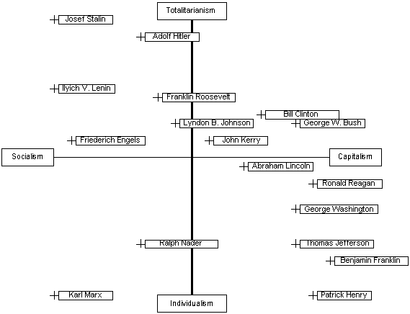

Slide 20
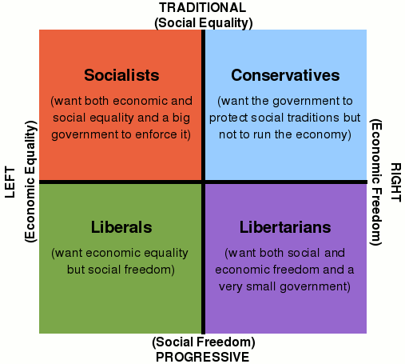

Slide 21
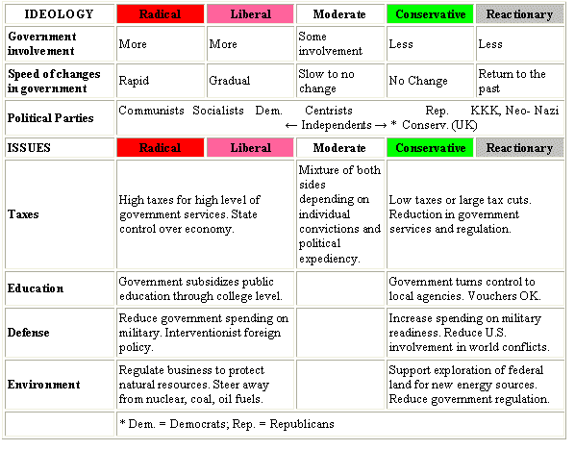

Slide 22
Parties 3 Main Rolls
a. nominating candidates for office-this is the main function. Candidates must generally support the parties views. Parties bring $, campaign workers and support to candidate.
b. aiding the electoral process- by educating people about their position on major issues. Help identify who to vote for based upon views. Help citizens register to vote, learn about issues, where to vote. Keep and eye on elected officials to make sure they are continuing to promote the views they were elected to support.
c. Help run the government- usually one party is in the majority and controls that house.

Slide 23
American 2 Party System-US parties emerged shortly after ratification. Federalist party faded away and Democratic-Republican split to form the two major parties we have had for the last 150 years.
Types of Systems:
1 Party-duh
2 Party- 2 compete to control government
Multiparty- frequently unstable due because no party has much influence.
A third party is any political party in a two party system besides the 2 major parties. Ie) libertarian, green,
An independent is a candidate that is not associated with ANY party.

Slide 24
Party Organization
Local-organized at county level, divided into precincts. A ward is comprised of several precincts. Run by local party members.
State- run by a central committee made up of representatives from each county. These leaders attempt to elect local, state and national candidates from their party.
National- committee of members from state parties. National chairman has large staff that manages party operations, raises campaign funds, etc.

Slide 25
Political Parties and the Public Good
Pro’s- because there is always another side- both parties filter out extreme or unconventional ideas, because each side wants/needs to win a majority they must appeal to more voters- so frequently are driven to be meet the needs of the maj.
More views represented generally leads to an increase in political and social stability.
Party loyalty encourages political stability.
Parties provide a “brand name” So if you don’t know the candidates, you can at least vote for the party that best represents and supports your views.
Con’s-because parties are trying to attract so many voters with so many promises, often not all are able to be met. Criticism of parties being driven by interest groups=cuz of the money they provide to parties-small groups of people w huge sway.
Parties are full of individuals who are more interested in PERSONAL success not country.
Some candidates will SAY anything to get elected, even switch opinions (flip-flop) and PARTIES. (C. Christ)
Some say parties should stop fighting and concentrate on the problems our country is facing.

Slide 26
The Electoral Process
Best way to affect political process is to VOTE.
Why run for office? Honor, a way to contribute to society, POWER.
Campaigning is expensive and time consuming. Television and internet is the primary method to spread their message.
Candidates must raise money. PAC’s , party, personal and maybe even public funds.
Hard money=money donated to an individual campaign. State and federal laws limit the amount individuals and corporations can contribute. Reports must be filed.
Soft money= a way to get around limits is soft money= $ given to a PARTY not a specific person.

Slide 27
Choosing Candidates
Nomination is the first step, political parties generally nominate candidates.
Self- announcement-person announces that they are running for a party or independent. Usually have to register and pay fee. (petition can replace fee)
Write in candidate- run against the parties chosen candidate, ask voters to write your name on ballot on voting day. They usually LOSE!! No money or support.
Caucuses-not used much anymore. Iowa
Conventions-party members attend conventions to nominate candidates. Local, state, then states choose delegates for national nominating convention.

Slide 28
Primary Elections- held when more than one candidate from the same party is running for the same position.
Direct Primary- parties candidate is chosen directly by voters.
closed primary- only voters registered as party members can vote in selecting that parties candidates.
open primary- any registered voter can vote in either party’s primary, but only 1.
FLORIDA IS A CLOSED PRIMARY STATE.
Most states hold presidential primaries to choose presidential candidates. Many states try to hold primaries early so that they can have more influence in the nomination process.

Slide 29
Voting Behavior
Voting is a right, some believe a DUTY.
<2/3 eligible voters voted in presidential election, state and local is even lower.
To vote:
US citizen
18 years of age
Resident of the state in which you wish to vote
Registered to vote (except N.D.) Does requiring registration reduce voter turnout?, Fraud
Behavior: Why we vote the way we do…..
Party identification-
Voters views on issues important to them
Candidates background, personality, record, age, gender, race, religion, beliefs, education ..

Slide 30
General Elections- those in which the candidate is elected to office, ie-after a primary election if more than one candidate running for a single office.
If partisan – plurality wins- the candidate with the most votes.
If non partisan usually need a majority and there will be a runoff.
Special elections- state and local- to replace a dead or removed official.
Federal elections must take place on the first Tuesday following the first Monday in November of every even numbered year. Most states and local hold their local/state elections then as well.
Votes are cast in secret, some use paper other electronic.
You can vote absentee if not available to vote on day of election. May also vote early by mail.

Slide 31
Campaigns and the Public Good
Political parties, interest groups and individuals have and impact on who represents us at the local ,state and national level.
Good- elections/candidates spend a lot of time educating the public about issues, this helps voters make informed decisions on election day.
BUT- incorrect information given by candidates to influence you, negative advertising, etc.

