Slide 1
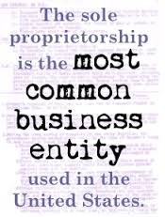
Sole Proprietorship
A Sole Proprietorship consists of one individual doing business. Sole Proprietorships are the most numerous form of business organization in the United States, however they account for little in the way of aggregate business receipts.
The most daunting disadvantage of organizing as a sole proprietorship is the aspect of unlimited liability. An advantage of a sole proprietorship is filing taxes as an individual rather than paying corporate tax rates.

Slide 2
Sole Proprietorship: A sole proprietorship is one person alone. He or she will have unlimited liability for all debts of the business, and the income or loss from the business will be reported on his or her personal income tax return along with all other income and expense he or she normally reports. Although proprietorship avoids the expense of forming a partnership or corporation, many start businesses this way because they are unfamiliar with the other forms of organizations.

Slide 3
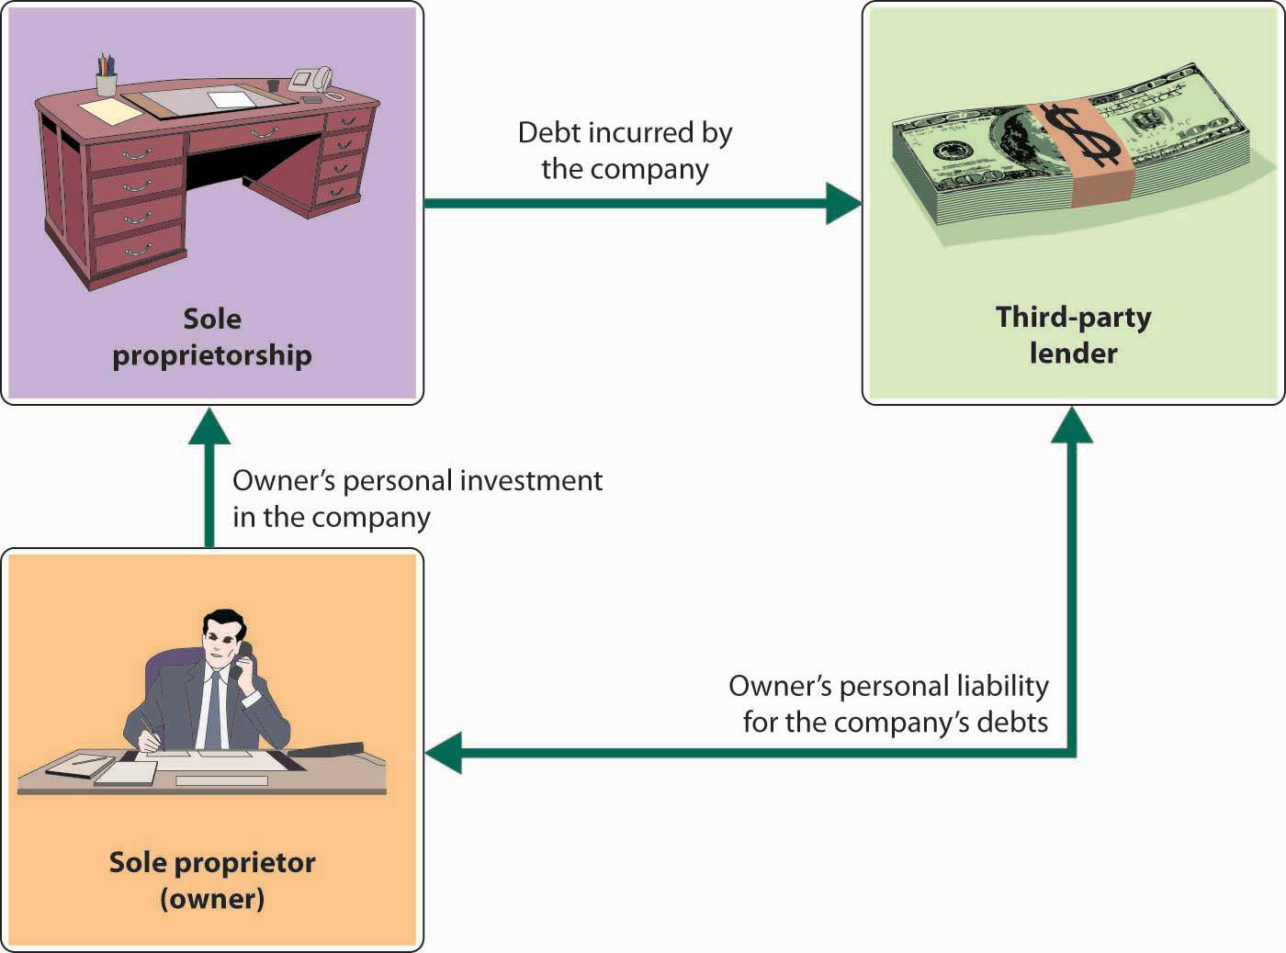

Slide 4
Unlimited Liability- you are responsible personally for the debts of the sole proprietorship or partnership.
So… you invest $100,000 to start your business. A few years later you get sued because someone finds a finger in your chili special. Jury awards 3 million.
You loose your $100,000 investment and your personal assets may also be taken. (cars, boat, savings accounts, land, etc.) generally your personal house is safe but not always.
THIS IS WHY PEOPLE INCORPORATE!!!!

Slide 6
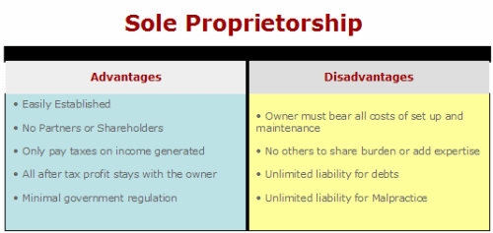

Slide 7
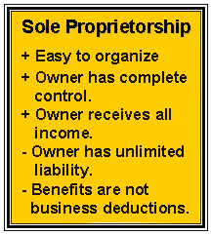

Slide 8
2. Partnership
A partnership is a business owned by two or more persons who contribute resources into the entity. The partners divide the profits of the business among themselves.
In general partnerships, all partners have unlimited liability. In limited partnerships, creditors cannot go after the personal assets of the limited partners.

Slide 10
General Partnership: In a general partnership, each of the two or more partners will have unlimited liability for the debts of the business. The income and expense is reported on a separate return for tax purposes, but each partner then reports his or her pro-rata share of the profit or loss from the business as one line on his personal tax return.

Slide 12
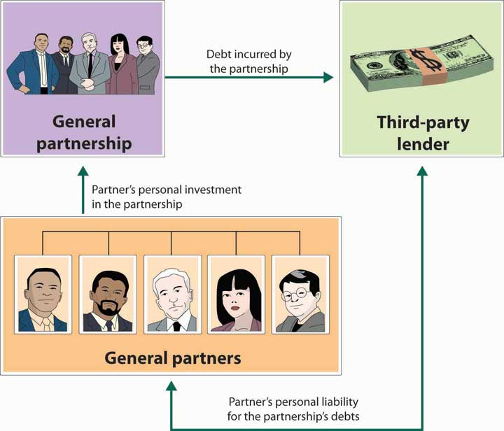

Slide 14
Limited Partnership: With a limited partnership, each of the general partners has unlimited liability for the debts of the partnership, but the limited partner's exposure to the debts of the partnership is limited to the contribution each has made to the partnership. With certain minor exceptions, the reporting for tax purposes is the same as for a general partnership.

Slide 15
Advantages
Synergy. There is clear potential for the enhancement of value resulting from two or more individuals combining strengths.
Partnerships are relatively easy to form, however, considerable thought should be put into developing a partnership agreement at the point of formation.
Partnerships may be subject to fewer regulations than corporations.
There is stronger potential of access to greater amounts of capital.
No corporate income taxes. Partnerships declare income by filing a partnership income tax return. Yet the partnership pays no taxes when this partnership tax return is filed. Rather, the individual partners declare their pro-rata share of the net income of the partnership on their individual income tax returns and pay taxes at the individual income tax rate.
Disadvantages
Unlimited liability. General partners are individually responsible for the obligations of the business, creating personal risk.
Limited life. A partnership may end upon the withdrawal or death of a partner.
There is a real possibility of disputes or conflicts between partners which could lead to dissolving the partnership. This scenario enforces the need of a partnership agreement.

Slide 16
Corporation
Corporations are probably the dominant form of business organization in the United States. Although fewer in number, corporations account for the lion's share of aggregate business receipts $$$$ in the U.S. economy. A corporation is a legal entity doing business, and is distinct from the individuals within the entity. Public corporations are owned by shareholders who elect a board of directors to oversee primary responsibilities. Along with standard, for-profit corporations, there are charitable, not-for-profit corporations.

Slide 17
3. Corporation
A corporation is a business organization that has a separate legal personality from its owners. Ownership in a stock corporation is represented by shares of stock.
The owners (stockholders) enjoy limited liability but have limited involvement in the company's operations. The board of directors, an elected group from the stockholders, controls the activities of the corporation.
In addition to those basic forms of business ownership, these are some other types of organizations that are common today:

Slide 18
Limited Liability- your only liability is the amount of your investment.
So… if you purchase 100 shares of Apple for $126.41 per share your investment is $12,641.00. If Apple Inc. gets sued for zillions of dollars, you can only loose your $12, 641.00 investment. You will not be responsible for any amount over that. (your share of the debt)

Slide 19
Closely held corporations- shares are not publicly traded! Ie.) You cannot invest in the company unless you are invited to do so.
Snapchat is close to finalizing a $20 million fundraising round led by VC firm Kleiner Perkins at a $10 billion valuation, The Wall Street Journal and TechCrunch are reporting.
The messaging app now has 100 million users, according to the WSJ report.
Turned down 3b from FaceBook

Slide 20
Publicly traded corporations: you can buy share(s) and own a piece of these companies.

Slide 21
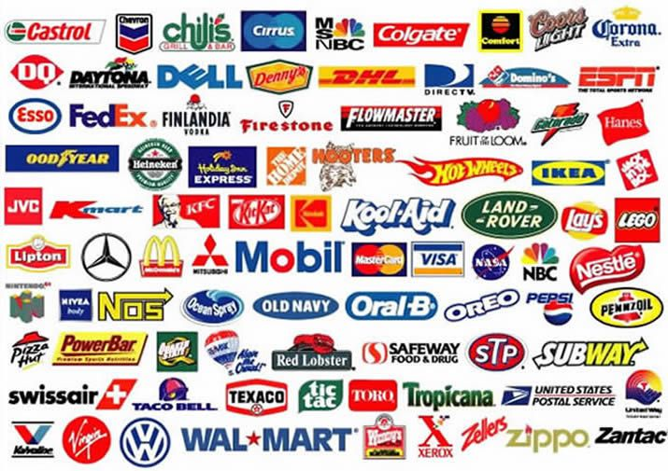

Slide 22
Advantages
Unlimited commercial life. The corporation is an entity of its own and does not dissolve when ownership changes.
Greater flexibility in raising capital through the sale of stock.
Ease of transferring ownership by selling stock.
Limited liability. This limited liability is probably the biggest advantage to organizing as a corporation. Individual owners in corporations have limits on their personal liability. Even if a corporation is sued for billions of dollars, individual shareholder's liability is generally limited to the value of their own stock in the corporation.
Disadvantages
Regulatory restrictions. Corporations are typically more closely monitored by governmental agencies, including federal, state, and local. Complying with regulations can be costly.
Higher organizational and operational costs. Corporations have to file articles of incorporation with the appropriate state authorities. These legal and clerical expenses, along with other recurring operational expenses, can contribute to budgetary challenges.
Double taxation. The possibility of double taxation arises when companies declare and pay taxes on the net income of the corporation, which they pay through their corporate income tax returns. If the corporation also pays out dividends to individual shareholders, those shareholders must declare that dividend income as personal income and pay taxes at the individual income tax rates. Thus, the possibility of double taxation.

Slide 24
Some hybrid forms of business organization may be employed to take advantage of limited liability and lower tax rates for those businesses that meet the requirements. These include S Corporations, and Limited Liability Companies (LLC's). Where S-Corps are a Federal Entity, LLC's are regulated by the various states. LLC's give the option for profits from the business to pass through to the owner's individual income tax return.

Slide 25
"S" Corporation: A corporation that has made an election to be an "S" Corporation for federal income tax purposes is treated as a partnership for tax purposes, although it is treated as a regular corporation for other purposes. LIMITED LIABILITY!!!

Slide 26
Unlimited liability exists for partnerships just as for sole proprietorships. One way to alleviate this risk is through Limited Liability Partnerships (LLP's). As with LLC's, LLP's may offer some tax advantages while providing some risk protection for owners.

Slide 27
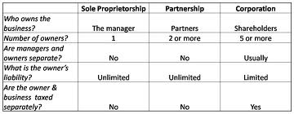

Slide 29
Limited Liability: A limited liability company provides limited liability for all of its members, but typically can be treated as a partnership for federal income tax purposes. State laws may differ as to whether it is treated as a partnership or a corporation for state income tax purposes. It can be managed by all of the members or can have centralized management in one or more of the members.
Limited Liability Company
Limited liability companies (LLCs) in the USA, are hybrid forms of business that have characteristics of both a corporation and a partnership. An LLC is not incorporated; hence, it is not considered a corporation.
Nonetheless, the owners enjoy limited liability like in a corporation. An LLC may elect to be taxed as a sole proprietorship, a partnership, or a corporation.

Slide 30
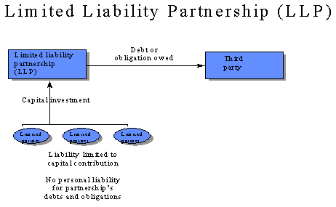

Slide 31
