Slide 1
Chapter 7 The Executive Branch

Slide 2
A bureaucracy- any organization, either in government or private, having the following features: a clear, formal structure, a division of labor, and a set of rules and procedures by which it operates.
Federal bureaucracy contains all departments and agencies of the executive branch.
3 types of independent agencies:
Independent executive agencies
Independent regulatory commissions
Government corporations

Slide 3
Top administrators in the federal bureaucracy are appointed by the president BUT most are career employees that survive changes in the administration.
Civil Service-is made up of civilians who carry out the work of the federal government. Today workers are hired through competitive processes.

Slide 4
Spoils system-pre1871 government jobs were given out by the president, usually as political rewards to people who supported the president’s policies or campaign.
Was criticized for corruption and inefficiency.
Civil Service Advisory-1871 10% of government workers covered. Hiring based upon merit. Congress has expanded coverage to 90% of government jobs are now covered.

Slide 5
Executive Departments- 15 make up the major units of administration and policy making in the executive branch. The heads of these departments make up the presidents cabinet.
Congress creates departments and approves the budget for each department. The president nominates the top officials in each dept. Senate consents to appointment.

Slide 6
Congress creates new departments to address new needs or changing priorities.
Departments:
Health and Human Services
Department of Defense
Department of Homeland Security
Department of Energy Homeland Security- most recently created, due to 9-11 terrorist attacks.
…….

Slide 7
Health and Human Services-
Protect the health of the people, Social Security, Medicare and Medicaid and Food and Drug Administration
Department of Defense-
Protecting the nation, 1.3 million active duty members. 1.1 reserve and National Guard
670k civilian employees also support.
DOD has larger budget than any other dept.

Slide 8
Independent Agencies- 140 they operate separately from the executive departments. Created by an act of Congress, to cover specific issues (environment) Sometimes Congress gives the agency the power to make regulations governing their area of interest.
Congress can override any laws.
3 types
Independent Executive Agencies
Independent regulatory commissions
Governmental corporations

Slide 9
Independent Executive Agencies-
Oversee and manage a specific aspect of the federal government. Congress creates them and has authority over them, president controls much of their operation and appoints their top officials. NASA

Slide 10
Independent Regulatory Commissions- to regulate some aspect of the economy. They set and enforce rules that have force of law. Led by a 3 to 7 member board who are nominated by the president and confirmed by the Senate. Must be bipartisan (both R/D)
Interstate Commerce Commission
Federal Communications Commission-radio, tv, satellite,

Slide 11
Government Corporations- organized and run like a business but are owned in whole or part by the federal government. Congress creates to achieve a public goal that private business most likely could not provide at a profit. US Postal Service

Slide 12
Power and Accountability in the Federal Bureaucracy
President has appointment power for top officials. Committees and subcommittees of Congress monitor agency activities and can cut funds.
Congress has also passed legislation to ensure agencies are accountable. Administrative Procedure Act

Slide 13
Paying for the Government-
Collecting revenue and borrowing money. Revenue comes from taxes, fees and nontax sources.
Income Taxes-16th Amendment gives Congress right to charge a income tax. Personal or corporate on income. Today the income tax collects the largest share of the governments revenue.

Slide 14
Income tax is a progressive tax- a tax whose rates increase as the amount that is subject to taxation increases. Rates are from 0 to ____ .
Payroll taxes-collected to help pay for Social Security, Medicare and other forms of social insurance. 34% of federal revenues, it is regressive-tax that has a greater impact on lower-income earners than on upper-income earners. (but it is a % of salary up to $97,500.) So if you make 200k it is smaller % than if make 50k.

Slide 15
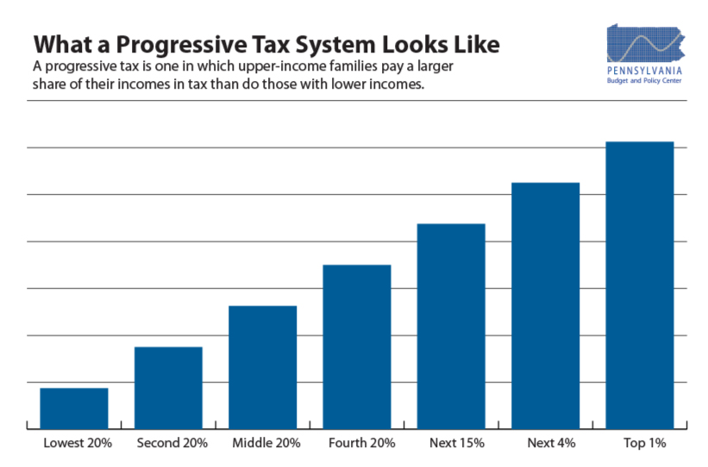

Slide 16
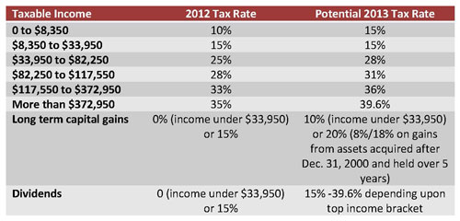

Slide 17
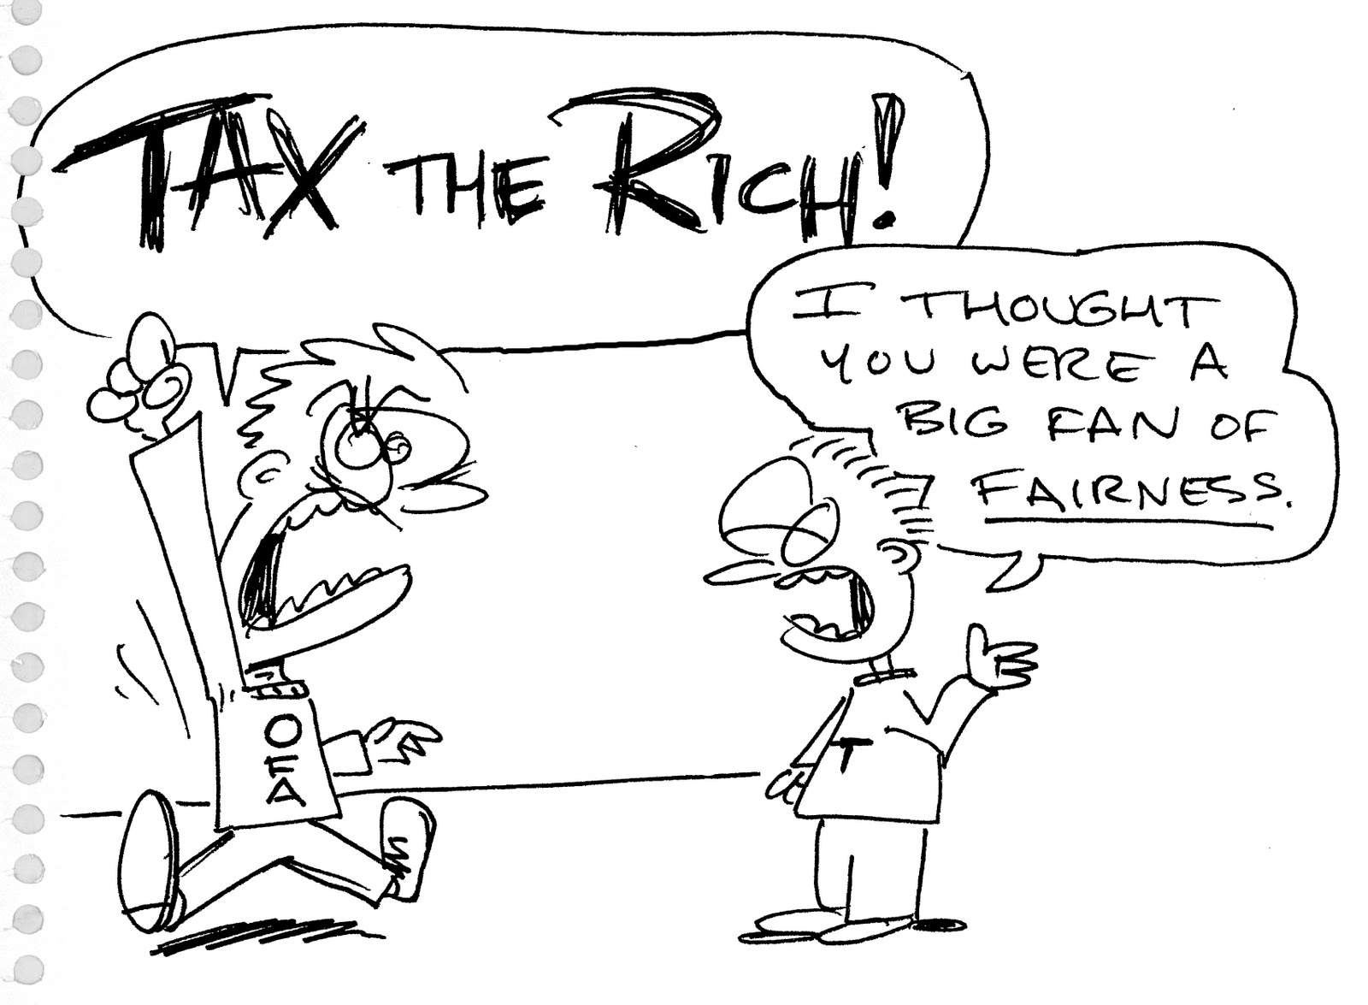

Slide 18
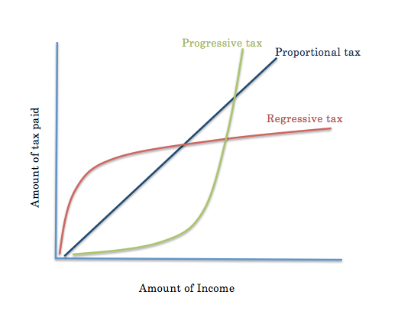

Slide 19
Proportional Tax- tax that is applied at the same rate against all income. (some say it is also regressive)
Other sources of revenue- 6% of revenues-excise taxes and tariffs=taxes on imported goods. Estate taxes-taxes on property and money that is passed on to heirs.
Gift taxes- taxes on money or property given from one living person to another.
Fees- national parks, etc. Federal Reserve Bank also has earnings from money loaned.

Slide 20
Borrowing Money- sells bonds, a financial instrument by which a borrower agrees to pay back borrowed money plus interest at a future date. Historically was only implemented in an emergency, BUT we have had a deficit since 1970 except for (1998-2001). Ie) government revenues are lower than expenses. Today in excess of 17 trillion!!!!! $17,000,000,000,000.00
Some years we are only paying the interest.

Slide 21
Government Spending- mandatory and discretionary.
Mandatory- spending required by law and not subject to the annual budget process. A large % goes to entitlement programs that people are entitled to by law, ie. Social security. Gov cannot deny funding without changing law.
Used to be about 26% of budget NOW 69%!!!

Slide 22
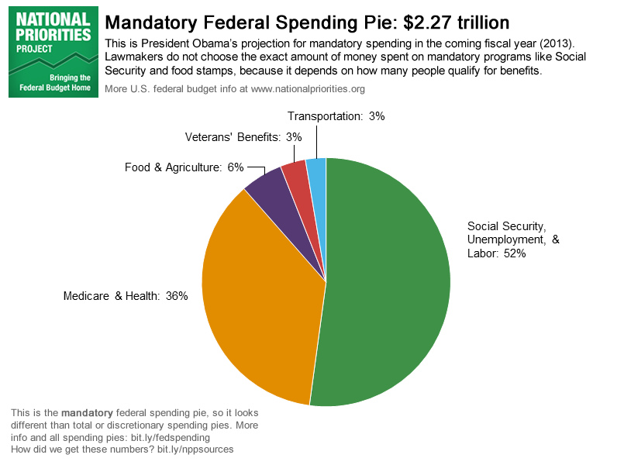

Slide 23
Discretionary Spending-spending subject to the annual budget process. Congress uses its judgment to allocate funds. ~ 31% of budget.
Once president proposes budget Congress must still pass it.

Slide 24
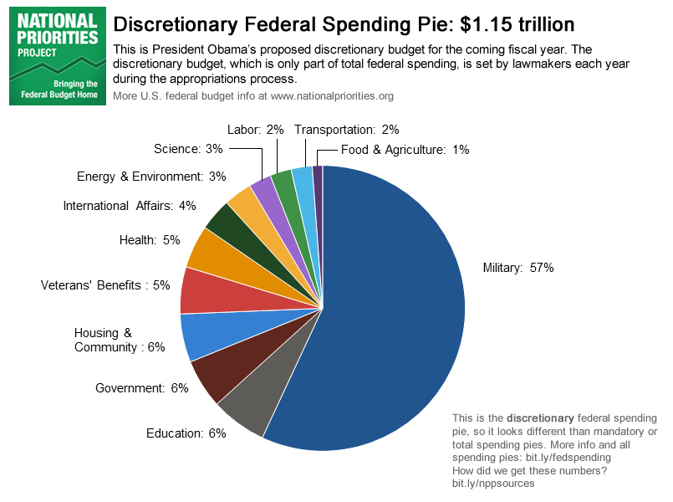

Slide 25
Budget Process-reflects the nations priorities, and how branches compromise.
FY 2014 = October 1, 2013 thru September 30, 2014
Budget is one fiscal year. See above.

Slide 26
President’s Budget- President responsible for preparing and presenting the national budget. Reflects his legislative priorities- areas he feels most need funding.
Office of Management and Budget OMB-help create the budget. It works with departments and agencies, they submit budget requests to OMB, which reviews them and makes adjustments according to presidential priorities. Generally finished by January, new year starts October.

Slide 27
The Budget in Congress: President must present budget to Congress by the first Monday in February. All in Congress hands now. CBO helps (non partisian).
1st –Congress needs to agree on totals for revenue and spending and pass a concurrent resolution. Budget committees-(not signed by pres., no force of law.)
2nd- Budget hearings-Appropriations committees. They have authority over discretionary spending.

Slide 28
3rd- spending bills to president.
4th- Should be finished by beginning of fiscal year, if not Congress will need to sign continuing resolution to keep gov’t funded. If cannot agree could cause gov’t shutdown.
2013 was shut down from Oct. 1-16th.
Finally

Slide 29
1. Why did the government shut down?
Congress has one key duty in the Constitution -- pass spending bills that fund the government. If it doesn't, most functions of government -- from funding agencies to paying out small business loans and processing passport requests -- grinds to a halt. But some services, like Social Security, air traffic control and active military pay, will continue to be funded. Oh, and Congress still gets paid, too.

Slide 30
Fiscal and Monetary Policy
F= Congress and the president create by making the budget and tax laws.
M=when government changes amount of money in circulation and interest rate at which money can be borrowed.

Slide 31
Fiscal and Monetary policies help federal work toward 4 part economic goal.
Economic growth
Low unemployment
Stable prices for goods and services
Balanced budget

Slide 32
Fiscal Policy- goal is to provide adequate funds for government without adversely affecting the overall economy.
If economy is growing slowly or shrinking gov can: spend more money or cut taxes. Through targeted spending the economy can be stimulated to produce more goods and hire workers. By cutting taxes, the people get to keep more money which some will spend thereby stimulating the economy.

Slide 33
If government spends more

