Slide 1
The next part of Chapter 3
SUPPLY

Slide 2
The Law of Supply
According to the law of supply, suppliers will offer more of a good at a higher price.
Price
As price
increases…
Supply
Quantity supplied increases
Price
As price falls…
Supply
Quantity supplied falls

Slide 3
How Does It Work?
Economists use the term quantity supplied to describe how much of a good is offered for sale at a specific price.
The promise of increased revenues when prices are high encourages firms to produce more.
Rising prices draw new firms into a market and add to the quantity supplied of a good.

Slide 4
Supply Schedules
A market supply schedule is a chart that lists how much of a good all suppliers will offer at different prices.
Market Supply Schedule
Price per slice of pizza
Slices supplied per day
$.50
1,000
$1.00
1,500
$1.50
2,000
$2.00
2,500
$2.50
3,000
$3.00
3,500

Slide 5
Supply Curves
A market supply curve is a graph of the quantity supplied of a good by all suppliers at different prices.
Again, this is just another way of looking at the same information presented on the supply schedule.
Market Supply Curve
3.00
2.50
2.00
1.50
1.00
.50
0
Supply
Price (in dollars)
0
500
1000
1500
2000
2500
3000
3500
Output (slices per day)

Slide 6
Back to elasticity
Elasticity of supply is a measure of consumers’ reactions to a change in price.
If supply is not very affected by a change in price, it is considered Inelastic.
If Supply IS very affected by the change in price, it is Elastic.

Slide 7
What Affects Supply?
TIME:
In the short run, a company is not easily able to change their output, so supply is inelastic
In the Long run, though, a company is more flexible, so the supply is more elastic.

Slide 8
1. What is the law of supply?
  (a) the lower the price, the larger the quantity supplied
  (b) the higher the price, the larger the quantity supplied
  (c) the higher the price, the smaller the quantity supplied
  (d) the lower the price, the more manufacturers will produce the good
2. What happens when the price of a good with an elastic supply goes down?
  (a) existing producers will expand and some new producers will enter the market
  (b) some producers will produce less and others will drop out of the market
  (c) existing firms will continue their usual output but will earn less
  (d) new firms will enter the market as older ones drop out

Slide 9
Section 2: Costs of Production

Slide 10

Labor decisions
Marginal Product of Labor
Companies must decide how the number of workers will affect their total production.
The Marginal product of labor is the change in output after hiring one additional laborer, or worker.
Labor (number of workers)
Output (beanbags per hour)
Marginal product of labor
0
0
—
1
4
4
2
10
6
3
17
7
4
23
6
5
28
5
6
31
3
7
32
1
8
31
–1

Slide 11
Marginal Returns
Increasing marginal returns occur when marginal production levels increase with new investment.
Increasing, Diminishing, and Negative Marginal Returns
8
7
6
5
4
3
2
1
0
–1
–2
–3
Increasing marginal returns
Diminishing marginal returns
Diminishing marginal returns occur when marginal production levels decrease with new investment.
Marginal Product of labor
(beanbags per hour)
Negative marginal returns
Negative marginal returns occur when the marginal product of labor becomes negative.
1
2
3
4
5
6
7
8
9
Labor
(number of workers)

Slide 12

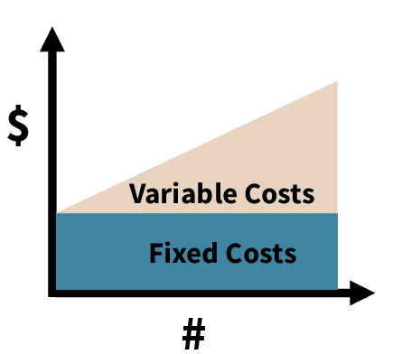
Production Costs
A fixed cost is a cost that does not change, regardless of how much of a good is produced. Examples: rent and salaries
Variable costs are costs that rise or fall depending on how much is produced. Examples: costs of raw materials, some labor costs.
The total cost equals fixed costs plus variable costs.
The marginal cost is the cost of producing one more unit of a good.

Slide 13
Setting Output
Marginal revenue is the additional income from selling one more unit of a good. It is usually equal to price.
To determine the best level of output, firms determine the output level at which MARGINAL REVENUE IS EQUAL TO MARGINAL COST.
Production Costs
Beanbags (per hour)
Fixed cost
Variable cost
Total cost (fixed cost + variable cost)
Marginal cost
Marginal revenue (market price)
Total revenue
Profit
(total revenue – total cost)
0
1
2
3
4
$36
36
36
36
36
$0
8
12
15
20
$36
44
48
51
56
—
$8
4
3
5
$24
24
24
24
24
$0
24
48
72
96
$ –36
–20
0
21
40
5
6
7
8
36
36
36
36
27
36
48
63
63
72
84
99
7
9
12
15
24
24
24
24
120
144
168
192
57
72
84
93
9
10
11
12
36
36
36
36
82
106
136
173
118
142
172
209
19
24
30
37
24
24
24
24
216
240
264
288
98
98
92
79

Slide 14
Section 2 Questions
1. What are diminishing marginal returns of labor?
  (a) some workers increase output but others have the opposite effect
  (b) additional workers increase total output but at a decreasing rate
  (c) only a few workers will have to wait their turn to be productive
  (d) additional workers will be more productive
2. How does a firm set its total output to maximize profit?
  (a) set production so that total revenue plus costs is greatest
  (b) set production at the point where marginal revenue is smallest
  (c) determine the largest gap between total revenue and total cost
  (d) determine where marginal revenue and profit are the same

Slide 15
Section 3: Changes in Supply

Slide 16
Input costs and supply
Any change in the cost of an input such as the raw materials, machinery, or labor used to produce a good, will affect supply.
As input costs increase, the firm’s marginal costs also increase, decreasing profitability and supply.
Input costs can also decrease. New technology can greatly decrease costs and increase supply.

Slide 17


Government influences on Supply
By raising or lowering the cost of producing goods, the government can encourage or discourage an entrepreneur or industry.
Subsidies
A subsidy is a government payment that supports a business or market. Subsidies cause the supply of a good to increase.
Taxes
The government can reduce the supply of some goods by placing an excise tax on them. An excise tax is a tax on the production or sale of a good.
Regulation
Regulation occurs when the government steps into a market to affect the price, quantity, or quality of a good. Regulation usually raises costs.

Slide 18
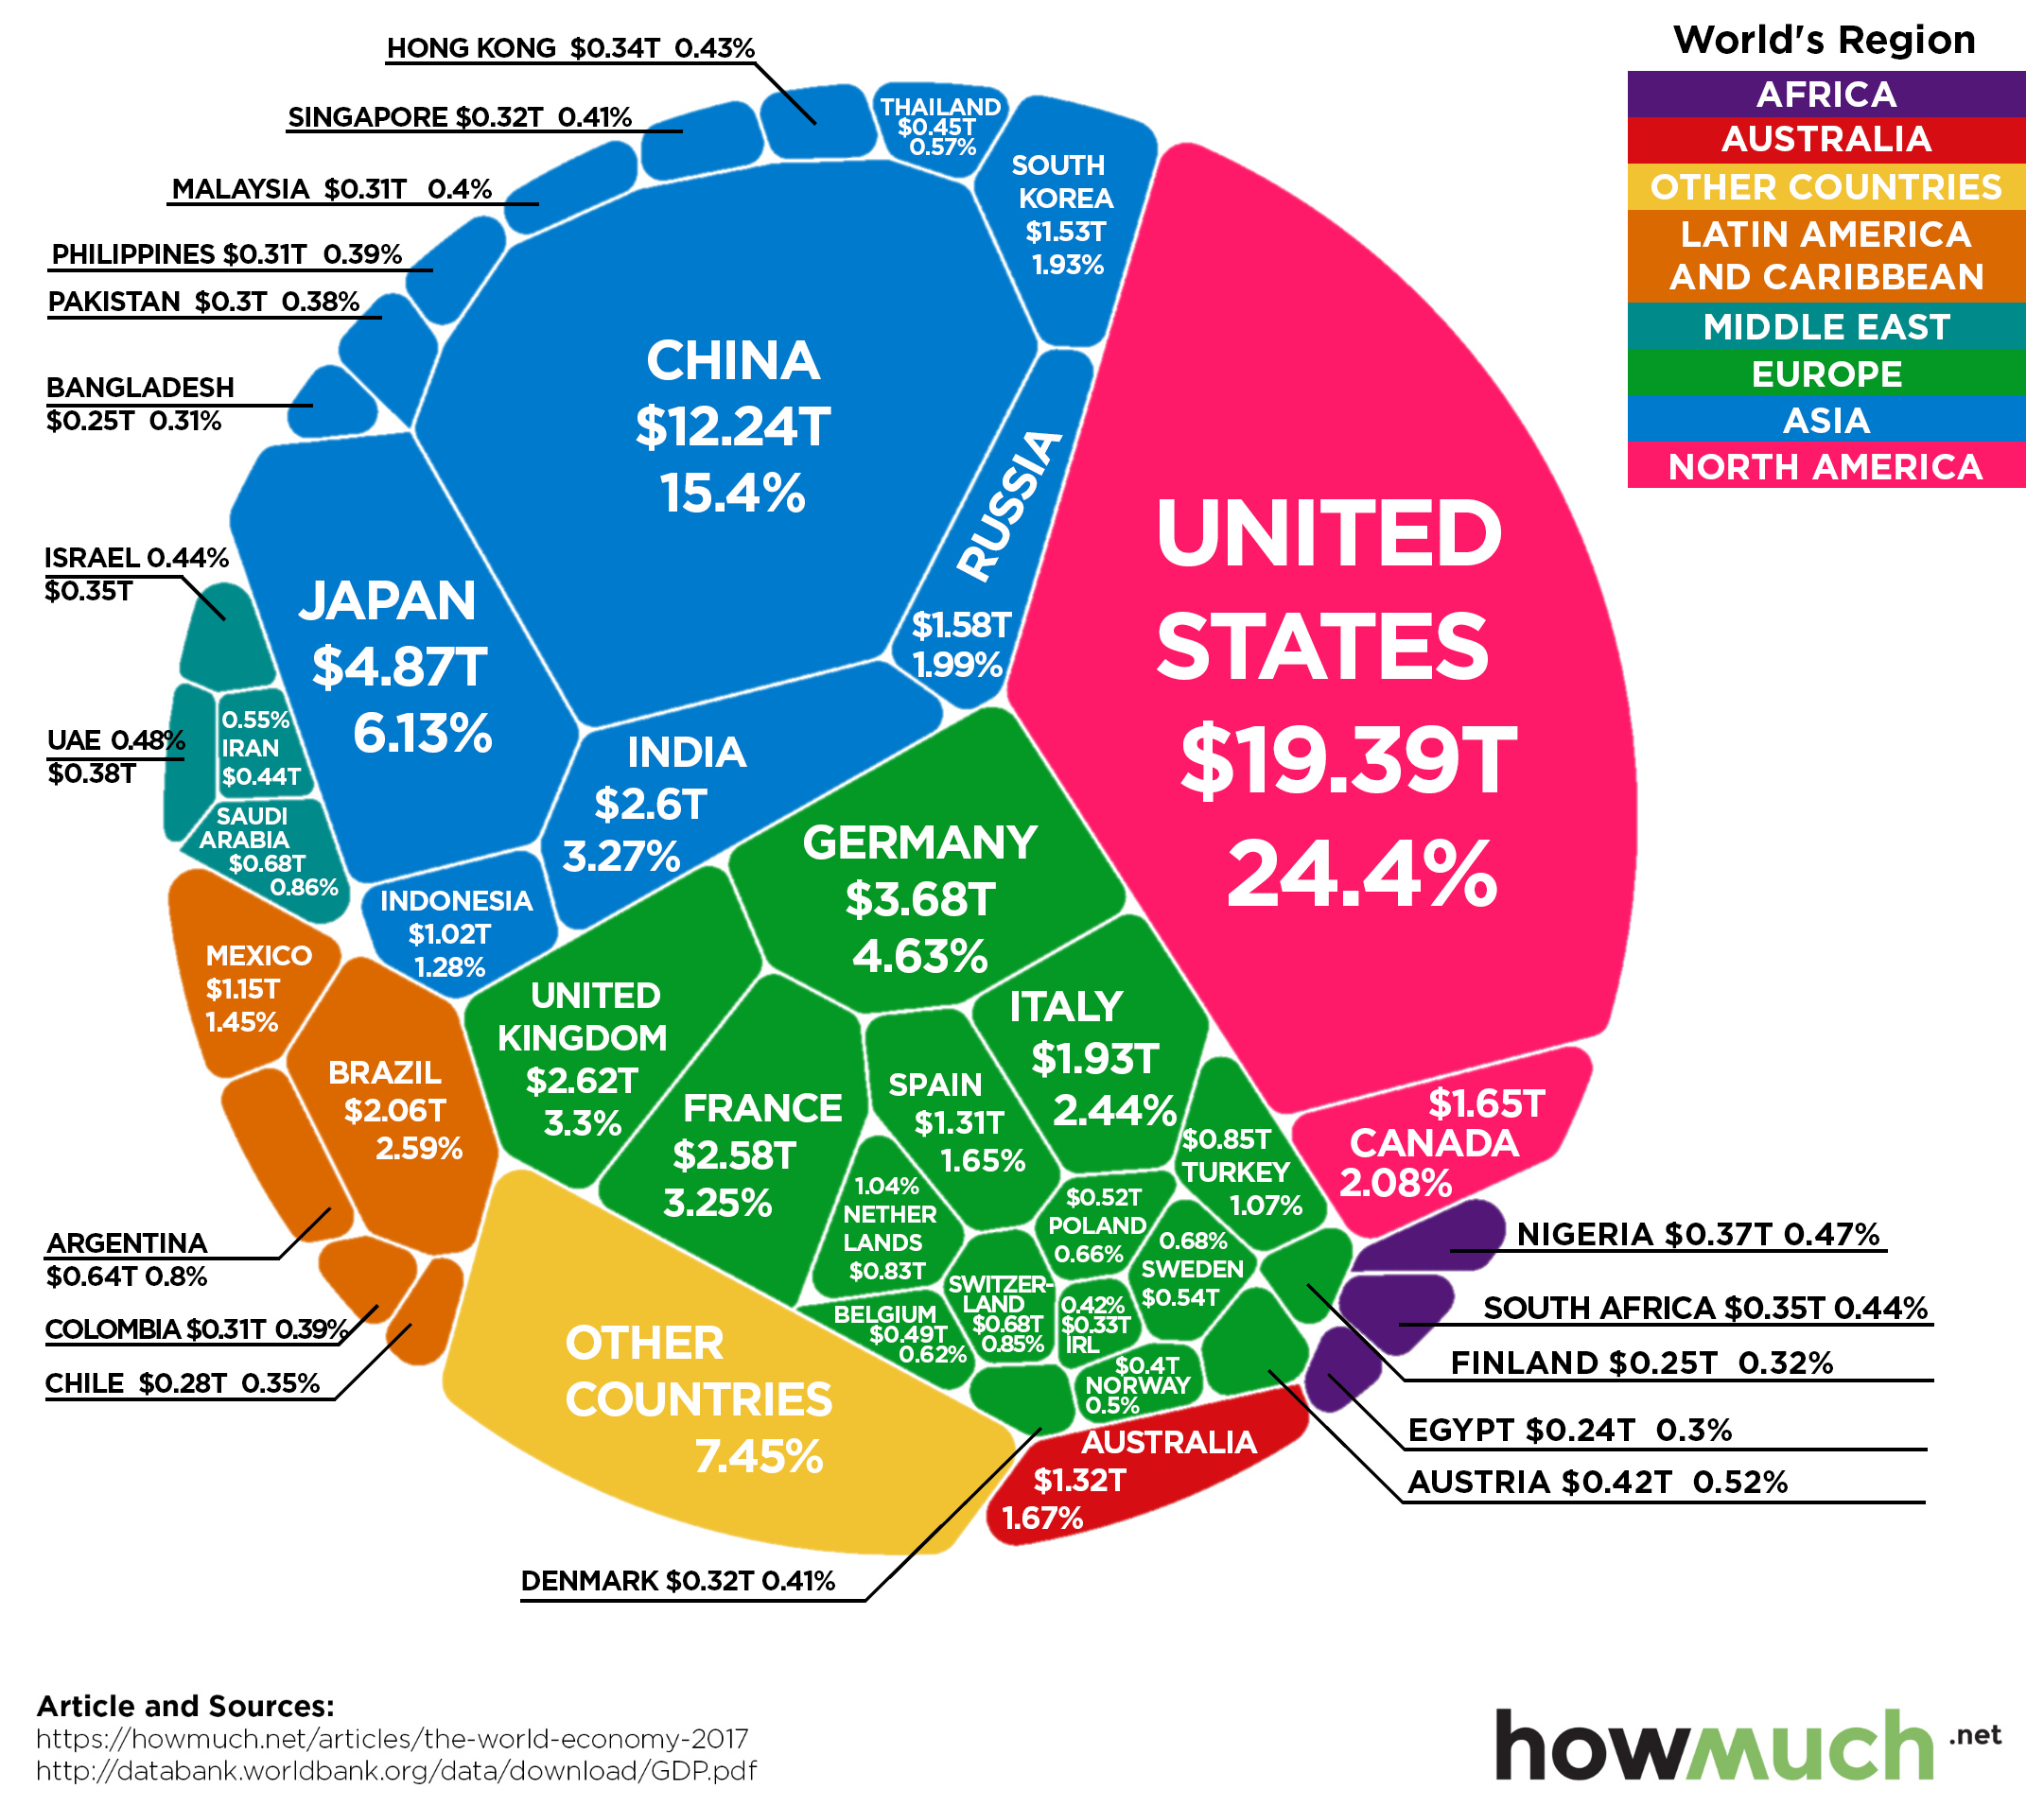
Other Affecting factors
The Global Economy
  The supply of imported goods and services has an impact on the supply of the same goods and services here.
  Government import restrictions will cause a decrease in the supply of restricted goods.
Future Expectations of Prices
  Expectations of higher prices will reduce supply now and increase supply later. Expectations of lower prices will have the opposite effect.
Number of Suppliers
  If more firms enter a market, the market supply of the good will rise. If firms leave the market, supply will decrease.

Slide 19
1. What affect does a rise in the cost of raw materials have on the cost of a good?
  (a) A rise in the cost of raw materials lowers the overall cost of production.
  (b) The good becomes cheaper to produce.
  (c) The good becomes more expensive to produce.
  (d) This does not have any affect on the eventual price of a good.
2. When government actions cause the supply of a good to increase, what happens to the supply curve for that good?
  (a) It shifts to the left.
  (b) It shifts to the right.
  (c) It reverses direction.
  (d) The supply curve is unaffected.

