Slide 1
The Last Part of Chapter 3
Prices

Slide 2
Balancing the Market
The point at which quantity demanded and quantity supplied come together is known as equilibrium.
Finding Equilibrium
Equilibrium Point
Combined Supply and Demand Schedule
$3.50
$3.00
$2.50
$2.00
$1.50
$1.00
$.50
Price of a slice of pizza
Quantity demanded
Quantity supplied
Result
$ .50
300
100
Shortage from excess demand
Price per slice
Equilibrium Price
a
$1.00
250
150
$1.50
200
200
Equilibrium
Equilibrium Quantity
Supply
Demand
$2.00
150
250
$2.50
100
300
Surplus from excess supply
0
50
100
150
200
250
300
350
Slices of pizza per day
$3.00
50
350

Slide 3


Interactions between buyers and sellers will always push the market back towards equilibrium.
If the market price or quantity supplied is anywhere but at the equilibrium price, the market is in a state called disequilibrium. There are two causes for disequilibrium:
Excess Demand
Excess demand occurs when quantity demanded is more than quantity supplied.
Excess Supply
Excess supply occurs when quantity supplied exceeds quantity demanded.

Slide 4

Price ceilings
CEILING
In some cases the government steps in to control prices. These interventions appear as price ceilings and price floors.
A price ceiling is a maximum price that can be legally charged for a good.
An example of a price ceiling is rent control, a situation where a government sets a maximum amount that can be charged for rent in an area.

Slide 5

Price floors
A price floor is a minimum price, set by the government, that must be paid for a good or service.
One well-known price floor is the minimum wage, which sets a minimum price that an employer can pay a worker for an hour of labor.
FLOOR

Slide 6
Section 1 Questions
1. Equilibrium in a market means which of the following?
  (a) the point at which quantity supplied and quantity demanded are the same
  (b) the point at which unsold goods begin to pile up
  (c) the point at which suppliers begin to reduce prices
  (d) the point at which prices fall below the cost of production
2. The government’s price floor on low wages is called the
  (a) market equilibrium
  (b) base wage rate
  (c) minimum wage
  (d) employment guarantee

Slide 7
First part of project
Over the weekend, decide what career you want to have.
On a sheet of paper, write it down.
Research the yearly salary for that career and write it down on the same paper.
Simple.

Slide 8
Shifts in supply
Graph A: A Change in Supply
$800
$600
$400
$200
0
Understanding a Shift
  Since markets tend toward equilibrium, a change in supply will set market forces in motion that lead the market to a new equilibrium price and quantity sold.
Excess Supply
  A surplus is a situation in which quantity supplied is greater than quantity demanded. If a surplus occurs, producers reduce prices to sell their products. This creates a new market equilibrium.
A Fall in Supply
  The exact opposite will occur when supply is decreased. As supply decreases, producers will raise prices and demand will decrease.
a
b
Original supply
c
Price
New supply
Demand
1
2
3
4
5
Output (in millions)

Slide 9
Shifts in demand
Excess Demand
  A shortage is a situation in which quantity demanded is greater than quantity supplied.
Search Costs
  Search costs are the financial and opportunity costs consumers pay when searching for a good or service.
A Fall in Demand
  When demand falls, suppliers respond by cutting prices, and a new market equilibrium is found.
Graph B: A Change in Demand
$60
$50
$40
$30
$20
$10
Supply
Price
c
a
b
New demand
Original demand
0
100
200
300
400
500
600
700
800
900
Output (in thousands)

Slide 10
Section 2 questions
1. When a new equilibrium is reached after a fall in demand, the new equilibrium has a
  (a) lower market price and a higher quantity sold.
  (b) higher market price and a higher quantity sold.
  (c) lower market price and a lower quantity sold.
  (d) higher market price and a lower quantity sold.
2. What happens when any market is in disequilibrium and prices are flexible?
  (a) market forces push toward equilibrium
  (b) sellers waste their resources
  (c) excess demand is created
  (d) unsold perishable goods are thrown out

Slide 11
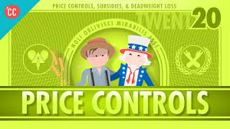
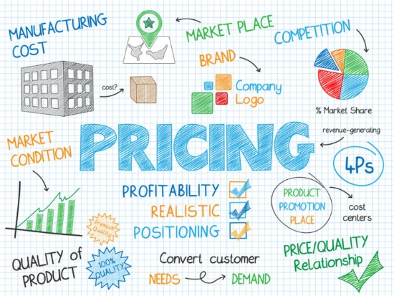
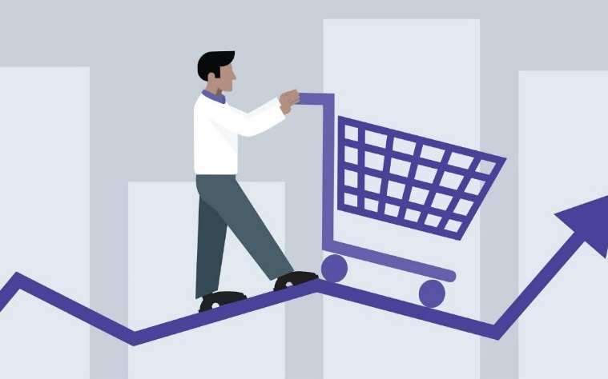

Prices in the Free Market
Prices serve a vital role in a free market economy.
Prices help move land, labor, and capital into the hands of producers, and finished goods in to the hands of buyers.
Prices create efficient resource allocation for producers and a language that both consumers and producers can use.

Slide 12

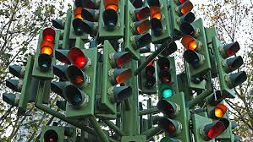

Advantages of Prices
Prices provide a language for buyers and sellers.
1. Prices as an Incentive
Prices communicate to both buyers and sellers whether goods or services are scarce or easily available. Prices can encourage or discourage production.
2. Signals
Think of prices as a traffic light. A relatively high price is a green light telling producers to make more. A relatively low price is a red light telling producers to make less.
3. Flexibility
In many markets, prices are much more flexible than production levels. They can be easily increased or decreased to solve problems of excess supply or excess demand.
4. Price System is "Free"
Unlike central planning, a distribution system based on prices costs nothing to administer.

Slide 13


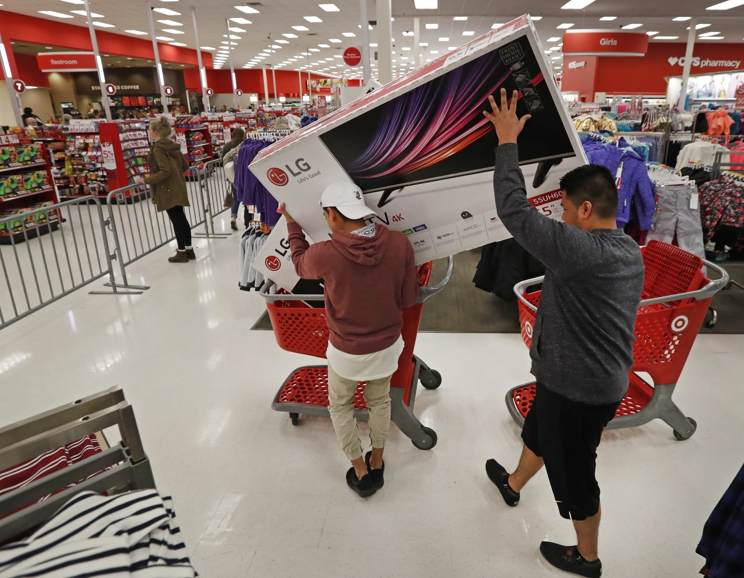
Efficient Resource Allocation
Resource Allocation
  A market system, with its fully changing prices, ensures that resources go to the uses that consumers value most highly.
Market Problems
  Imperfect competition between firms in a market can affect prices and consumer decisions.
Spillover costs
  externalities, are costs of production, such as air and water pollution, that “spill over” onto people who have no control over how much of a good is produced.
  If buyers and sellers have imperfect information on a product, they may not make the best purchasing or selling decision.

Slide 14
Section 3 Questions
1. What prompts efficient resource allocation in a well-functioning market system?
  (a) businesses working to earn a profit
  (b) government regulation
  (c) the need for fair allocation of resources
  (d) the need to buy goods regardless of price
2. How do price changes affect equilibrium?
  (a) Price changes assist the centrally planned economy.
  (b) Price changes serve as a tool for distributing goods and services.
  (c) Price changes limit all markets to people who have the most money.
  (d) Price changes prevent inflation or deflation from affecting the supply of goods.

Slide 15
More on the Project
First off, your hypothetical careers and their annual salaries are due today.
Next, the other part is something I will give you until WEDNESDAY march 6 to turn in.

Slide 16
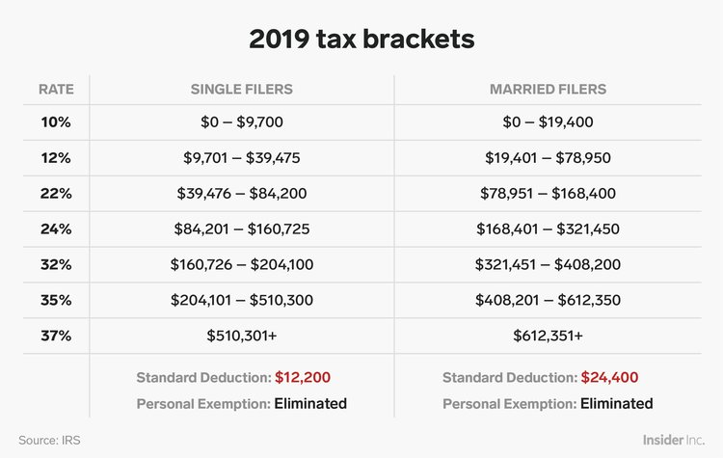
Taxes
On your own paper, research and write down:
how much federal income tax (FIT) is withheld for your career.
Next, find out how much you would make per paycheck, if you were paid every other week.
How much social security (SS) is taken out of each paycheck. This will be a percentage.
Use the tax bracket percentage to find out how much FIT will be taken out per paycheck
Subtract SS and FIT from weekly paycheck amount.

Slide 17
Part 3 (Wednesday)
What is a W-2? Does anyone know?
Every year around tax season, the company you work for will send you a series of documents that outline how much you made from them within the past year (or since you started working if it was less than a year.)
This document also tells you how much was taken from our pay by social security and Federal income tax in that time.
You will use all of that information to fill out your tax forms.

Slide 18
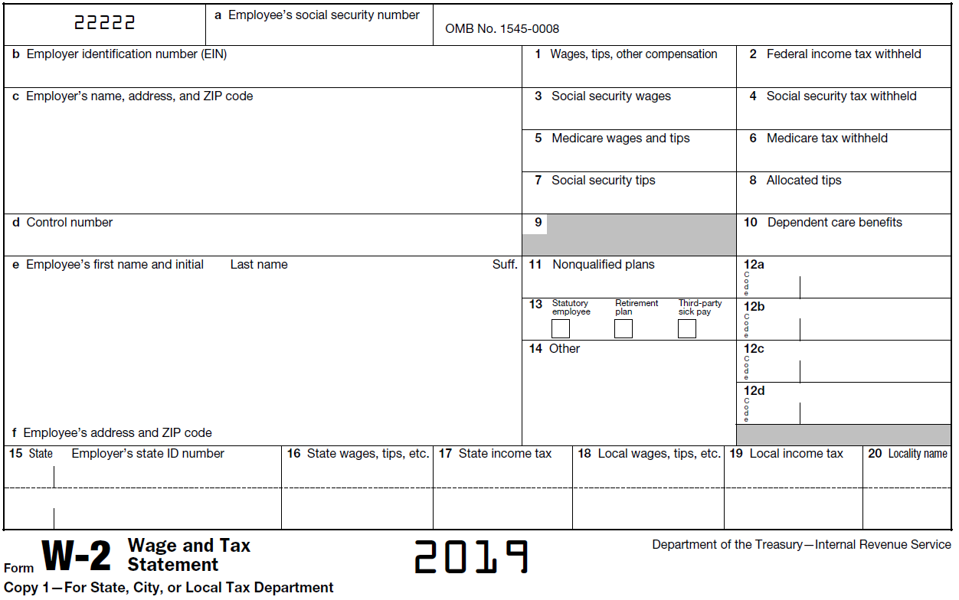
Part 3 (Wednesday)

Slide 19
Part 4 (___day)
A 1040 form is used to calculate how much you overpaid, or owe, from the paying taxes the previous year.
This final part of the project will be a step by step process on how to fill our your own 1040 form using the information on your W-2.

Slide 20
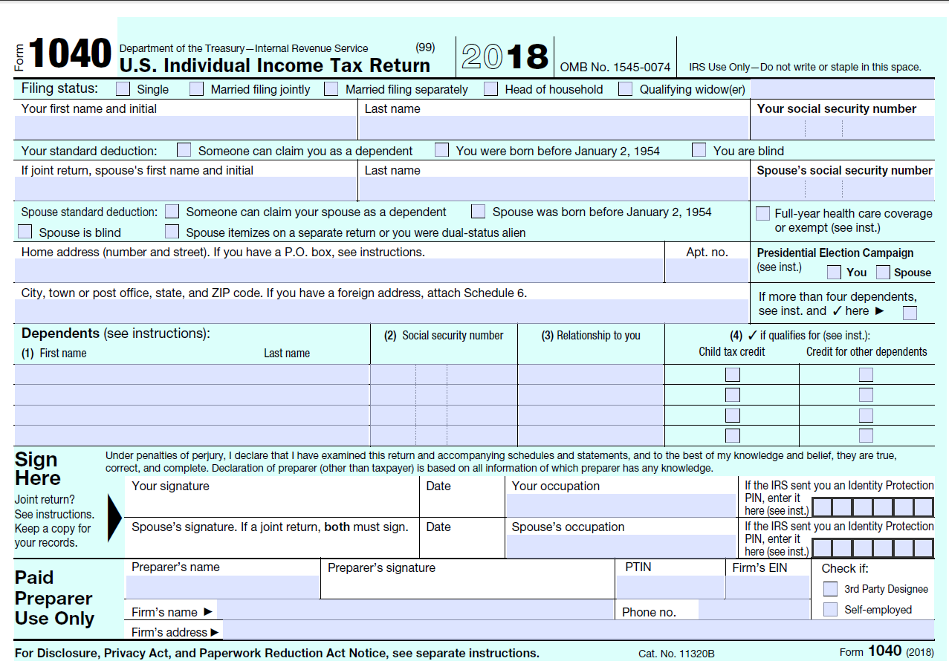
Part 4 (___day)

Slide 21
