Slide 1
Economics is the study of how individuals, families, businesses, and societies use limited resources to fulfill their unlimited wants.
The study of economics begins with the idea that people cannot have everything they need and want.
A need is something like air, food, or shelter that is necessary for survival.
A want is an item that we desire but that is not essential to survival.
Because people cannot have everything the need or want they must consider their options and decide which choice will fit their needs best.

Slide 2
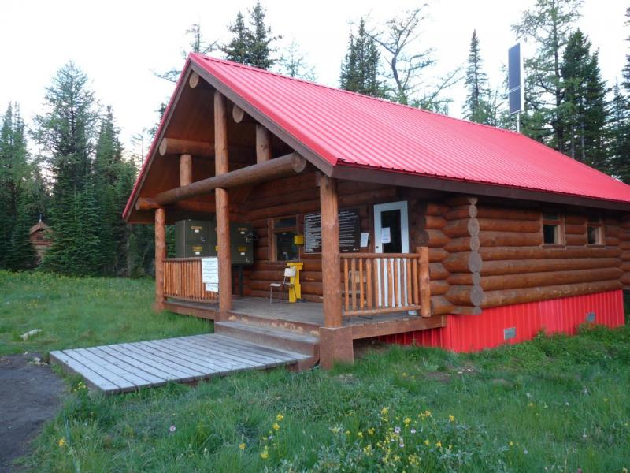
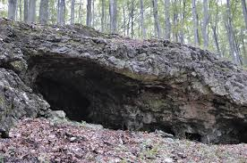
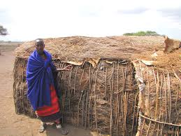
Need- Shelter

Slide 3
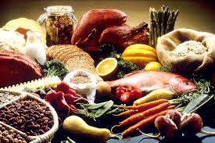
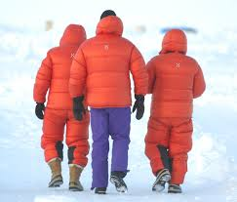
Need- Food Need- Clothing

Slide 4
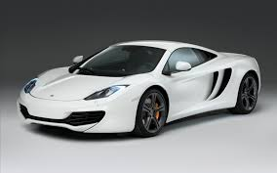
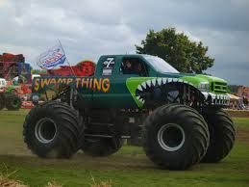
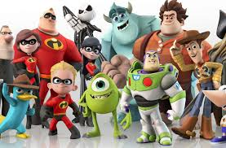
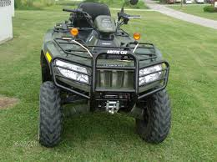
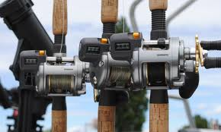
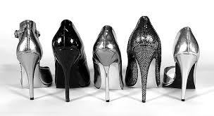
Wants
JACK

Slide 5
But why must people make such choices? The reason is scarcity. Scarcity means that people do not have and cannot have enough income, time, and other resources to satisfy their every want.
Scarcity exists in all places, at all times.
Scarcity is not the same as a shortage, a shortage occurs when producers will not or cannot offer goods and services at the current price. Shortages can be temporary of long-term.

Slide 6
Economist call the resources that are used to make all goods and services the factors of production or factor resources. The factors of production are:
land
labor
capital
some economist add:
entrepreneurship
technology
Goods are physical objects such as shoes and shirts.
Services are actions or activities that one person performs for another (haircuts, dental checkups, and tutoring).

Slide 7
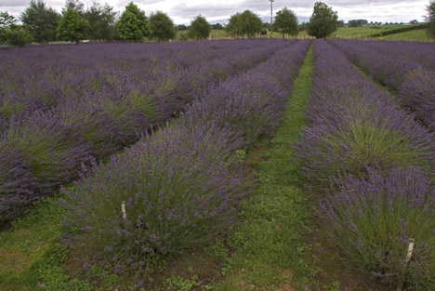
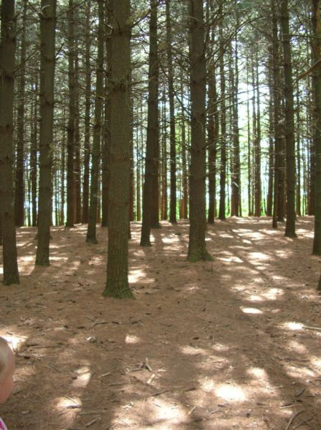
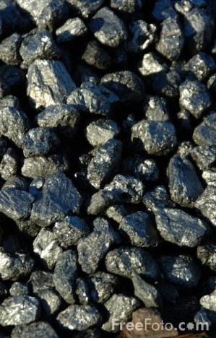
Land
Economist use the term land to refer to all natural resources used to produce goods and services. Natural resources are materials found in nature. They include land for farming and products that are on the land, such as coal, water, and forests.

Slide 8
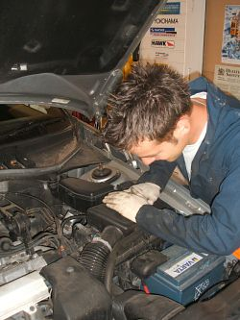
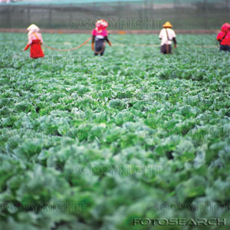
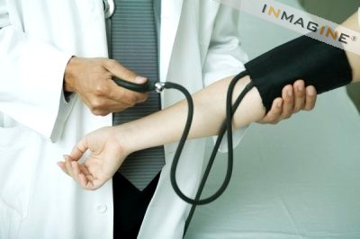
Labor
Another factor of production is labor. Labor is the effort that a person devotes to a task for which that person is paid. Labor includes the work a car mechanic does on your car, the laborer in the fields, as well as the medical aid provided by a doctor.

Slide 9
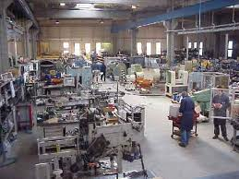
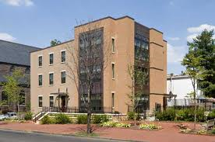
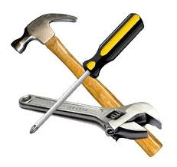
Capital
Capital is any human-made resource that is used to produce other goods and services. The two categories of capital are physical capital and human capital.
Capital increases productivity. Productivity-the amount of output (goods and services)that results from a given level of inputs (land,labor,capital,entrepreneurship)

Slide 10
Entrepreneurs
If land, labor, and capital are the essential ingredients for creating all goods and services, who pulls these resources together? Entrepreneurs are ambitious leaders who decide how to combine land, labor, and capital resources to create new goods and services.
They are individuals who take risks to develop original ideas, start businesses, create new industries, and fuel economic growth.
34% of new business fail

Slide 11
Technology
Any use of labor, land, or capital that produces goods and services more efficiently.
end of 10.1
Trade-offs
Economists point out that all individuals, businesses, and large groups of people-even governments- make decisions that involve trade- offs.
Trade-offs are all the alternatives that we give up whenever we choose one course of action over another. In other words, a trade-off is all of the possible alternatives that are rejected when a choice is made.

Slide 12
Whenever individuals, businesses, or governments decide on a course of action, they face many trade-offs. One alternative, though, is usually more desirable than all the others. The most desirable alternative given up as the result of a decision is called the opportunity cost.
If a family buys a computer, family members cannot use the same money to pay for their second choice, going on a trip. The trip, then, is the opportunity cost of buying the computer.

Slide 13
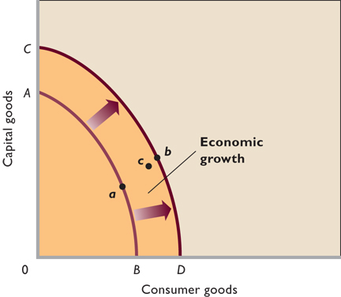
Efficiency-use of resources in such a was as to maximize the output of goods and services.
Underutilization- use of fewer resources than the economy is capable of using.
Growth- PPC is a snap shot in time showing all the combinations. If more factors are put into play the curve “shifts to the right”

Slide 15
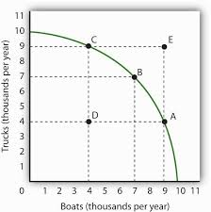

Slide 16
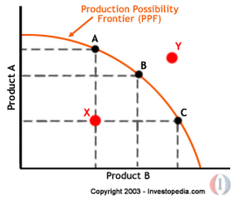

Slide 17
Alternatives
Sleep late
Wake up early to study
Benefits
Enjoy more sleep
Have more energy during the day
Better grade on test
Teacher and parental approval
Personal satisfaction
Decision
Sleep late
Wake up early to study for test
Opportunity Cost
Extra study time
Enjoy sleep time
Benefits forgone
Better grade on test
Teacher and parental approval
Personal satisfaction
Enjoy more sleep
Have more energy during the day
A production possibilities curve, or graph, shows maximum combinations of goods and services that can be produced from a fixed amount of resources in a given period of time.
look at Figure 1.6 p. 15

Slide 18
Economists simplify their explanations of the trade-offs countries face by using the example of guns or butter.
In short, a country that decides to produce more military goods ("guns") has fewer resources to devote to consumer goods ("butter") and vice versa.
The steel used to make a tank is no longer available for building the dairy equipment needed to make butter.
end of 1.2
Microeconomics - economic theory dealing with behaviors and decision making by small groups or individuals.
Macroeconomics-economic theory dealing with the economy as a whole and decision making by large units.

Slide 19
Economy- all the activity in a nation that together affects the production, distribution and use of goods and services. Economists use models to explain/predict economic behavior in real world.
Values- are beliefs or characteristics that a person or group considers important, such as religious freedom, equal opportunity, individual initiative, freedom from want, etc.

Slide 20
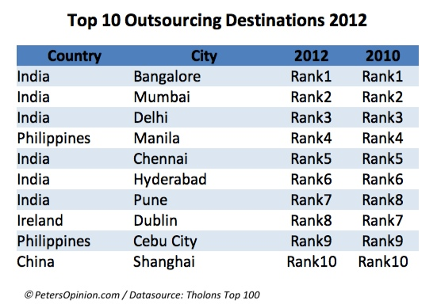

Slide 21
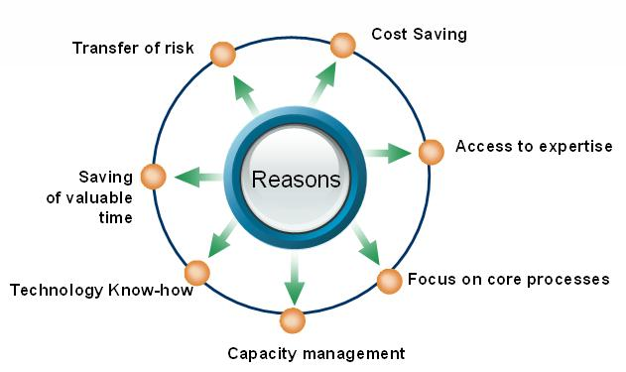

Slide 22
Cost- PPC can also show costs of a decision. If you make more cars then fewer tractors can be made. Cost does not necessarily mean money. Economists mean opportunity costs.
Law of Increasing Costs-

Slide 23
