Slide 1
Chapter 16
The Reformation in Europe
9.2
http://www.youtube.com/watch?v=-fadCAHjN-s&safe=active Henry VIII
http://www.youtube.com/watch?NR=1&feature=endscreen&v=3EGzHsye71c&safe=active

Slide 2
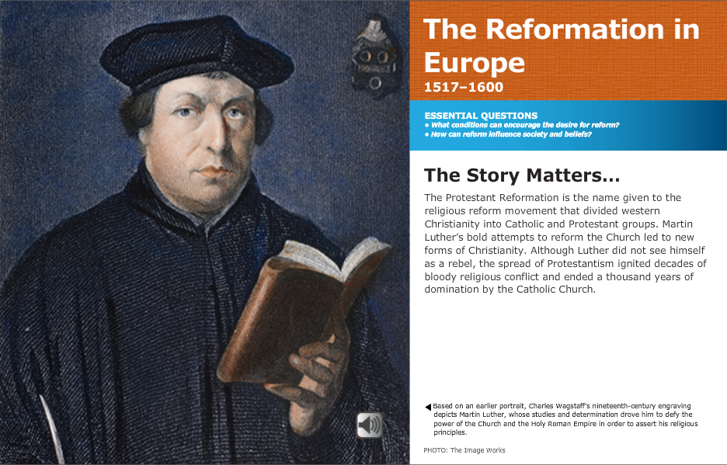

Slide 3
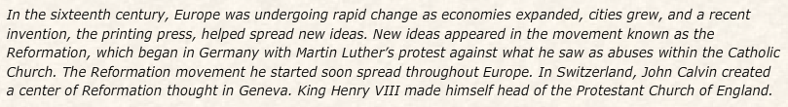
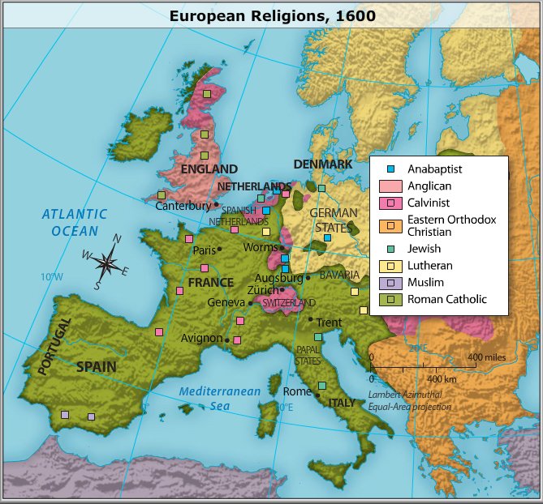

Slide 4
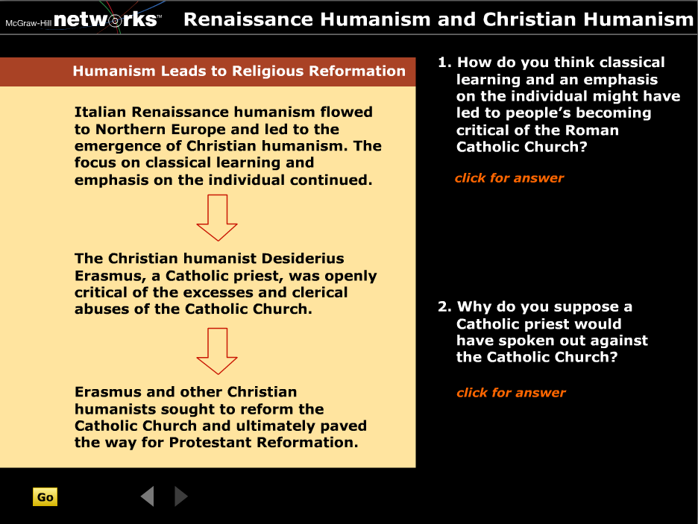

Slide 5
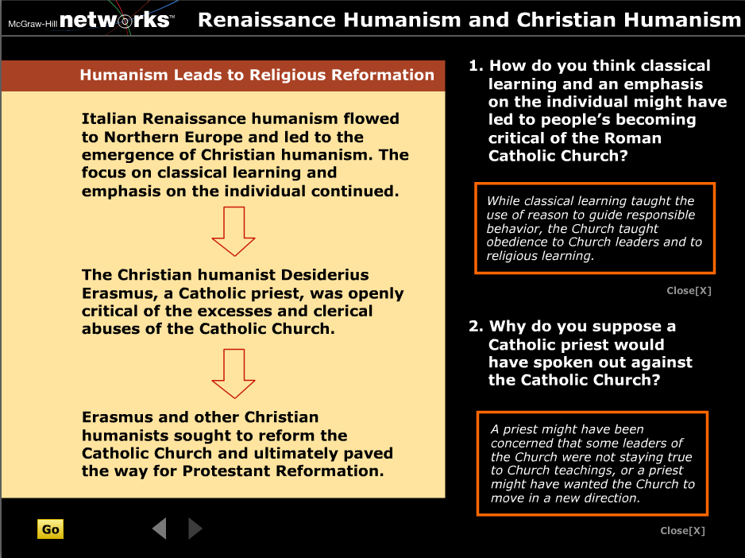

Slide 6
Ch 10.1, Vocab
Christian humanism
Salvation
Indulgence
Lutheranism
Fundamental
External
Valid

Slide 7
Humanism from Italy spreads North comes to be called Christian Humanism
Goal is to reform the Catholic Church
    Belief that humans had the ability to reason and improve themselves.
    By reading the classics and Christian fundamentals you would become more religious.

Slide 8
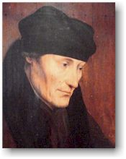
Erasmus
Erasmus thought that Christiantiy should show people how to live good lives on a daily basis rather than provide a system of beliefs that people have to practice to be saved. He sought to reform the Catholic Church not break away.
Erasmus and others were calling for reforms because of the corruption in the Catholic Church.

Slide 9
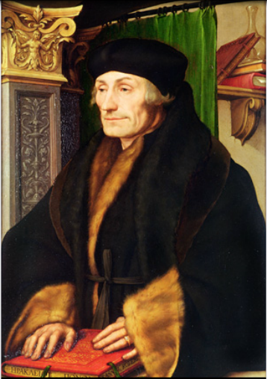
Erasmus
Father of Christian Humanism
  Into self improvement in the spirit of purging impure appetites
    Thought Catholic ideas were unnecessary: pilgrimage, fasting, relics, etc.

Slide 10
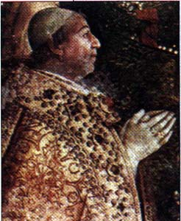
The popes who ruled during the Renaissance patronized the arts, spent extravagantly on personal pleasure, and fought wars. Many popes were too busy pursuing worldly affairs to have much time for spiritual duties.
Pope Alexander VI, for example, admitted that he had fathered several children.
A BIG NO NO !!!

Slide 11
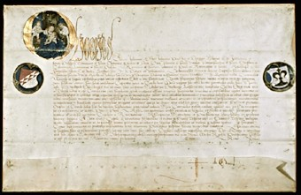
An indulgence was a
"paid for" pardon . It released a sinner from performing the penalty that a priest imposed for sins. Indulgences were not supposed to affect God's right to judge. Unfortunately, this gave people the impression that by buying indulgences, they could buy their way into heaven.

Slide 12
Problems w/ Church
Ineffective leadership
  Corruption
  Politics instead of faith
  Spiritual duties less important
Indulgences
  Releases from the punishment of sin

Slide 13
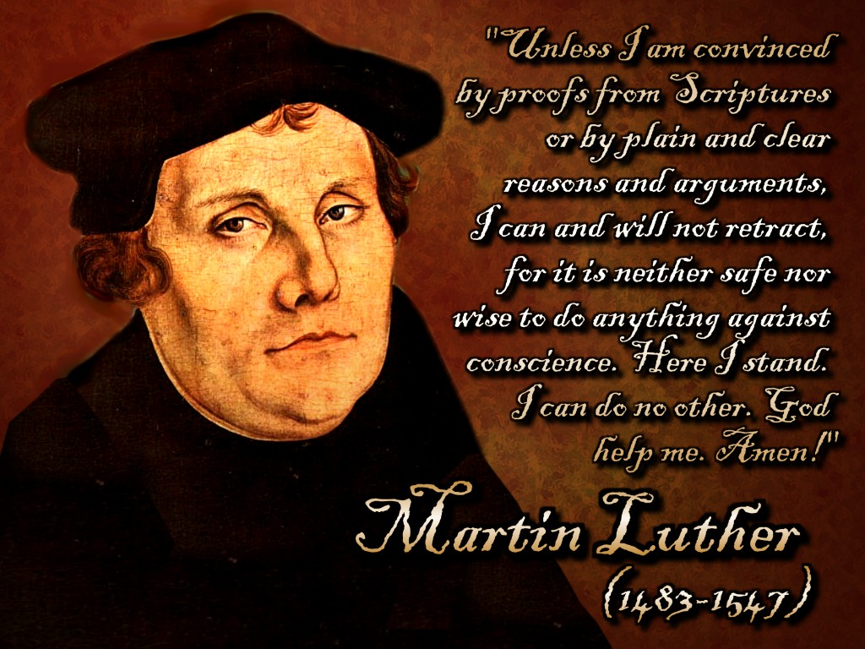
Martin Luther (the original)
Monk/professor
  Decides to break away from Catholic Church
Writes 95 Theses
  All about problems w/ church and indulgences
Justification by Faith alone

Slide 14
Catholic teachings stressed salvation through both faith and good works. Luther came to believe that humans were saved NOT by their good works but through their faith in GOD. He came to this belief by studying the Bible.

Slide 15
God's grace cannot be earned by performing good works. This idea called justification (being made right before God) by faith alone, became the chief teaching of the Protestant Reformation. The Bible became the only source of the religious truth for all Protestants.

Slide 16
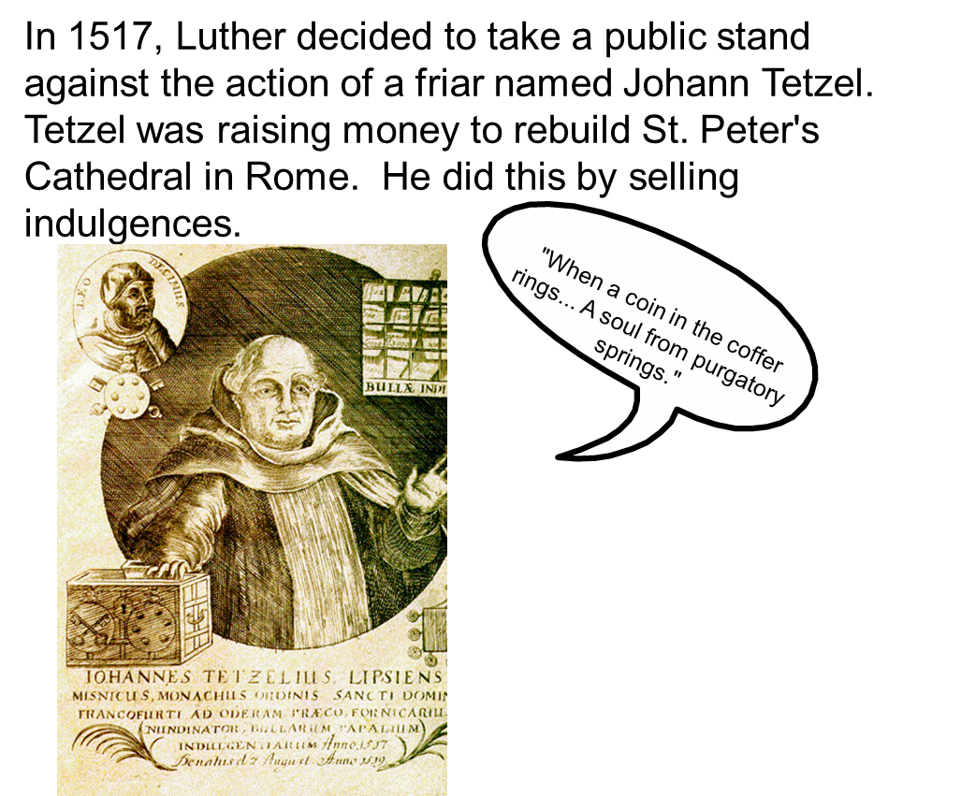

Slide 17
Query
Why did Luther object to the selling of indulgences?

Slide 18
Query
Why did Luther object to the selling of indulgences?
  B/c they gave ppl false hope in material solutions to sin, instead of leading them to develop their own faith – which Luther believed was the only road to salvation.

Slide 19
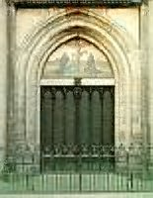
Luther wrote 95 Theses, or formal statements attacking the abuses in the sale of indulgences, beginning the Protestant Reformation. On October 31, 1517, he posted these statements on the door of the castle church.

Slide 20
http://player.discoveryeducation.com/index.cfm?guidAssetId=E8A6F7FA-9115-4521-8A57-7A905A6CE15C&blnFromSearch=1&productcode=US
4.14 min about M. Luther (dry)

Slide 21
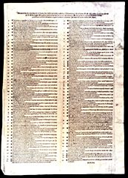
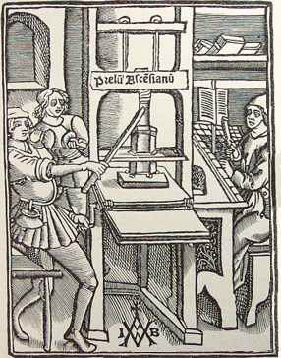
Someone copied Luther's words and took them to a printer. Quickly, Luther's name became known all over Germany. His actions began the Reformation, a movement for religious reform. It led to the founding of Christian churches that did not accept the pope's authority.
Calls to Reform the Church

Slide 22
95 Theses, But the Pope Ain’t One

Slide 23
Martin Luther ideas:
2 sacraments only-baptism and communion
Let clergy marry
Salvation by faith alone
Bible only source of religious truth

Slide 24
Initially, Church officials in Rome viewed Luther simply as a rebellious monk who needed to be punished by his superiors. However, as Luther's ideas became more popular, the pope realized that this monk was a serious threat. In one angry reply to Church criticism, Luther actually suggested that Christians drive the pope from the Church by force.

Slide 25
In 1520, Pope Leo X issued a decree threatening Luther with excommunication unless he took back his statements. Luther did not take back a word. Instead, his students at Wittenberg gathered around a bonfire and cheered as he threw the pope's decree into the flames. Leo excommunicated Luther.

Slide 26
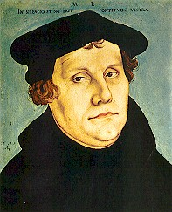
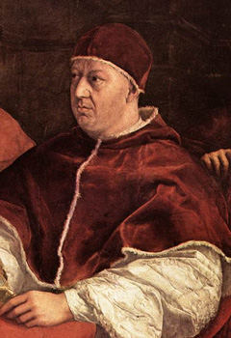
Take it back, Luther, Take it back!!!
Yeah, Uhmm...
No.

Slide 27

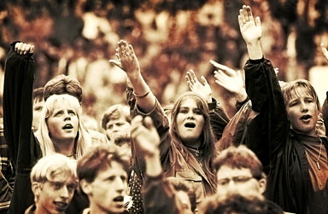

Yeah, Uhmm...No.
Go Luther.. Go Luther.. It's your birthday. Go Luther!!!
Dearest Luther,
Take it back or else.
Yours truly,
The Pope

Slide 28
Oh yeah?
Well I excommunicate you. What do you think of that?
.
Whatever dude

Slide 29
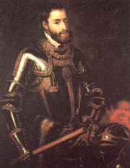
Holy Roman Emperor Charles V, a devout Catholic, also opposed Luther's teachings. Charles controlled a vast empire, including the German states. He summoned Luther to the town of Worms (vawrmz) in 1521 to stand trial. Told to recant, or take back his statements, Luther refused.
Yeah, Uhmm...
No.
Take it back, Luther, Take it back!!!

Slide 30

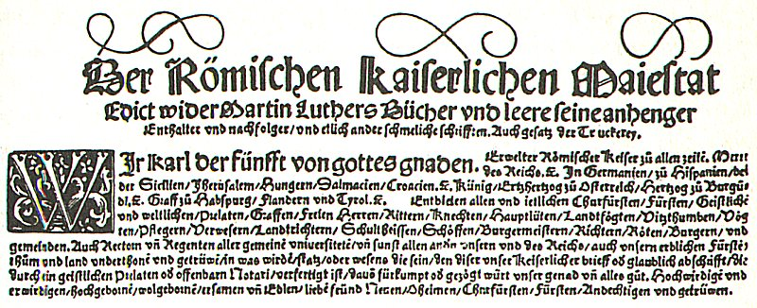
A month after Luther made that speech, Charles issued an imperial order, the Edict of Worms. It declared Luther an outlaw and a heretic in the Holy Roman Empire. According to this edict, no one in the empire was to give Luther food or shelter. All of his books were to be burned.

Slide 31
However, a German Prince, disobeyed the emperor, he hid Luther in one of his castles. Luther translated the New Testament into German during this time.
Many German rulers took over the Catholic churches in their territories. Their services consisted of Bible readings, preaching the word of God and song. Instead of continuing to seek reforms in the Catholic Church, Luther and his followers become a separate religious group, called Lutherans.
Lutheranism became the first Protestant faith.

Slide 32
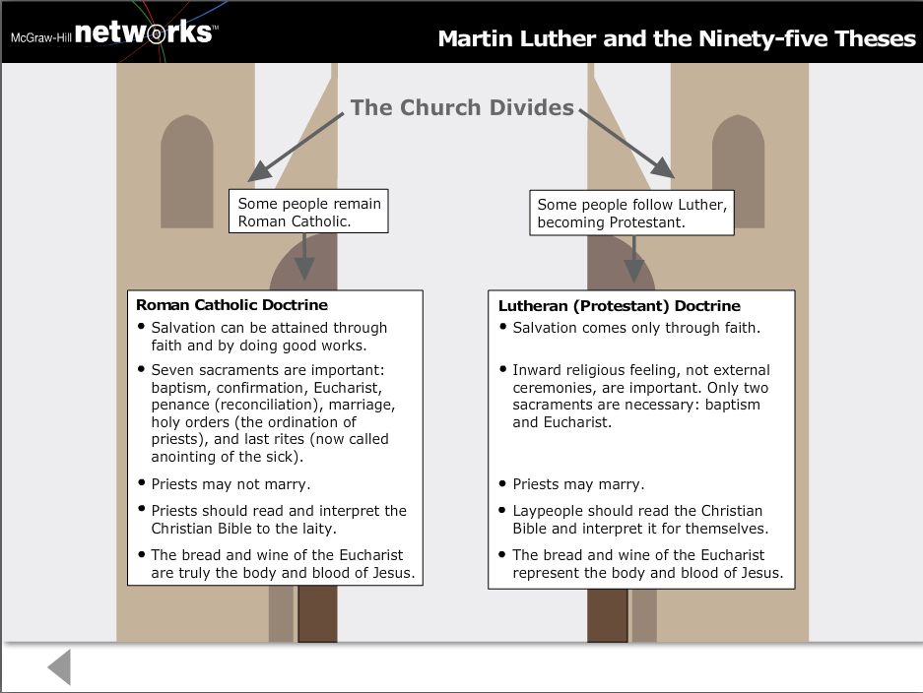

Slide 33
Rise of Lutheranism
Some German rulers embrace Protestantism
  Motivated by politics, economics
  The Peasants’ War- German peasants revolted against lords in 1524, Luther sided with rulers…need peace to spread Gospel.
  Luther marries former nun.

Slide 34
Still determined that his subjects should remain Catholic. Charles V (HRE) went to war against the Protestant princes. Weary of fighting, he ordered all German princes, both Protestant and Catholic, to assemble in the city of Augsburg.
There the Princes agreed that each ruler would decide the religion of his state. This famous religious settlement was known as the Peace of Augsburg.
The Peace of Augsburg formally accepted the division of Christianity in Germany.

Slide 35
Politics and Reformation
Charles V couldn’t fight Germany b/c of wars w/ France and Ottoman Empire
  His forces were already spread to thin
  Agrees to Peace of Augsburg

Slide 36
Query
What conditions in the Roman Catholic Church encouraged the desire of ppl like Erasmus and Luther to call for reform?

Slide 37
Query
What conditions in the Roman Catholic Church encouraged the desire of ppl like Erasmus and Luther to call for reform?
  Corruption, indulgences, wealth, politics, and general discontent

Slide 38
Ch 10.1 Discussion & Review
What was the name of Martin Luther’s revolutionary document?
T/F: Lutheranism was the first Protestant faith.
What European intellectual movement combined classical learning w/ the goal of reforming the Catholic church?

Slide 39
Ch 10.1 Discussion & Review
What was the name of Martin Luther’s revolutionary document?
  95 Theses
T/F: Lutheranism was the first Protestant faith.
  True
What European intellectual movement combined classical learning w/ the goal of reforming the Catholic church?
  Christian Humanism

Slide 40
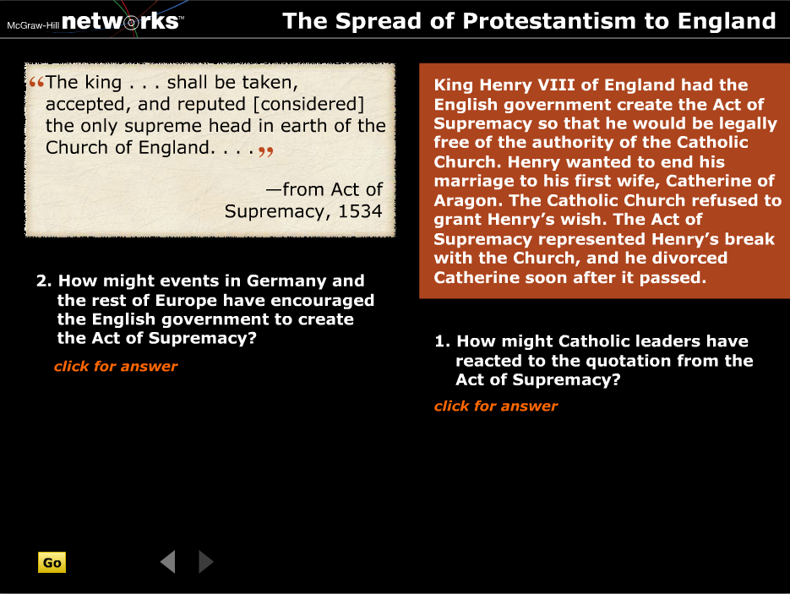

Slide 41
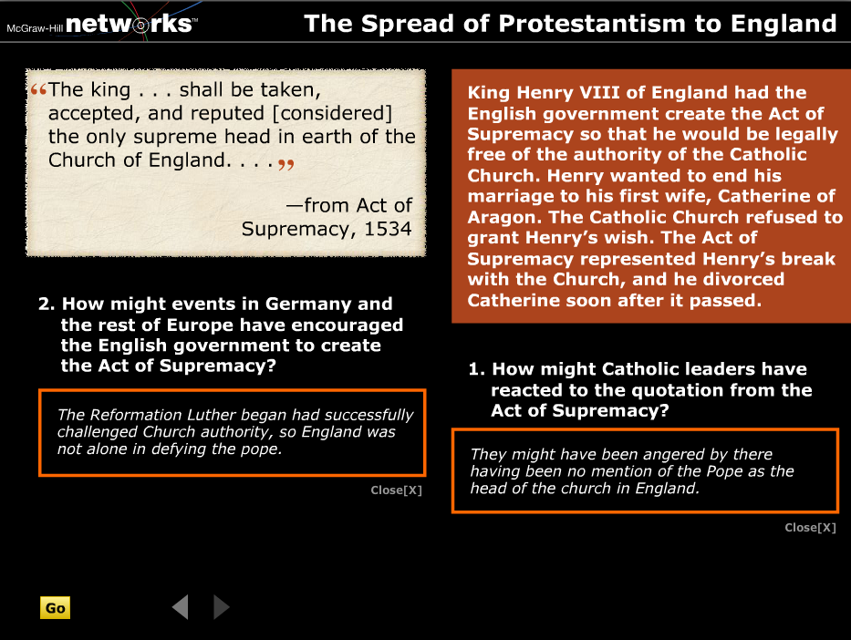

Slide 43
Protestantism continues…
Ulrich Zwingli attempts to introduce reforms in Switzerland, but is killed by Swiss Catholics leadership of Protestantism passed to JC
John Calvin becomes a famous Protestant leader b/c of his writings on predestination
  He wrote - Institutes of the Christian Religion spread widely due to printing press.

Slide 44
He believed that God has known since the beginning of time who will be saved and who would be damned. This doctrine is called predestination.
Calvin agreed with Luther on most important doctrines except predestination.
The religion based on Calvin's teachings is called Calvinism.
http://player.discoveryeducation.com/index.cfm?guidAssetId=fe7c56aa-b884-4c84-8783-4081bff1eea8&productcode=US&CFID=1445738&CFTOKEN=96076979

Slide 45
The Catholic Church soon faced another great challenge to its authority, this time in England. England breaks ties to the Roman Catholic Church for political and personal, not religious reasons. King Henry VIII needs a male heir!!!! He feared a civil war if he died without son. He and his wife, Catherine of Aragon, (Spain) had one living child - a daughter Mary - but no woman had ever successfully claimed the English throne.

Slide 46
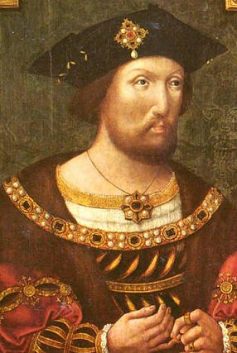
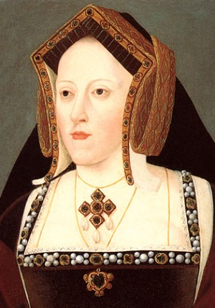
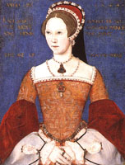
Henry VIII
Catherine of Aragon
Mary I

Slide 47
As daughter of Ferdinand and Isabella of Spain, and aunt of the Holy Roman Emperor, Charles V, Catherine of Aragon was a devout Catholic. Now to old for more kids. Henry ☹

Slide 48
By 1527, Henry wanted to divorce her and take a younger queen. Church law did not allow divorce. The pope could annul, (declare invalid) the marriage. In 1527, Henry asked the pope to annul his marriage, but the pope refused. The pope not want to offend Catherine's powerful nephew, the Holy Roman Emperor Charles V.

Slide 49
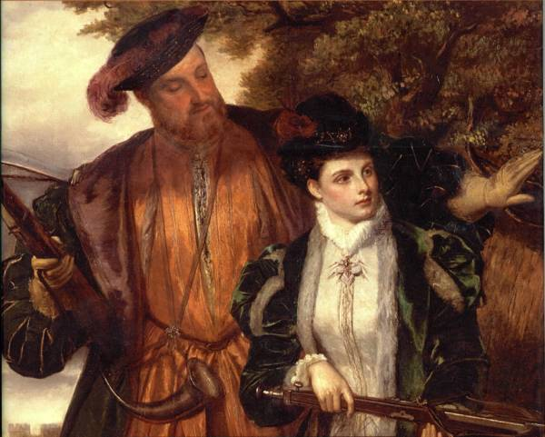
Henry decided to solve his marriage problem himself. He asked Parliament to pass a set of laws that ended the pope's power in England. This Parliament is known as the Reformation Parliament. The Church of England declared the marriage null and void. Soon afterwards, Henry secretly married Anne Boleyn, who was in her twenties.

Slide 50
Parliament legalized Henry's divorce from Catherine. In 1534, Henry's break with the pope was completed when Parliament voted to approve the Act of Supremacy.
This called on people to take an oath recognizing the divorce and accepting Henry, not the pope, as the official head of England's Church.
Henry VIII established the Church of England in 1534.

Slide 51
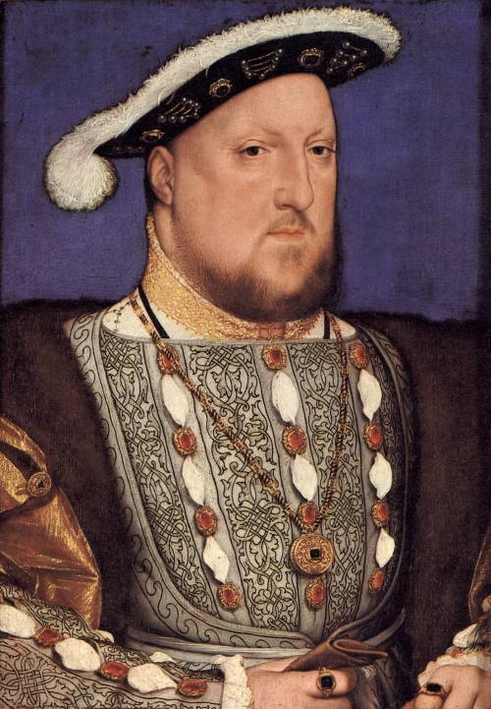
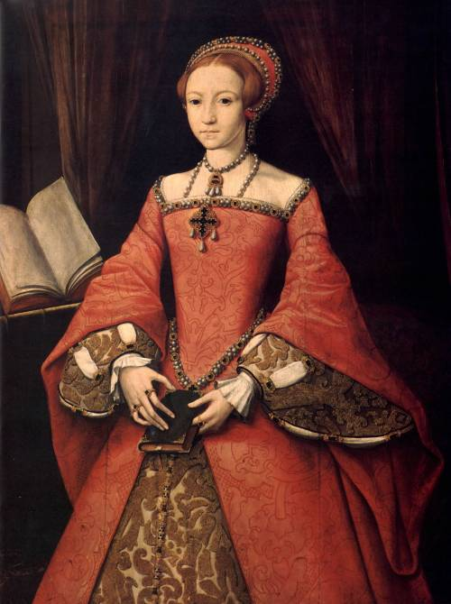
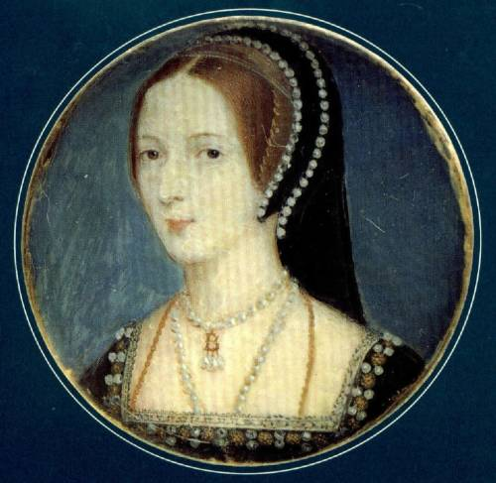
Henry did not immediately get the male heir he sought. After Anne Boleyn gave birth to a daughter, Elizabeth, she fell out of Henry's favor.
Henry VIII
Anne Boleyn
Elizabeth I
Chop Chop for Anne-he said she cheated!

Slide 52
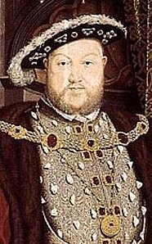
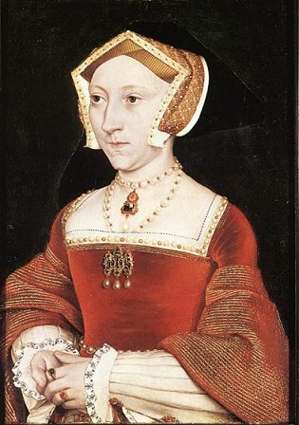
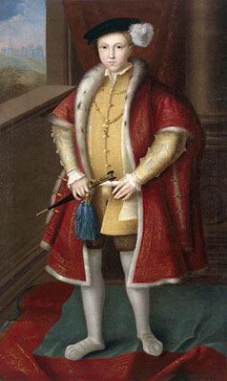
11 days after “chop” Henry took a third wife, Jane Seymour. In 1537, she gave birth to a son named Edward, Jane died soon after.
Henry VIII
Jane Seymour
Edward VII

Slide 53
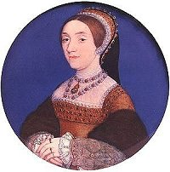
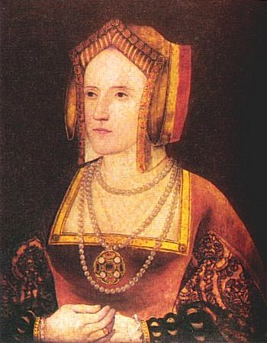
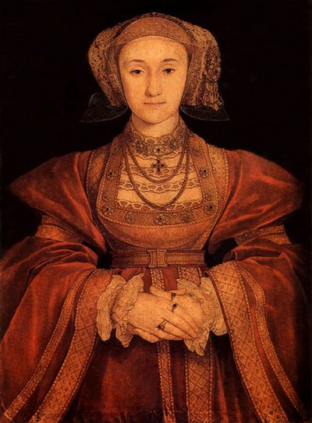
Henry married three more times. None of these marriages, however, produced kids.
Catherine Howard
Cousin to Anne B.
She got chop chop too!
Anne of Cleves
He divorced her, lucky girl.
Katherine Parr
She outlived him

Slide 54
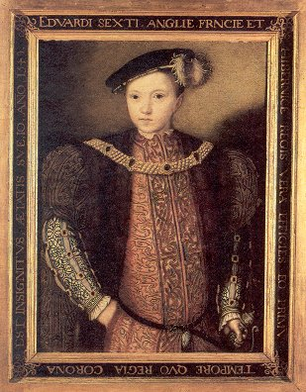
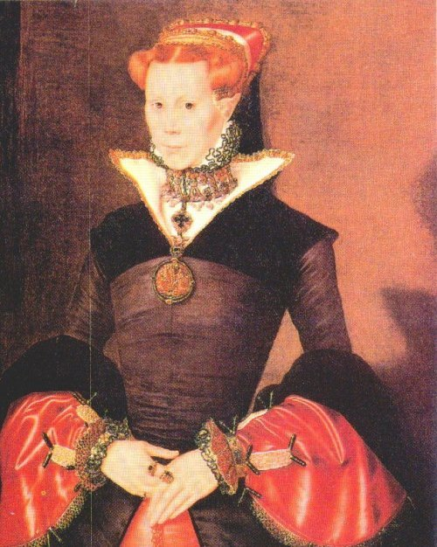
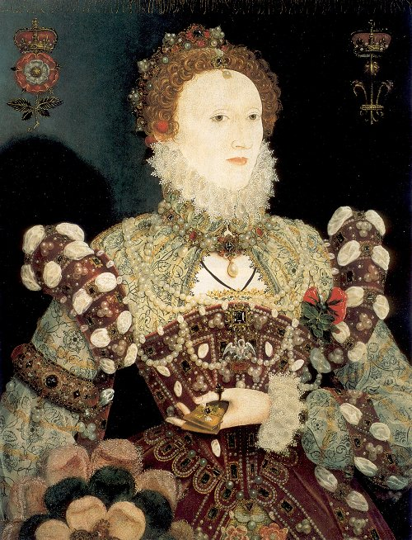
After Henry's death in 1547, each of his three children ruled England in turn. This created religious turmoil.
Religious Turmoil in England
Protestant
Catholic
Protestant
Edward VI
1547 – 1553
Died at age 16
Son of Jane
Mary I
1553 – 1558
Daughter of Catherine
Elizabeth I
1558 – 1603
Daughter of Anne Boleyn who was chopped!!

Slide 55
Anabaptists
Modeled after early Christians
  All believers equal, could be ministers
Believed in complete separation of church and state
  No holding of political office or bearing arms
  Adult baptism only
Heavily persecuted mostly by Catholics

Slide 56
Reformation & Society
Distribution of Bibles explodes across Europe- Movable type and religious hype
Protestants thought women should be the obedient servant and bearer of children.
Anti-Semitism…continues
  Jews refused to convert to Lutheranism in Germany, Luther urged that their homes and places of worship be burned
  Catholics also going after Jews

Slide 57
When Protestant churches won many followers, millions remained true to Catholicism. Helping Catholics to remain loyal was a movement within the Catholic Church to reform itself. This movement is now known as the Catholic Reformation.
Historians once referred to it as the Counter Reformation.

Slide 58
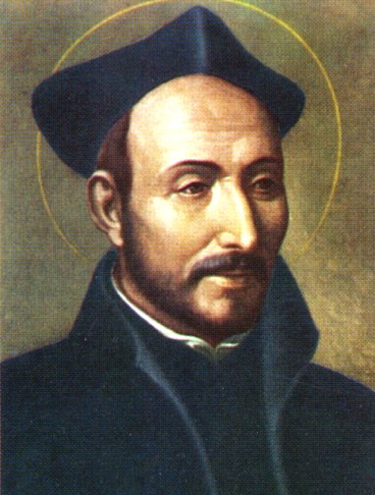
Ignatius Loyola was an important reformer of the Catholic Reformation. The pope created a religious order for his followers called the Society of Jesus. Members were called Jesuits. The Jesuits focused on three activities.
·First, they founded schools
·Convert non Christians to Catholicism
·Stop the spread of Protestantism

Slide 59
Council of Trent, findings:
The Church's interpretation of the Bible was final. Any Christian who substituted his or her own interpretation was a heretic.
Christians needed faith and good works for salvation. They were not saved by faith alone, as Luther argued.
Indulgences were valid expressions of faith. But the false selling of indulgences was banned.

Slide 60
Catholic Response
Catholicism’s Counter-Reformation
  Spain’s Ignatius of Loyola created the Jesuits
    Missionaries who spread Catholic faith via education
  Papal reform
    Pope Paul III appoints reform commission to look for corruption
  Council of Trent (took 18 yrs!) → did little reforming
    Reaffirmed traditional Catholic teaching and printed clear doctrine

Slide 61
Ch 10.2 Discussion & Review
Which Protestant group believed that church and state should be separate?
What does the term ‘predestination’ mean?
T/F: The catholic church allowed clergy to marry.

Slide 62
Ch 10.2 Discussion & Review
Which Protestant group believed that church and state should be separate?
  Anabaptists
What does the term ‘predestination’ mean?
  God has already determined whether or not individuals would be saved.
T/F: The catholic church allowed clergy to marry.
  False

Slide 63
Chapters covered on Exam
World Map- continents and oceans
Chapters-
2
3
4
5
6
9
10

