Slide 1
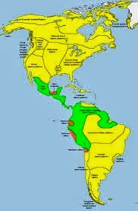
Chapter 8 Pre-Columbian America

Slide 2
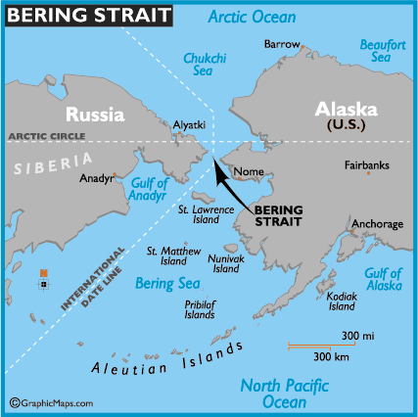
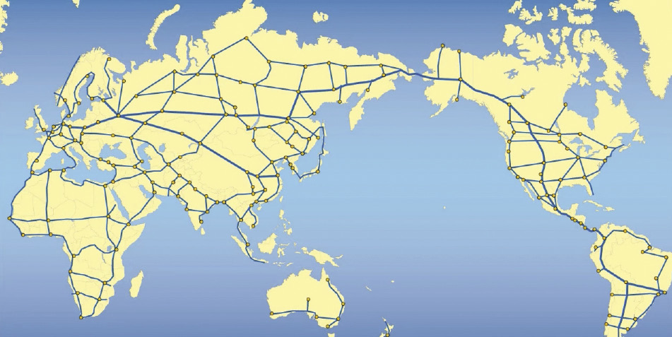
Bering Strait - between Alaska and Russia (58 miles) During the last Ice Age (100,000 - 8,000 years ago)there was a land bridge that allowed people from Asia to migrate to North America.

Slide 4
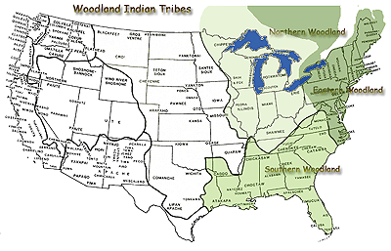
Eastern Woodlands: The Mound Builders
Great Lakes to the Gulf of Mexico
Made elaborate earth mounds used as tombs or for ceremonies.(1000 B.C.- 700 A.D.)
The Iroquois, Mound Builders, Algonquian and Shawnee, Cherokee, Mohawk, Huron

Slide 5
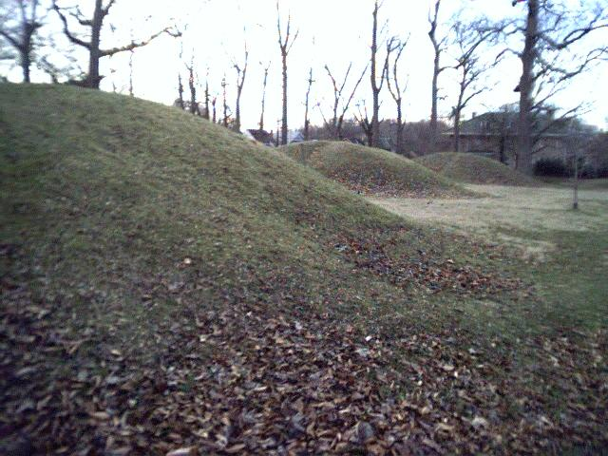
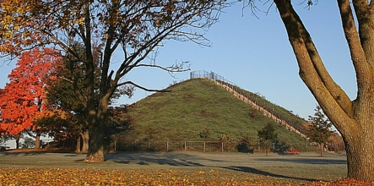
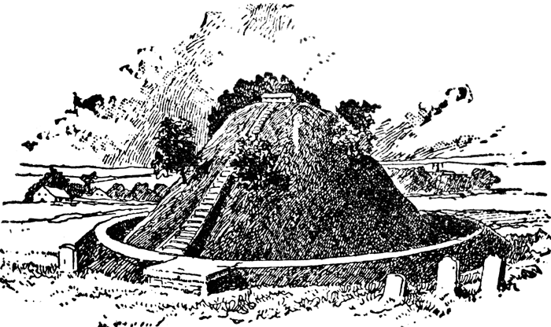

Slide 6
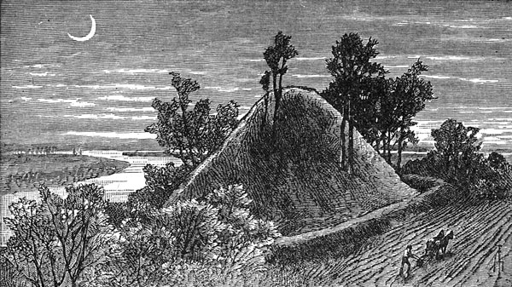
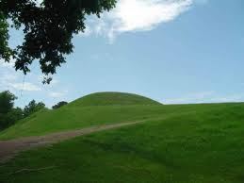

Slide 7
Eastern Woodlands: Iroquois
Northeast of the Mississippi culture. Lived in longhouses surrounded by a wooden fence. 150-200 ft. housed a dozen families. Men hunted deer, bear, caribou. Women owned the dwellings, gathered food, tended the gardens, 3 sisters= corn, beans and squash. Wars were common. The Great Peace=created the Iroquois League required they always think what is in the best interest of the GROUP. Council members (well respected male) were chosen by clan mother.

Slide 8
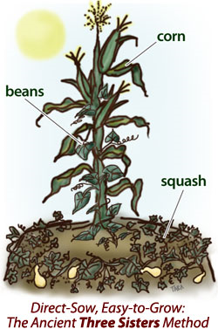

Slide 9
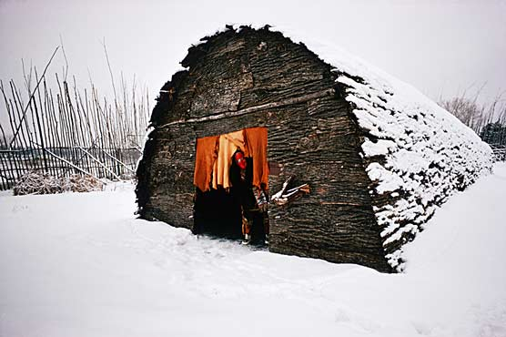

Slide 10
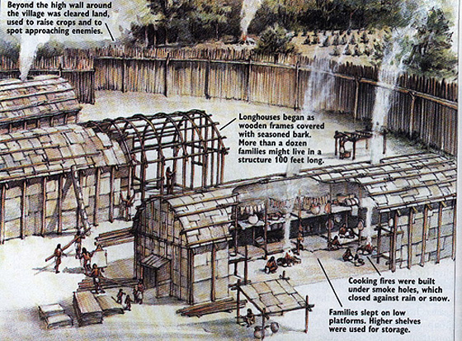

Slide 11
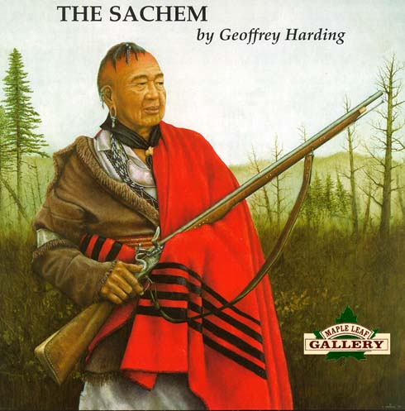
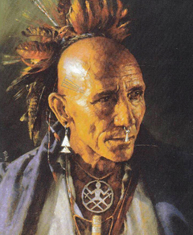
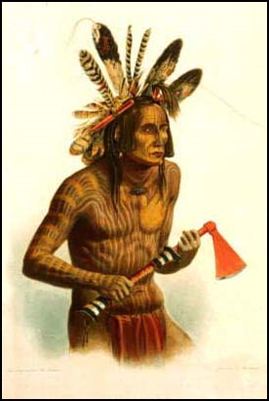
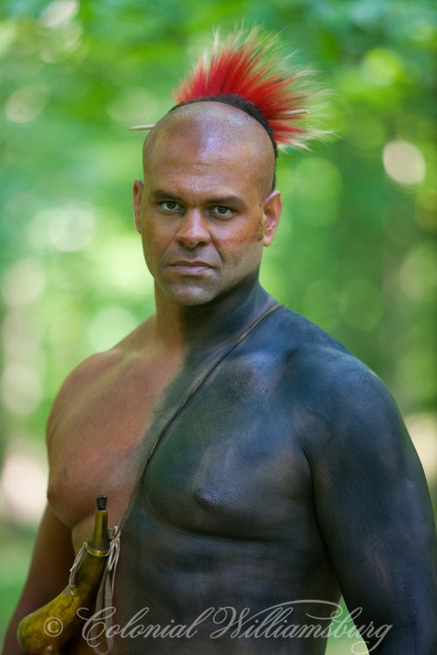

Slide 12
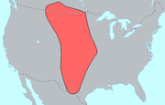
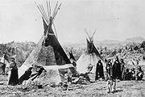
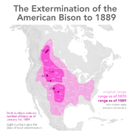
Great Plains Indians-west of the Mississippi. Men left villages every summer to hunt buffalo. Tepees were made from stretching buffalo skins over wooden poles.

Slide 13
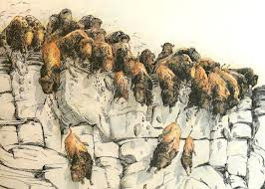
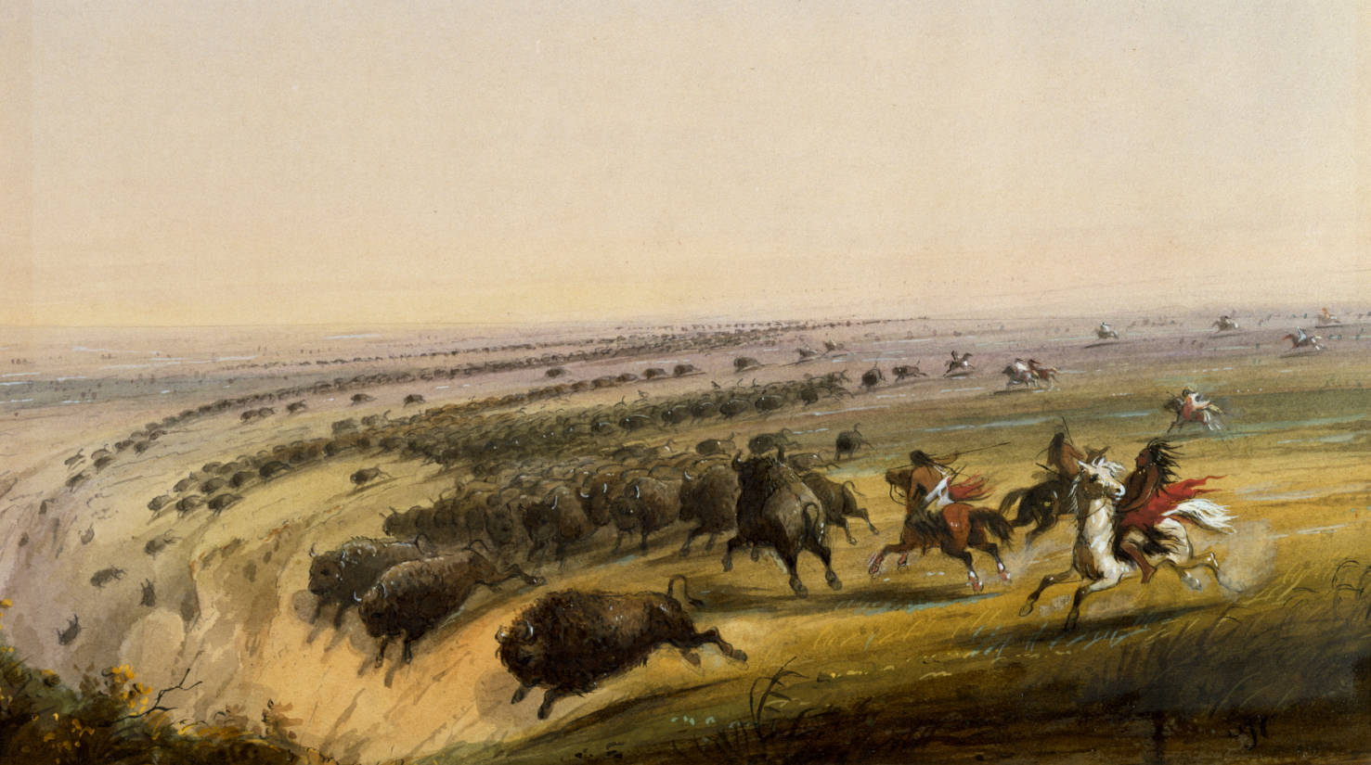
http://www.cbc.ca/archives/categories/lifestyle/travel/unesco-world-heritage-sites-in-canada/the-great-story-of-head-smashed-in-buffalo-jump.html

Slide 14
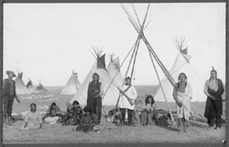
A few of the Plains tribes include: Blackfoot, Arapaho, Cheyenne, Comanche, Crow, Lakota, Apache – All parts of the buffalo were used, meat, skins, bones etc. They grew corn, beans and squash along river valleys too.

Slide 15
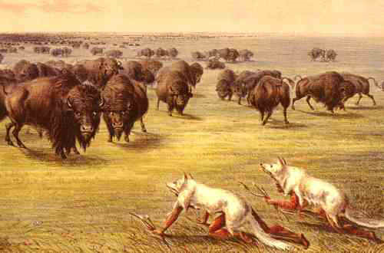
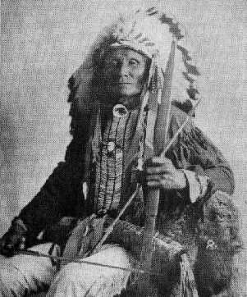

Slide 16
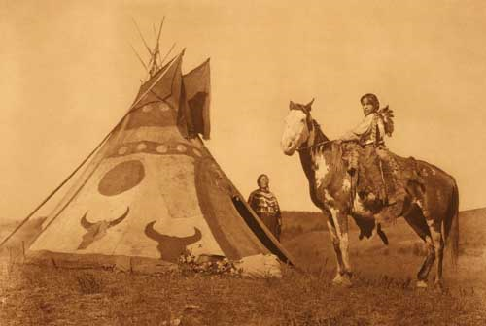
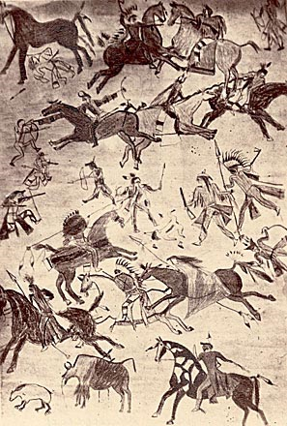
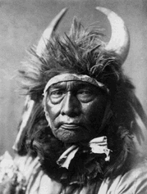

Slide 17
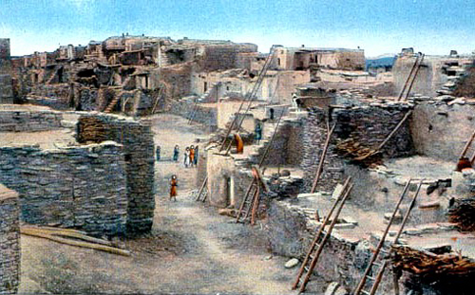
Southwest People: Anasazi
New Mexico etc. Very dry but they were able to establish an extensive farming society. They used canals and earth dams to turn desert into farmland. Great at making baskets and pottery.

Slide 18
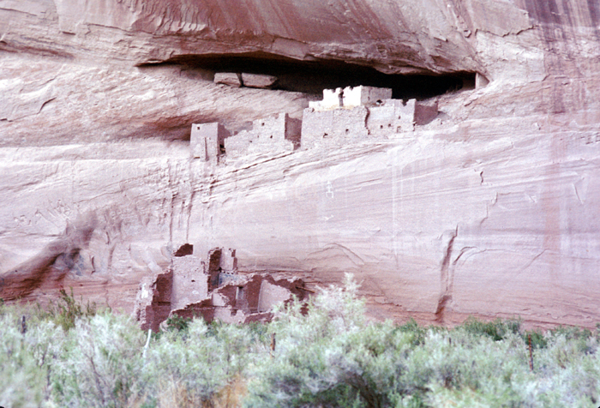

Slide 19
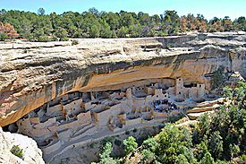
Mesa Verde-Colorado

Slide 20
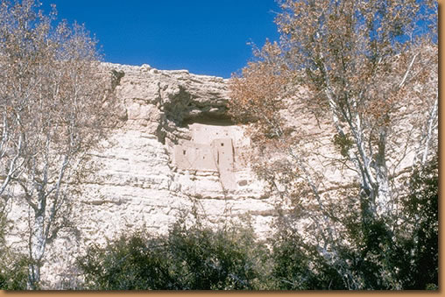

Slide 21
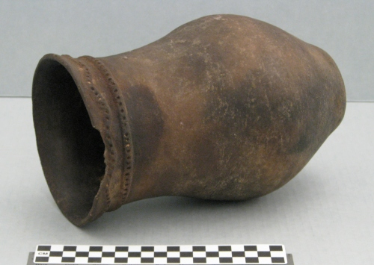
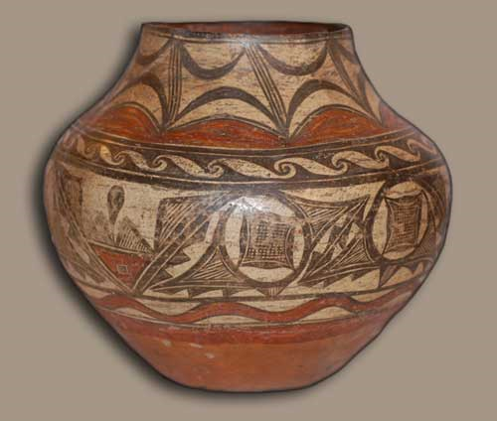

Slide 22
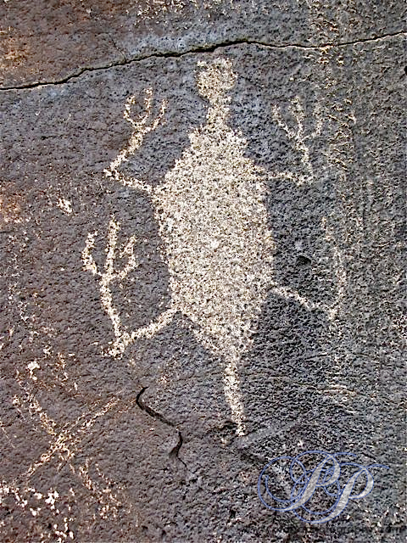

Slide 23
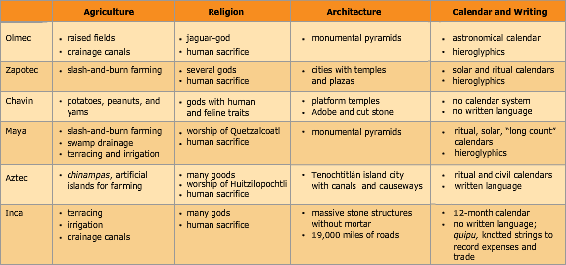

Slide 24
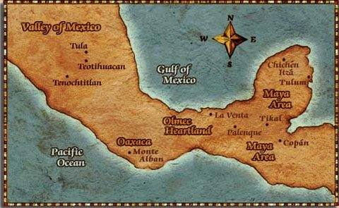

Slide 25
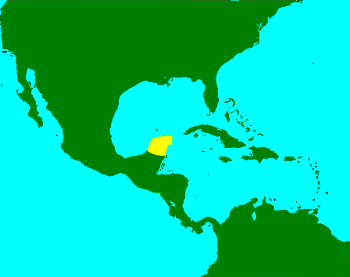
Maya and Toltec were located on the Yucatan Peninsula. (300-900 A.D.) It was one of the most sophisticated civilizations in the Americas. Decline came from revolt, invasion and natural disaster. (Volcano) Dense jungle covered cities that were not discovered until 1800's.

Slide 26
Mayan cities built around central pyramid topped by a shrine to the Gods. Developed a complicated calendar, palaces, ball court. Ruled by hereditary ruling class. City states often at war with each other, captured soldiers became slaves, captured nobles and war leaders were used for human sacrifice. Many kings claimed to be descended from the gods. Most peasants were farmers.
Maya numerals based on 20 and had a symbol for 0.

Slide 27
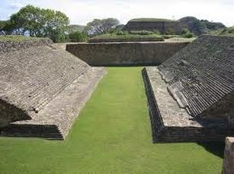
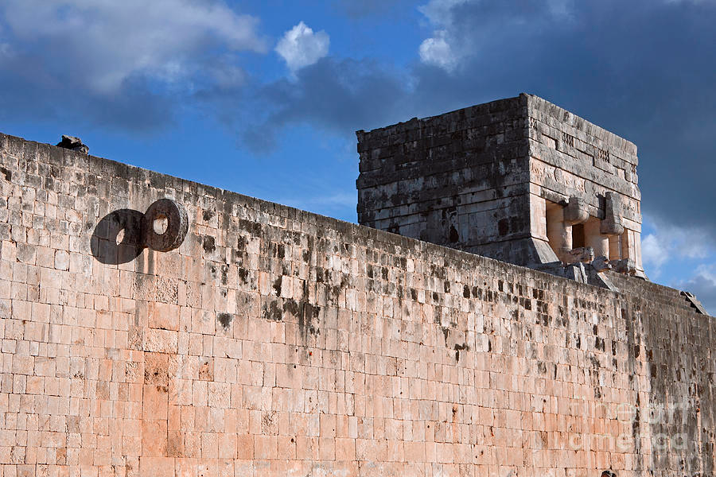

Slide 28
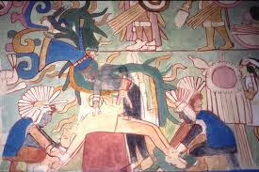

Slide 29
Mayan supreme god = Itzamna Human sacrifice to keep gods happy. Created a complex writing system of hieroglyphs. (Egypt) Spanish conquerors destroyed most writings stating they were evil. Wrote on bark 4 remain.
Calendar = long count, based on cycles of creation and destruction. 12/23/2012 was supposed to be the END, were still here.
2 systems for measuring time. Solar calendar 365 days (18 months of 20 days plus 5 extra. And the sacred calendar of 260 days. (priests)

Slide 30
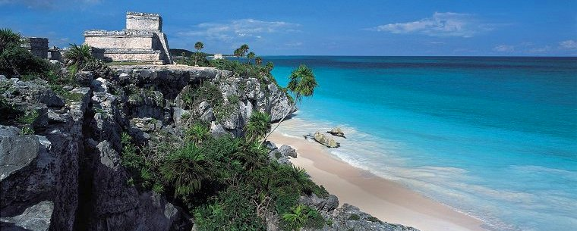
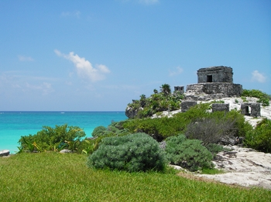

Slide 31
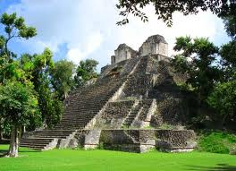
Dzibanche Ruins

Slide 32
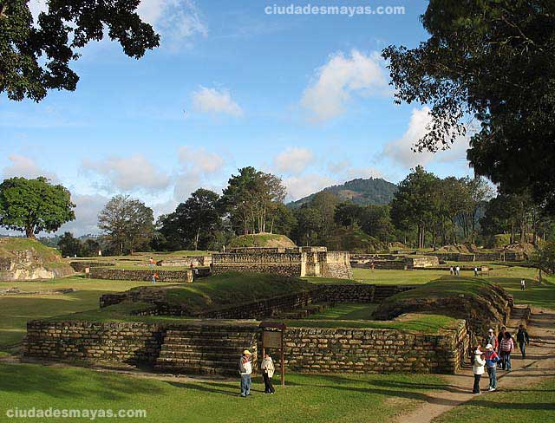

Slide 33
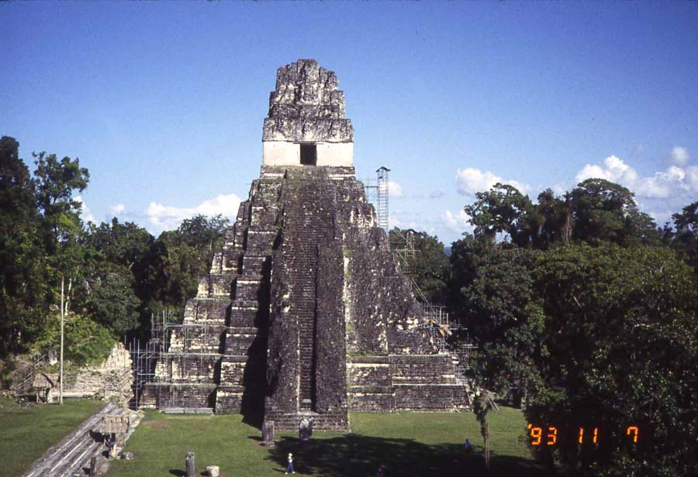

Slide 34
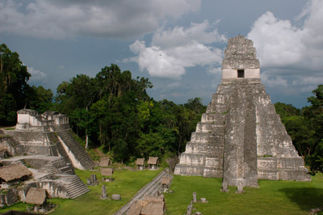

Slide 35
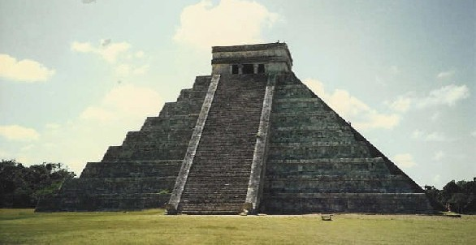

Slide 36
The Toltec-peak at 950 to 1150, Tula near Mexico City.
Claim to fame!!! First to do metal work in Mesoamerica (Gold, silver and copper)
Like Bantu in Africa.
Began to decline ~ 1125 due to fighting among groups in Tula. No single ruling group for 200 years when Aztec Empire emerged, they carried on many of the Toltec traditions.

Slide 37
Aztec- 12th century-Valley of Mexico, capital at Tenochtitlan now Mexico City. When Aztec’s arrived in the area, they were forced into the swamp snake infested area. Aztec persevered! Huitzilopochtli-Aztec God of war and of the sun, told them when they saw an eagle perched on a cactus growing out of a rock their journey would end. That was Tenochtitlan! For 100 years they built temples, public houses and houses. Also stone roadways across Lake Texoco to city of Tenochtitlan.

Slide 38
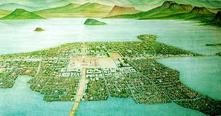

Slide 39
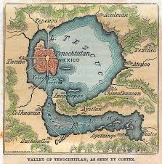

Slide 40
Created the Triple Alliance with Aztec, Tetzcoco, and Tlacopan, they dominated much of Mexico. Montezuma was the last leader, Spanish arrival in the 1500’s was the end.
Political and Social Structures-by 1500 ~ 4m Aztec lived in the valley of Mexico. King (monarch) claimed total power and to be related to the Gods. Council of lords and gov’t officials helped ruler.
Nobility held positions in Gov’t, sons were sent to temple schools, military training.

Slide 41
Noble sons could choose a career in military, priest or government. They received large estates from gov’t for their work. Rest of population was indentured workers, slaves and commoners. Most were commoners. They built chinampas (swampy islands surrounded by canals where crops were grown. Canals provided method of travel too. Trade was active.

Slide 42
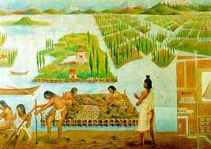

Slide 43
Gender rolls-
Men-warriors, farmers etc.
Women-weavers, raising children some trained as priestesses.
Women could inherit property, enter into contracts.
Polytheistic
Supreme God =Ometeotl-power of the heavens.
Huitzilopochtli= God of sun and war
Quetzalcoatl= long story…….

Slide 44
Quetzalcoatl left valley of Mexico in 10th century promising to return in triumph. When Spanish show up, Aztec’s believe that they are representatives of Quetzalcoatl.
Religion-based on belief of unending struggle good v. evil. 4 cycles have been completed. To keep Gods happy they practiced human sacrifice. At top of pyramid dedicated to Huitzilopochtli.
Advances in astronomy-sun calendar. Very similar to Maya, number system too.

Slide 45
Nazca and Moche- were around before Inca in S.A. What we know is from what they left behind. Nazca = Peru, pottery, no pyramids.
Nazca lines- did they worship outdoors??? Images scratched in the ground shaped like animals, birds, humans, geometric shapes.
SHAPES CAN ONLY BE SEEN FROM THE AIR.

Slide 51
The Moche- Pacific coast near Ecuador, grew maize, peanuts, potatoes and cotton. No written language, pottery shows a culture of warfare and sacrifices.
Collapsed ultimately replaced by the Inca.
Inca- mountains of southern Peru. Initially very small but under Pachacuti they launched a campaign of conquest that brought the entire region under Inca control.

Slide 52
Cuzco (high in the mountains) the capital went from mud to major city of stone. Huge temple dedicated to the sun. Grew to near 12m people. Area enlarged by war! All young men required to serve in the army.
No wheel! Used llamas.
When new people conquered they were taught the language. High Inca official sent to rule new areas. Children of local leaders taken hostage and sent to capital and educated in Incan ways.

Slide 53
Inca divided into 4 quarters each ruled by governor related to royal family. Emperor believed to be a descendent of Inti “sun god”. Forced labor-all Inca were required to provide labor several weeks each year.
Men and women were required to choose spouse from immediate tribal group. W- raise kids and weave cloth. Some girls= priestesses.

Slide 54
Inca economy = high altitude agriculture, terraced farms & irrigation systems, corn, potatoes. Extensive trade networks, organized and regulated by government.

Slide 55
Inca were great builders and the best engineers of Native American people. Built 24.8 miles of roads!!! No wheels.
Rest houses located day apart, suspension bridges over ravines and waterways. Roads built primarily for military and govt, need permission to use for personal use.
Trained runners would carry messages up to 140 miles per day (pony express, royal road)

Slide 57
Buildings and monuments- built with perfectly cut stone without mortar!

Slide 58
No written writing system- quipu system of knotted strings. Maintain records war, goods exchanged. Number based on 10.
Plays- valiant military victories. Actors were members of the nobility.
Astronomy and calendars using the sun 365.

