Slide 1
Chapter 7 African Society and Culture

Slide 2
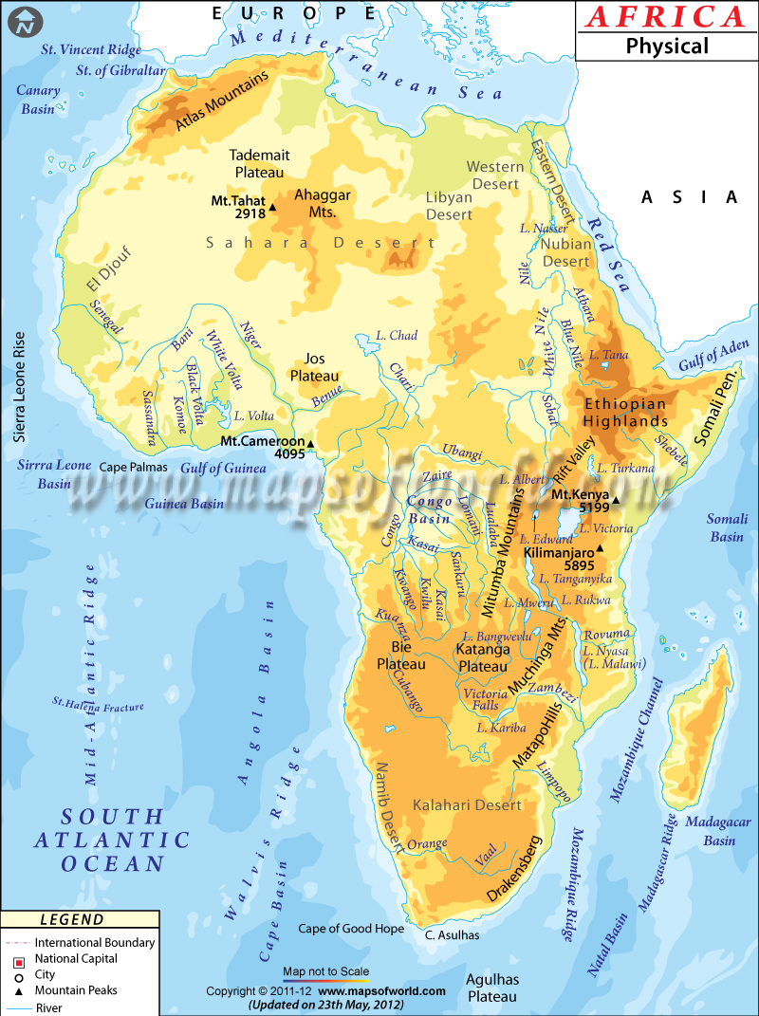
2nd largest continent
4 climate zones
Mild-10%
Deserts-40%
Rain forest-10%
Savannas-40%

Slide 3
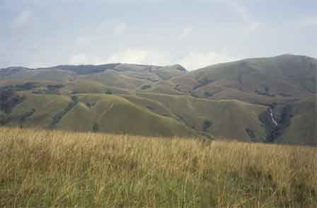
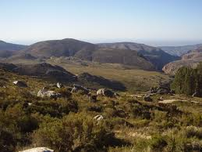
Mountains and deep canyons
Plateau

Slide 4
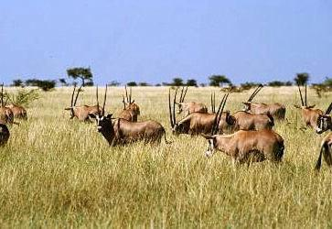
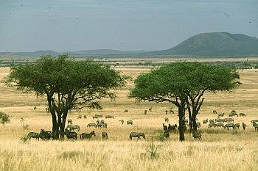
Savanna

Slide 5
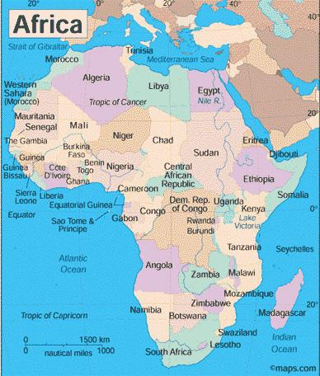
Hump

Slide 6
African society-most societies did not have a written language so descriptions come from visitors. Most live in small rural villages. Extended family very important. Lineage groups are basic building blocks of African society. All members trace to common ancestor. Each lineage group can trace back to a founding ancestor- ritual ceremonies were dedicated to ancestors cuz they are believed to be closer to the Gods and have power to influence the lives of their descendants.

Slide 7
Women tend fields, men cattle and hunted.
Matrilineal- heritage through mother
Patrilineal- heritage through father.
Children raised by mothers till age 6 then girls and boys off to separate houses. Girls learn from mothers how to tend fields and be good mothers and wives. Boys to hunt, fish, farm, how to survive in the natural world. At puberty both enter community as adults.

Slide 8
Slavery practiced throughout the world. Was NOT introduced by Europeans. Slaves included people captured in war, debtors, and some criminals.
Most African shared some common religious ideas, including a belief in a single God. Ritual was used to communicate with the Gods, diviners were used. (people who were believed to have the power to foretell events)

Slide 9
Arab conquest of Africa introduced Islam, trade spread the religion. In most instances Islam combined with native beliefs to create a unique brand of Africanized Islam.

Slide 10
Painting, literature, dance and music were a way to serve religion. They were ways to express religious convictions. Dance was a way to communicate with the spirits. Without a written language-songs passed down folk legends and religious traditions from generation to generation.
Griots-storytellers-kept history alive by telling stories.

Slide 11
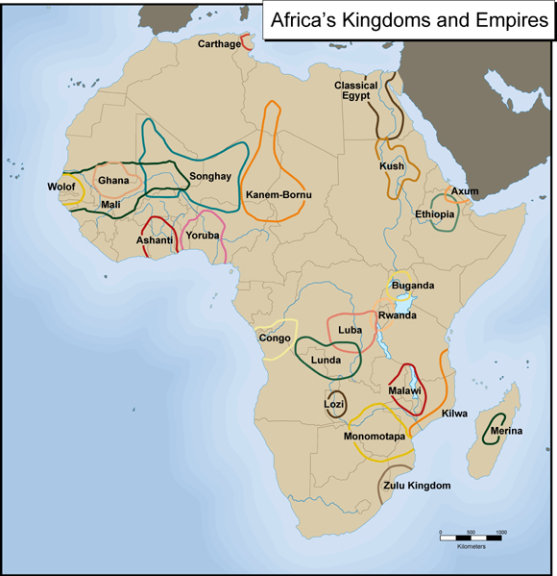
6.2

Slide 12
Ghana-First great trading state in Africa. Most were farmers living in villages ruled by kings without written laws. Protected by an army of thousands of well trained men. Became really rich from: iron ore and gold. Muslim merchants from NA brought textiles, horses and salt. Caravans of camels=“fleets of the desert”. Trading merchants became wealthy and taxes on imports and exports made kings rich.

Slide 13
Mali- replaced Ghana as the center of trade founded by Sundiata Keita. Built wealth on gold and salt trade. Mansa Musa was one of the richest and most powerful kings, he doubled size of kingdom and created strong government. Made Timbuktu a center for Islamic learning, he built mosques and libraries. Pilgrimage to Mekkah-gold, gold, g.
He was the LAST powerful ruler of Mali.
http://www.youtube.com/watch?v=jvnU0v6hcUo&safe=active crashcourse Mansa Musa 10 min

Slide 14
Songhai- On the Niger River-floods made for rich soil allowing crops and cattle. Songhai benefitted from Muslim trade routes. Salt and gold !!! Used cowrie shells as a medium of exchange. United rural and urban dwellers. Stretched for a thousand miles along the Niger River, it became the largest empire in African history.

Slide 15
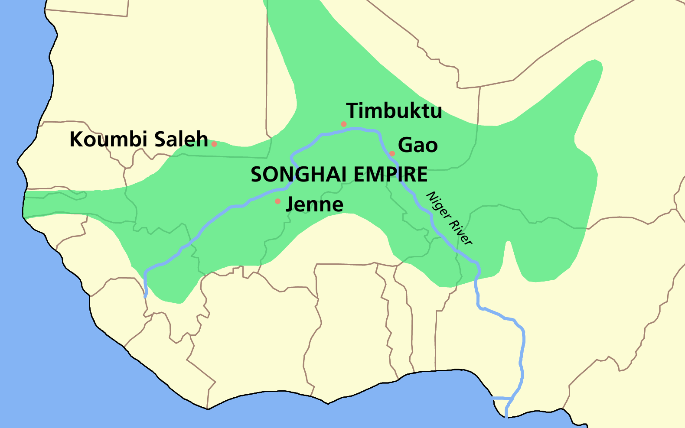

Slide 16
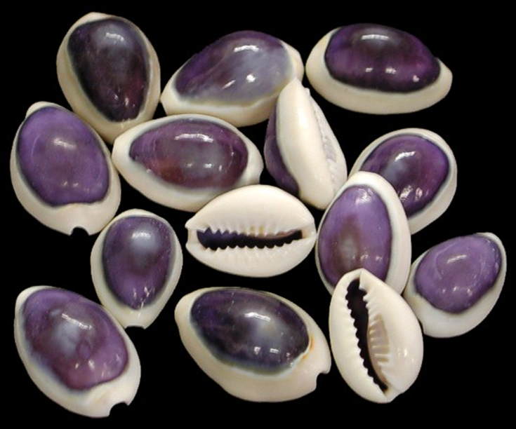
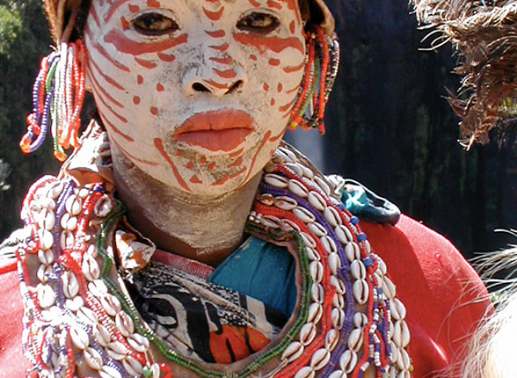

Slide 17
Societies in East Africa-
Bantus- subsistence farming, spread iron-smelting techniques, and high yield crop info (yams and bananas)-established city of Great Zimbabwe. Later moved on to coast on Indian Ocean, Islam big influence, huge trade network along coast. Major cities=Mogadishu, Mombasa and Kilwa in modern day Tanzania.

Slide 18
2 major buildings in Kilwa-coral cut from cliffs
Great Mosque of Kilwa-

Slide 19
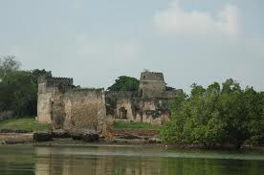

Slide 20
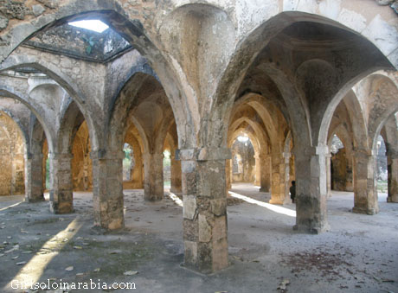

Slide 21
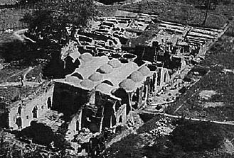

Slide 22
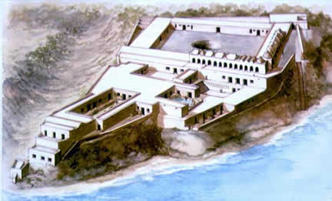
Husuni Kumba palace-

Slide 23
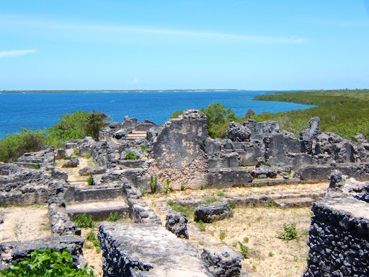

Slide 24
1505 Portuguese sacked city and destroyed buildings. Overtime a mixed culture of African and Arabian emerged along coast=Swahili became a language as well combining Bantu and Arabic.

Slide 25
Societies in South Africa-early on most were stateless societies (independent villages ruled by clan head.) In 1100’s began to unite, villages inside walls-to protect livestock from predators at night. Zimbabwe wealthiest and most powerful of region. Gold and trade with Swahili. City had enormous wall surrounding , city abandoned around mid 15th century.

Slide 26
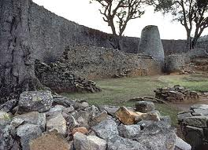
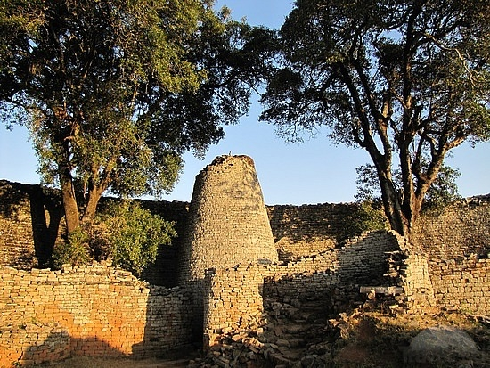
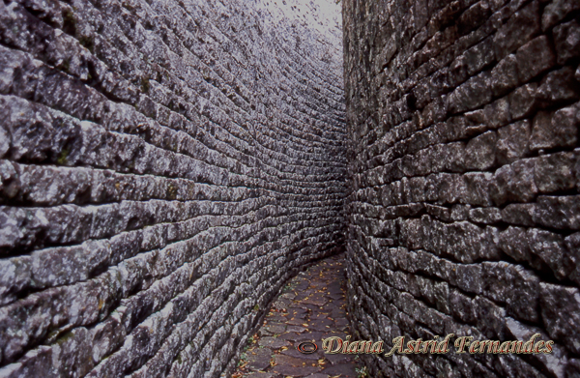
Great Zimbabwe

Slide 27
