Slide 1
Economics
Ch 2
Economic Systems
http://www.youtube.com/watch?v=d8ivuSUfTg4
14 min

Slide 2
Scarcity forces societies and nations to answer some hard economic questions. Different economic systems have evolved in response to the problem of scarcity.
An economic system is the method used by a society to produce and distribute goods and services.
Which economic system a society employs depends on that society's goals and values.

Slide 3
Three Key Economic Questions:
Because economic resources are limited, every society must answer three key economics questions.
What goods and services should be produced?
How should these goods and services by produced?
Who consumes these goods and services?

Slide 4
What goods and services should be produced?
Each society must decide what to produce in order to satisfy its needs and wants. In today's complex societies, it is often difficult to distinguish between needs and wants.
How much of our resources should we devote to national defense, education, public health and welfare, or consumer goods?
Which consumer goods should we produce?

Slide 5
How should goods and services be produced?
Although there are countless ways to create all of the things we want and need, all require land, labor, and capital.
These factors of production can be combined in different ways.
With today's mechanical farming equipment, farming is much more efficient and takes less worker hours than hand tools.

Slide 6
Who consumes goods and services?
The answer to the question of distribution is determined by how societies choose to distribute income.
Factor payments are the income people receive for supplying factors of production - land, labor, capital, or entrepreneurship. Landowners receive rent, workers receive wages, and those who lend money to build factories or buy machinery receive payments called interest. Entrepreneurs earn profits if their enterprises succeed.

Slide 7
The question of who gets to consume which goods and services lies at the very heart of the differences between economic systems today. Each society answers the question of distribution based on its unique combination of social values and goals.
Different societies answer the three economic questions based on the importance they attach to various economic goals.

Slide 8
Economic Efficiency
Because resources are always scarce - that is, they always involve an opportunity cost - most societies try to maximize what they can get for the resources they have to work with. If a society can accurately assess what to produce, it increases its economic efficiency.
A manufacturer would be wasting resources producing record albums if people prefer to buy CDs. Knowing the best way to produce a product cuts waste, too.
Of course, in the end, products need to reach consumers. An economy that can't deliver goods isn't efficient.

Slide 9
Economic Freedom
Most of us value the opportunity to make our own choices. How do you feel about laws that keep you from earning an income? What about laws that forbid you to make certain purchases or possess certain items? The economic systems of different nations allow different degrees of economic freedoms. In general, however, people all over the world face limitations on economic freedom.

Slide 10
In the United States, the economic freedoms that we as American enjoy are an important reason for our patriotism.
Patriotism is the love of one's country - the passion that inspires a person to serve his or her country, either in defending it from invasion or protecting its rights and maintaining its laws and institutions. The freedoms that allow any American who so chooses to become an entrepreneur, for example, are continuing sources of pride and patriotism

Slide 11
Economic Security and Predictability
Most people don't like uncertainty. We want to know that we can get milk and bread every time we go to the grocery store, or that the gas pumps will be full when we go to gas up our cares. We want to feel confident that we will get our paychecks every payday. Ideally, economic systems reassure people that goods and services will be available when they need them and that they can count on receiving expected payments on time.

Slide 12
We also want to the security of knowing that help is available if were are elderly, poor, unemployed, or facing some other potential economic disadvantage. Most people feel that the government should provide some kind of safety net, or set of government programs that protect people experiencing unfavorable economic conditions.
These include injuries, layoffs, natural disasters, or severe shortages. (TEMP)
Most countries also believe in providing some sort of base income for retired persons to ensure that older people can support themselves after retirement.

Slide 13
Economic Equity
Each society must decide the best way to divide its economic pie. What constitutes a fair share? Should everyone get the same, or should ones consumption depend on how much one produces? How much should society provide for those who are unable or unwilling to produce?

Slide 14
Many people believe in equal pay for equal work, but society does not value all jobs equally.
Most lawyers earn more than most nurses.
Most computer programmers earn more than most truck drivers.
Not everyone is able to work. How should we provide for the ill and infirm?

Slide 15
A nation's economy must grow for a nation to improve its standard of living, or level of economic prosperity. This is especially true if a country's population is growing. The economy also must grow to provide new jobs and income for people.
Innovation plays a huge role in economic growth. Innovations in technology increase the efficiency of production and usher in new goods and services. In you lifetime, you are witnessing innovations in computer and networking technology that are changing the ways people work, shop, conduct business, locate information, and communicate.

Slide 16
A society may value goals in addition to those already described. Environmental protection, full employment, universal medical care, and other important concerns may be among a nation's chief economic goals.
All nations must prioritize their economic goals, or arrange them in order of importance. No matter how a nation prioritized its goals, one fact remains:
Achieving any economic goal comes only with some kind of economic trade-off.

Slide 17
Four different economic systems have developed to address the three key economic questions. Each system reflects a different prioritization of economic goals. It also reflects the values of the societies in which these systems are present.
Traditional Economies
Market Economies
Command Economies
Mixed Economies

Slide 18
Traditional Economies
A traditional economy relies on habit, custom, or ritual to decide what to produce, how to produce it, and to whom to distribute it. There is little room for innovation or change. The traditional economic system revolves around the family. Work tends to be divided along gender lines. Boys tend to take up the occupations of their fathers, while girls follow in the footsteps of their mothers.
In most cases, these communities lack modern conveniences and have a low standard of living.

Slide 19
Market Economies
In a market economy, economic decisions are made by individuals and are based on exchange, or trade. The choices made by individuals determine what gets made and how, as well as who consumes the goods and services produced.
Market economies are also called free markets, or capitalism.

Slide 20
Command Economies
In a centrally planned economy, the central government alone decides how to answer all three key economic questions. Centrally planned economies are sometimes called command economies, because a central authority is in command of the economy.

Slide 21
Mixed Economies
Most modern economies are mixed economies - market-based economic systems in which government plays a limited role.
A market is an arrangement that allows buyers and sellers to exchange things. Markets exist because no one is self- sufficient. In other words, none of us produces all we require to satisfy our needs and wants.
Markets allow us to exchange the things we have for the things we want.

Slide 22
Instead of being self-sufficient, each of us produces just one or a few products. A nurse specializes in caring for the sick. A marine mechanic specializes in repairing machinery aboard crafts. A baker specializes in making breads, cakes, and cookies.
Specialization is the concentration of the productive efforts of individuals and firms on a limited number of activities.
Specialization leads to efficient use of resources, including capital, land, and labor. It is easier to learn on task or a few tasks very well than to learn them all.

Slide 23
Buying and Selling
Because each of us specializes in producing just a few products, we need markets to sell what we have and to buy what we want. The typical person earns an income (specializing at a particular job) and uses this income to buy the products that he or she wants to consume.
If each person were self-sufficient, producing everything he or she wanted to consume, there would be no need for markets.

Slide 24
Free Market Economy
Economic systems that are based on voluntary exchanges in markets are called free market economies. In a free market economy, individuals and businesses use markets to exchange money and products. In a free market system, individuals and privately owned businesses own the factors of production, make what they want, and buy what they want.
In other words, individuals answer the three key economic questions of what to produce, how to produce it, and who consumes that which is produced.

Slide 25
The players in the free market economy are households and firms. A household is a person or group of people living in the same residence. Households own the factors of production - land, labor, and capital. Households are also the consumers of goods and services.
A business, or firm, is an organization that uses resources to produce a product, which it then sells. Firms transform "inputs," or factors of production, into "outputs," or products.

Slide 26
A factor market is a market in which firms purchase the factors of production form households.
Firms purchase or rent land (natural resources). They hire workers, paying them wages or salaries for their labor. They also borrow money from households to purchase capital, paying households interest or profits in return. Profit is the financial gain made in a transaction.
The market in which households purchase the goods and services that firms produce is the product market.

Slide 27
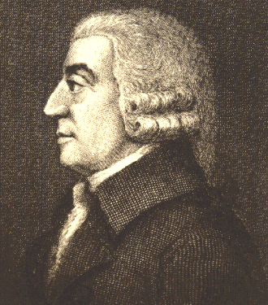
According to Adam Smith, competition and our own self-interest keep the marketplace functioning. Adam Smith was a Scottish social philosopher, who, in 1776, published a book titled The Wealth of Nations, in which he described how the market functions.
Smith observed that an economy is made up of countless individual transactions. In each transaction, the buyer and seller consider only their self- interest, or their own personal gain. Self-interest, in other words, is the motivating force in the free market.

Slide 28
Consumers (households), in pursuit of their self-interest, have the incentive to look for lower prices. An incentive is the hope of reward or the fear of punishment that encourages a person to behave in a certain way.
Adam Smith observed that people respond predictably to both positive and negative incentives. As for consumers,we can predict that they will respond to the positive incentive of lower prices. This makes sense, because spending less money on a good lowers the opportunity cost of the purchase.

Slide 29
Firms, meanwhile, seek to make greater profits by increasing sales. Let's take, for example, a boxer manufacturer. The manufacturer produces and sells polka-dotted boxers and striped boxers. The striped boxers are far outselling the polka-dotted boxers. The manufacturer has the incentive - from more potential sales and profits - to produce more striped boxers.
Other manufacturers, observing consumers' desire for striped boxers, also have the incentive to sell striped boxers. With all these manufacturers in the market, consumers have all the striped boxers they want.

Slide 30
Manufacturers also have a second incentive - to make the most profit in selling striped boxers. What keeps manufacturers' pursuit of profit from causing prices to skyrocket?
If one manufacturer begins charging $30.00 for a striped boxers, another manufacturer can come along and sell striped boxers for $25.00. If the first manufacturer wants to sell any more striped boxers, he or she had better drop the selling price.
Consumers, pursuing their self- interest, will buy the lower-priced boxer. Economist call this struggle among producers for the dollars of consumers competition.
While self-interest is the motivating force behind the free market, competition is the regulating force.

Slide 31
Self-interest and competition work together to regulate the marketplace.
Self-interest spurs consumers to purchase certain goods and services and firms to produce them. Competition causes more production and moderates firms' quests for higher prices. The overall result is that consumers get the products they want at prices that closely reflect the cost of producing them. All of this happens without any central plan or direction.
Adam Smith called this phenomenon "the invisible hand" of the marketplace."

Slide 32
Competition and the pursuit of self- interest serve the public interest. The free market, on its own, meets many economic goals.
1. Economic efficiency: Because its is self-regulating, a free market economy responds efficiently to rapidly changing conditions. Producers make only what consumers want, when they want it, and generally at prices they are willing to pay.

Slide 33
2. Economic Freedom: Free market economies have the highest degree of economic freedom of any system. This includes the freedom of workers to work where they want, of firms to produce what they want, and of individuals to consume what they want.
3. Economic growth: Because competition encourages innovation, free markets encourage growth. Entrepreneurs are always seeking profitable opportunities, contributing new ideas and innovations.

Slide 34
4. Additional goals: Free markets offer a wider variety of goods and services than any other system, because producers have incentives to meet consumers' desires. consumers, in essence, decide what gets produced. This is called consumer sovereignty.
Despite its advantages, no pure market economy exists on any meaningful scale. The same features that make free markets attractive also represent the weaknesses of the free market.
The goals of economic equity and economic security are difficult to achieve in a pure market system.

Slide 35
Centrally Planned Economies
Centrally planned economies operate in direct contrast to free market systems.
Centrally planned economies oppose private property, free market pricing, competition, and consumer choice.
The government will tell you the firms (factory's) what color boxers to produce, so in essence they are telling you what color you will wear.

Slide 36
In a centrally planned economy, the central government, rather than individual producers and consumers in markets, answers the key economic questions of production and consumption.
A central bureaucracy makes all the decisions about what items to produce, how to produce them, and who gets them.
After collecting information, bureaucrats tell each firm what and how much to produce. It is up to the bureaucrats to ensure that each firm has enough raw materials and workers to meet its production goals.

Slide 37
In a centrally planned economy, the government owns both land and capital. In a sense it owns labor, too, by controlling where individuals work and what wages they are paid.
The government decides what to produce, how much to produce, and how much to charge.
Each year, the government directs workers to produce a certain number of trucks, no many yards of cotton fabric, a certain amount of glass, and so on.
Farmers are told what to plant, how to plant and where to send their crops.
The free market forces of self-interest and competition are absent from the system.

Slide 38
In a centrally planned economy, decisions on what to produce and how much to produce are not determined by consumers. Chances are that many citizens living under this economy would still need sweaters.
This lack of consumer voice in production and distribution shows that under centrally planned economies, consumers do not have consumer sovereignty.
The words most often associated with centrally planned economies are socialism and communism.

Slide 39
Socialism is a social and political philosophy based on the belief that democratic means should be used to distribute wealth evenly throughout a society.
Real equality, socialists argue, can only exist when political equality is coupled with economic equality. Economic equality is possible only if the public controls the centers of economic power. Although socialist nations may be democracies, socialism requires a high degree of central planning to achieve economic equality.

Slide 40
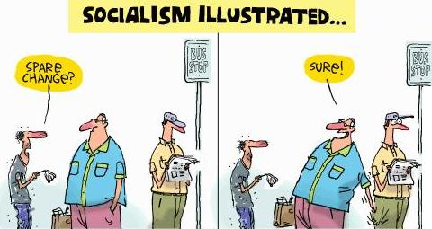
In socialist countries the government often owns major industries, such as utilities. Socialism, exists to varying degrees in different nations throughout the world.
Communism is a political system that arose out of the philosophy of socialism. Communism is characterized by a centrally planned economy with all economic and political power resting in the hands of the central government.

Slide 41
The following is a list of such countries with reasons for including them. Keep in mind that this information is as of 2006, some countries may eventually need to be added or removed from the list.
Cuba: Cuba is one of the most Socialist nations, as it has a mostly state-run economy, universal healthcare, government- paid education at all levels, and a number of of social programs. It does not have a stock exchange.
North Korea: The same is true of North Korea, which has an almost entirely state-run economy, as well as the same social programs mentioned for Cuba. Like Cuba, North Korea does not have a stock exchange.
Venezuela: Economy has more private ownership, but the government social programs are quite extensive and the foreign policy is very left-wing. Cuban doctors and teachers have been brought to Venezuela to provide some medical and educational services.
China: A substantial part of the economy is still state-run, although there are not as many social programs as there once were and universal healthcare has been eliminated. Still has a Socialist-type foreign policy, for the most part.
Vietnam: A significant part of the economy is state-run. Close ties with Cuba, Venezuela, and Belarus.
Syria: Although not commonly referred to as Socialist in the West, Syria has a mostly state-run economy and universal healthcare, along with a left-wing foreign policy.
Belarus: Much of the Belarussian economy is state-run and some govt. social programs are available. Belarus has close ties with Venezuela, China, and other Socialist countries.
Sweden: Mostly private industry, but many well-funded govt. social programs are offered. Universal healthcare and government-provided education at all levels is made available.

Slide 42
Unlike socialist, however, communist believed that a socialist society can only come after a violent revolution. while socialist economies can still allow for democracy, communist governments are authoritarian.
Authoritarian governments exact strict obedience from their citizens and do not allow individual freedom of judgment and action. Throughout history, communist nations have been dominated by a single political party or dictator.
The former Soviet Union was a communist nation that provides us with a good case study of how a centrally planned economy works- and doesn't work.

Slide 43
The Soviet Union arose out of a pair of revolutions in Russia in 1917. In March, imperial rule in Russia came to an end when Czar Nicholas II was forced from the throne. A provisional republican government was set up, but by November, it too, was toppled. It was taken over by the Bolsheviks, revolutionary socialists led by Vladimir Lenin.

Slide 44
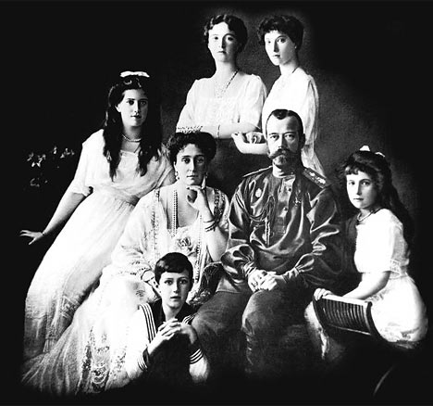
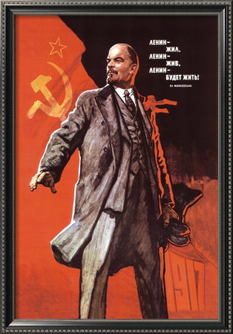
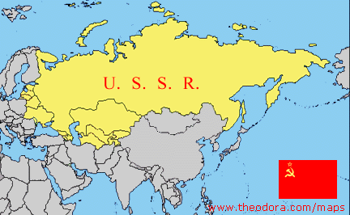

Slide 45
Once in power, the Bolsheviks, renamed themselves communists. Under the control of the Communist party, central planning was introduced during the 1920's and continues to operate until the break up of the Soviet Union in 1991.
Soviet planners were most concerned with building national power and prestige in the international community. As a result, they allocated the best land, labor, and capital to the armed forces, space program, and production of capital goods such as farms equipment and factories.
The committees that ran the system were responsible for deciding the quantity, production process, and distribution of 24 million different goods and services.

Slide 46
In the Soviet Union, the central government created large state-owned farms and collectives for most of the country's agricultural production. On state-run farms, the state provided farmers with all equipment, seed and fertilizer. Farmers worked for daily wages set by economic planners.
Collectives were large farms leased from the state to groups of peasant farms. Farmers managed operation of the collectives, though they were still required to produce what the government instructed them to. Farmers either received a share of what they produced or income from its sale.

Slide 47
Agricultural workers were guaranteed employment and income, and the government established quotas and distribution. Under such a system, individuals had few incentives to produce more or better crops.
While Russia had been a major exporter of wheat until 1913, before long the soviet Union could not keep its own people fed. Soviet agriculture bore much of the opportunity cost of Soviet central planning decisions.

Slide 48
Soviet factories also were state-owned. Like agriculture, industry was characterized by a lack of incentives. Jobs were guaranteed, and wages were set by the government. Once a production quota was met, there was no reason to produce more goods. Workers had little incentive to work harder or to innovate.
In fact, it was illegal for workers to exhibit entrepreneurial behavior and start their own businesses.

Slide 49
Soviet consumers, too, experienced the opportunity cost of central planners' decisions. A popular joke in the Soviet Union went, "We pretend to work, and they pretend to pay us."
A workers wages were not worth much because consumer goods were scarce and usually of poor quality. Manufacturers had the incentive to focus on quantity, not quality.

Slide 50
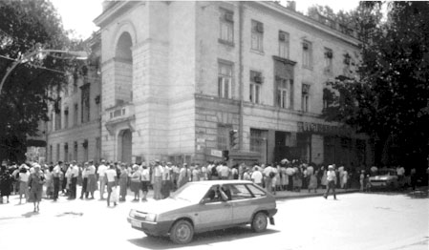
Bread Line

Slide 51
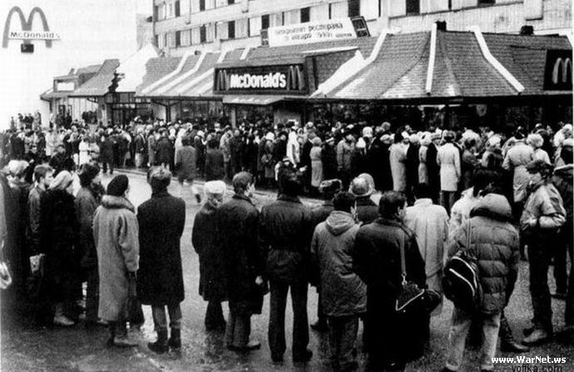
Around 20 years ago McDonalds got a permission from the Communist Party of Soviet Union to open its first resturant in Soviet Russia. It was not only the first McDonalds but generally the first fast food place in Russia ever.

Slide 52
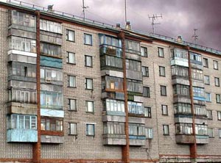
Consumers often had difficulty getting goods, too. They wasted countless house waiting in line to purchase goods and services. Luxuries such as meat were made affordable by government price setting, but they were rarely available.
Housing shortages forced people to live in crowded and poorly constructed apartments. Because of the long waiting list for apartments, it was not unusual to find a family living in just two rooms.

Slide 53
Problems of Centrally Planned Economies
Central planning can be used to jump start selected industries and guarantee jobs and income. But, other side of the coin is poor quality, serious shortages of non-priority goods and services, and diminishing production.
Perhaps the greatest disadvantage of centrally planned economies is that their performance almost always falls short of the ideals upon which the system is built. In addition, such systems generally cannot meet consumers' needs or wants.
Since the government owns all production factors, workers lack any incentive to work hard. These systems also do not reward innovation, actively discouraging any kind of change.

Slide 54
The large expensive bureaucracy necessary to make the thousands of production and distribution decisions to run the economy lacks the flexibility to adjust to consumer demands. Decisions become overly complicated. Finally, command economies sacrifice individual freedoms in order to pursue societal goals.

Slide 55
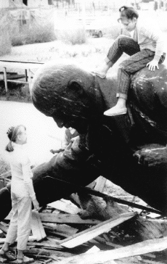
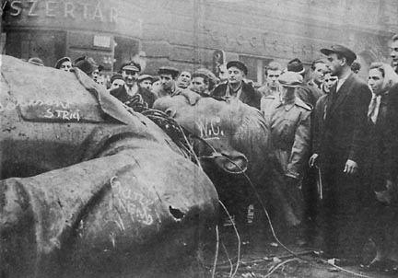
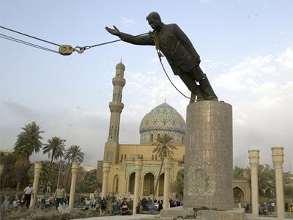
Most of the less developed countries that have experimented with centrally planned economies, have failed. Instead most of these nations have moved toward mixed economies over the past twenty years.
Sadaam Statue
Lenin Statue
Stalin Statue

Slide 56
Mixed Economies
You cannot find today any economic system that relies exclusively on central planning or the individual initiative of the free market. Instead, most economies are a mixture of economic systems.
No single economic system has all the answers. Centrally planned economies are cumbersome, do not adequately meet consumer needs, and limit freedom. Traditional economies have little potential for growth or change. Even market economies, with all of their advantages, have certain drawbacks.

Slide 57
Adam Smith and other early free market philosophers believed that, left to its won devices, the free market system would provide the greatest benefit for consumers and raise the standard of living. They preached laissez faire, the doctrine that government generally should not intervene in the market place.
Even Smith acknowledged, however, the need for a certain limited degree of government intervention in the economy.

Slide 58
As market economies have evolved since Smith's time, government intervention has become greater because some needs and wants of modern society are difficult to answer in the marketplace. How well, for example, could the marketplace provide for national defense or for roads and highway systems?
Some needs that markets could meet fall to governments so that all members of society could participate. Education is one example.

Slide 59
Governments create laws protecting property rights and enforcing contracts. There would be little incentive to develop new products without property rights or patent laws (laws that give the inventor of a new product the exclusive right to sell it for a certain period of time).
Without laws insisting on competition, many people fear that some firms would dominate others in their industry and be able to charge consumers any price.
Like when a company has a monopoly.

Slide 60
A society must assess its values and prioritize its economic goals. Some goals are better met by the open market and others are better met by government action. Each nation decides what it is willing to give up to meet its goals.
What are you willing to give up? Are you willing to pay taxes to fund the army? To give money to people without jobs? To give all people an education? To subsidize farms? Should the government establish job- safety guidelines or a minimum wage?

Slide 61
The foundation of the United States economy is the free market. An economic system characterized by private or corporate ownership of capital goods is called free enterprise.
In a free enterprise system investments are determined in a free market by private decision rather than by state control.

Slide 62
Continuum of Mixed Economies
Centrally Planned
Free Market
Iran
Mexico
France
United Kingdom
Hong Kong
North Korea
China
South Africa
Canada
Singapore
Cuba
Russia
Poland
Japan
United States

Slide 63
In China, where the economy is dominated by the government, 1/4 of all enterprises are at least partly owned by individuals. China, like many nations that have relied heavily on central planning in the past, is in transition, a period of change in which an economy moves away from central planning toward a market-based system.
To make the transition, state firms must be privatized, or sold to individuals, and then allowed to compete with one another in the marketplace.

Slide 64
The United States has a free enterprise economy. Still, the government intervenes to keep order, provide vital services, and to promote the general welfare. Some people argue for more governmental services, while others say that the government already intervenes too much in the economy. Nevertheless, the United States enjoys a high level of economic freedom.
United States protects private property. The marketplace operates with a low level of government regulation.

