Slide 1
Chapter 15 Section 1
Scientific Revolution
Scientists from the Middle Ages relied upon a few ancient authorities-Aristotle, Ptolemy, Plato etc. But things were beginning to change. The invention of new instruments made fresh scientific discoveries possible, the printing press also spread new ideas quickly

Slide 2
Mathematics played a very important role in the scientific discoveries of the 16 and 17 centuries. Copernicus, Kepler, Galileo, Newton discarded many of the ancient ideas and developed the theories that would become the foundation of the Scientific Revolution.

Slide 3
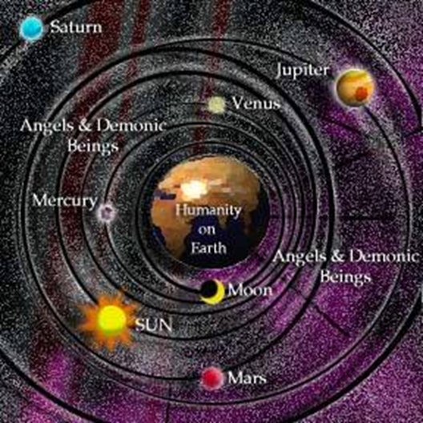
Astronomy- new discoveries rocked the world

Slide 4
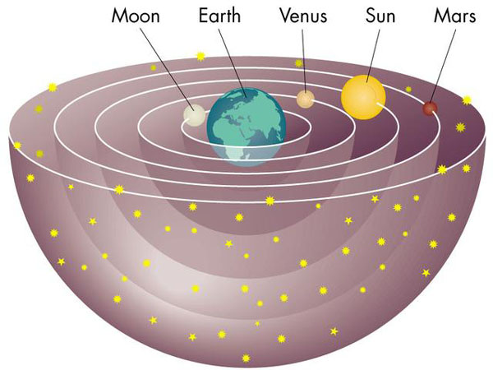
Ptolemaic System= Geocentric
Greek thinkers thought that the universe was circular with the earth at its center. The sun, planets, and stars, they believed, revolve around the earth in circular orbits.

Slide 5
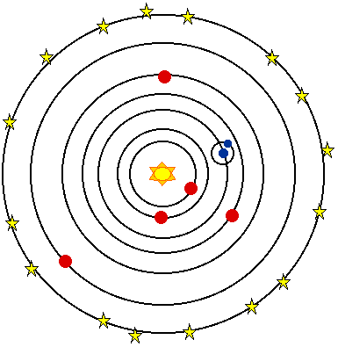
Copernicus believed in a heliocentric or sun centered idea of the universe. A more accurate explanation than the Ptolemaic system.

Slide 6
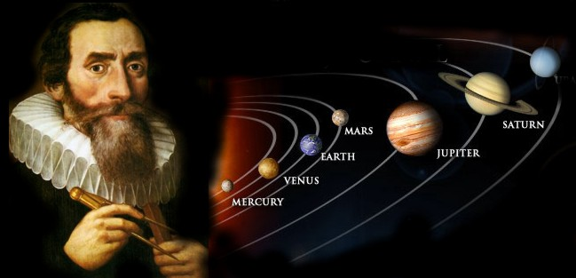
Kepler, a mathematician confirmed that the sun was at the center of the universe and that the orbits of the planets around the Sun were NOT circular but elliptical (egg- shaped).

Slide 7
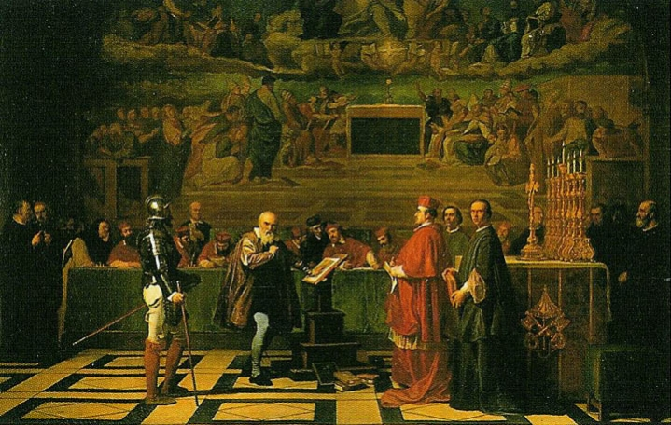
The Church ordered Galileo to abandon the Copernican idea, because it threatened the Church's entire belief of the universe and contradicted the Bible.

Slide 8
Newton-defined three laws of motion that govern the planetary bodies, as well as objects on Earth. At the center of these laws was the universal law of gravitation. Every object in the universe is attracted to every other object by a force called gravity.

Slide 9
Medicine and Chemistry
Andreas Vesalius was responsible for the modern knowledge of anatomy.
Boyle-was a first to conduct controlled experiments, his work led to "Boyle's Law" volume of gas varies with the pressure exerted on it.

Slide 10
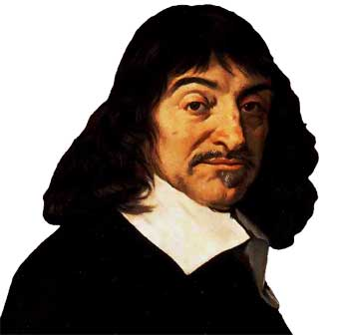
Descartes-"I think, therefore I am" , led to the idea that mind and matter are separate, he became the father of modern rationalism.

Slide 11
"I think _________, therefore I am _____________." In other words, "I think I am angry, therefore I am angry." "I think I am tired, therefore I am tired." "I think I am busy, therefore I am busy."

Slide 12
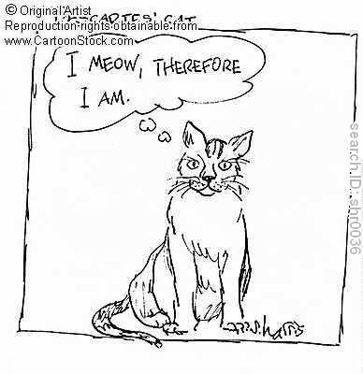
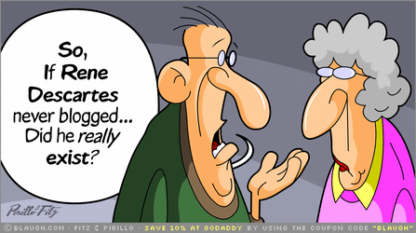

Slide 13
Scientific Method
Systematic method for collecting and analyzing evidence, developed by Francis Bacon who relied on inductive reasoning- going from the particular to the general.

Slide 14
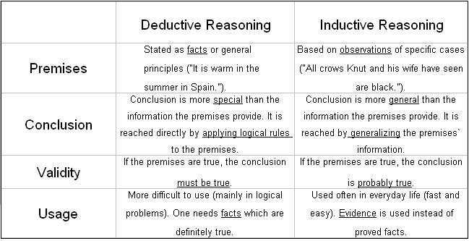

Slide 15
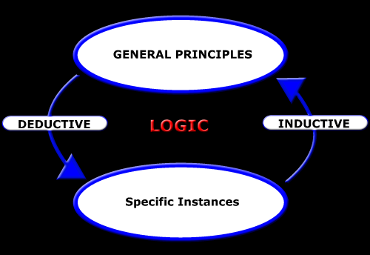

Slide 16
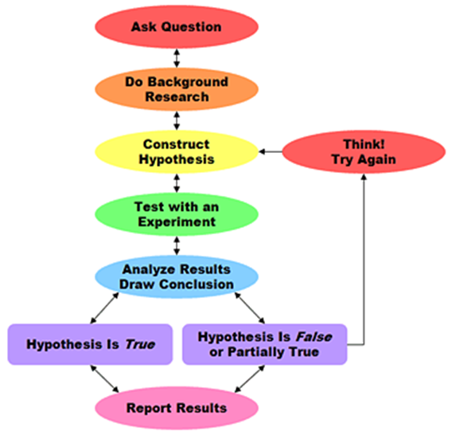

Slide 17
Galileo-first European to make regular observations of the heavens using a telescope, he discovered mountains on the moon, 4 moons revolving around Jupiter. Galileo stated that heavenly bodies were composed of material substance, like earth, not just light.

Slide 18
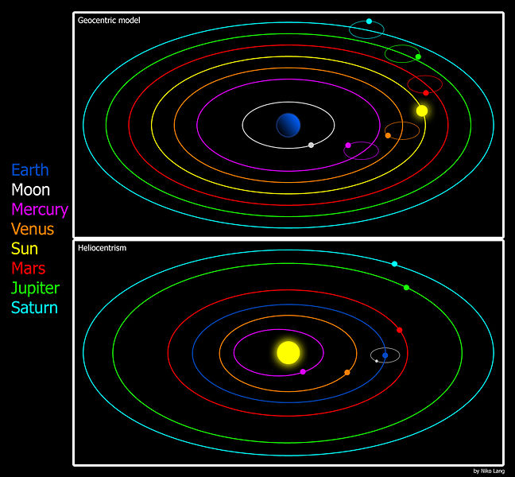

Slide 19
Chapter 17 Section 2
Enlightenment was an 18th century philosophical movement of intellectuals who were very impressed with the achievements of the Scientific Revolution. "Reason" was a favorite word used by these intellectuals, it meant to apply scientific method to gain an understanding of all life. They hoped by doing this they could progress towards a better society. "Reason, hope, natural law, progress"

Slide 20
Intellectuals believed that if Newton could discover the natural laws that governed the physical world then they could use his methods to discover the natural laws that governed human society.

Slide 21
Locke suggested that people molded by the experiences that came through their senses from the surrounding world. If environments were changed and people were exposed to the right influences, then people could be changed and a new society created.
Born with a blank mind.

Slide 22
The intellectuals of the Enlightenment were known by the French name philosophe, meaning "philosopher". The role of the philosopher was to change the world, to apply himself to the study of society with the purpose of making his kind better and happier. This study was to be done using reason, (an appeal to the facts). Rational criticism was to be applied to everything, including religion and politics.

Slide 23
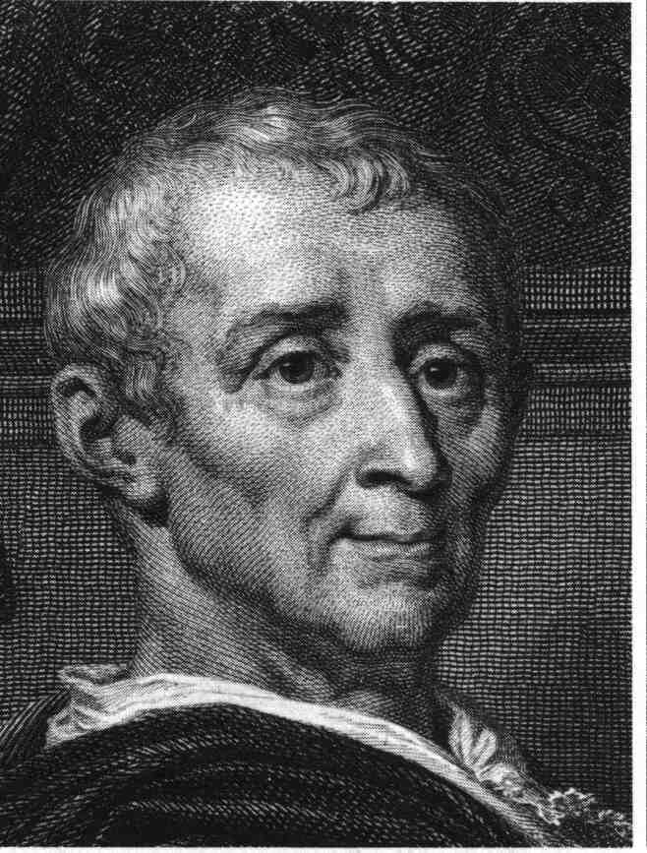
Montesquieu
Wrote, The Spirit of the Laws. He tried to use the scientific method to find the natural laws that govern the social and political relationships of human beings.

Slide 24
Montesquieu, 3 basic kinds of governments
republics-suitable for small states
despotism-appropriate for large states
monarchies-ideal for moderate-sized states.
Separation of powers- executive, legislative and judicial powers of the government limited and controlled each other in a system of checks and balances. Influenced USA.

Slide 25
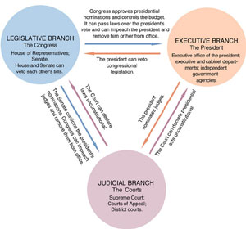

Slide 26
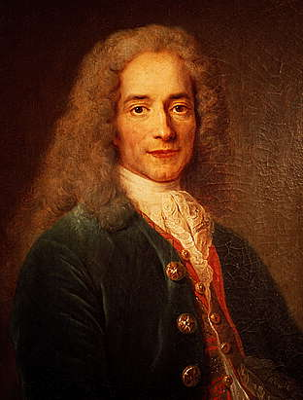
Voltaire-very well known for his criticism of Christianity and his strong belief in religious tolerance. He believed in deism- God had created the universe, and allowed it to run without interference according to its own natural laws.

Slide 27
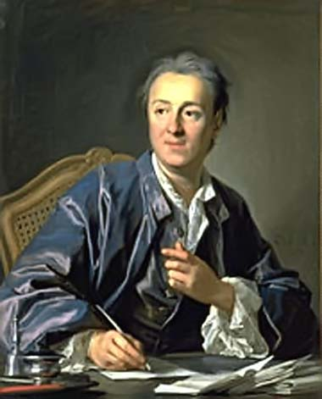
Diderot-The Encyclopedia, to change the general way of thinking. Social, legal, political views to make society more tolerant and humane.

Slide 28
Adam Smith-father of economics- believed that governments had 3 roles.
protect society from invasion-army
defending citizens from injustice-police
keeping up certain public works-highways, things to expensive for individuals.
Laissez-faire=let people do what they want, government stay out of business.

Slide 29
Jean-Jacques Rousseau- social contract-an entire government agrees to be governed by its general will. Liberty is achieved by being forced to follow what is best for the general will, because the general will represents what is best for the entire community.

Slide 30
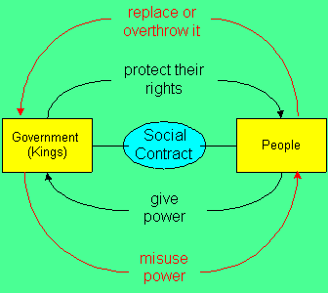
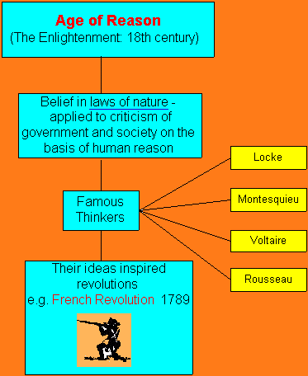

Slide 31
Rights of women-Mary Wollstonecraft, founder of modern women's rights. Women should have equal rights in education, as well as in economic and political life.

Slide 32
Growth of Reading-helped spread the ideas of the Enlightenment era. Reading was no longer just for the rich upper class, books were now directed towards the middle class.

Slide 33
Enlightenment ideas were also spread through the salon, elegant rooms in the homes of the very wealthy. Guests would gather and take part in conversations that were focused around the new ideas. Women frequently participated.

Slide 34
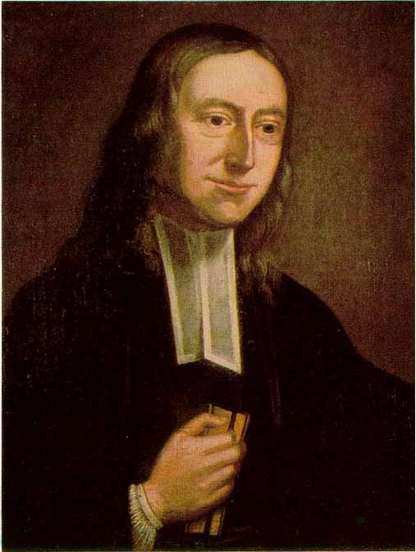
Religion-most philosophers were still Christians. John Wesley, started Methodism. He preached in open fields, and appealed to the lower class. Wesley's members worked to see the slave trade abolished.

Slide 35
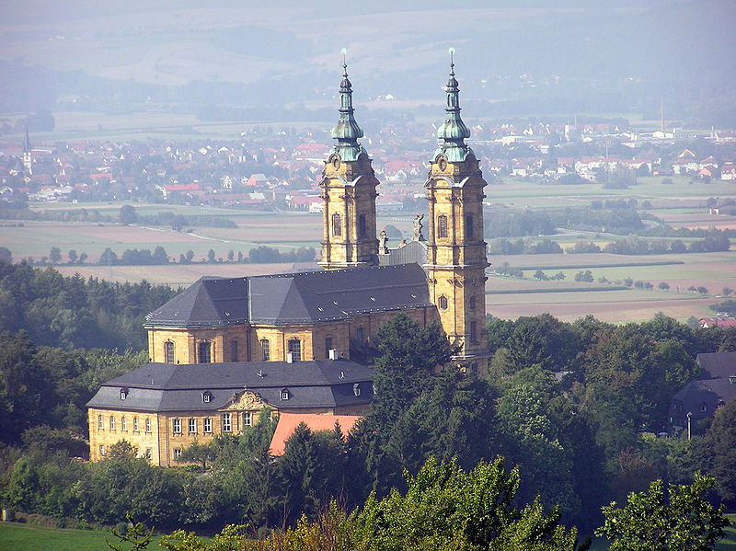
The Enlightenment period also had a huge impact on the world of culture. (art, music and literature)
Architecture- Neumann's Church of the 14 Saints in Germany

Slide 36
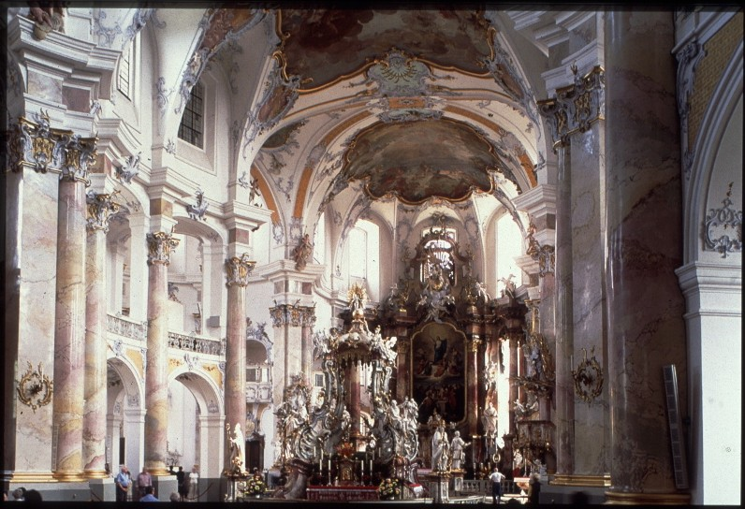

Slide 37
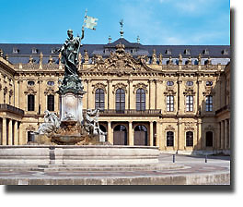
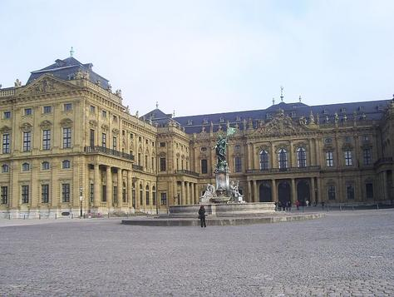
Residence of Prince-bishop of Wurzburg (stressed grandeur and power)

Slide 38
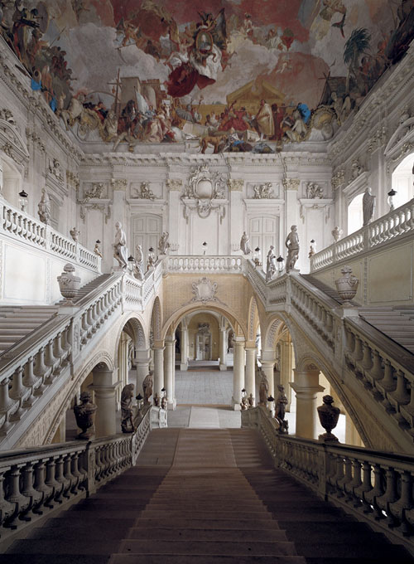
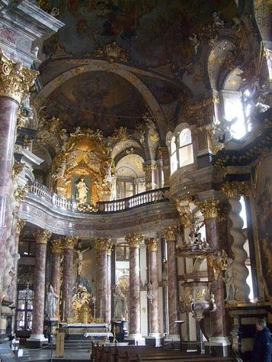

Slide 39
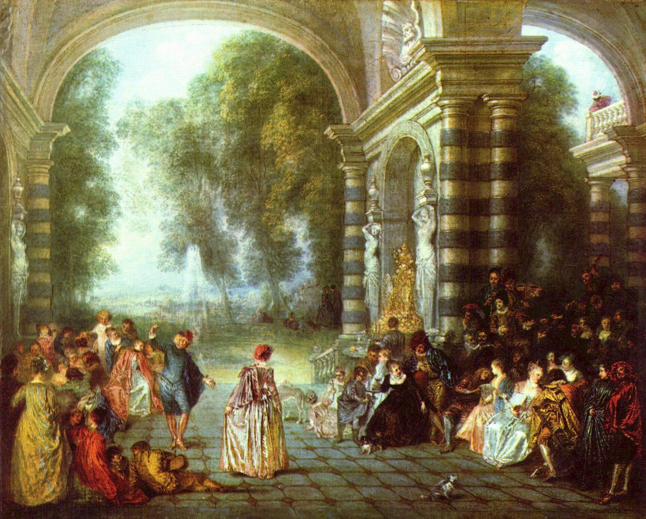
Rococo-new artistic style that had spread all over Europe by 1730's. (grace, charm, graceful curves)

Slide 40
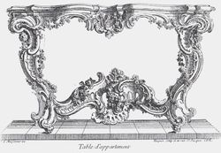
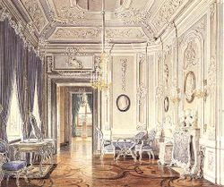
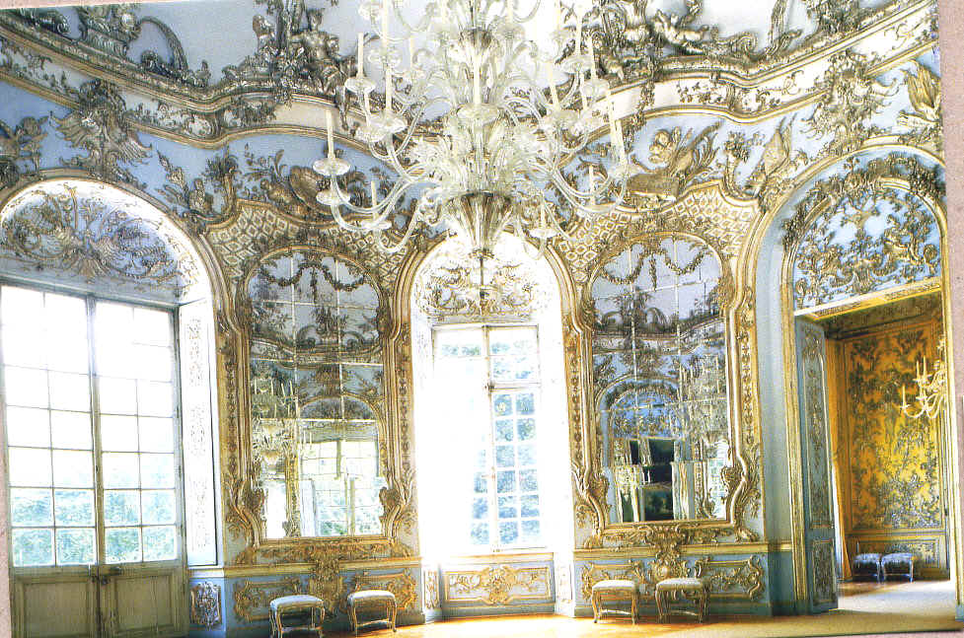

Slide 41
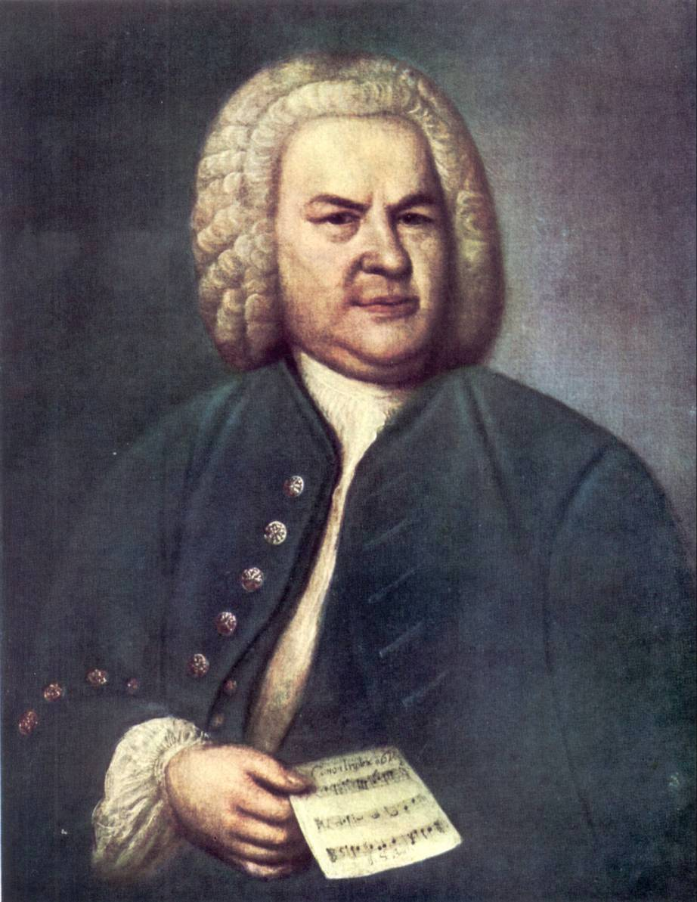
Musical Geniuses
1st half of 18th century
Johann Sebastian Bach
http://www.youtube.com/watch?v=Xq2WTXtKurk&safety_mode=true&persist_safety_mode= 1&safe=active
http://www.youtube.com/watch?v=CTVraVgzC9U&safety_mode=true&persist_safety_mode= 1&safe=active

Slide 42
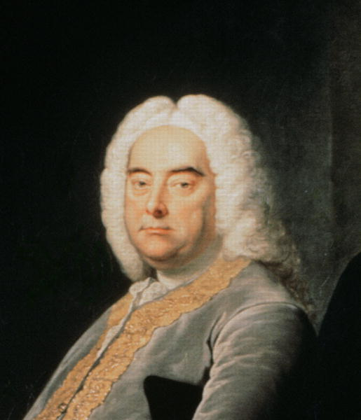
Frederick Handel
http://www.youtube.com/watch? v=KBWK5LDxlAM&feature=related&safety_mode=tr ue&persist_safety_mode=1&safe=active

Slide 43
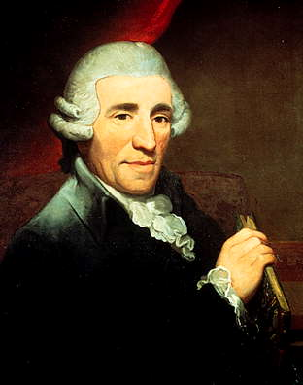
2nd half of the 18th Century
Franz joseph Haydn
http://www.youtube.com/watch?v=BX1ljYx3g3k&list=PL7B5E4DDF85D9FAD6&index=4
bugs
http://www.youtube.com/watch?v=bo3w7R_1tPs
http://www.youtube.com/watch? v=TFcONi1ynIM&feature=related&safety_mode=true&persist_ safety_mode=1&safe=active
http://www.teachertube.com/viewVideo.php?video_id=82913&title=Luke_the_Squirrel

Slide 44
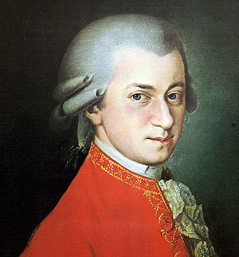
Wolfgang Amadeus Mozart
http://www.youtube.com/watch?v=AWRZut6klgE
bugs
http://www.youtube.com/watch?v=I4vW93quOBk
bugs
Child prodigy-The Marriage of Figaro, The Magic Flute and Don Giovanni are three of the worlds greatest operas.
http://www.youtube.com/watch? v=Qb_jQBgzU- I&safety_mode=true&persist_safety_mod e=1&safe=active
http://www.youtube.com/watch? v=Zi8vJ_lMxQI&safety_mode=true&persist_safety_mode=1 &safe=active

Slide 45
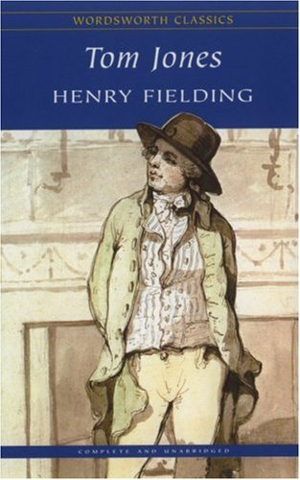
Literature
The 18th century also saw the development of the European novel. This appealed to the growing middle class.

Slide 46
Enlightenment also had an effect of political life. The philosophers believed in natural rights for all people. These rights included equality before the law, freedom of religious worship, freedom of speech, freedom of the press, and the right to assemble, hold property and to pursue property.

Slide 47
But how to establish these rights and preserve them? Most philosophers believed we needed to be governed by enlightened rulers. Enlightened rulers should protect the natural rights and enforce the laws fairly for all subjects. Possible????

Slide 48
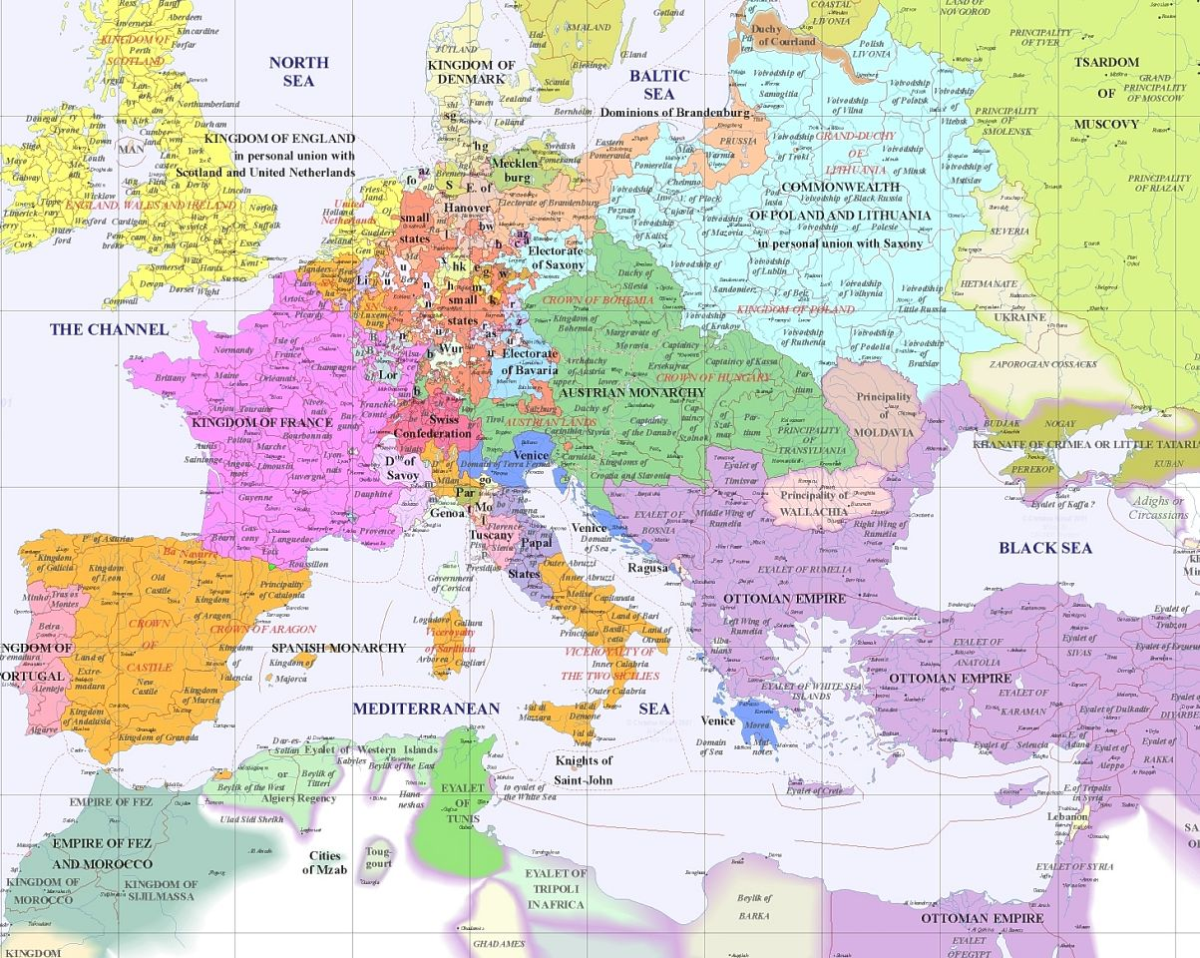

Slide 49
Prussia
Frederick William I- no way! He demanded total devotion.
Frederick II -Frederick the Great-very educated, knew about the Enlightenment ideas, allowed some freedom of speech and press, some religious toleration, but maintained serfdom and rigid social structure.

Slide 50
Austrian Empire
Difficult to rule because many different languages, religions and cultures were represented. Maria Theresa made no reforms but did help the serfs. Her son Joseph II made huge reforms (equality in law, religious reforms, ended serfdom etc.) (These actions failed, everyone was angry)

Slide 51
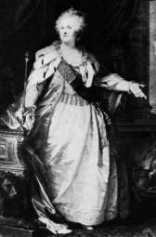
Russia- Catherine the Great
Took over after husband murdered. She was smart, and liked reforms but did nothing because she needed the support of the nobility. Greatly expanded territory of Russia.

Slide 52
Russia, Prussia and Austrian rulers did not use their power to make reforms, they taxed more to create huge armies to wage war and gain more power. Balance of Power- idea that states should have equal power, to prevent one from dominating the others. This did not mean they wanted peace.

Slide 53
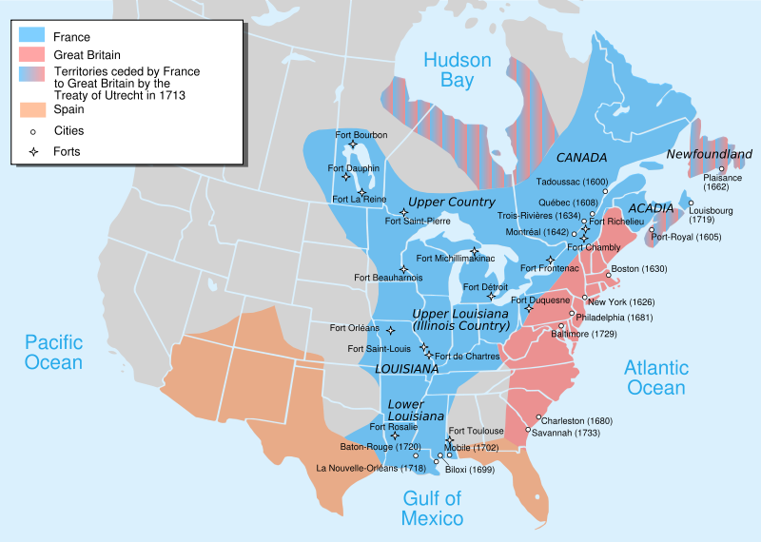
French Indian War-North America's part in the 7 Year Wars

Slide 54
French and British colonies were set up differently. French North America was run by the French government as a trading area. (furs, leather, fish, timber) not many French residents in N.A. so populated very sparsely. British colonies were more populated (1 million). Fought over 2 areas (modern day Nova Scotia and the Ohio River Valley).French had the support of the Indians, The French had more troops in N.A. but not enough naval support.

Slide 55
Treaty of Paris-French forced to make peace. Canada and lands east of the Mississippi were given to England. Spain transferred Florida to England. France gave their Louisiana territory to the Spanish.

Slide 56
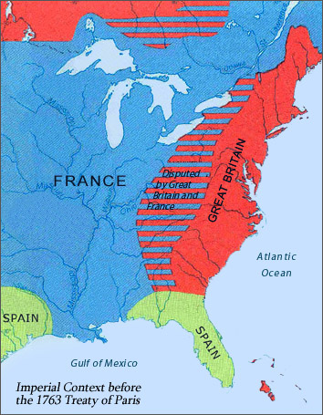
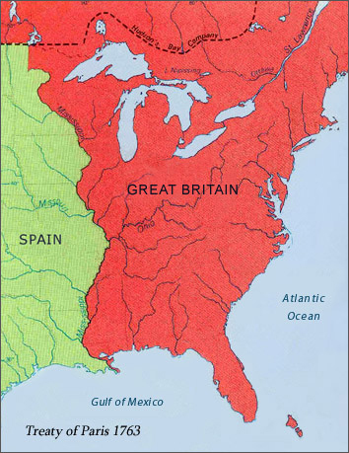

Slide 57
Chapter 17 Section 4
Portugal dominated Brazil. Spain controlled parts of North America, Central America and most of South America.
Latin America was a multiracial society. Mestizos= children of Europeans and Native Americans. Mulattoes= children of Africans and Europeans.

Slide 58
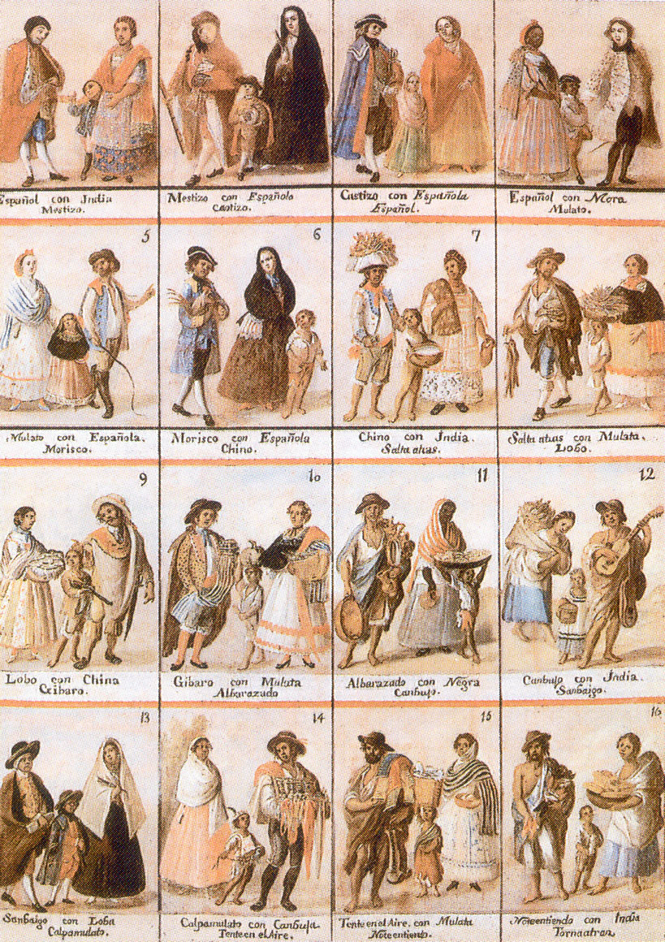

Slide 59
Both Spanish and Portuguese sought to profit from their colonies in Latin America. Gold, silver were sent to Europe. Farming provided more long lasting revenue. Huge estates were created and worked by poor farmers. Sugar, tobacco, diamonds, and animal hides. They tried to keep other countries out but the British and the French moved in.

Slide 60
Spanish and Portuguese rulers were determined to Christianize the native people. The Catholic Church played a very important role. Catholic missionaries- Dominicans, Franciscans and Jesuits spread the word and taught trades and encouraged the planting of crops.
Catholic Church built cathedrals, hospitals, orphanages and schools. The church offered an alternative to marriage to women- becoming a nun.

Slide 61
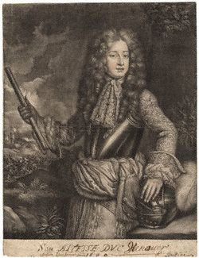
British= English and Scots 1707. Hanover's from Germany took over when Queen Anne, the last Stuart ruler died without an heir. George I and George II knew little of the British system. British colonies in the Americas were run mostly by legislatures that tended to act independently. BUT

Slide 62
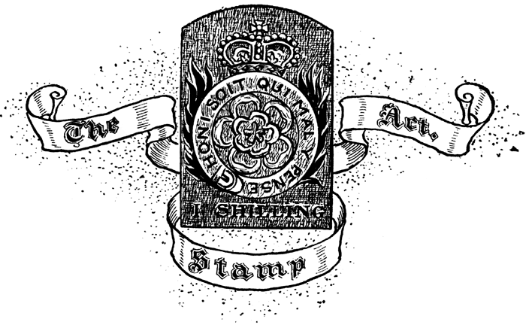
After the Seven Years' War the British wanted new revenues to make up for war costs. Parliament imposes Stamp Act 1765-printed materials-legal documents, newspapers, etc. must have a stamp showing tax had been paid. Only lasted 1 year, colonists protested violently.

Slide 63
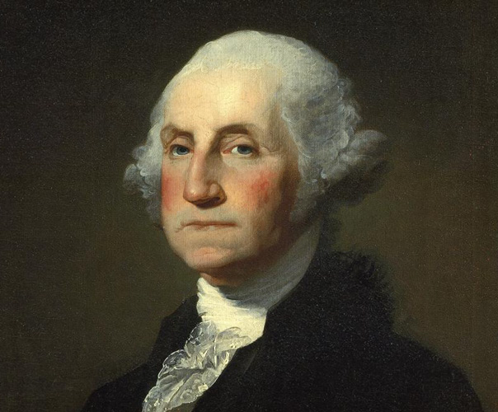
Colonies organized the First Continental Congress in response to British actions (1774) Fighting started between colonists and the British in 1775 at Lexington and Concord, Massachusetts. The Second Continental Congress met, formed an army and chose George Washington as its commander.

Slide 64
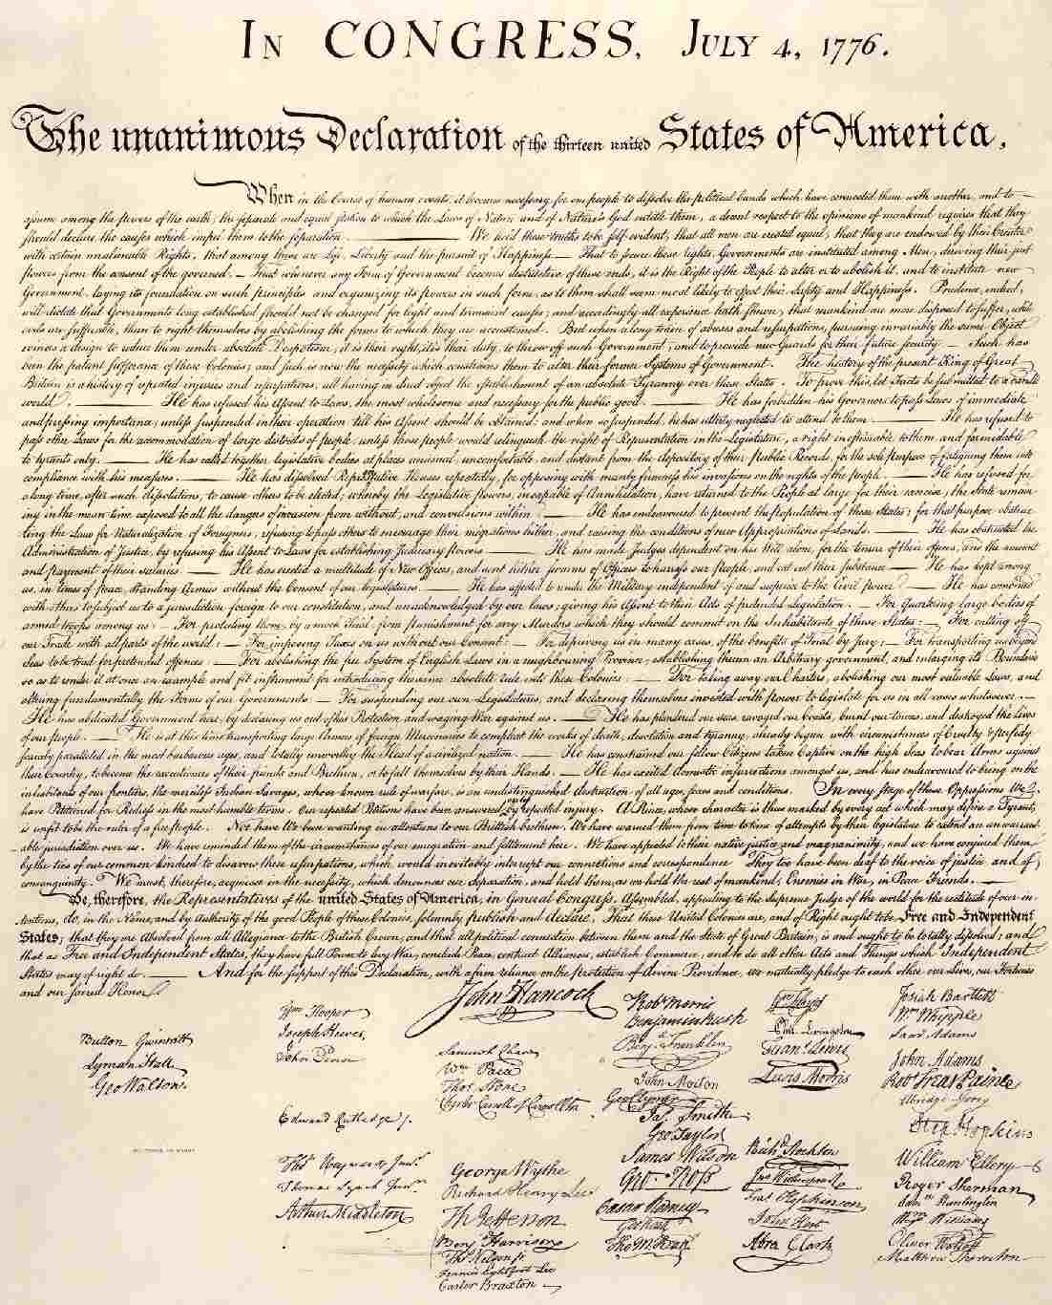
July 4, 1776 2nd Continental Congress approves a Declaration of Independence written by Thomas Jefferson. The document declared the colonies to be "free and independent states absolved from all allegiance to the British Crown"

Slide 65
This document led to war! Britain=strong military power, lots of resources. Colonies=amateur soldiers who had agreed to serve a short period. Foreign countries supported the colonies, some to get revenge for earlier defeats by the British. France was a huge help, they sent soldiers and officers. The French also diplomatically recognized America.

Slide 66
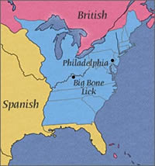
The British called "uncle" when they had to surrender at Yorktown, Virginia. The Treaty of Paris 1783 recognized the independence of the American colonies and gave them control of the western territory Appalachians to Mississippi River.

Slide 67
Birth of A Nation
13 separate states, each with its own interests, not really interested in creating a strong central government.
1781 Articles of Confederation-1st constitution-no strong central gov't., no power to deal with countries problems.
1787 (55 delegates) met in Philadelphia to revise (fix) the Articles, they ended up drafting an entirely new plan "Constitutional Convention"

Slide 68
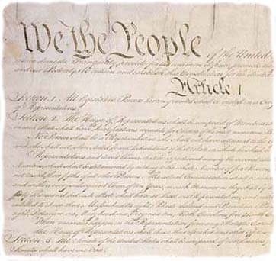

Slide 69
The Constitution created a Federal System- power shared between the states and the national government.
National gov't- power to levy taxes, raise an army, regulate trade, and create a national currency. ($)

Slide 70
Each branch has some power to check the workings of the others.
"Checks and Balances"
Executive=president, power to execute laws, veto legislature's acts, supervise foreign affairs and direct military forces.
Legislative=2 houses
Senate=members elected from state legislatures
House of Representatives= elected directly by the people.
Judiciary= Supreme Court- enforces the Constitution as the supreme law of the land.

Slide 71
The Constitution had to be ratified (approved) by 9 out of 13 states to pass, promises to add a Bill of Rights helped it pass.
Bill of Rights- First 10 Amendments to the Constitution
Guaranteed: freedom of religion, speech, press, petition and assembly.
right to bear arms (guns)
right against unreasonable search and seizures
guaranteed trial by jury
due process of law

Slide 72
Many of the ideas that were included in the Constitution and the Bill of Rights were derived from the natural rights proposed by the enlightenment philosophers.

